Slide 1
JANICULUM

Slide 2
Where is it?
It's the “8th Hill” of Rome: Janiculum is one of the highest hills, even though it isn't one of the Seven Hills of the “Eternal City”. But it is famous for being one of the most charming corners of Rome, a balcony with breath-taking views over the expanse of churches, squares, and monuments below, with the meandering Tiber taking centre stage. Towards the east, the hill descends to another famous and ancient Roman quarter: Trastevere.
The name Janiculum comes from the belief that in ancient times it was the place where the god Janus was worshipped.
The fourth king of Rome, Ancus Marcius, was the first to occupy, fortify, and join this high ground to the city by way of the Pons Sublicius. The Via Aurelia, connecting Rome to Etruria, passed over this bridge.

Slide 3
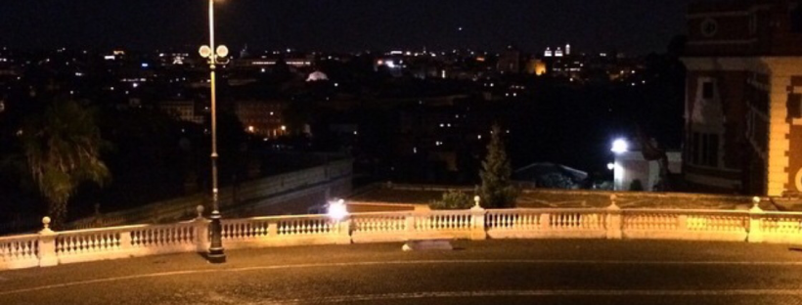
Because of its elevation and incredible view of the entire city, Janiculum became an area filled with sacred woods and buildings associated with worship; the hill was in fact the most suitable place for priests to read the sky for signs and be as close as possible to the gods.
Here stood an eastern temple dedicated to Isis, some of whose remains are kept at the museum of the
Palazzo Altemps.

Slide 4
THE JANICULUM WALL
In the 17th century, Pope Urban VIII enclosed the hill with a wall that came to be called the Janiculum wall.
Later on, stately houses such as Villa Doria Pamphili and Villa Corsini were built in former Janiculum parks; it also remained a place linked with worship, in the meanwhile, of Christianity. It became populated with churches such as San Pietro in Montorio and convents like Sant'Onofrio and the ancient San Pancrazio.

Slide 5
HISTORY
In 1849 Janiculum was the scene of an important battle, where Giuseppe Garibaldi fought the French troops summoned by Pope Pius IX. There are various monuments on the hill commemorating this event and recalling both the battle and that period of Italian history.

Slide 6
GARIBALDI MONUMENT
The equestrian monument dedicated to Giuseppe Garibaldi is an imposing equestrian
statue placed in Rome on the highest point of the Janiculum hill on the square Piazza Garibaldi.
It was released by Emilio Gallori in 1895, and has been referred by the title "the Hero of the Two Worlds".

Slide 7
HISTORY OF THE MONUMENT
The monument consists of a bronze statue portraying the hero riding a horse, which is placed on a big marble base; on each side are engraved allegorical figures of Europe and America and bas-reliefs that commemorate the landing in Marsala, the resistance of Boiada, the defence of Rome and the group of liberty. On the steps up right the monument Ettore Ferrari had created a crown, in order to remember that Garibaldi was the first Master of Italian Freemasonry. During Fascism it was replaced by fascist symbols and a copy of it was put in place only in 1943. The monument was inaugurated on September 20, 1895 by Enrico Gallori

Slide 8
PROMENADE OF THE JANICULUM
It’s the most striking, an avenue lined by trees that end up in the central square. On the edges you can admire the statues of 84 heroes partisans who fought to defend Rome.

Slide 9
Renamed Parco degli Eroi (Heroes’ Park) in 2011, the memorials to the soldiers who fought and died for the defence of the Roman Republic (1849) from the attack of the French troops in defence of the Pope, busts, commemorative steles, monuments to Anita Garibaldi, the Faro degli Italiani (Beacon of the Italians) and the wall with the full text of the Constitution of the Roman Republic can be found along the tree-lined avenues and amongst the flower beds on the sides of the great road. But the garden, with its famous and beautiful panoramic views of Rome, is not only a shrine to the Risorgimento; commemoration of two illustrious figures from Italian literary and spiritual history can also be found: the remains of the oak tree in whose shadow Torquato Tasso is said to have meditated, and the theatre where the Oritorian fathers organized sacred representations in memory of San Filippo Neri.

Slide 10
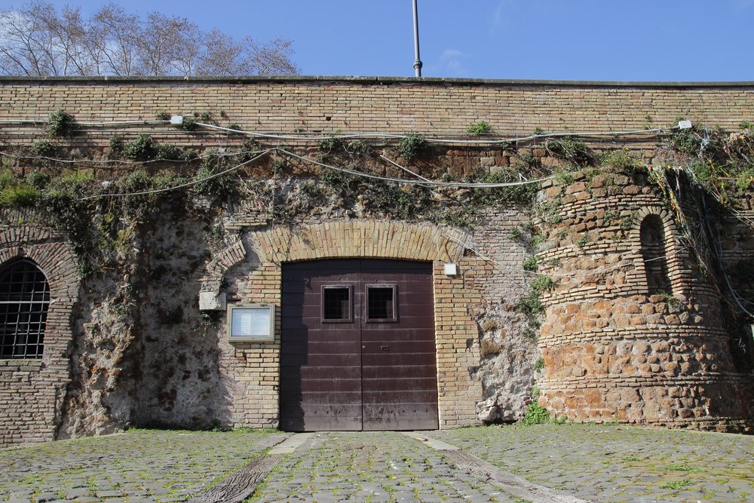
THE CANNON
On 1st December 1847 the Pope Pio IX introduced the use of marking the time with a cannon in order to have only one signal for the official time rather than the uncoordinated sound of the bells of Churches.
The tradition continued with the unification of Italy. The cannon fired until August 1903 from its first position in Castel Sant'Angelo; it was then moved to the slopes of Monte Mario and finally to Gianicolo on 24th January 1904.
During the Second World War the tradition was interrupted because of the war.

Slide 11
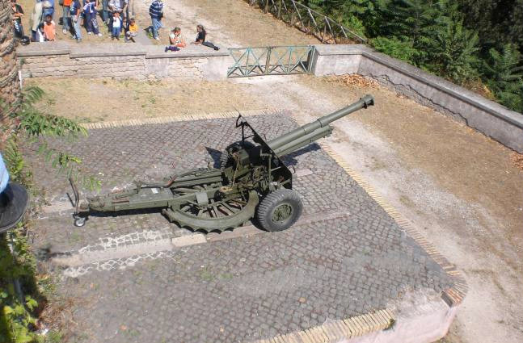
On 21st April 1959, in occasion of the 2712 Anniversary fro​m the foundation of Rome, the cannon started again to mark the "noon" for the Roman citizens.
The type of cannon used until August 1904 is unknown. Then a cannon of 75 mm was used, the same employed by the Artillery of the Kingdom of Italy to open the breach of Porta Pia.
Afterwards an howitzer of 149/13 was used; its gun tube, war booty of the Austro-Hungarian Army in the 1915-1918 war, was installed on an Italian gun carriage.
On 1st February 1991, that cannon fired its last shot.
Now it is used an howitzer resulted from the assembly of the 105/22 gun tube with the 88/27 gun carriage used during the World War II.

Slide 12
LIGHTHOUSE OF ITALIANS OF ARGENTINA
Among the monuments of the Janiculum you can admire the lighthouse of the Italians of Argentina, donated more than 100 ago by Italian immigrants in Argentina, on the occasion of the fiftieth anniversary of the unification of Italy, in September 1861.

Slide 13
THE CHURCH OF SAN PIETRO IN MONTORIO
On the spot where it was said St. Peter was crucified, the church of San Pietro in Montorio sits overlooking the eastern slope of Gianicolo hill. Built in the 15th century, the gorgeous church holds copious amounts of Italian renaissance art including frescoes.
It is a titular church, whose current title holder, since 1st March 2008, has been Cardinal James Francis Stafford.

Slide 14
THE FOUNTAIN OF THE ACQUA PAOLA
The Fountain of the Acqua Paola also known as Il Fontanone ("The big fountain") is a monumental fountain located on the Janiculum Hill, near the church of San Pietro in Montorio, in Rome, Italy. It was built in 1612 to mark the end of the Acqua Paola aqueduct, restored by Pope Paul V, and took its name from him. It was the first major fountain on the right bank of the River Tiber

Slide 15
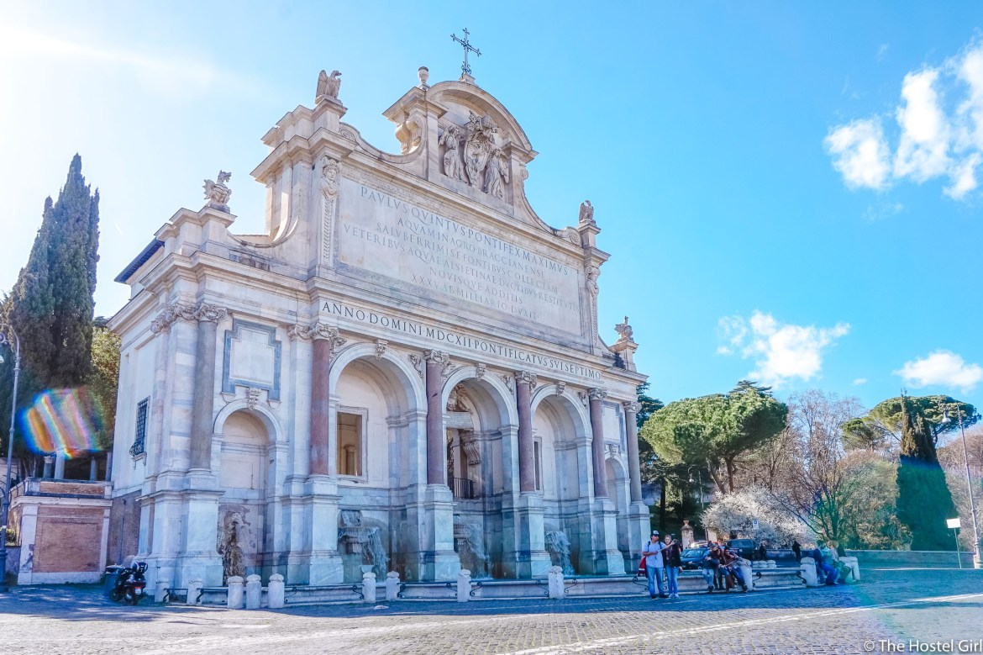
The Fontana dell'Acqua Paola was inspired by the popularity of the Fontana dell'Acqua Felice, built in 1585-88 by Pope Sixtus V. Pope Paul V decided to rebuild and extend the ruined Acqua Traiana aqueduct built by the Emperor Trajan in order to create a source of clean drinking water for the residents of the Janiculum Hill, who were forced to take their water from brackish springs or from the polluted Tiber. He raised funds for his project in part by imposing a tax upon wine, which caused complaints among some residents. The funding from this tax and other sources allowed him to purchase the rights to the water of a spring near Lake Bracciano, not far from Rome, as the source for the fountain.

