Slide 1
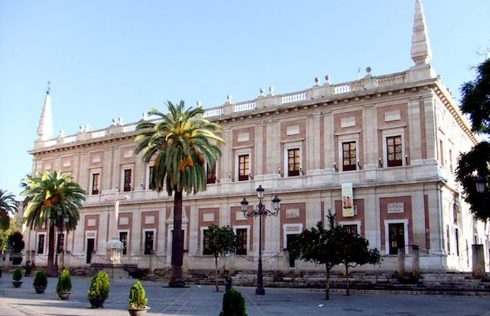
Archivo de indias

Slide 2
History
After America’s discovery, the crown selected Seville like the exclusive port for the trade with this continent. The merchants used the catedral grades for the trading. To avoid this the Canonry of the cathedral installed columns with chains around the cathedral. Because of the complices of Cabildo Metropolitano, the king Felipe II decided the construction of a building as a trade place, and some years later it ended like Archivo de indias Indias seat.

Slide 3
Style
Renaissance style.

Slide 4
Description
It is an extense building with a central floor and patio in a square form. It is 2 floors high, with red bricks in the exterior and stone elements. Inside it is the patio decorated with arches and half columns. We can stand out the stairs decorated with marble. If you look up you can see a torch cupola.

Slide 5
A detail
Outside the building we can see the fountain of Archivo de indias.

