Slide 1
Acropolis, Athens

Slide 2
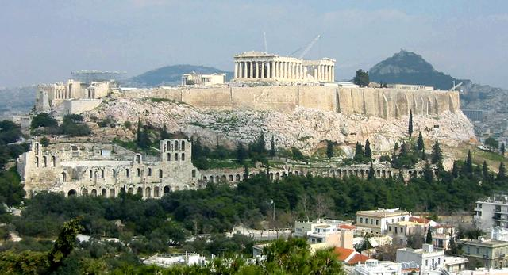
This place is located in Athens. This is limestone hill with a relative height of 90 m.

Slide 3
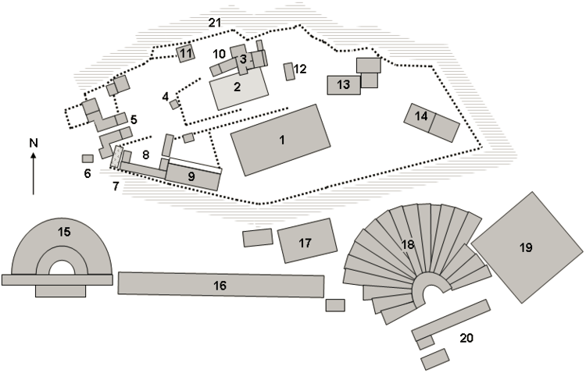
It consists of 21 buildings

Slide 4
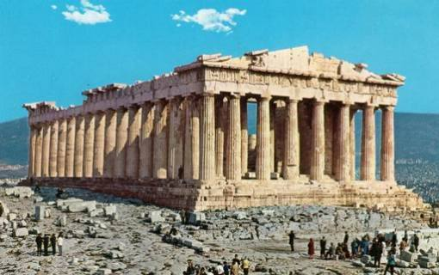
It was a temple of Greek Gods.

Slide 5
El greco
He was born in 1541 and died on 7 April 1614
He was an artist.

Slide 6
Family & Life
He had a child Jorge Manuel
He had a wife Jerónimy de las Cuevas
In 1577 he left Rome
He lived in Teoledo for the rest of his life

Slide 7
This is Espolio. He painted it between 1577 and 1579.
He made it with oil and canvas.

Slide 8
Elia Kazan

Slide 9
Elia is a director of Bumerang and baby doll…

Slide 10
He had three wives and six children.

Slide 11
He wrote 22 books. The most famous books are „Dubler’’ and „Act love’’.

Slide 12
He was born on 7 September 1909.

Slide 13
Kazan died on 28 September 2003.

Slide 14
JenifFer Aniston

Slide 15
Jenifer aniston
Born on 11 February 1969 in Shemran Oaks but her dad was born in Greece,
She is an actress.
She is the daugther of an actor and an actress.
She married Justin Theroux

Slide 16
She is 48 years old.
She might expect a child.
Jeniffer has 2 dogs.

Slide 17
Maria Callas

Slide 18
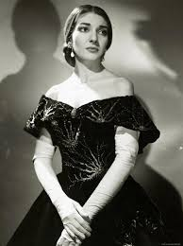
She was born on 2nd December in 1929. She died in 1977 in Paris. She was a famous Greek Opera Singer. She was called ,,La Diva”.

Slide 19
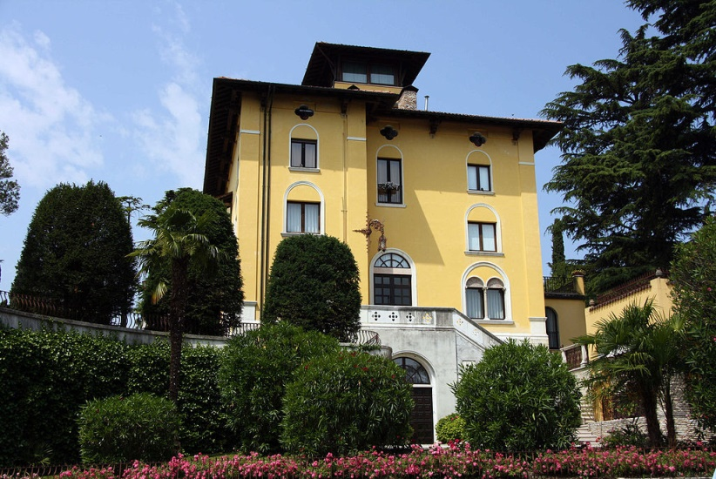
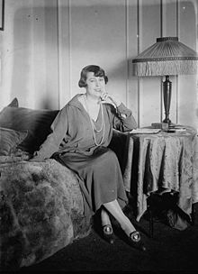
Villa in Sirmione, Maria Callas lived there in 1950-1959
Elvira de Hidalgo, Calla’s teacher

Slide 20
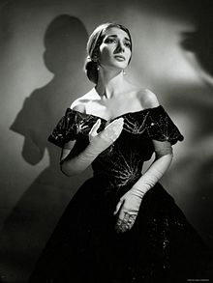
Maria Callas played the main part in Traviata opera. She played Violetta in this opera

Slide 21
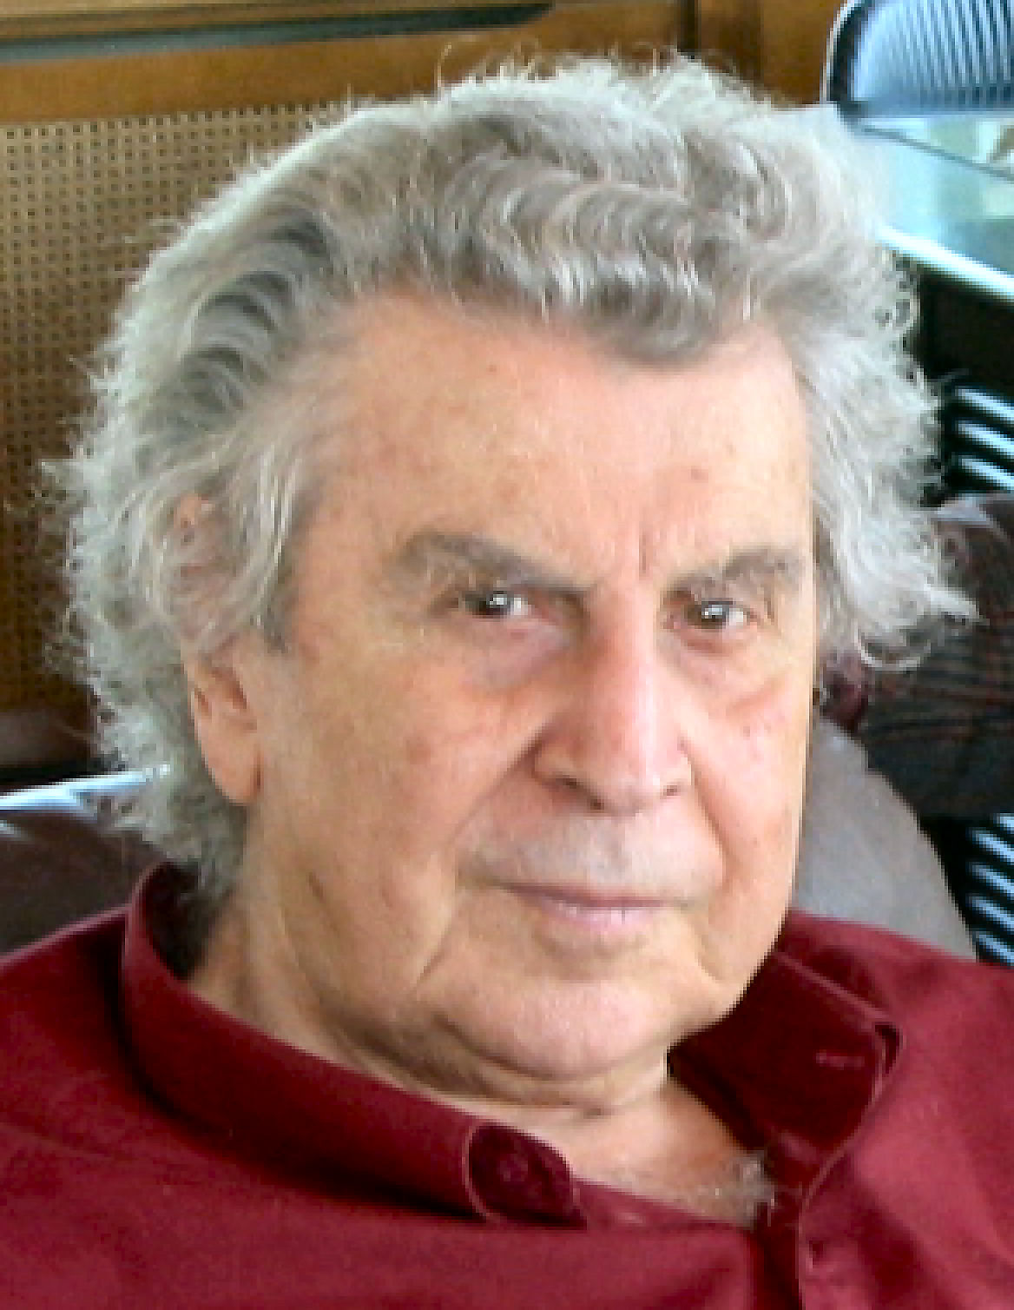
Mikis Theodorakis

Slide 22
Who is he?
He is a Greek songwriter and composer who has written over 1000 songs. He scored for the films Zorba the Greek, Z and Serpico.He composed the "Mauthausen Trilogy" also known as "The Ballad of Mauthausen", which has been described as the "most beautiful musical work ever written about the Holocaust" and possibly his best work.

Slide 23
Biography
Mikis Theodorakis was born on 29th of July 1925, on the Greek island of Chios. His father, a lawyer and a civil servant, was from the small village of Kato Galatas on Crete and his mother, Aspasia Poulakis, was from a Greek family in Çeşme, in what is today Turkey. His children are George Theodorakis and Margarita Theodorakis.

Slide 24
Where was he studying?
In 1954 he travelled with his young wife Myrto Altinoglou to Paris where he entered the Conservatory and studied musical analysis. His time in Paris, 1954–1959, was his second period of musical writing.

Slide 25
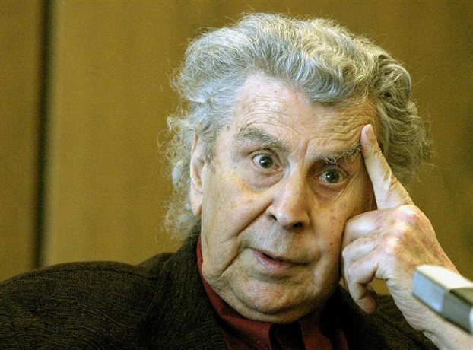
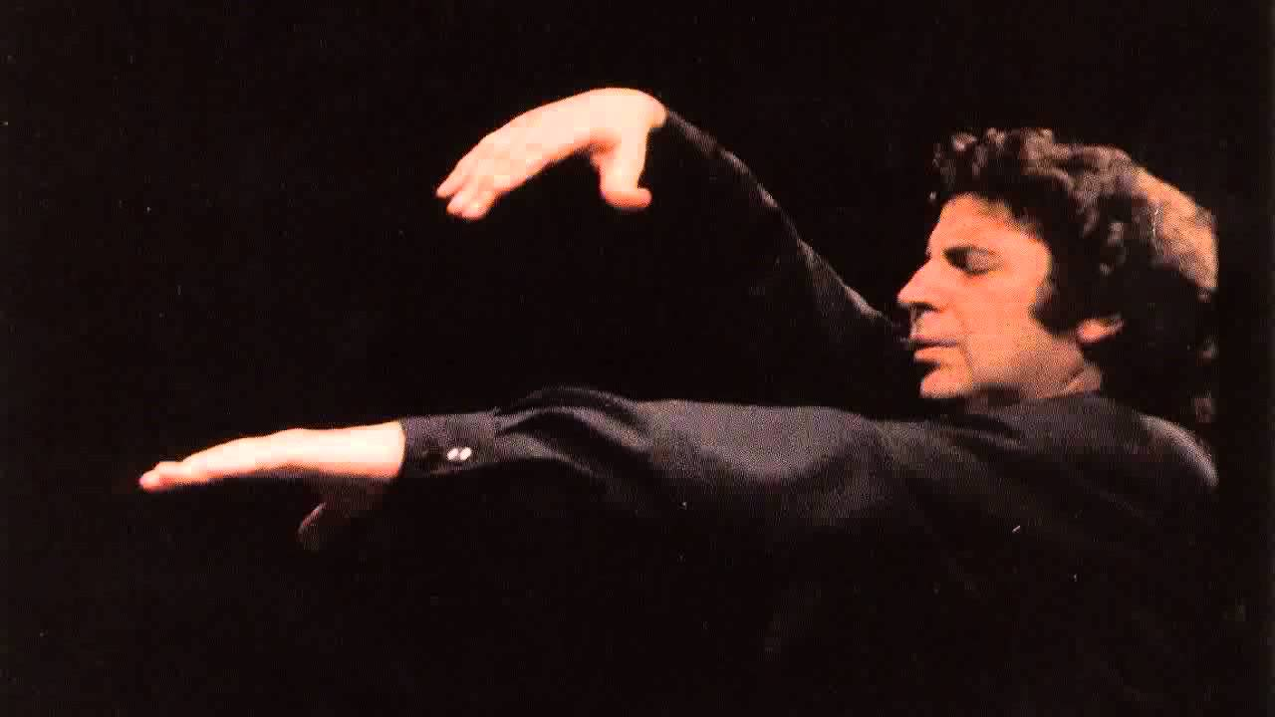
Photos:

Slide 26
Nana Mouskouri

Slide 27
She is a singer.
She was born on 13 October 1934.
Nana Mouskouri lives in Switzerland with her second husband André Chapelle, she got married in 2003.

Slide 28
Nana Mouskouri got two golden records for the record sales in the Netherlands (1971)

Slide 29
Theo Angelopoulos

Slide 30
Theodoros Angelopoulos was born in Athens on 27 April 1935. He died on 24 January 2012.
He was a film director and screenwriter
He started making films in 1967

Slide 31
He had three daughters.
Released seven films
Angelopoulos was the most famous in the world of Greek film directors.

Slide 32
Zach Galifianakis

Slide 33
Zach Galifianakis
Zach Galifianakis was born on October 1, 1969 Wilkesboro, North Carolina, U.S. Zach is an American actor, writer and comedian. He starred in films such as Puss in Boots, The muppets and Muppets most wanted, G force, and most recently, voicing the Joker in The Lego Batman Movie. He has won many awards for his movies.

Slide 34
Early life
Galifianakis was born in Wilkesboro, North Carolina. His mother, Mary Frances is a community arts center owner, and his father, Harry, is a heating oil vendor. He has a younger sister named Merritt and an older brother named Greg. He began acting on television, guest-starring in Boston Common and joined Saturday Night Live as a writer but lasted only two weeks.

Slide 35
Zach’s most popular movies.
Lego Batman Movie – Voicing the Joker
G-Force – Voicing Ben
The Hangover Trilogy – as Alan Garner
Puss in Boots – Voicing Humpty Dumpty
The Muppets – as Hobo Joe
Into the Wild – as Kevin
And many more!

Slide 36
Zach acting in popular movies.

Slide 37
Photos

Slide 38
Photos

Slide 39
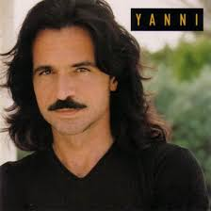
Yanni

Slide 40
Yanni is a famous singer in Greece

Slide 41
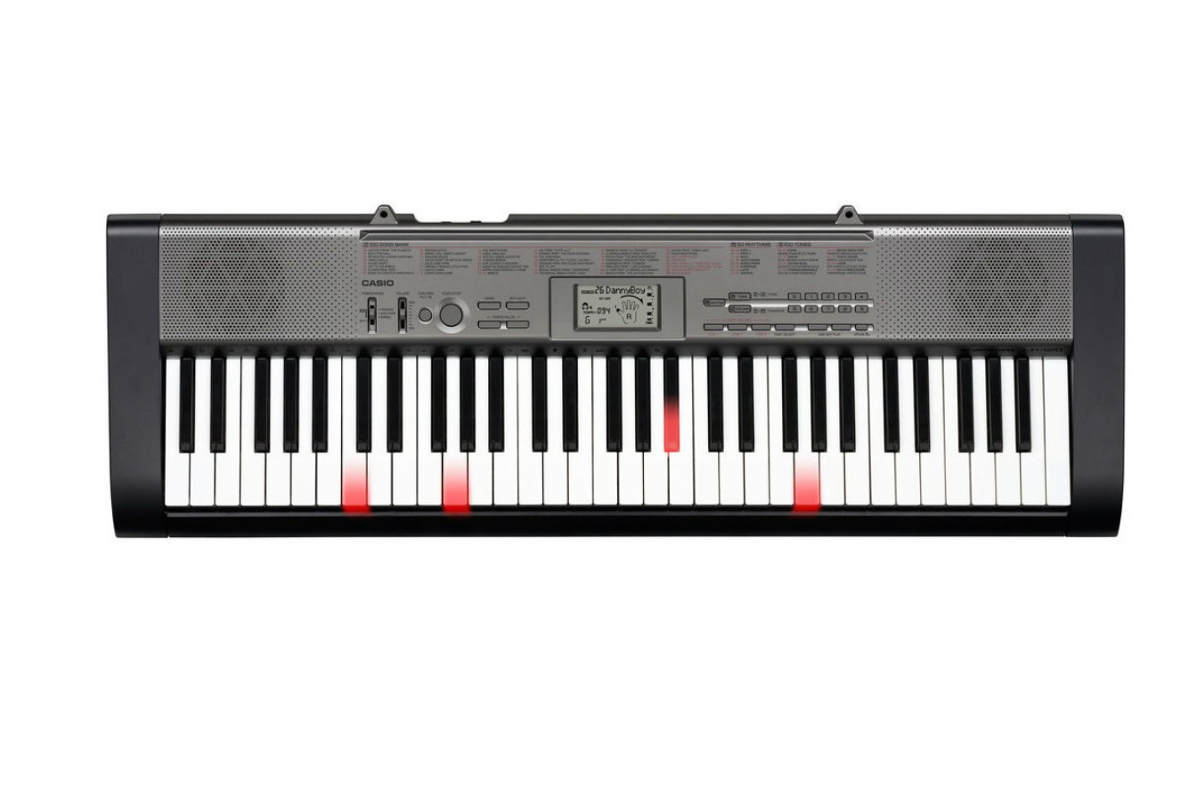
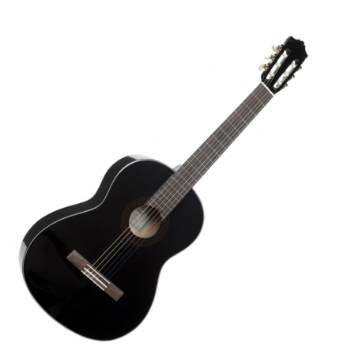
Yanni plays on these instruments

Slide 42
Yanni is 62 years old. He was born in 1954.

Slide 43
He is a very good singer

