Slide 1
Treasures of Spain

Slide 3
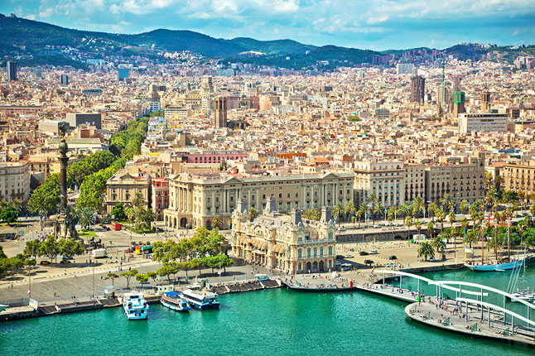
Barcelona/excitement
The capital city of the autonomous community of Catalonia in the Kingdom of Spain, as well as the country's second most populous municipality!

Slide 4
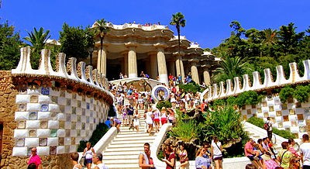
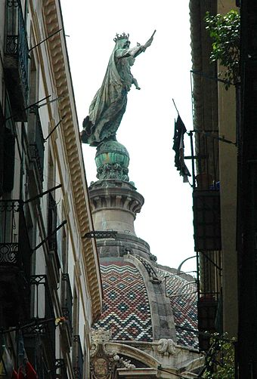
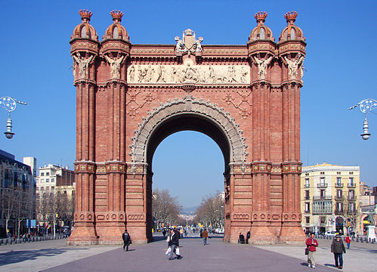
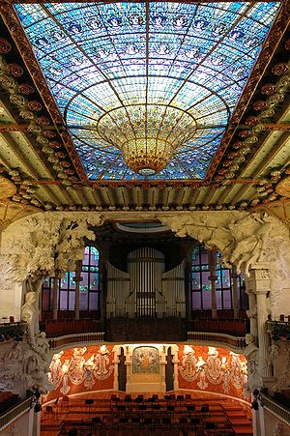
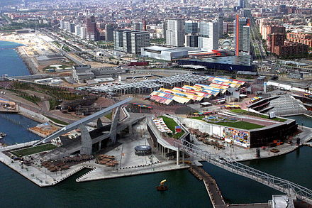

Slide 5
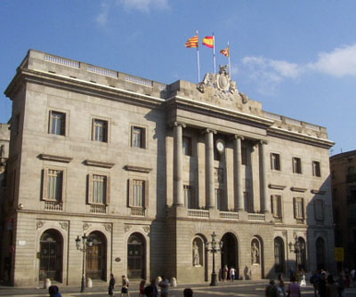
Barcelona's cultural roots go back 2000 years...

Slide 6
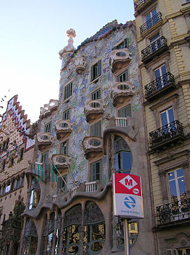
Barcelona's influence in commerce, education, entertainment, media, fashion, science and the arts, all contribute to its status as one of the world's major global cities!!

Slide 7
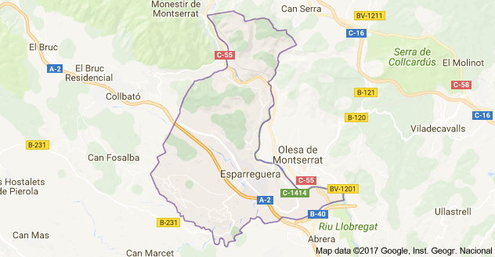
Esparreguera/warmth
Esparreguera is a municipality in Catalonia, in the province of Barcelona.

Slide 8
Esparreguera is famous in Catalonia for staging a grand version of the play Life and Passion of Jesus Christ every year in March and April, on the Sundays before and after Easter. The play is popularly known as ‘La Passió d' Esparreguera’.

Slide 9
Miguel de Cervantes Saavedra/admiration
Cervantes (1547 – 1616) was a Spanish writer who is widely
regarded as the greatest writer in the Spanish language and one of the world's pre-eminent novelists.

Slide 10
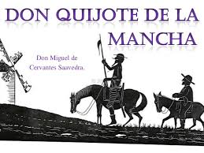
He created one of the world's greatest literary masterpieces, 'Don Quixote,' in the early 1600s.

Slide 11
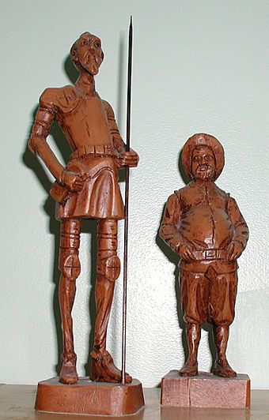
Don Quixote became the world's first best seller and was eventually translated into more than 60 different languages!

Slide 12
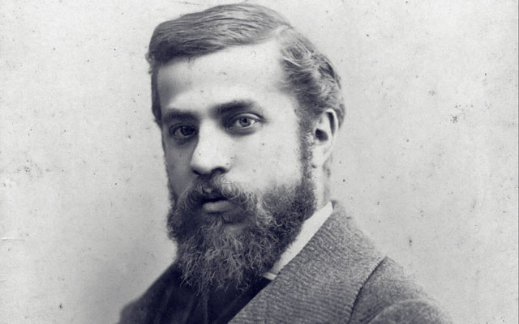
Gaudí/inspiration
Architect Antoni Gaudí was born in Catalonia on the Mediterranean coast of Spain in 1852.

Slide 13
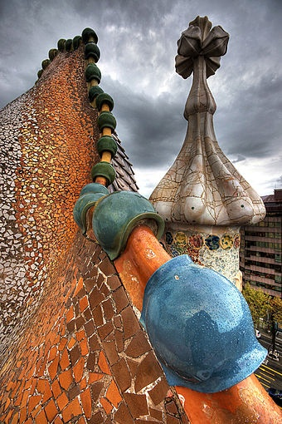
He helped Catalan architecture gain worldwide fame and reputation! He had the special ability to synthesise the old with the new and he also worked with all kinds of architectural elements!

Slide 14
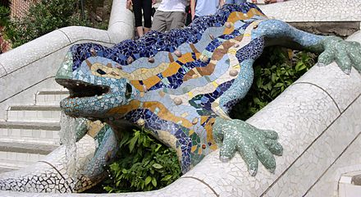
The salamander in Park Güell is representative of Gaudí's work.

Slide 15
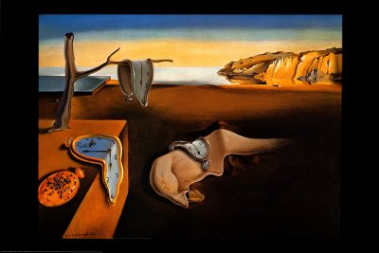
Salvador Dalí/innovation
Spanish artist and Surrealist icon Salvador Dalí (1904-1989) is perhaps best known for his painting of melting clocks, The Persistence of Memory.

Slide 16
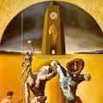
In the 1920s, he went to Paris and began interacting with artists such as Picasso, Magritte and Miró, which led to Dalí's first Surrealist phase.

Slide 17
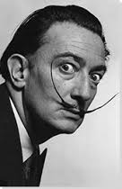
His eccentric manner was a reflection of his art and vice versa.

Slide 18
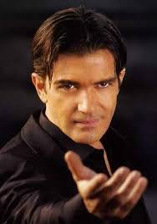
Antonio Banderas/passion
Antonio Banderas was born on August 10, 1960, in Málaga, Spain.

Slide 19
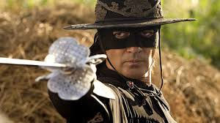
Banderas has appeared as an actor in many films. The Mask of Zorro (1998) made him well known internationally!

Slide 20
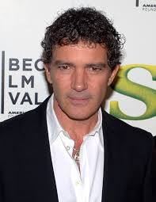
He won numerous awards and nominations for his works in film, including three ALMA awards and three Golden Globe nominations, among many others. In 1996, he was chosen as one of the 50 most beautiful people in the world by the People magazine.

Slide 21
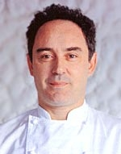
Ferran Adrià /creativity
Ferran Adrià, raised in Barcelona, in 1984, at the age of 22, joined the kitchen staff of El Bulli, and only 18 months later, he became head chef! He is now considered to be one of the most creative and inventive culinary geniuses in the world!

Slide 22
Thanks to him, el Bulli had 3 Michelin stars and became one of the best restaurants in the world.

Slide 23
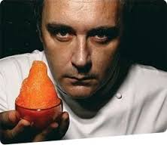
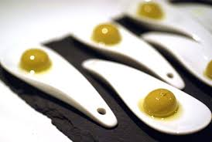
Among the many experiments Adrià conducted, one of the most impressive and well received was his use of foams, as well as the “liquid olives,” which resembled solid green olives but burst in the mouth with olive juice.

Slide 24
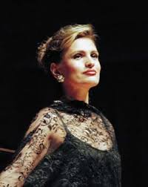
Ainhoa Arteta Ibarrolaburu/fascination
Ainhoa Arteta, born in 1964, in Tolosa, Guipúzcoa, Spain, made her opera debut in 1990 in the United States, as Clorinda in Rossini's La Cenerentola .

Slide 25
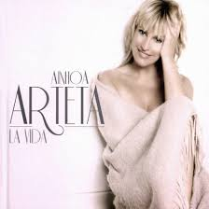
In 2009, Arteta made her album debut with La Vida, which peaked at number three on the Spanish albums chart and spent nine weeks in the Top Ten.

Slide 26
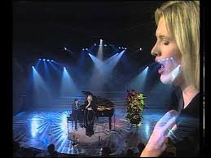
In the years that followed, she established herself as an accomplished opera performer with an international following!

Slide 27
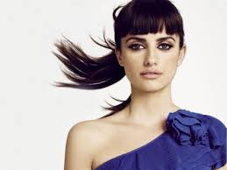
Penélope Cruz Sánchez/ astonishment
Born in Spain in 1974, actress Penelope Cruz studied classical ballet at a young age and later moved to Hollywood, California, to pursue acting. She soon landed roles opposite the likes of Matt Damon and Tom Cruise!

Slide 28
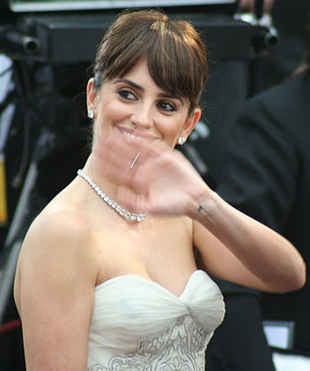
She won an Academy Award, becoming the first Spanish actress to do so, for her performance in the film Vicky Christina Barcelona. She is also the first Spanish actress to be presented with a star on the Hollywood Walk of Fame!

Slide 29
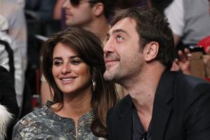
Cruz married her Vicky Cristina Barcelona co-star, Spanish actor Javier Bardem, in 2010.

Slide 30
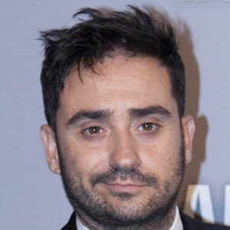
Juan Antonio García Bayona /brightness
Born in 1975 in Barcelona, Catalonia, he is a Spanish film director.

Slide 31
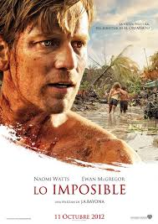
He is very well known for The Impossible (2012), The Orphanage (2007) and A Monster Calls (2016).

Slide 32
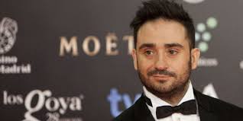
He earned several honors, including the 2008 "Best New Director" title at the Goya Awards.

Slide 33
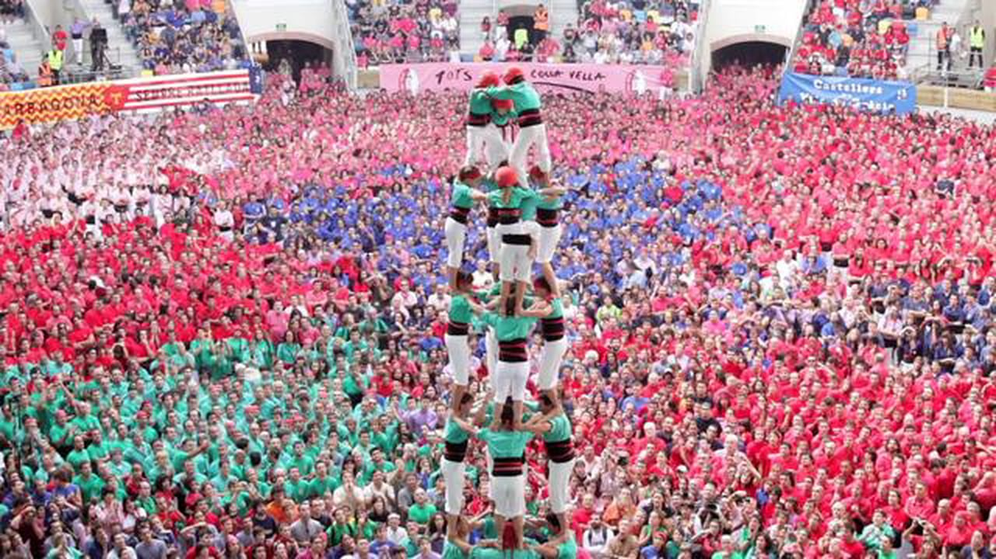
colles castelleres
A catalonian phrase that means groups who construct towers!

Slide 34
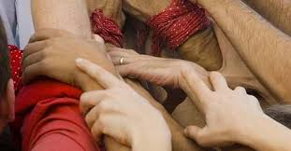
Human castle performances, as they require many helping hands, teach self-control, teamwork, as well as altruism.

Slide 35
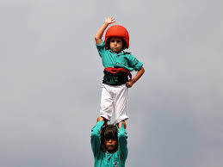
It’s a tradition originated at the end of the 18th century in Valls, Tarragona…and it is declared by UNESCO to be amongst the Masterpieces of the Oral and Intangible Heritage of Humanity!

Slide 36
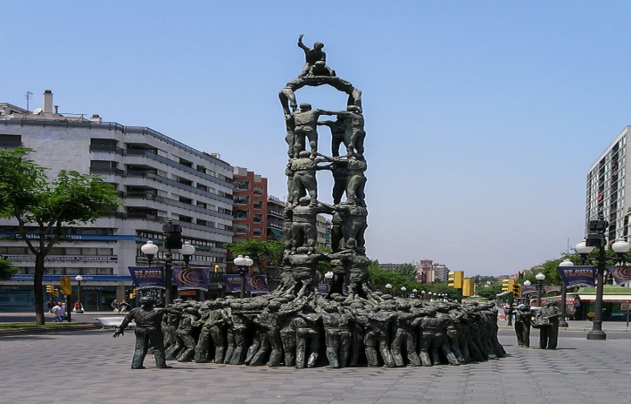
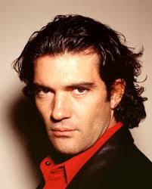
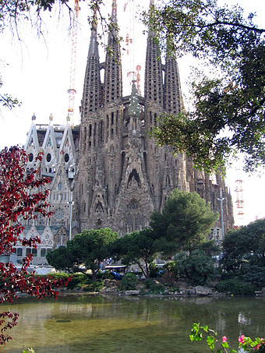
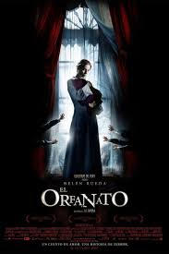
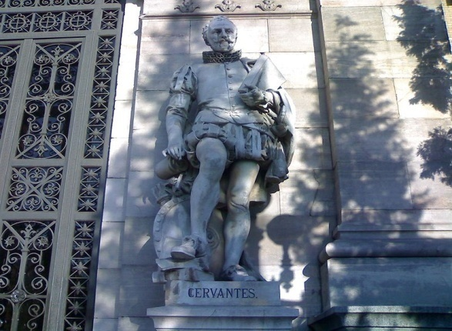
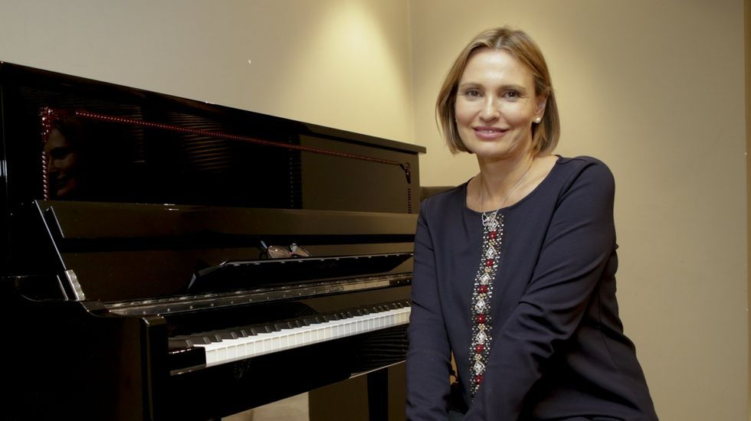
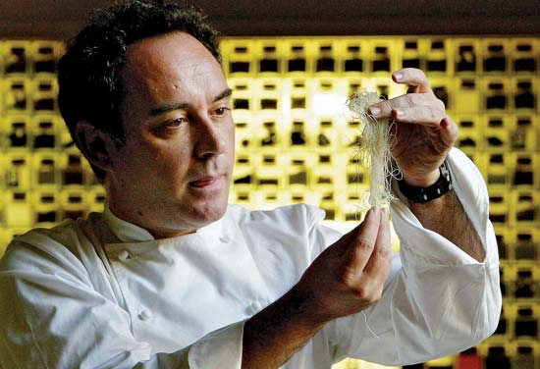
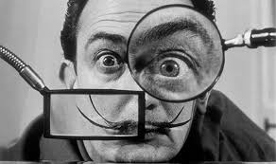
Learning about Spain is like wandering through a dream!!!

