Slide 1
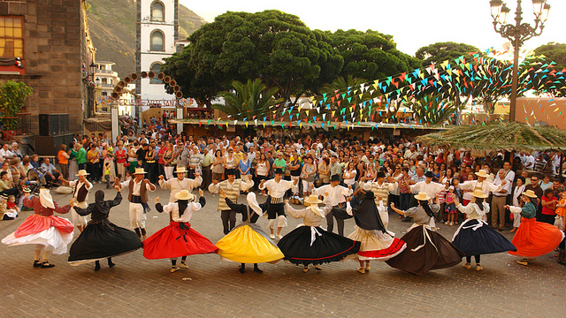
Folklore & typical dress
Nerea González & Diego González

Slide 2
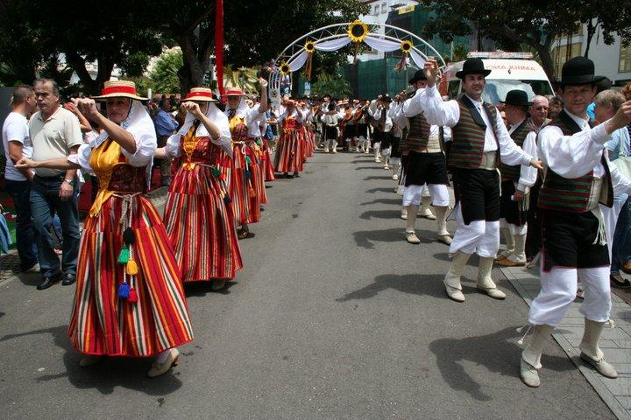
FOLKLORE
The term folklore was determined by the British antiquarian William John Thoms in 1846 to refer what was then known as popular antiquities.

Slide 3
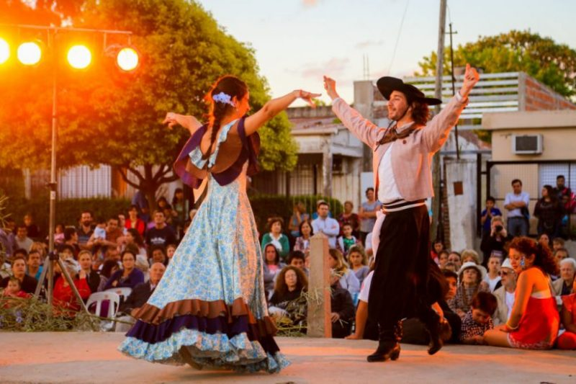
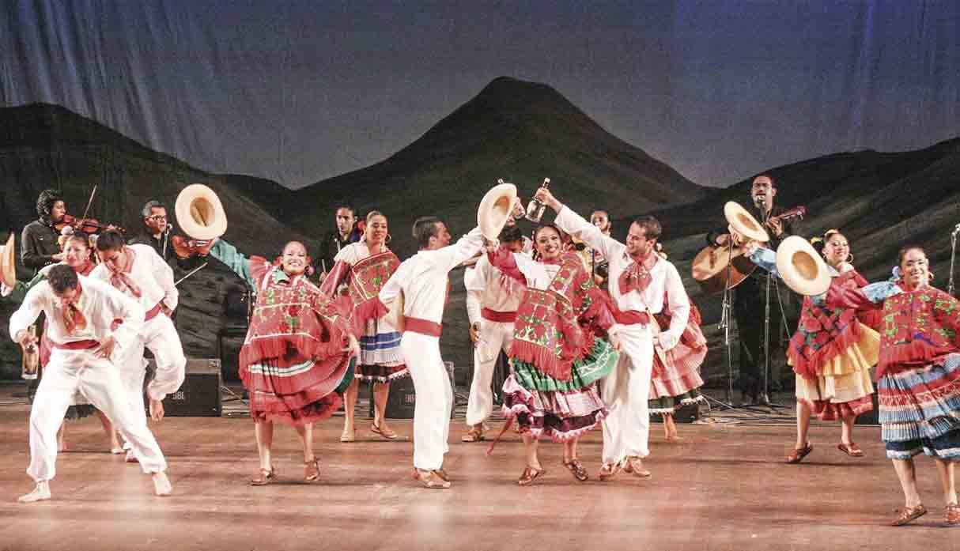
Folklore
Set of beliefs, practices and customs that are traditional of a people or culture.

Slide 4
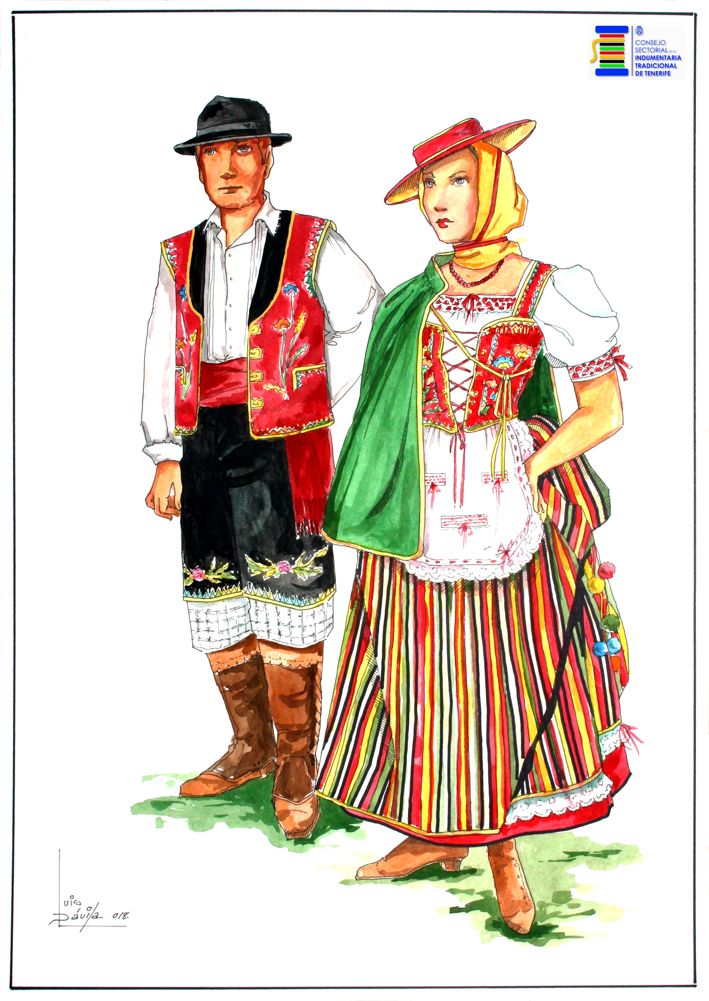
Typical dress
For the traditional parties called “Romerías” the people wear some typical clothes.

Slide 5
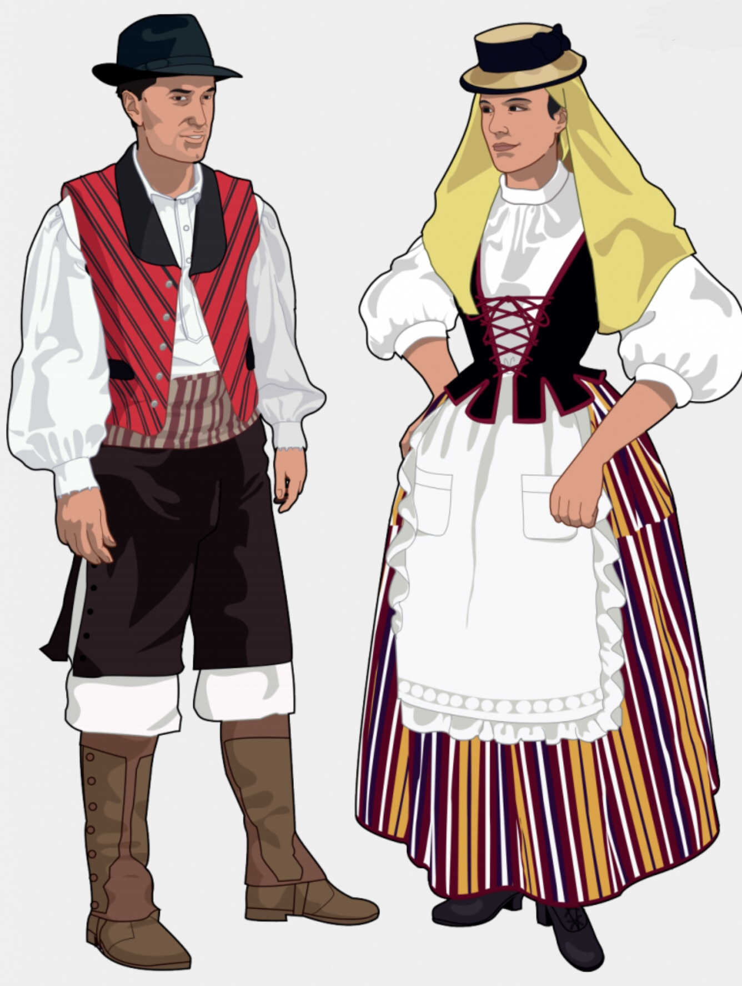
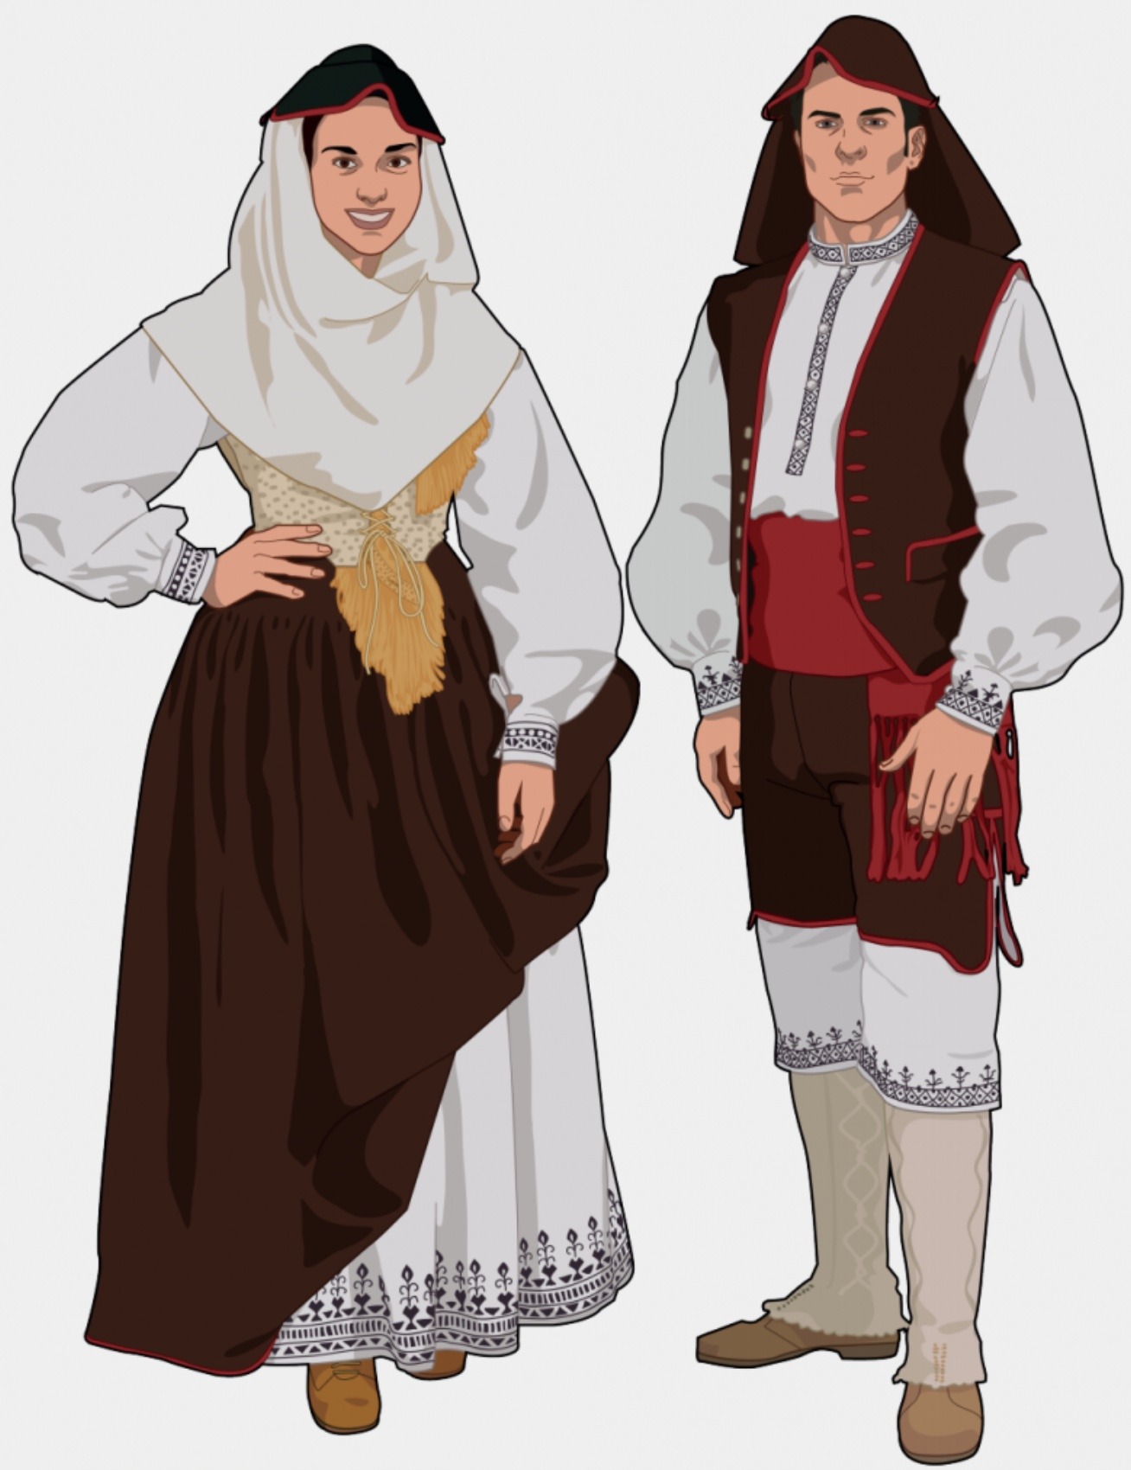
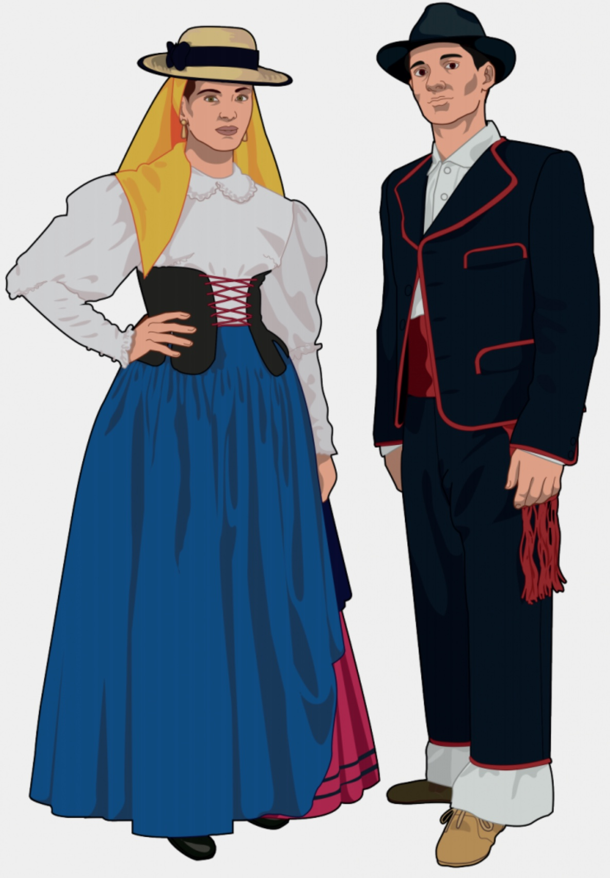
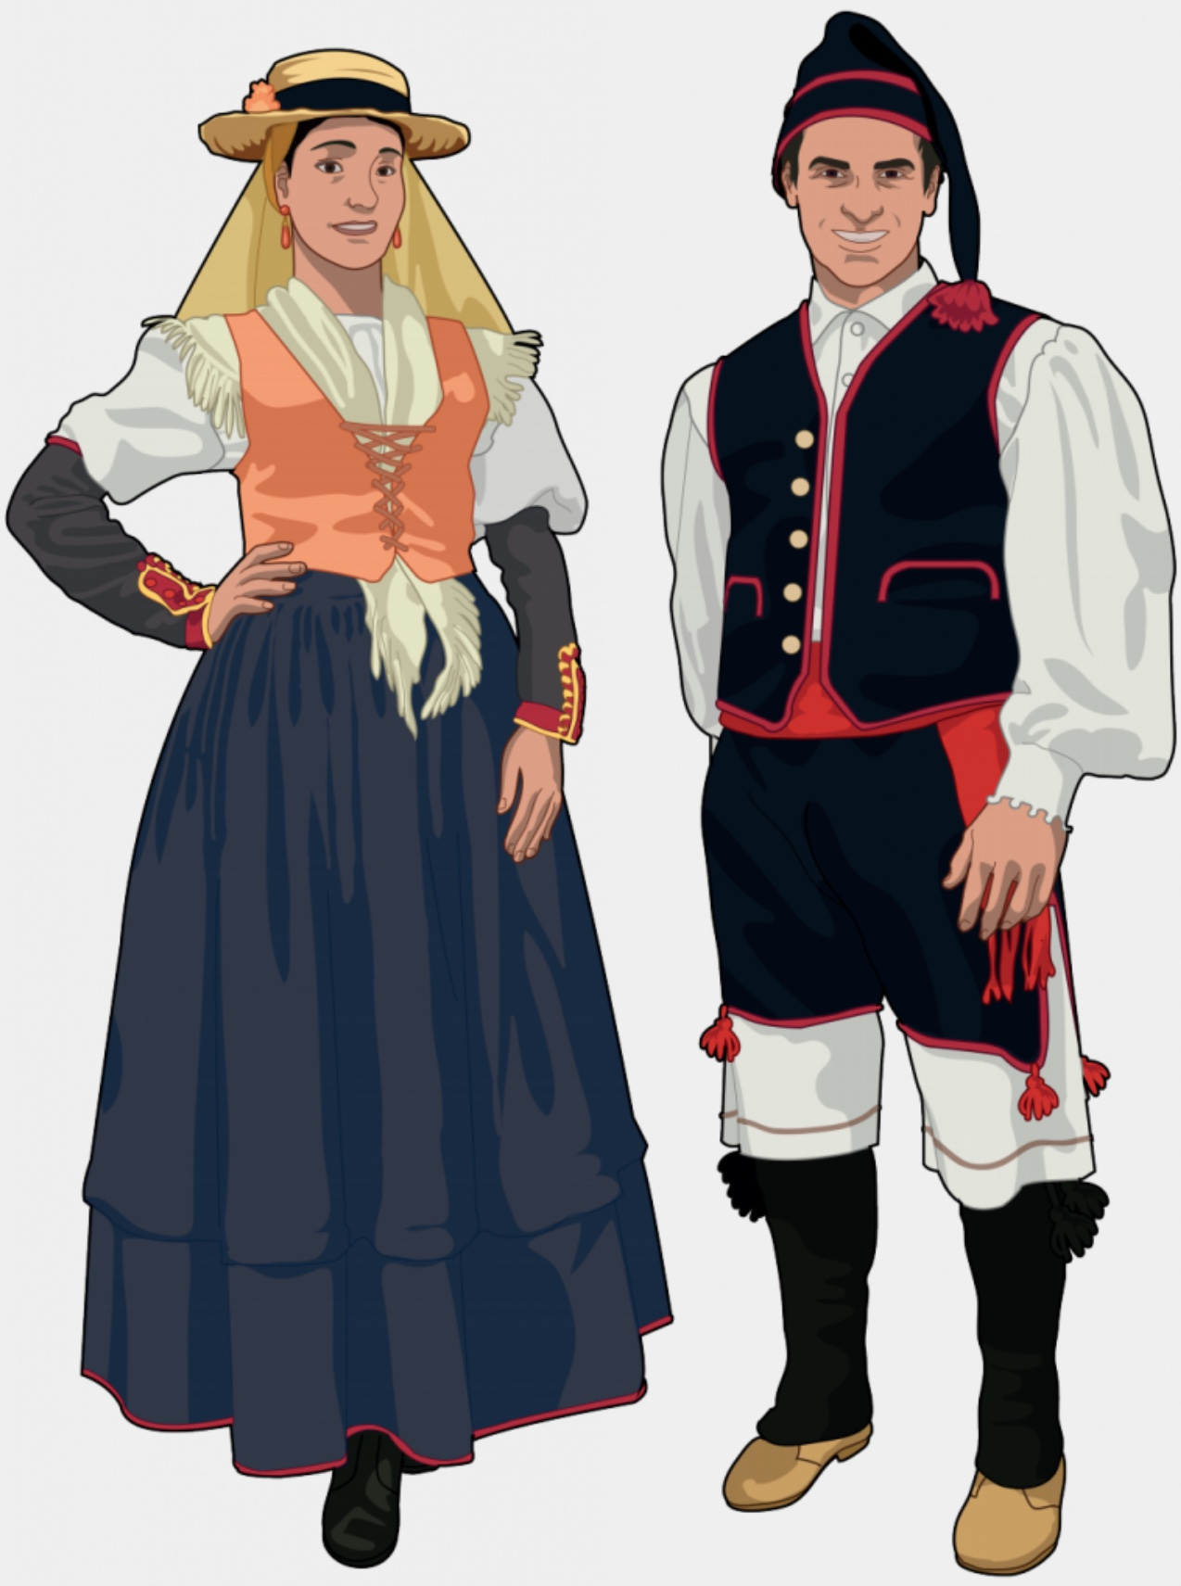
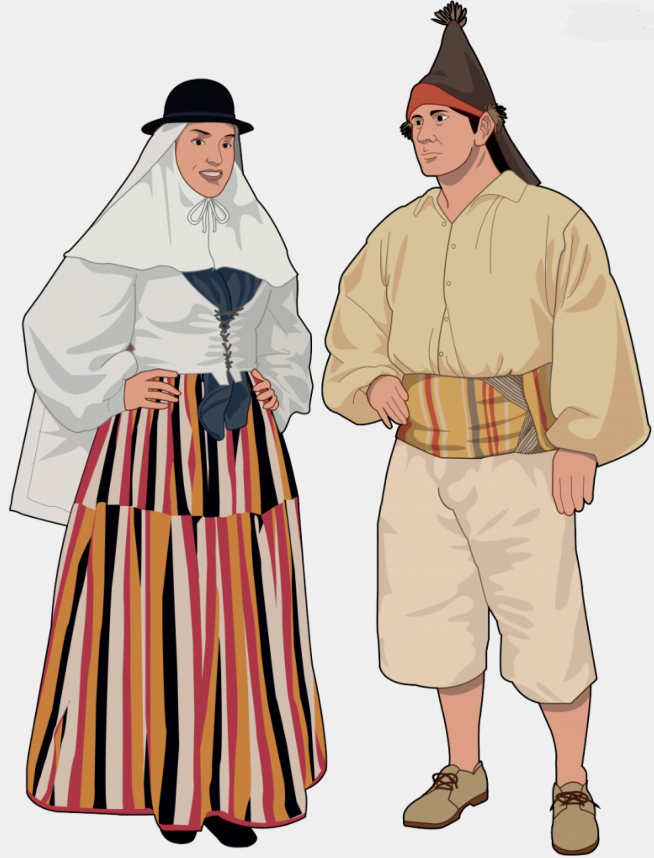
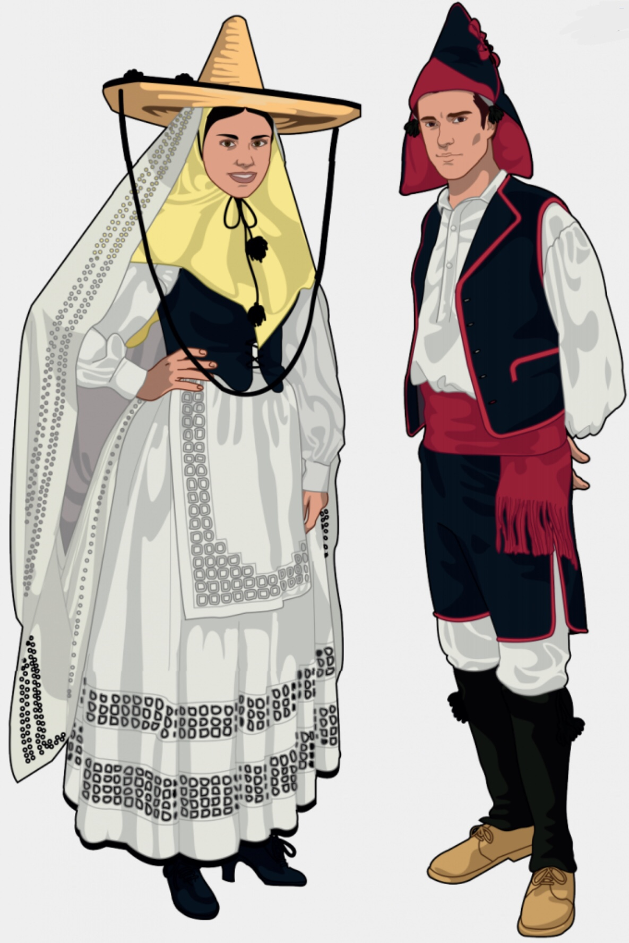
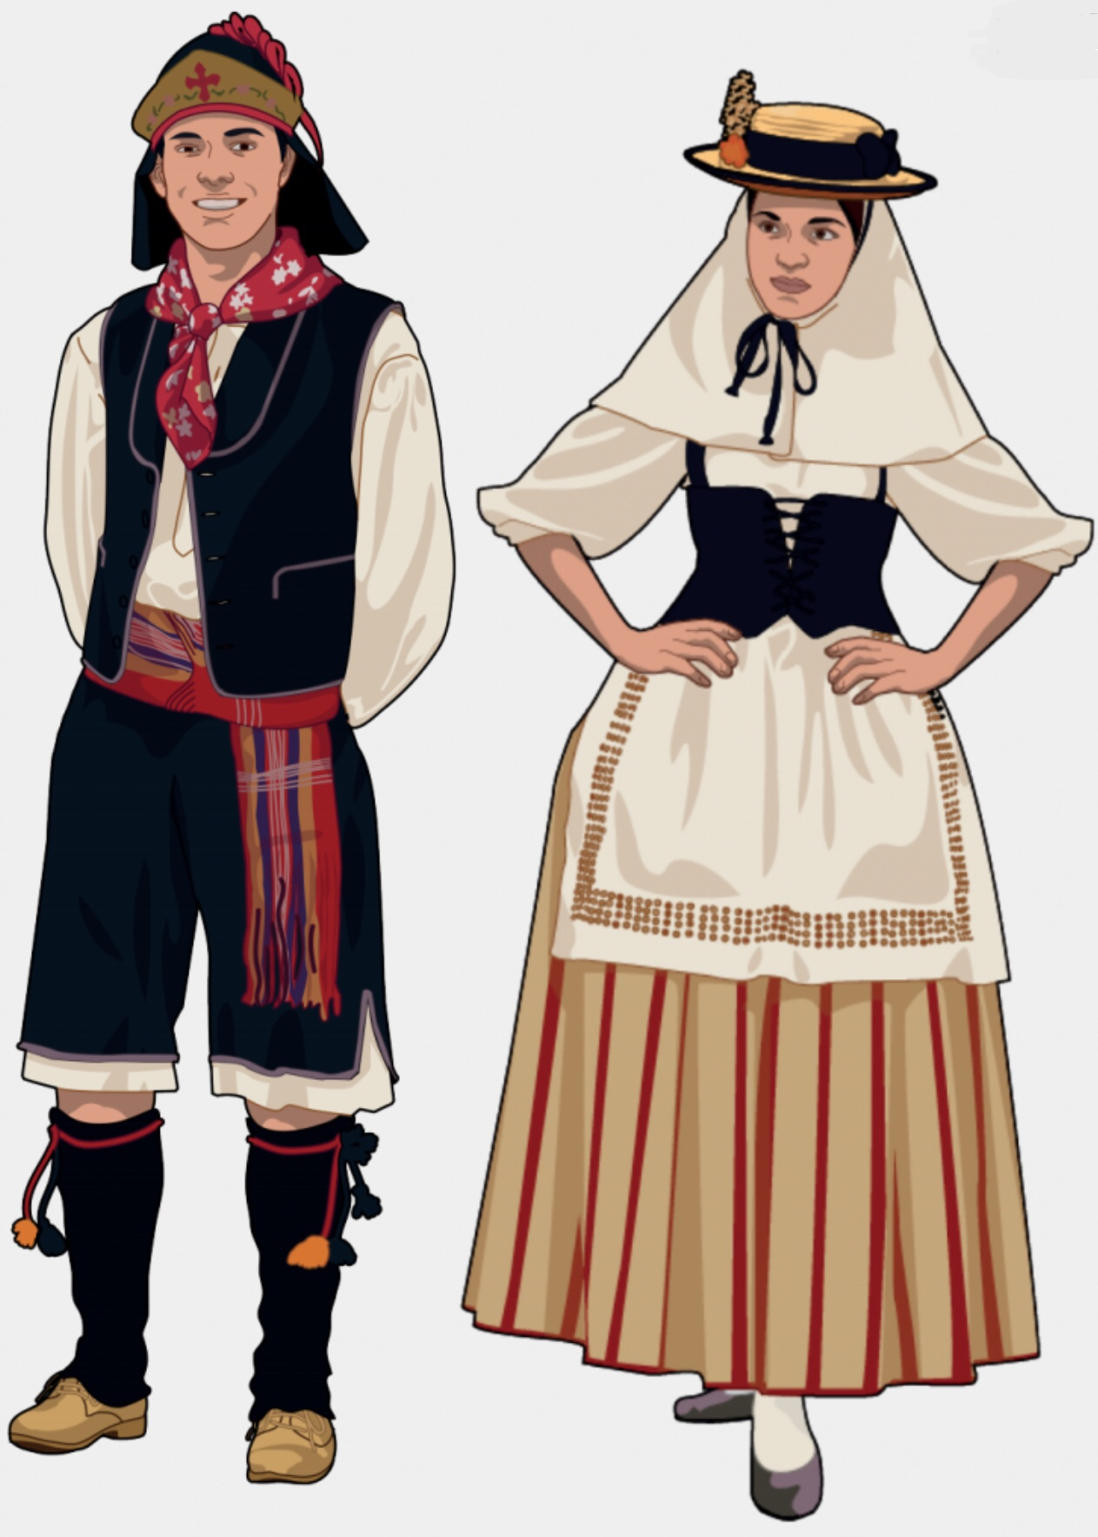
Typical dress
Western island: Eastern island:

Slide 6
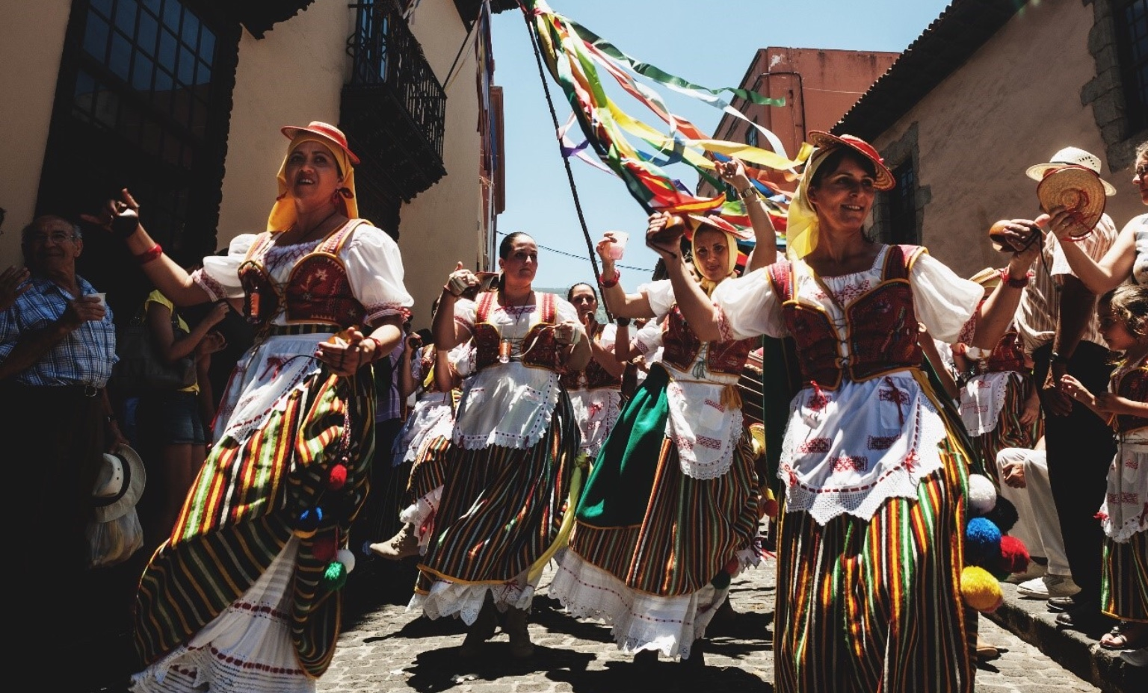
Romerías
It is a Catholic festival consisting of a trip or pilgrimage that goes to the sanctuary or hermitage of a virgin or a patron saint of the place, usually located in a country or mountain landscape.

Slide 7
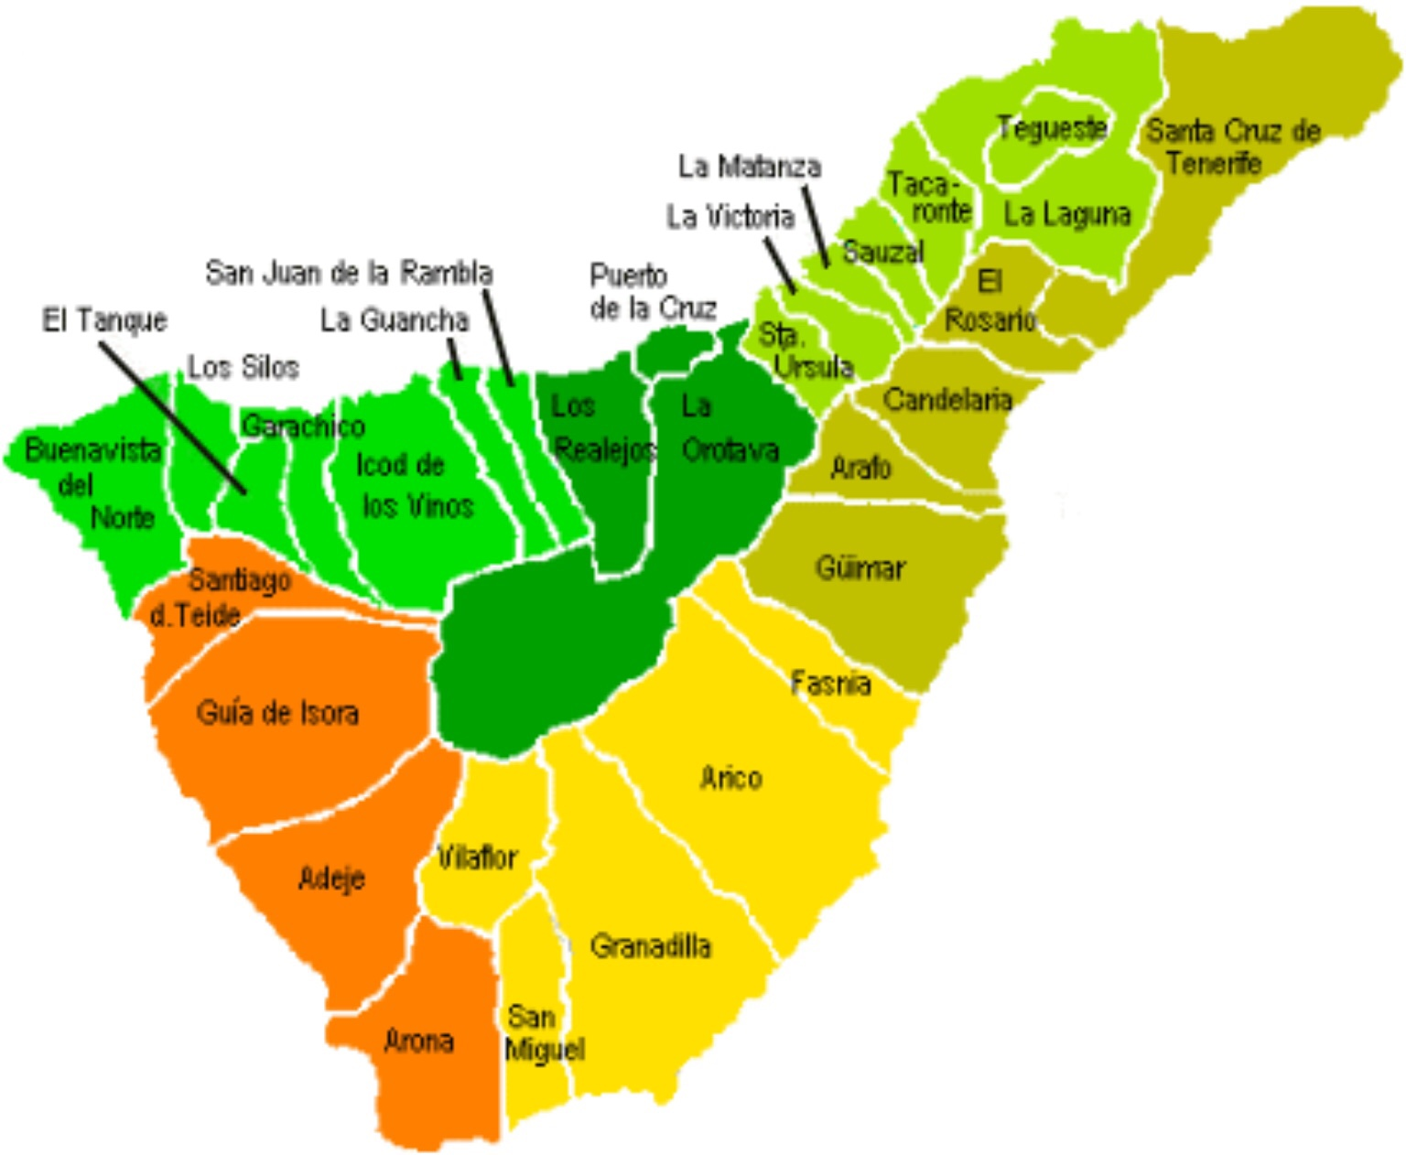
Romerías
The most important in Tenerife are from Tegueste, Tejina, La Esperanza, San Isidro…

