Slide 1
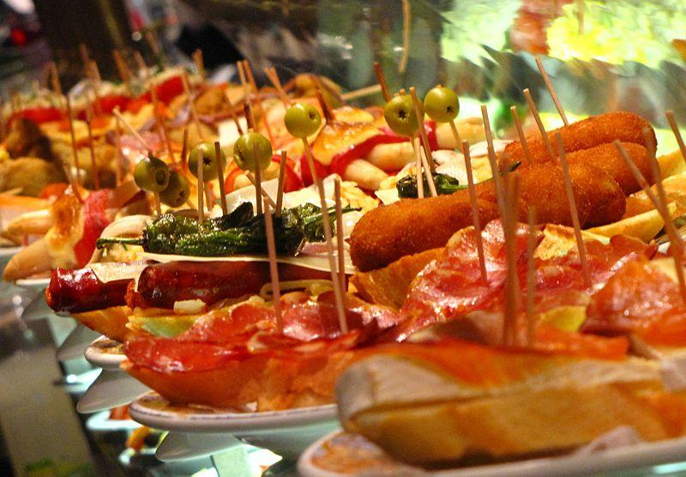
Gastronomy in spain
By: Joel Molina Borja
Rubén Cebrián Gómez
David López Cuartero

Slide 2
Etymology
The term gastronomy is of Greek origin, consists of two words,“gastros” meaning stomach more “nomos” meaning rule.
Gastronomy is the study of the relationship between food and culture, the art of preparing and service rich food and cooking styles.

Slide 3
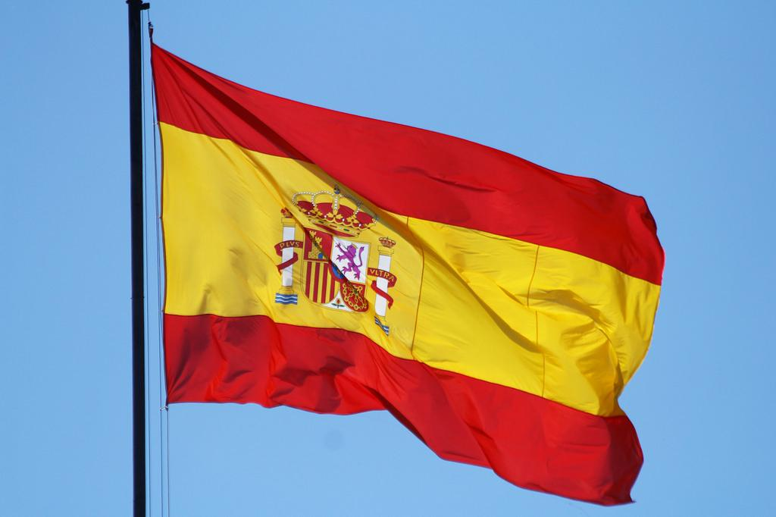
our cuisine
It is influenced by the Phoenicians, Greeks, Romans, Jews, Moors and muslim Adulicians.
The traditional pattern is composed of four meals a day plus some snacks:
A light breakfast,
midmornig breakfast
ligth snacks
lunch (Soup , salad,fhis etc…)
tea and pastries

Slide 4
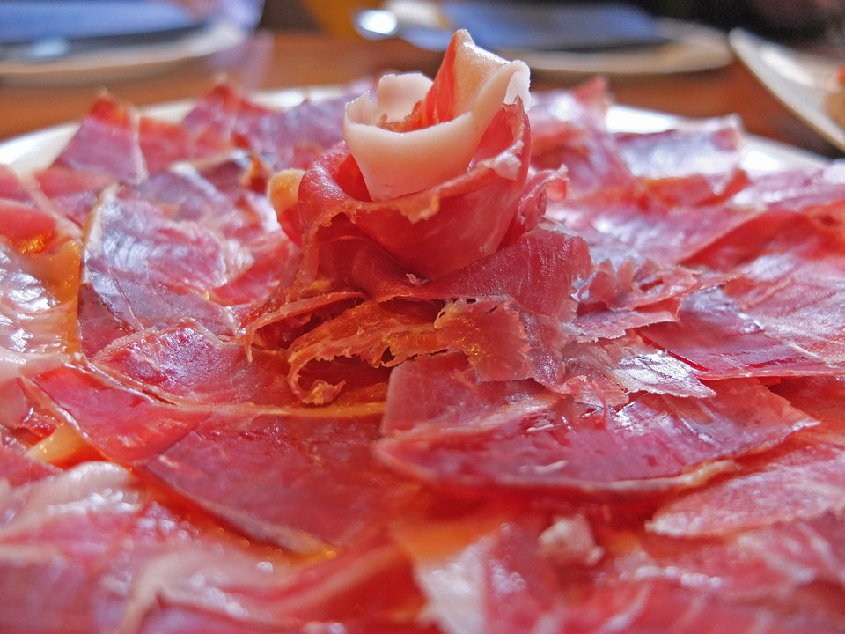
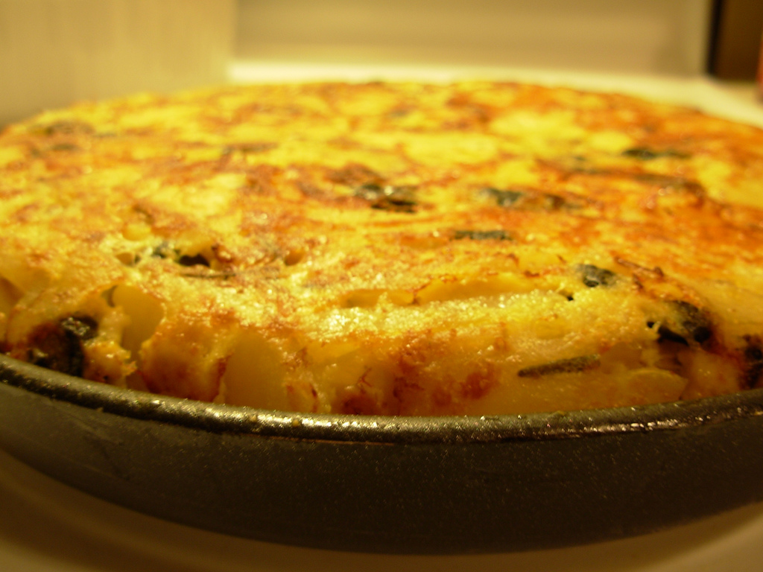
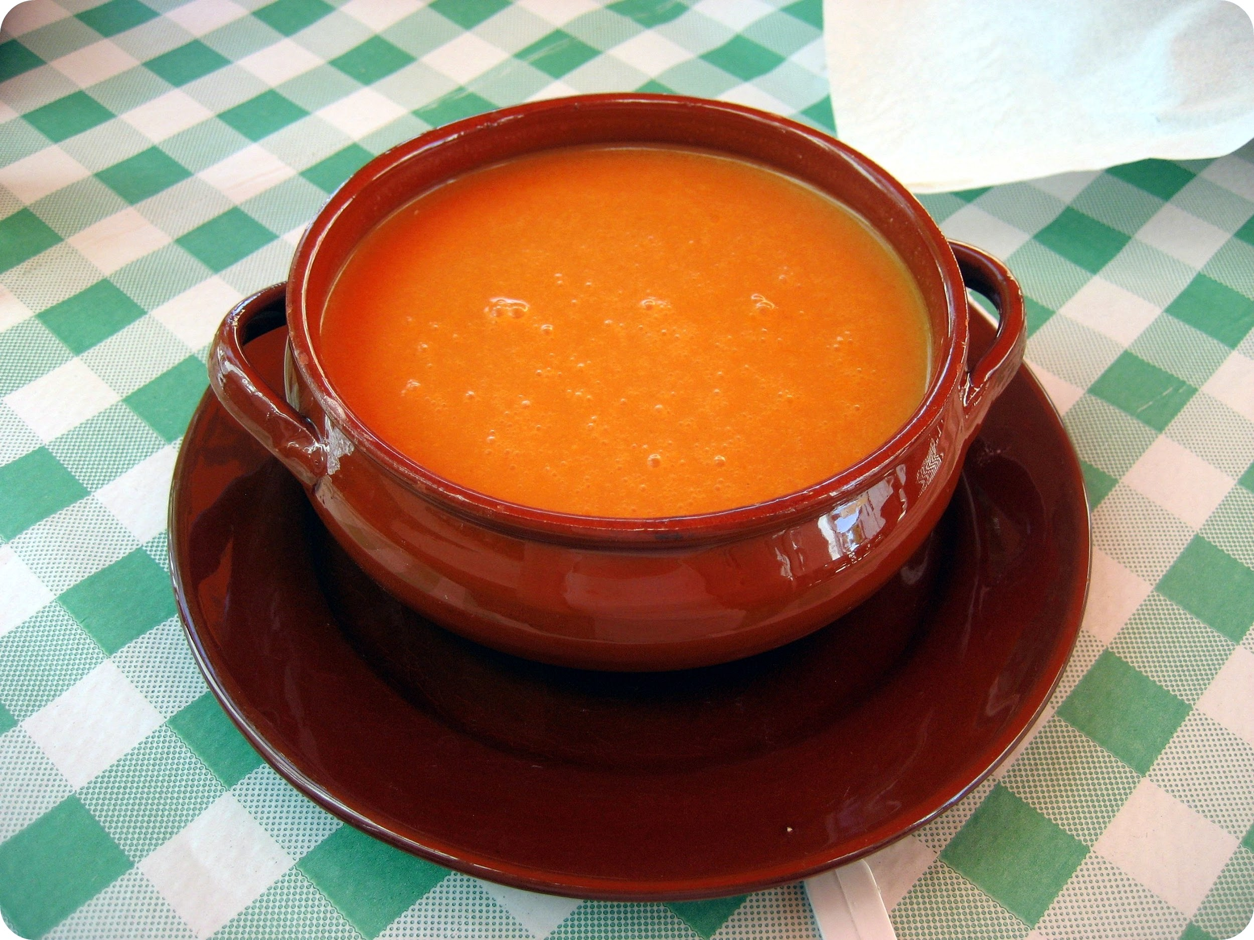
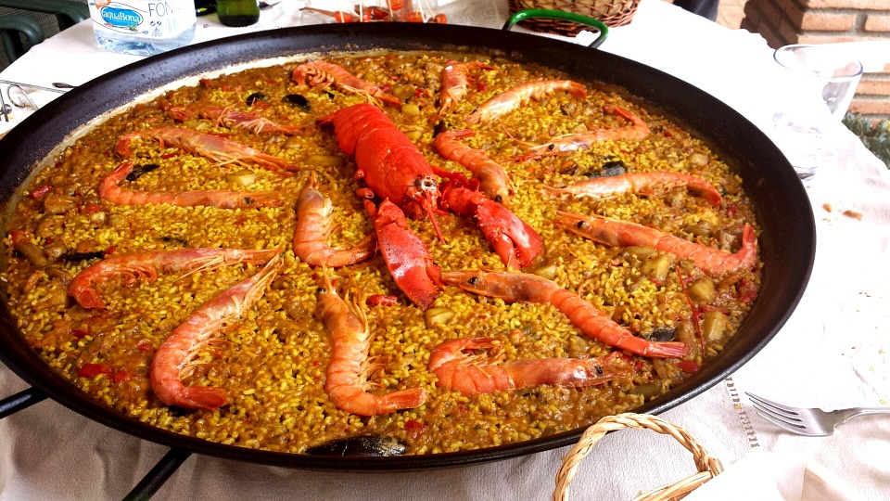
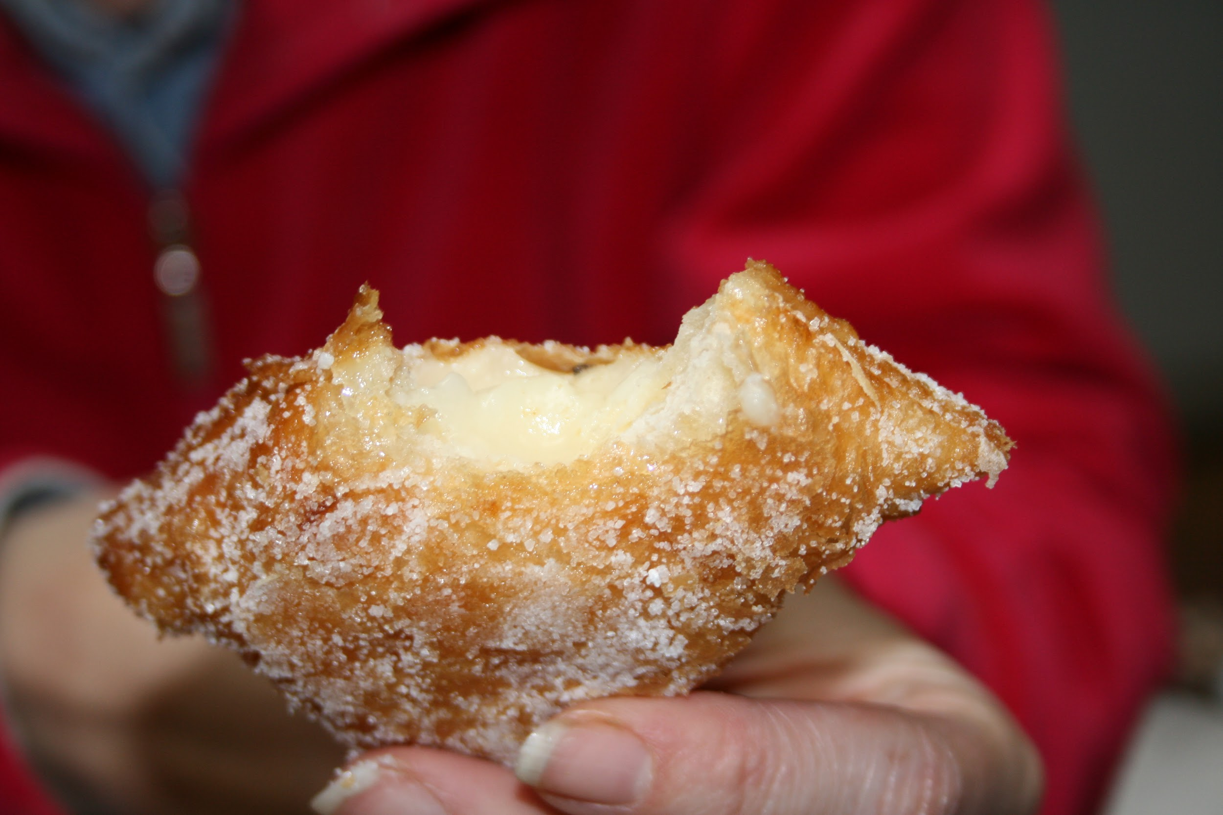
Typical dishes
The tipical dishes are:

Slide 5
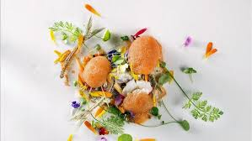
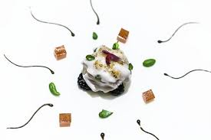
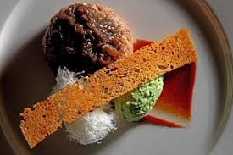
new cuisine
They are made with traditional Spanish products, but they are characterized by lighter, more delicate dishes and increased emphasis on presentation.

Slide 6
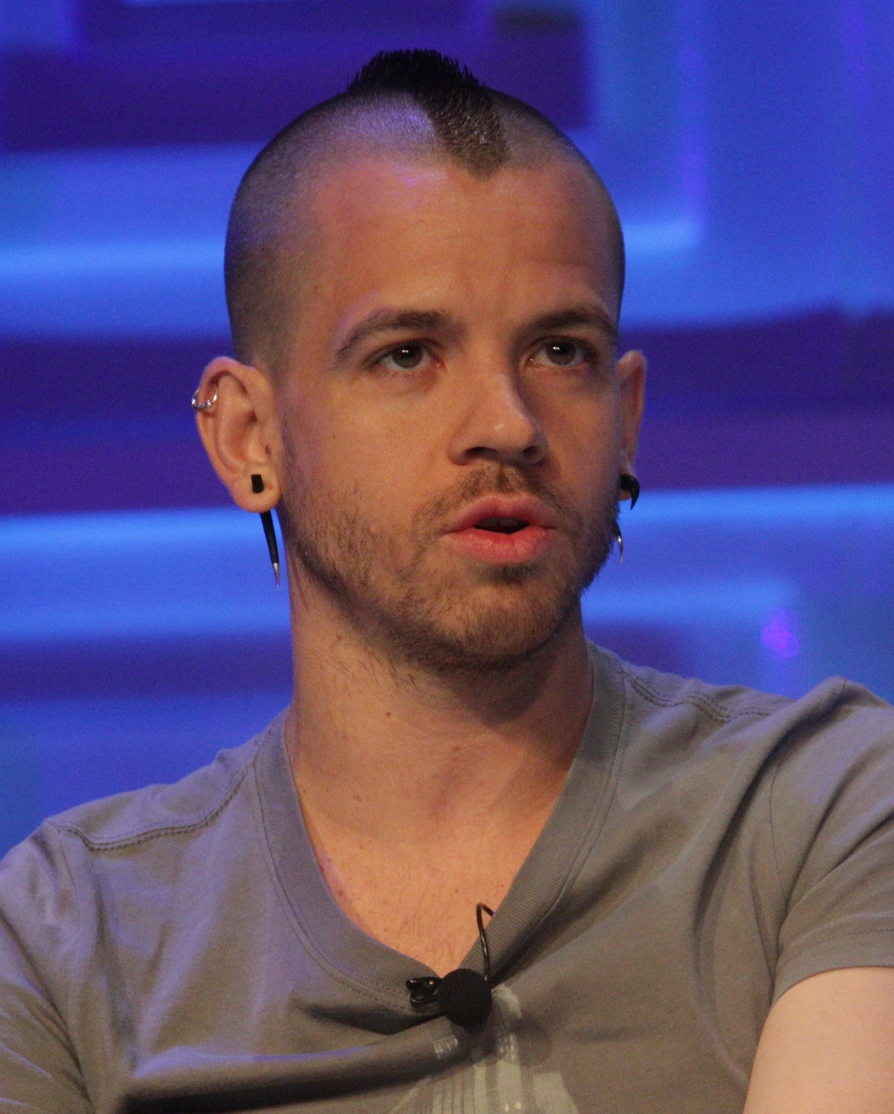
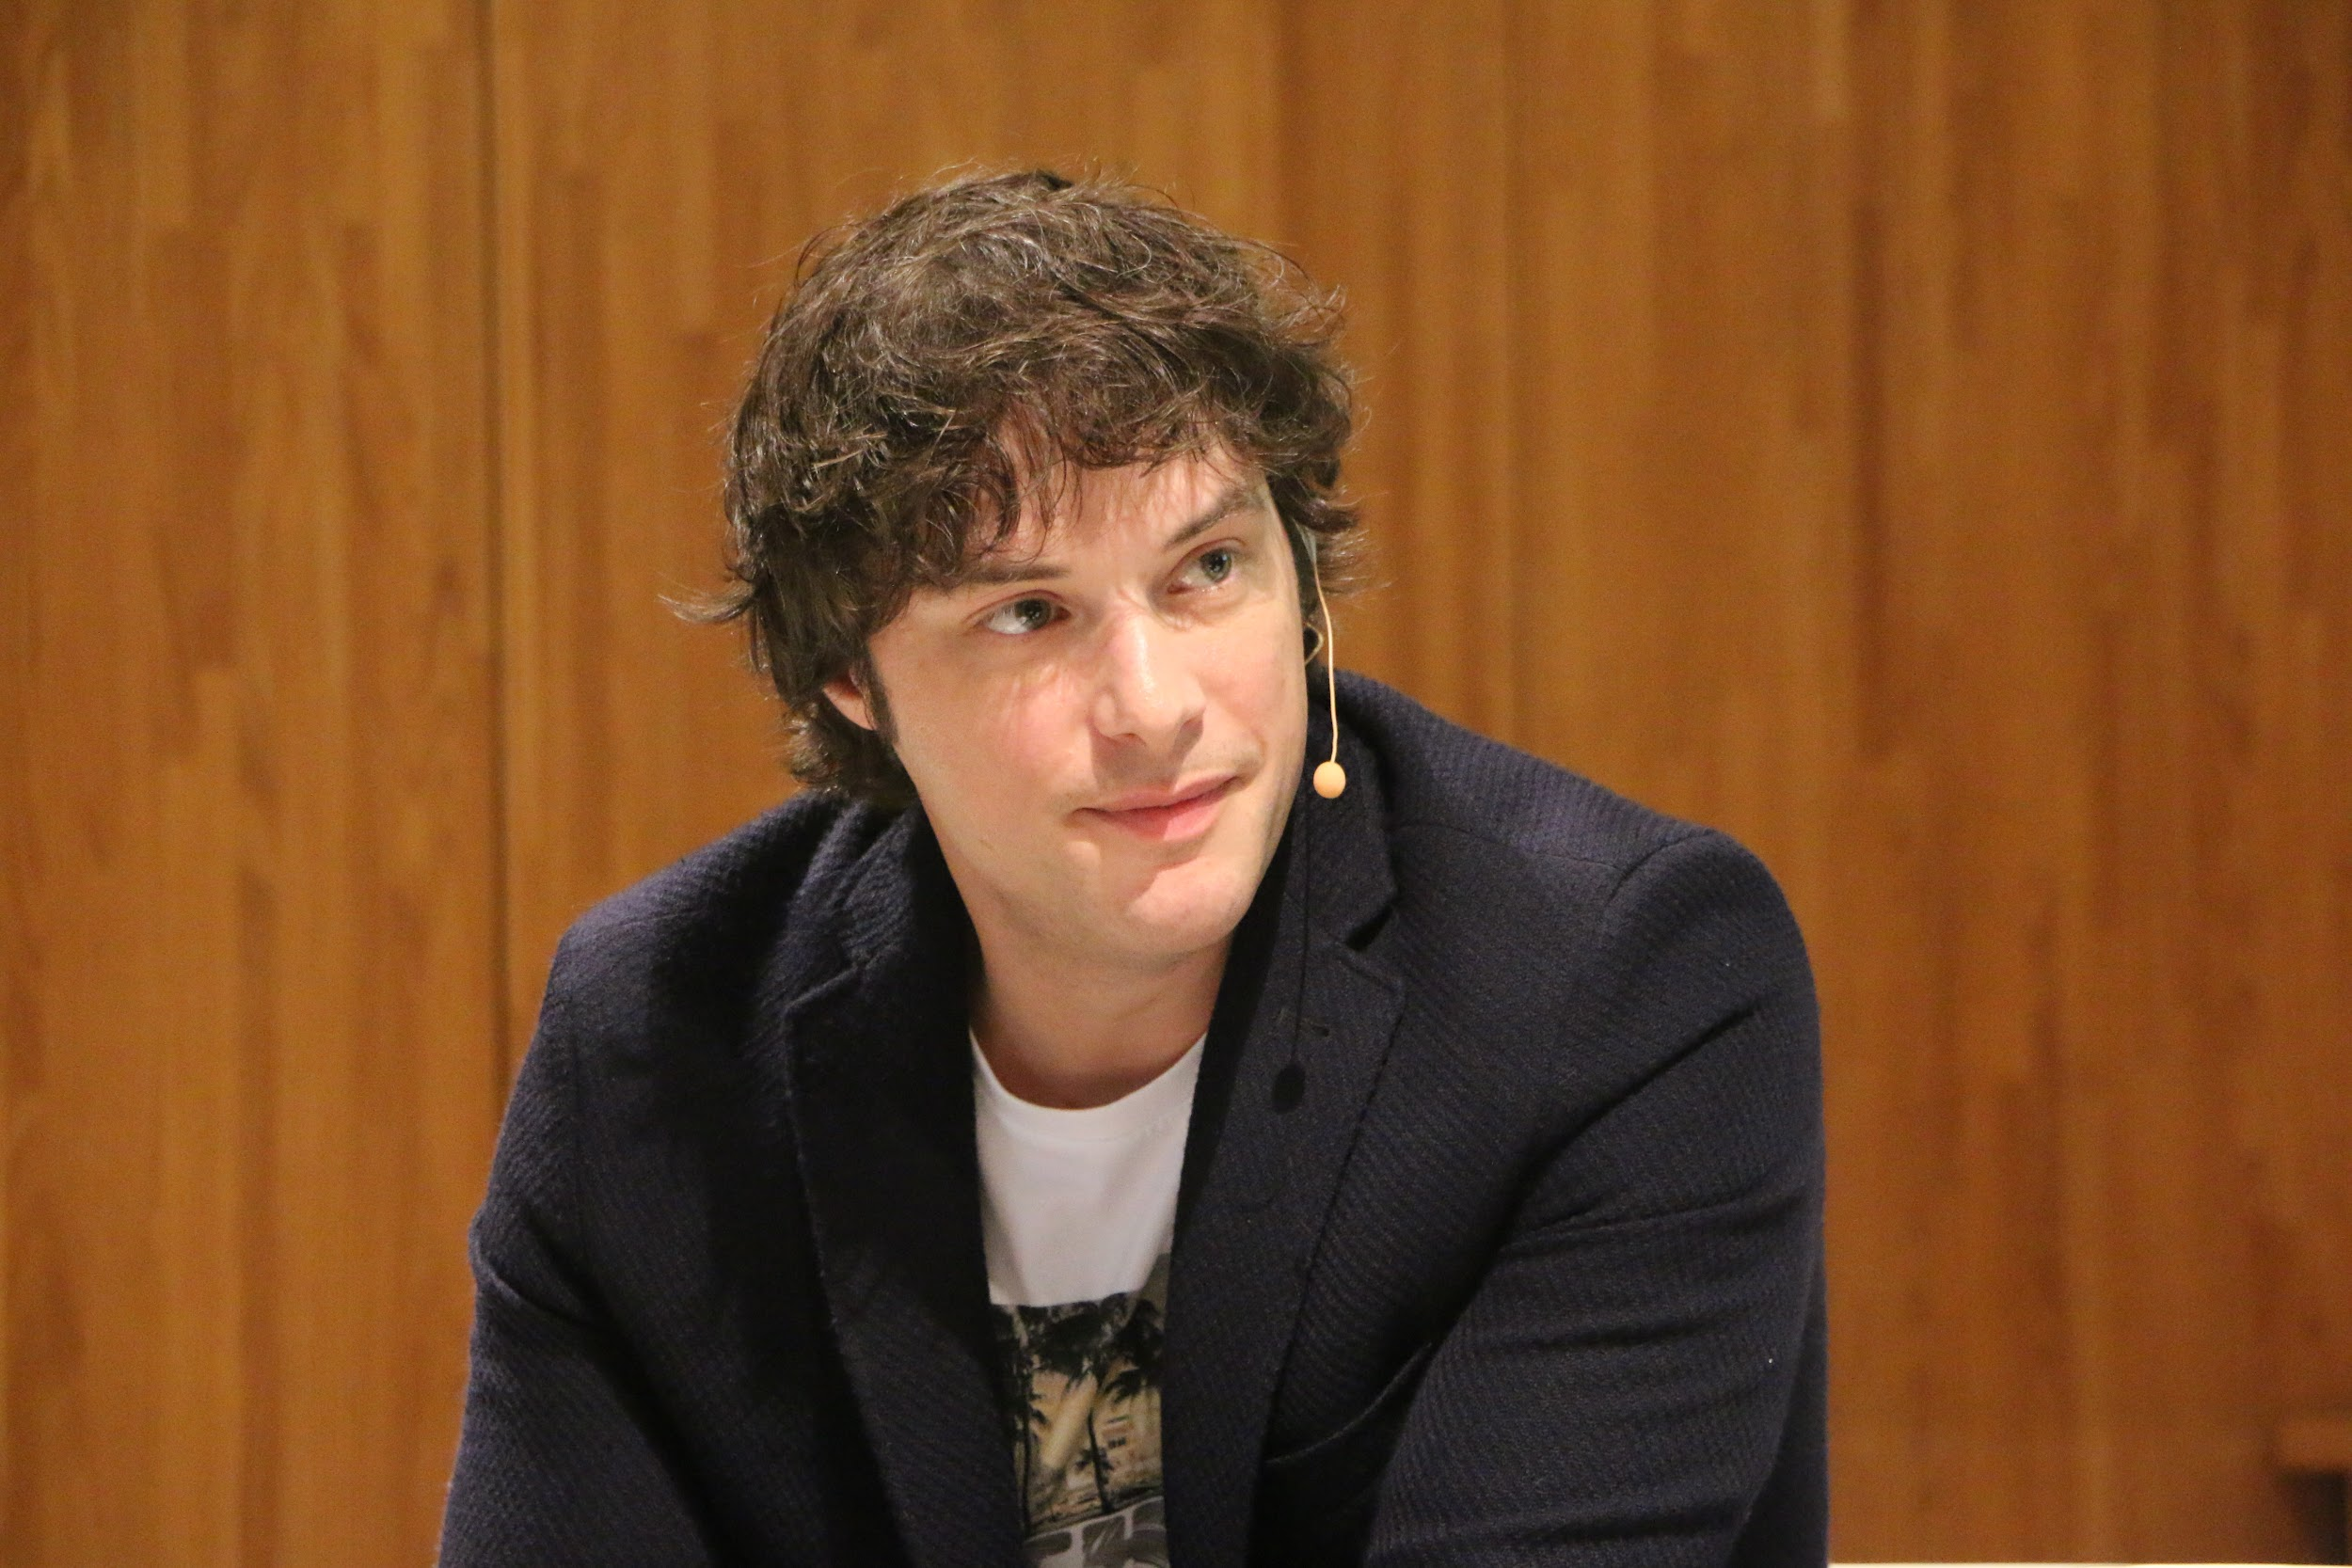
Famous cooks
Martín Berasategui,Dabiz Muñoz,Jordi Cruz,Eneko Atxa and Joan Roca are some Spanish chefs with Michelin stars among others.
Dabiz Muñoz have a restaurant in spain with three michelin stars, DiverXo,and has another restaurant in London, streetxo.
Jordi Cruz is a judge of a programme in TV, masterchef,with two others chefs with michelin stars.

Slide 7
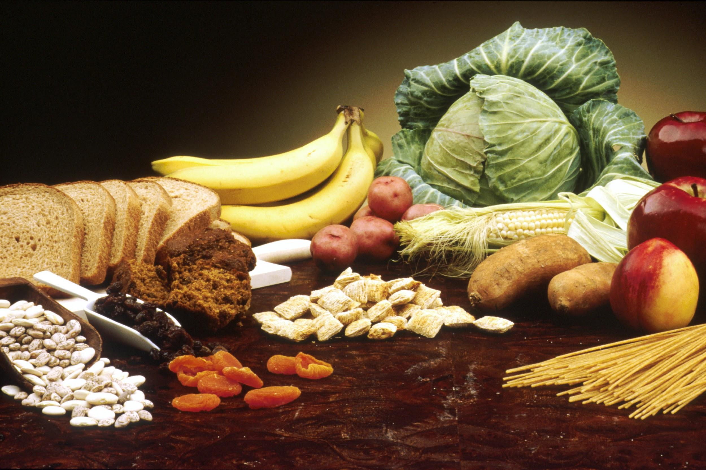
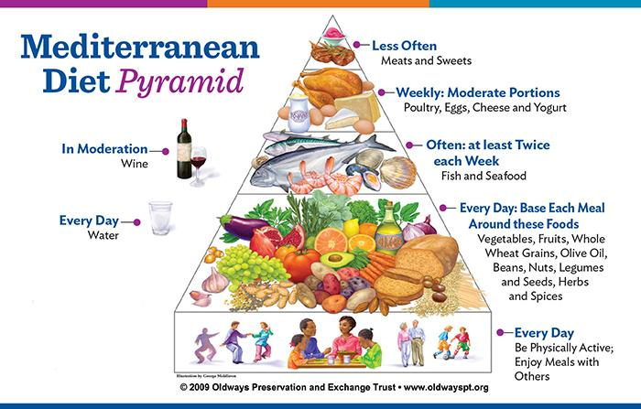
Mediterranean diet
The Mediterranean diet is based on the consumption of fresh and natural foods such as olive oil,fruits, vegetables,legumes,nuts,cereals,fish,milk and cheese.
You must avoid industrialized products.
You must have a healthy lifestyle doing sports and having a social life.

Slide 8
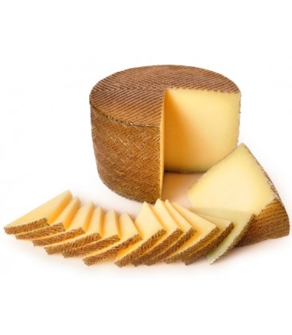
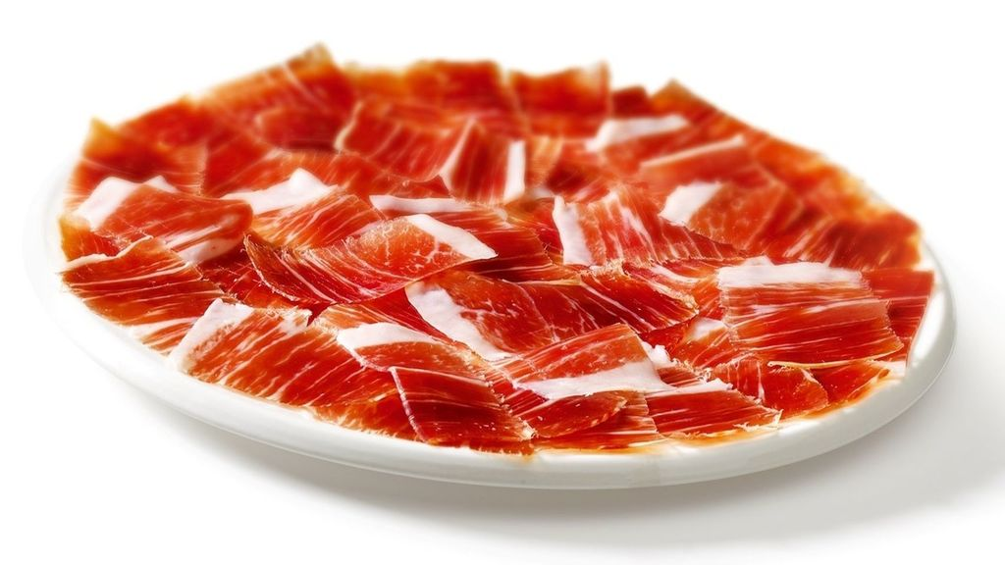
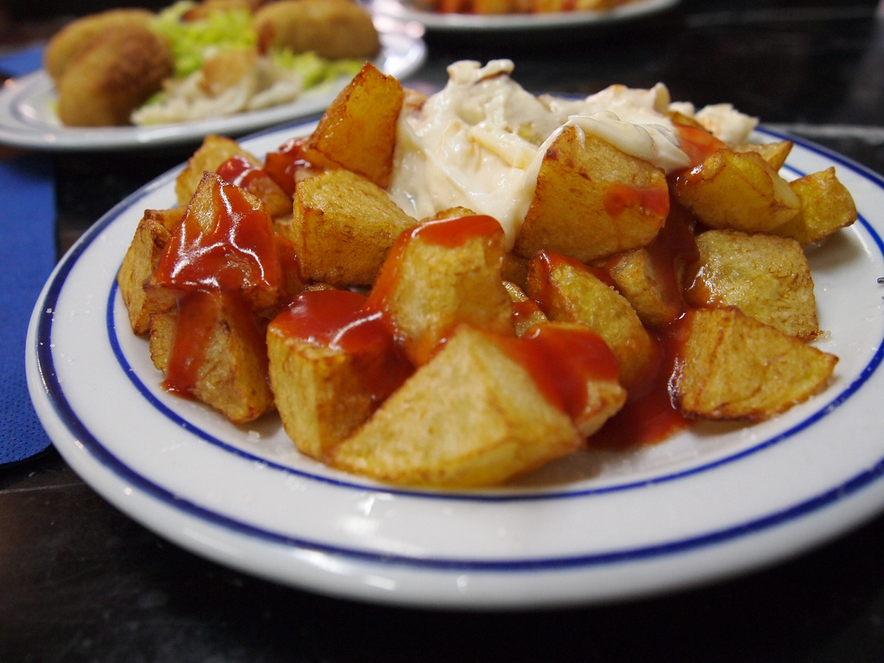
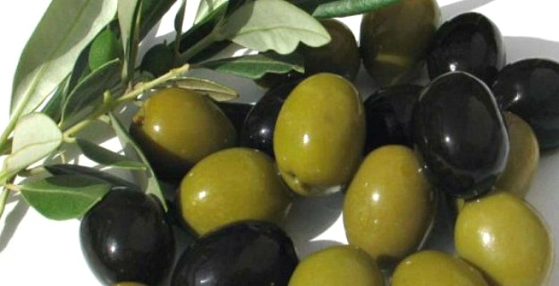
Starters
Manchego cheese
Ham
olives
Patatas bravas
Croquetas
snails

Slide 9
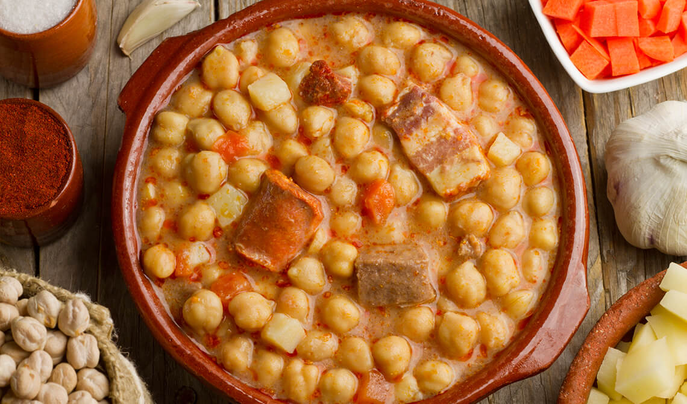
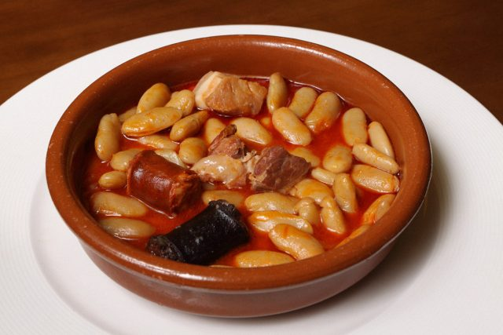
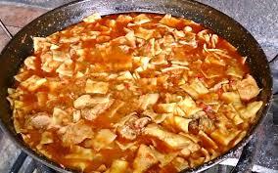
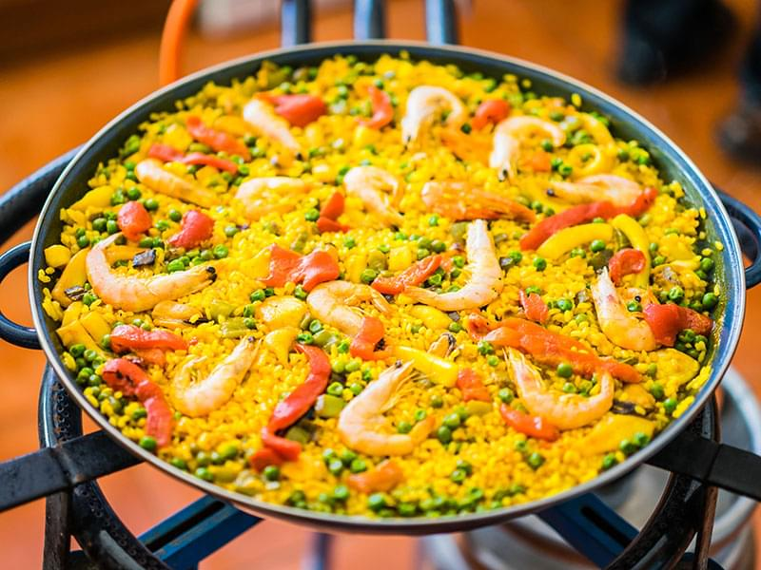
main course
Cocido
Fabada
Salmorejo
Paella
Gazpacho Manchego
Tortilla

Slide 10
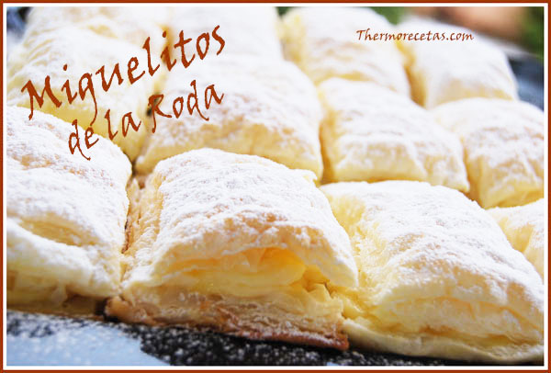
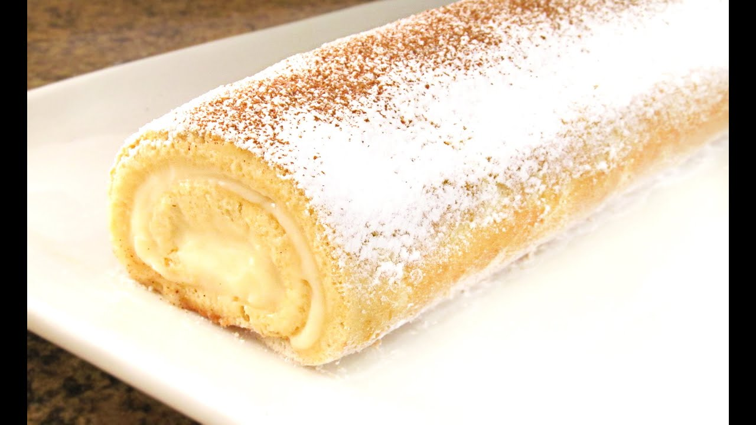
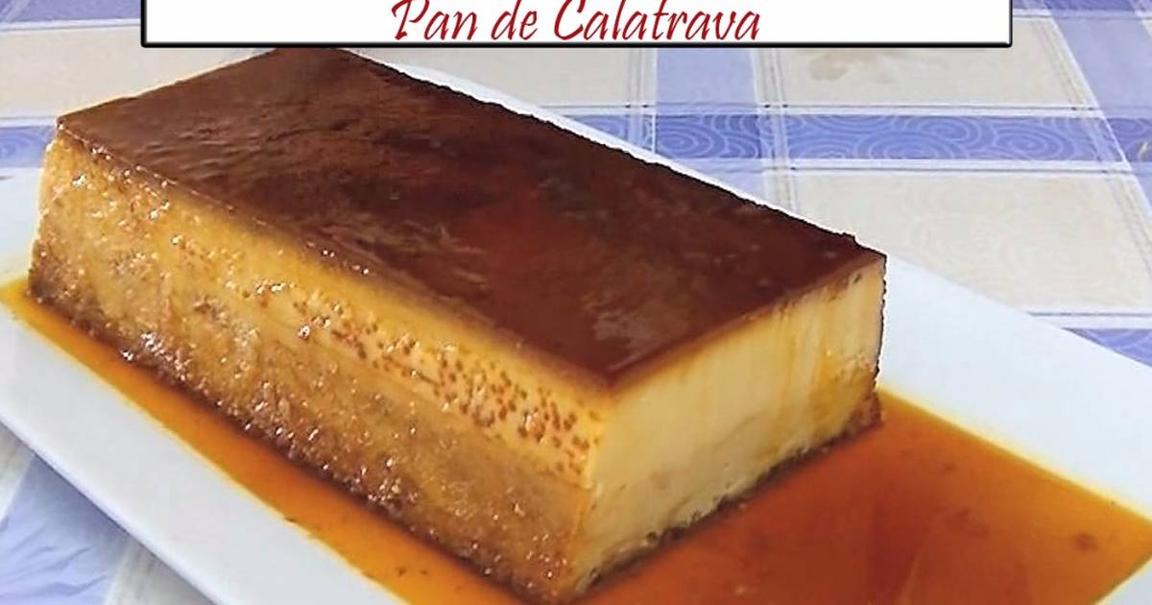
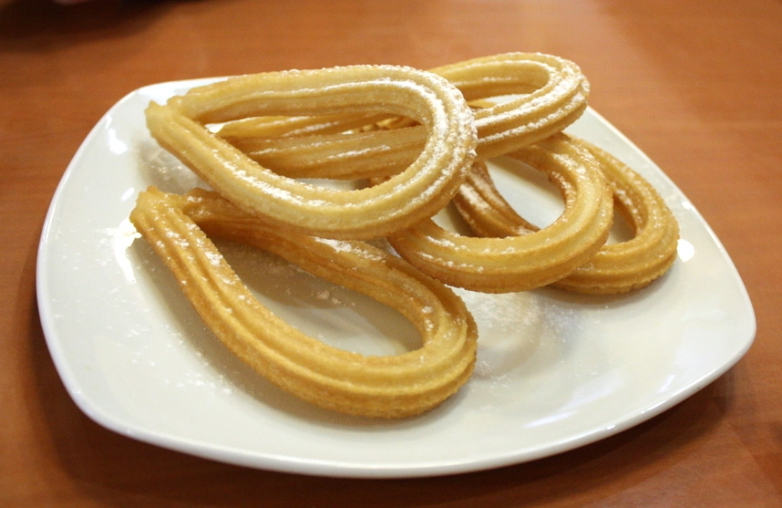
Dessert
Miguelitos de la roda
Brazo de gitano
Pan de Calatrava
Arroz con leche
Churros
Flor de carnaval
rollos

Slide 11
we are very proud of our spanish food.
I’m sure you’ll enjoy when you came to Spain.

