Slide 1
All About Spain.
Alicia Blázquez
Hugo Luján
Álvaro Jiménez
Raúl de la Rosa

Slide 2
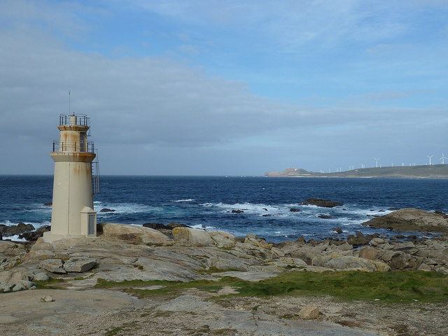
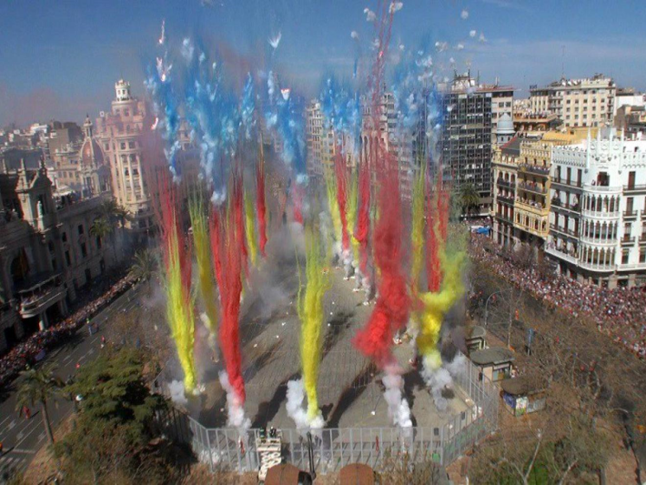
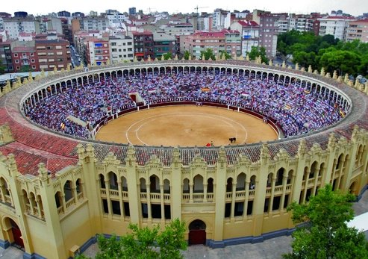
Spain
Places of interest.
Nature.
Weather.
Festivals.
Tourism and Gastronomy.
Fashion.

Slide 3
FESTIVALS
A festival is a competition of songs of one or several styles, they can be mixed or unique generally organized by a local community or by a municipality.
In mythology, a festival is also a set of celebrations in honor of the gods.

Slide 4
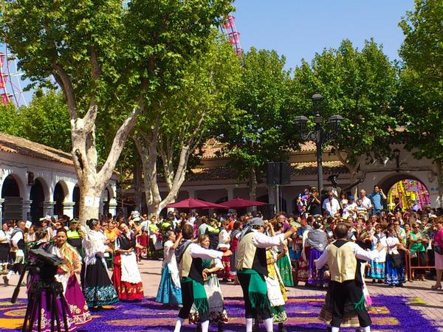
Albacete fair.
The fair of Albacete is in honor to “La virgen de los llanos” and and is celebrated from 7-17 of september is reconocided as being of international tourist interest.
Important events:
The Parade and the Flower offering.
There is variety of our cultural, gastronomic and musical events

Slide 5
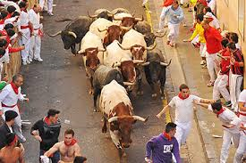
Sanfermines
it is a very typical celebration that is celebrated in Pamplona and it is of international tourist interest, is from 6-14 June.
Every morning, in a difficult race, hundreds of people run in front of the bulls through the old town until they reach the bullring, where the animals will be fought in the afternoon bullfight.
These three intense minutes, of risk and emotion hardly surmountable, are responsible for the world fame of this festival.

Slide 6
Fallas
They are festivities that go from 15 to 19 March with a tradition rooted in the city of Valencia and different populations of the Valencian Community.
From 1 -19 March, at 14:00 hours, the Town Hall Square is packed with Valencians and tourists, to enjoy one of the most characteristic appointments of this festival. The gunpowder, the noise and the fallero atmosphere are the main ingredients of the famous mascletás.

Slide 7
CARNIVALS
Carnival is a celebration that takes place immediately before Christian Lent. Traditionally it begins on a Thursday (lardero Thursday) and ends the following Tuesday (carnival Tuesday).
The carnival combines elements such as costumes, groups that sing coplas, parades and street parties. Despite the differences that its celebration presents in the world, its common characteristic is that of being a period of permissiveness and a certain lack of control.

Slide 8
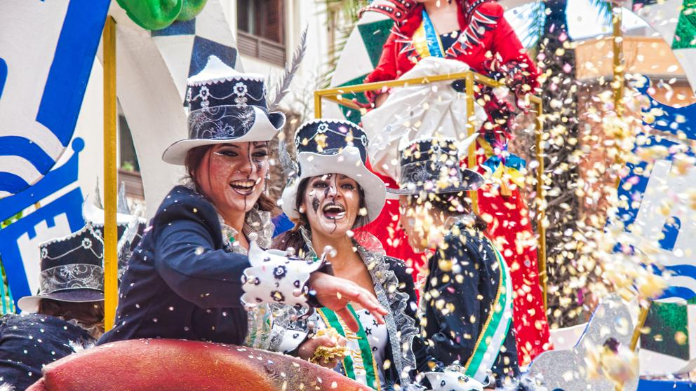
Cádiz carnival
The Cadiz carnival is the most important in Spain, this declaration of International Tourist Interest festivity.
This program includs: pregón, tablaos, masked dances, horseback riding, group competition and fireworks

Slide 9
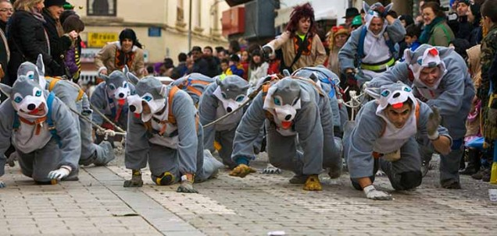
Carnivals in our region
VILLARROBLEDO
One of the most important carnivals in the province of Albacete is Villarrobledo.
It is recognized as being of National tourist interest
TARAZONA DE LA MANCHA
Another one of the most important carnivals is the one of Tarazona de la Mancha.
It is declared Festival of Regional Tourist Interest in Castilla-La Mancha.

Slide 10
Spanish Fashion
The word fashion refers to a style that is accepted and considered pleasant.
The word fashion comes from the French "mode" and this from the Latin "modus" (way or measure). So fashion is related to the "way" of the moment.

Slide 11
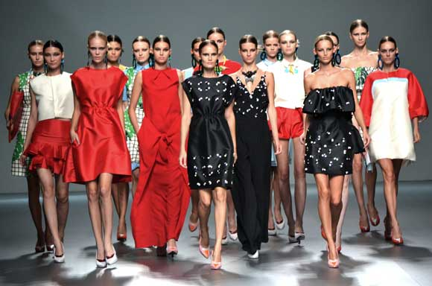
Mercedes-Benz Fashion Week Madrid
It is the great event of Spanish fashion and gathers more than 50,000 visitors.
In each edition, the best Spanish designers show their creativity and the quality of their work.
It also has a space for young creators in which new generations try to surprise with their talent.>

Slide 12
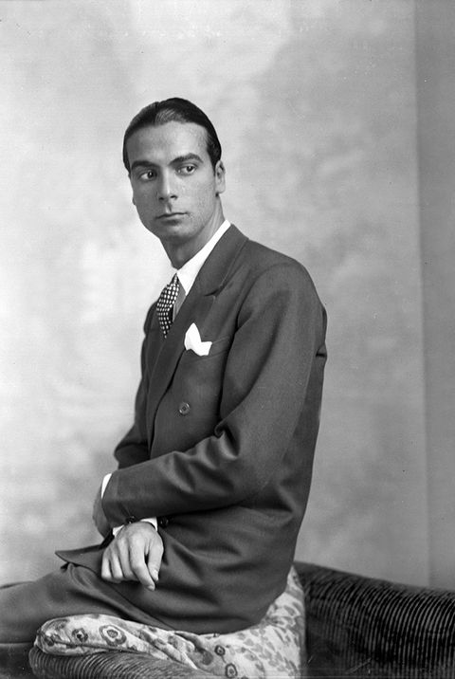
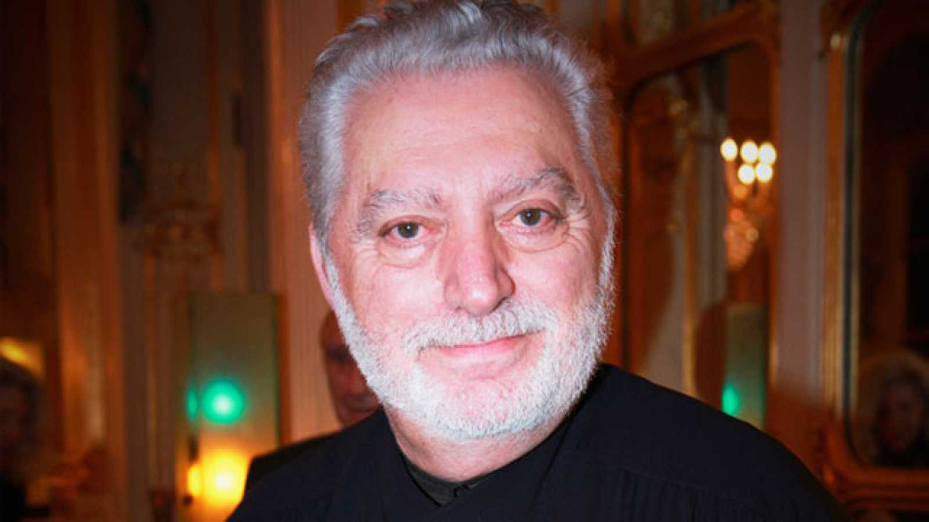
THE MOST FAMOUS SPANISH DRESSMAKERS
Cristóbal Balenciaga was a prestigious designer, considered one of the most important creators of haute couture.
He was previously trained as a tailor and had his own brands in Spain, where he is the most important Spanish haute couture designer in history.
Paco Rabanne is a Spanish fashion designer. He is known worldwide for his textile creations, in which he uses different colours and materials, and for his brand of perfumes.

Slide 13
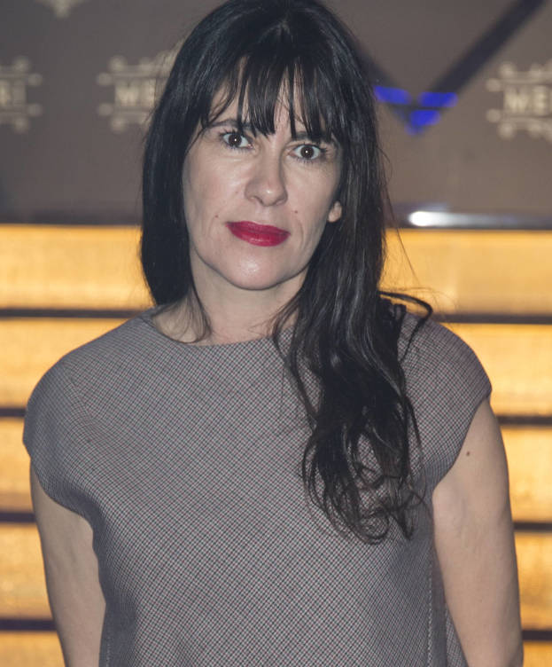
THE MOST FAMOUS SPANISH DRESSMAKERS
Ágatha Ruiz de la Prada became one of the most important promoters of the Spanish fashion.
Apart from creating clothing lines, entered the business of shoes, perfumes, watches.
Amaya Arzuaga in 1992 she finished her Higher Studies in Fashion Design and joined the family business Elipse as a designer, but in 1994 she created her own company.

Slide 14
Zara:Low Cost design
Zara stores have men's and women's clothing, as well as children's clothing (Zara Kids).
The reason of its success is that you can buy the product online, low prices and good service.
There are shops all over the world such as, Hong Kong, Beijing, New York and Madrid.

Slide 15
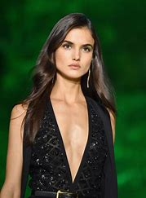
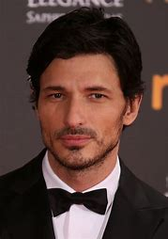
Famous Spanish Models
Blanca Padilla: In October 2017 she became the image of Givenchy Beauty. She is the first Spanish to parade twice for Victoria Secret.
Andrés Valencoso: is a Spanish model an actor, especially known for his advertising campaigns for Chanel Allure Homme, Sport fragrance and Louis Vuitton campaign with Jennifer Lopez in 2003.

Slide 16
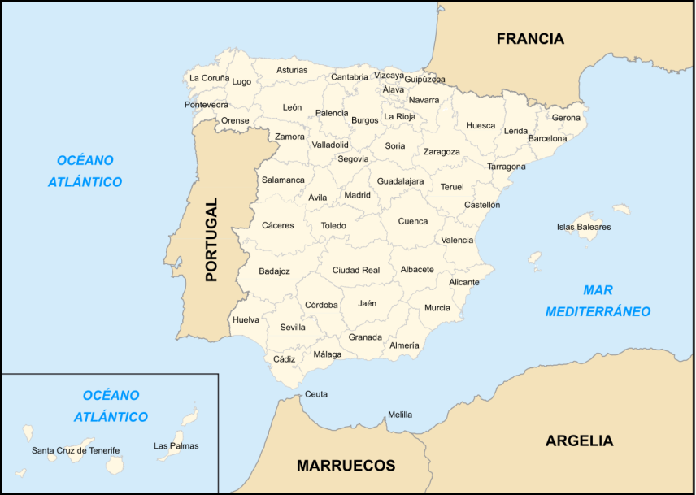
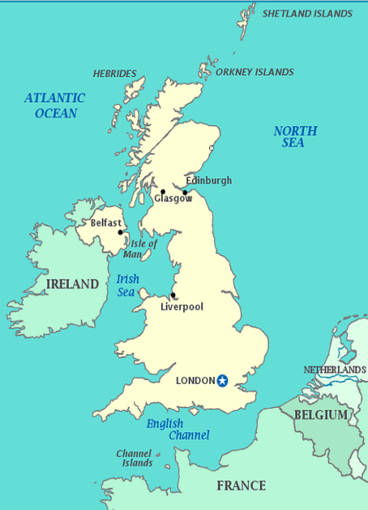
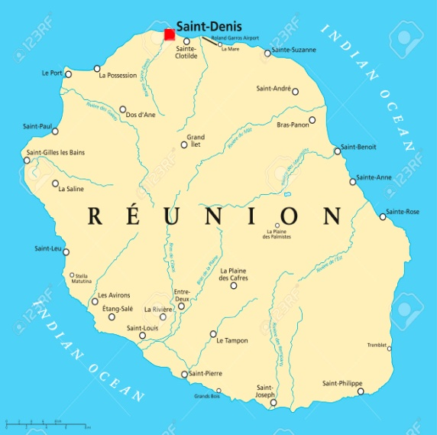
Thank you very much for your attention.
We hope you enjoy this presentation.

