Slide 1
ALL ABOUT SPAIN
Alejandro, Jorge, Andrés, Iván y Marina

Slide 2
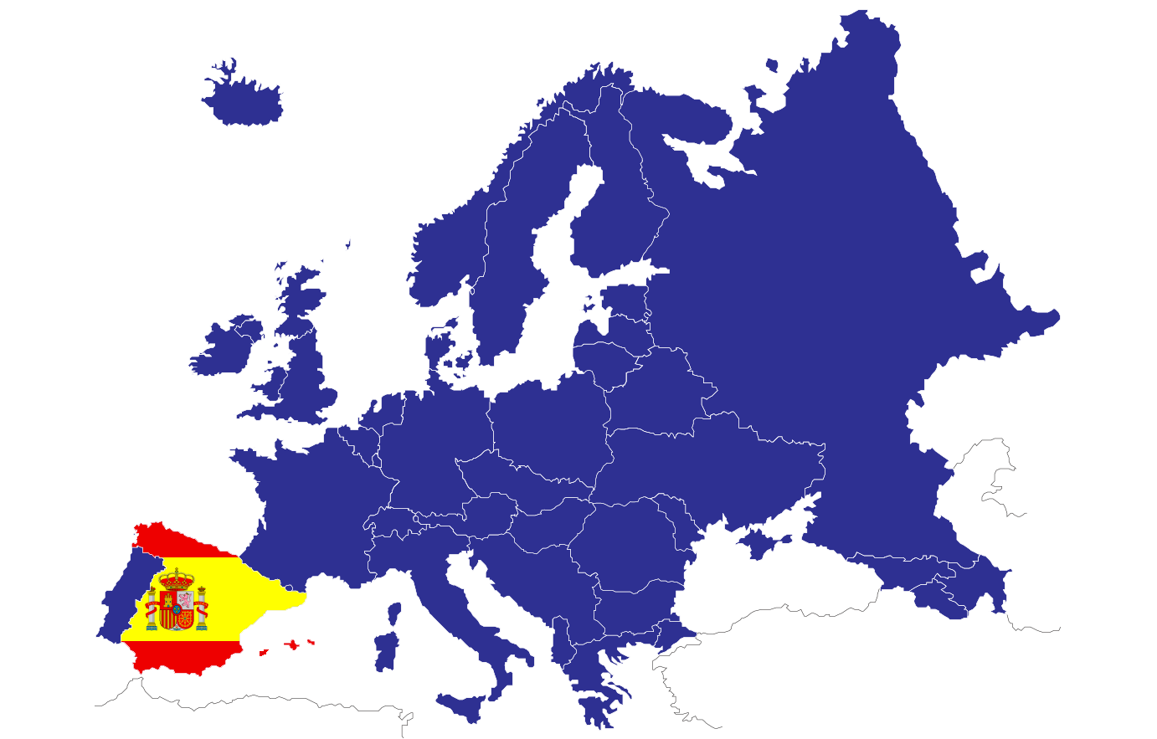
geography
- Spain is a country located in southwestern Europe.
- It occupies most of the Iberian peninsula, and it consists of two archipelagos (Canary Islands in the Atlantic Ocean and the Balearic Islands in the Mediterranean Sea)
-Two autonomous cities (Ceuta and Melilla) in North Africa.

Slide 3
CLIMATE OF SPAIN
Spain is in the temperate zone of the planet. It has different climates, with notable differences between one and the others:
- Atlantic climate: on the Cantabrian coast and western part of the Pyrenees.
- Mediterranean climate: on the southern coasts and on the Mediterranean coast.
- Mountain climate : typical of high altitudes. Zones above 1000 - 1200 metres.
-Subtropical climate: it occurs in the Canary Islands, and also affects areas of southern coast.

Slide 4
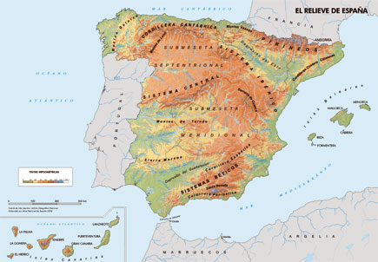
THe relief of spain
The relief of the Iberian Peninsula is articulated around a large central unit, the Central Plateau, with a high average altitude (650 m).
Spain is a mountainous country but almost we have plain in Albacete we think is the most plain zone in all Spain .
Also we have on the Canary Islands our most
high mountain, its named Teide

Slide 5
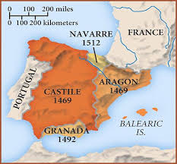
HISTORY
A brief explanation:
The Spanish Empire was one of the first modern world empires and one of the greatest empires in history, being considered the first global empire, with possesions around the world.

Slide 6
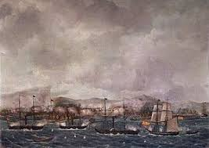
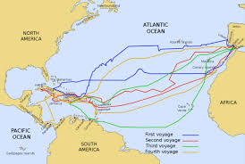
Spanish expeditions
They were expeditions carried out by Spanish explorers or sponsored by Spain.
The most important expeditions were: -The Discovery of America (1492)
-Vasco Núñez discovered the Pacific Ocean (1513)
-Fernando de Magallanes crossed the Pacific (1521).
-Juan Sebastian Elcano, making the first round-the-world voyage (1519-1522).

Slide 7
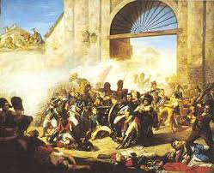
The wars in Spain
There have been many wars in Spain throughout the time.
The most important Spanish wars
-133 Battle of Numancia
-711 Battle of Guadalete
-722 Battle of Covadonga
-1212 Battle of Navas of Tolosa
-1571 Battle of Lepanto
-1805Battle of Trafalgar
-1824Battle of Ayacucho
-1868 Battle of Alcolea
-1936Battle of Madrid
-1938 Battle of Ebro
https://www.youtube.com/watch?v=Kbf_PfkYp2Q

Slide 8
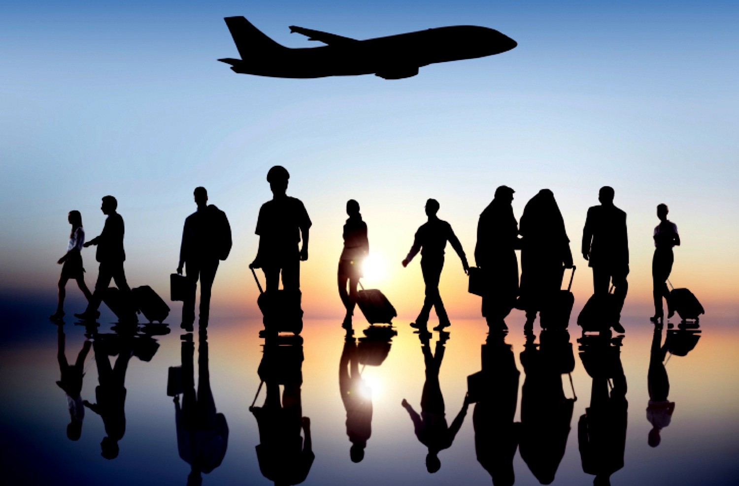
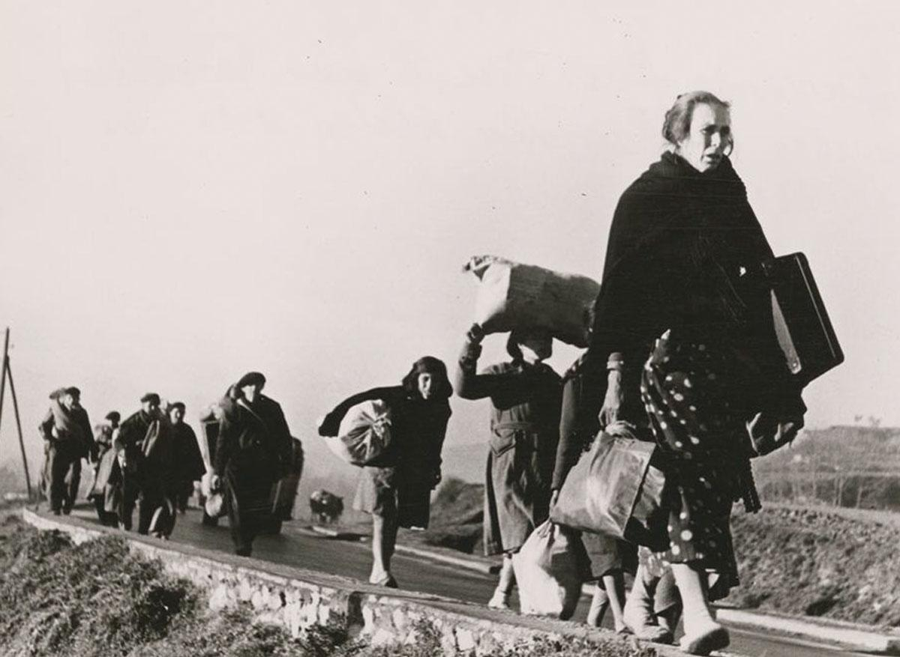
immigration
WHAT IS IMMIGRATION?
Immigration is the entry into a country or region of people who were born or come from another place.
Immigration after the civil war ( in he 40s)

Slide 9
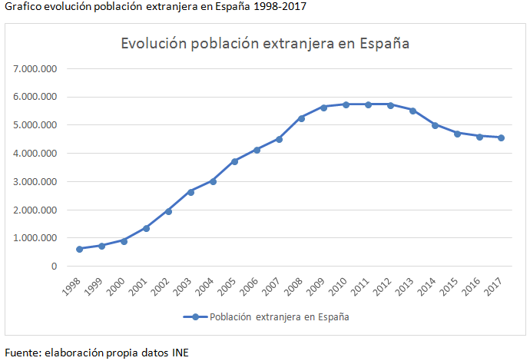
Immigration in Spain
Immigration in Spain began in the 2000s.
It has had a great demographic, social and economic importance in Spain.
It started increasing at the beginning of the 21st century until it reached 12.2% of the population in 2011.
Since 2011, immigration has been falling every year and by 2017 it had fallen by 20.5%.
Evolution of the foreign population in Spain

Slide 10
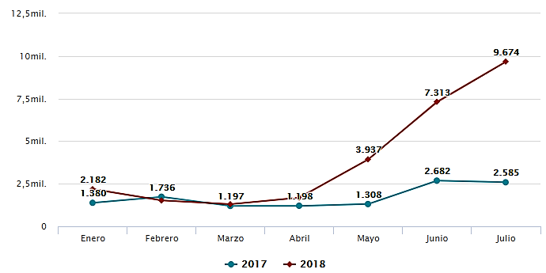
Immigration in 2018
In 2018, there has been an annual increase of 28% of immigrants.
We are more than 46 million habitants, more than the previous year.

Slide 11
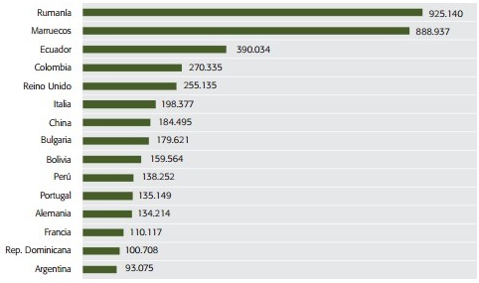
Where do immigrants to Spain come from?
Immigrants who arrived in Spain in 2014

Slide 12
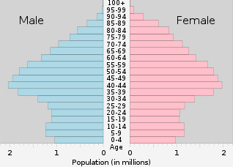
spanish population POPULATION

Slide 13
Thank you very much
I hope you learn a little bit more about Spain

