Slide 1
Anyone can make a film
Only some make good films

Slide 2
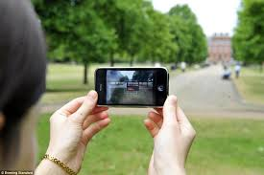
Which way up?

Slide 3
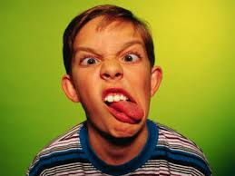
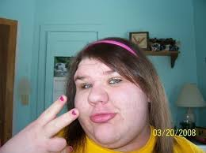
Composition – 1 The centred image

Slide 4
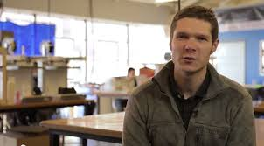
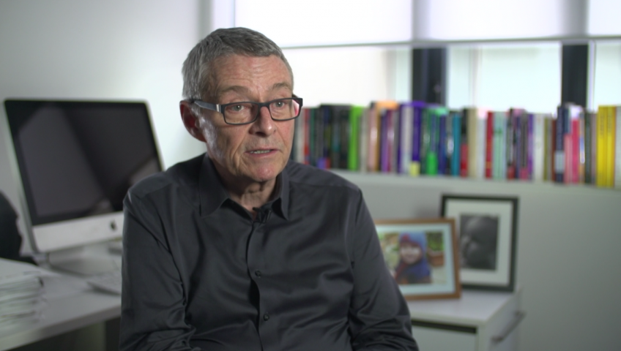
Composition 2 – Left and right

Slide 5
Composition 3 – Rule of Thirds

Slide 6
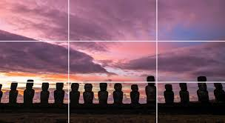
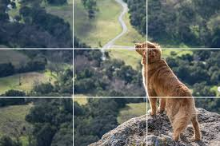
Composition 3 – Rule of Thirds

Slide 7
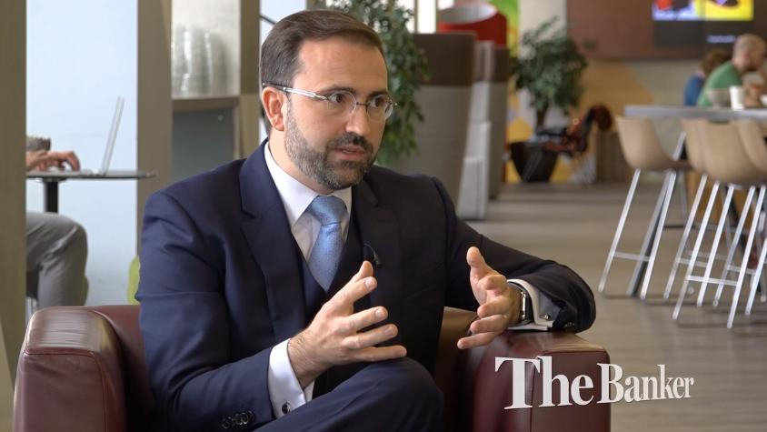
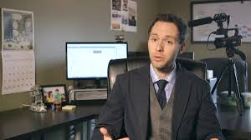
Composition 4 – Interview Angles

Slide 8
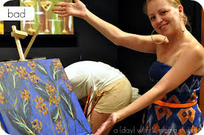
Composition 5 – Check the background!

Slide 9
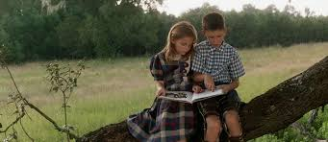
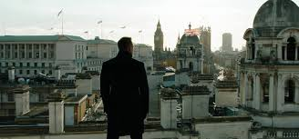
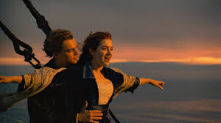
Varied Shots – long and medium shot

Slide 10
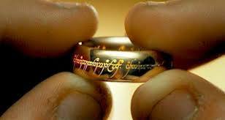
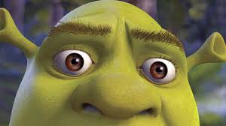
Varied shots – close up and extreme close up

Slide 11
Varied shots - reminder

Slide 12
Varied shots – mix it up!

Slide 13
Essentials 1 – shoot lots and extra parts

Slide 14
Essentials 2 – countdown before filming

Slide 15
Essentials 3 – don’t stop when they stop
Essentials 4 – don’t play ping pong

Slide 16
Essentials 5 – where is the light?

Slide 17
Essentials 6 – keep the camera still

Slide 18
Finally
Be polite
Be aware of what is around you
Bend your knees
Stretch your arms
Try the unpredictable
Film more than you need
Save your work

