Slide 1
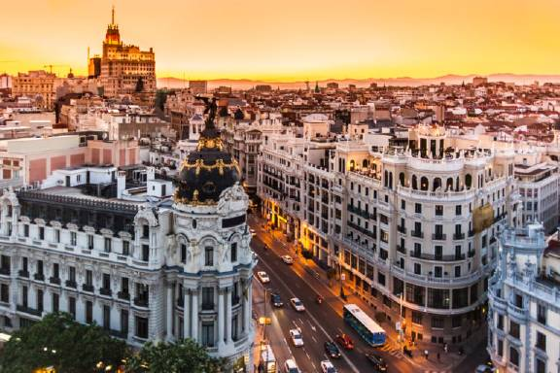
ALL ABOUT SPAIN:
By Rubén Corredor, Javier Herreros, Jaime Huertas, Carmen Leal

Slide 2
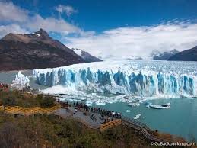
REMARKABLE NATURAL LANDMARKS IN SPAIN
WHAT ARE THE NATURAL LANDMARKS?
Natural landmarks are spaces of nature with a high landscape value, geological, historical or other. It needs protection

Slide 3
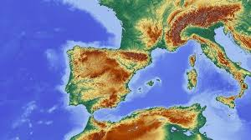
SOME NATURAL LANDMARKS IN SPAIN
In Spain, there are 10 natural landmarks that are worth visiting. Here there are some of them:

Slide 4
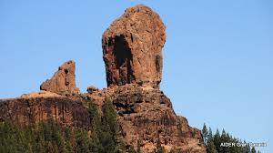
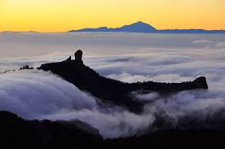
ROQUE NUBLO
Situated in the Gran Canaria, (Canary Islands)
1.813 m tall
Roque Nublo was formed during an eruptive cycle

Slide 5
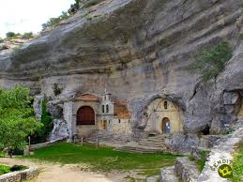
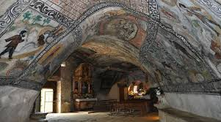
OJO GUAREÑA
In Burgos (Castilla y León)
Formed by more than 110 km of galleries
Natural Monument by the government of Castilla y León in 1996.

Slide 6
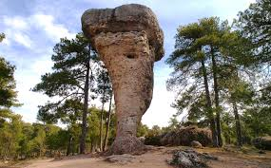
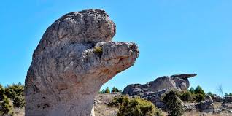
CIUDAD ENCANTADA
It´s located in Cuenca (Castilla-La Mancha)
It takes 3 km of circular route (the visit lasts 1h 30min aprox)

Slide 7
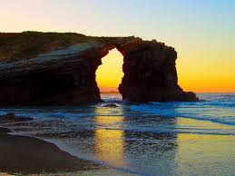
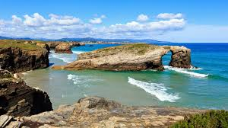
PLAYA DE LAS CATEDRALES
It's situated Lugo, (Galicia, Northern Spain)
It is about 890 m tall

Slide 8
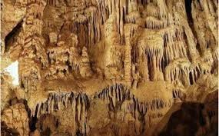
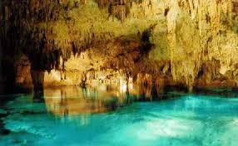
CUEVA DE LOS MURCIÉLAGOS
In Córdoba (Andalucía)
It is home of many species of bats
Is the largest cave in this province.

Slide 9
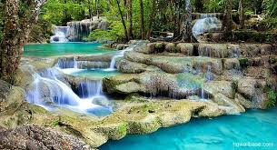
NATURAL PARKS IN SPAIN
WHAT´S A NATURAL PARK?
A natural park is a natural space with special characteristics in which it is pretended to protect. Natural parks focus their attention on the conservation of its flora and fauna.

Slide 10
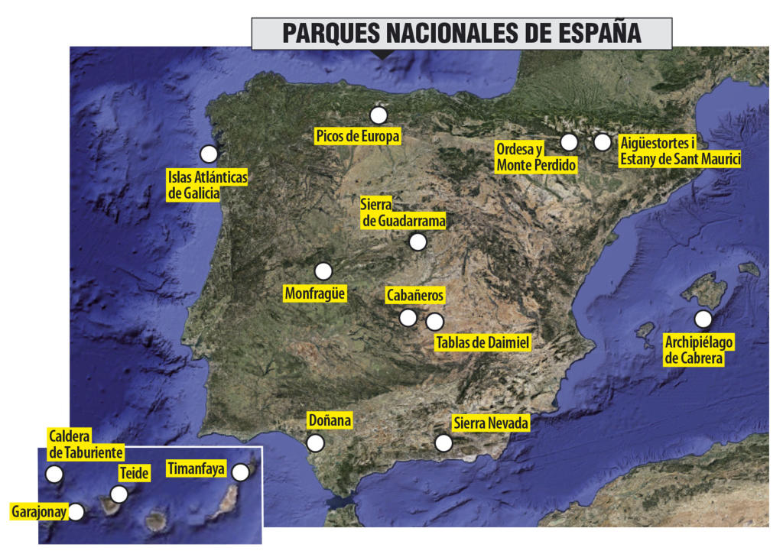
NATURAL PARKS IN SPAIN

Slide 11
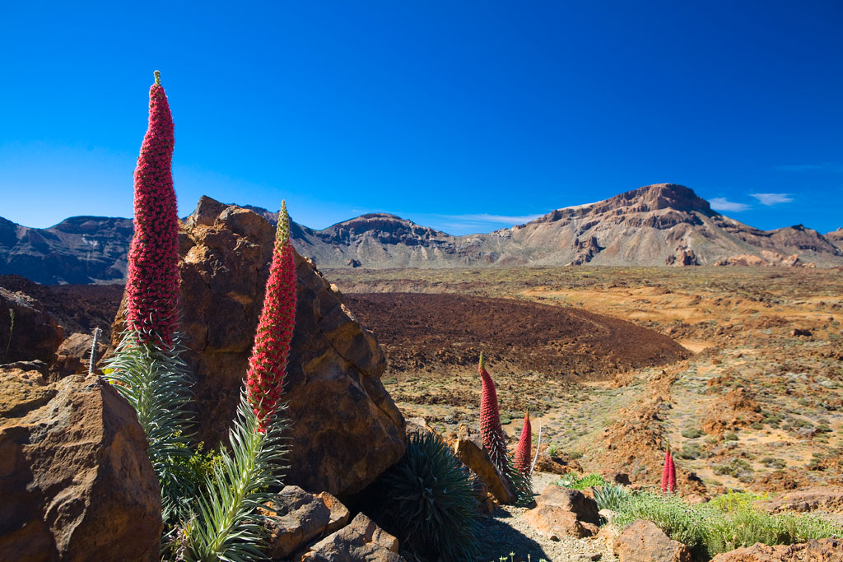
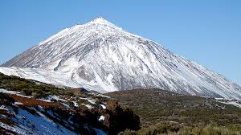
TEIDE
It is situated in Tenerife (Canary Islands)
The most visited park, with 4 079 823 visitors
3,718 meters above sea level

Slide 12
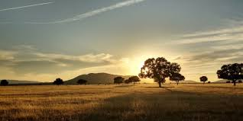
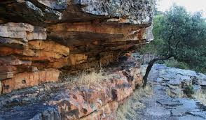
CABAÑEROS
Situated in Toledo and Ciudad Real (Castilla-La Mancha)
Least visited park, with 100 993 visitors There are some endangered species like the imperial eagle.

Slide 13
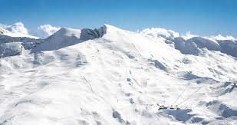
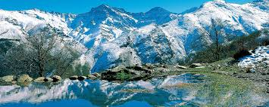
SIERRA NEVADA
Located in Granada (Andalucía)
It is the largest park of Spain, with 86 210 hectares
It has ski resorts

Slide 14
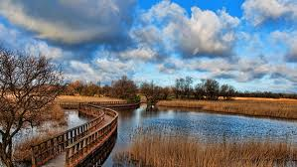
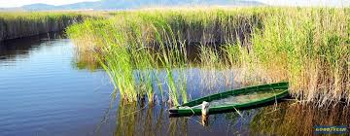
TABLAS DE DAIMIEL
You can find it in Ciudad Real (Castilla-La Mancha)
It's the smallest park, it takes 3030 hectares
Are one of the last representatives of an ecosystem called river tables

Slide 15
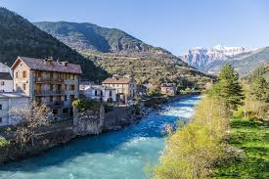
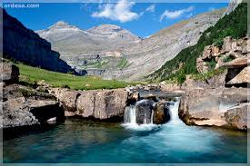
ORDESA Y MONTE PERDIDO
Located in Huesca, Pyrenees (Northern Spain)
It is the oldest natural park in Spain.
It has ski resorts

Slide 16
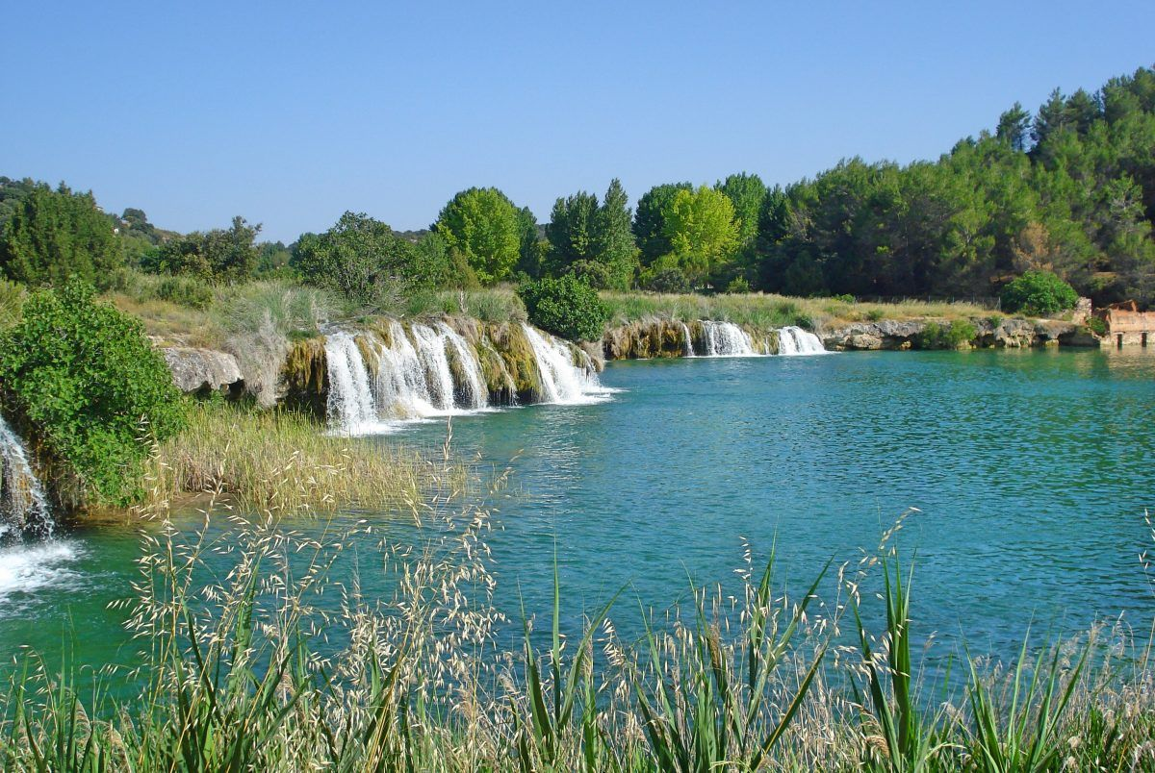
LAGUNAS DE RUIDERA
They belong to the provinces of
Albacete and Ciudad Real
A chain of fifteen lagoons form an
open space of lakes and rivers that
are unique to la Mancha's steppes.
They are supplied by the waters
of underground aquifers and
the river Pinilla
La Cueva de Montesinos is here

Slide 17
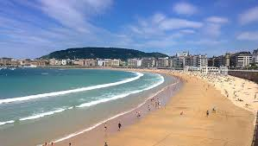
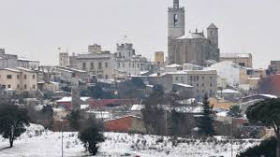
DIFFERENT TYPES OF CLIMATE IN SPAIN

Slide 18
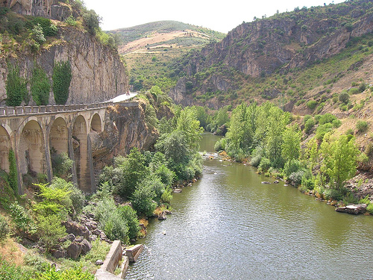
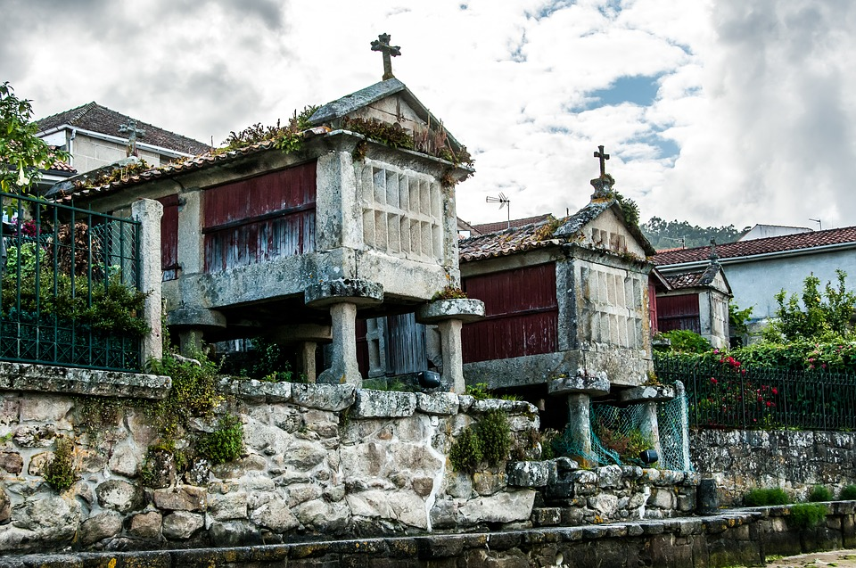
NORTH SPAIN
it is normally cold
In summer, the temperature rises up

Slide 19
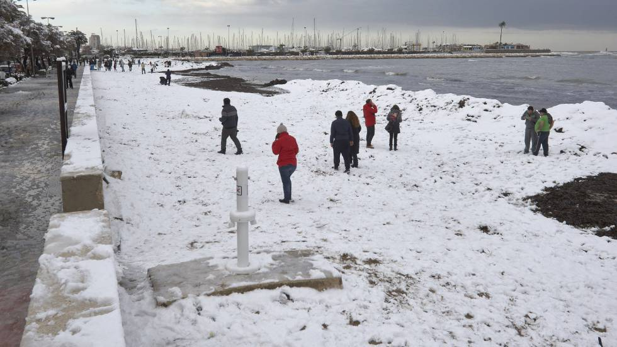
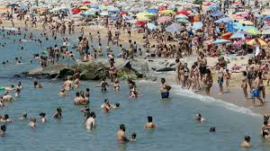
SOUTH SPAIN
It depends on the season, in spring and summer is hot, but in winter and autumn is colder.

Slide 20
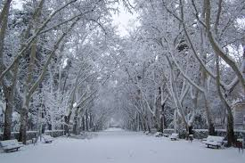
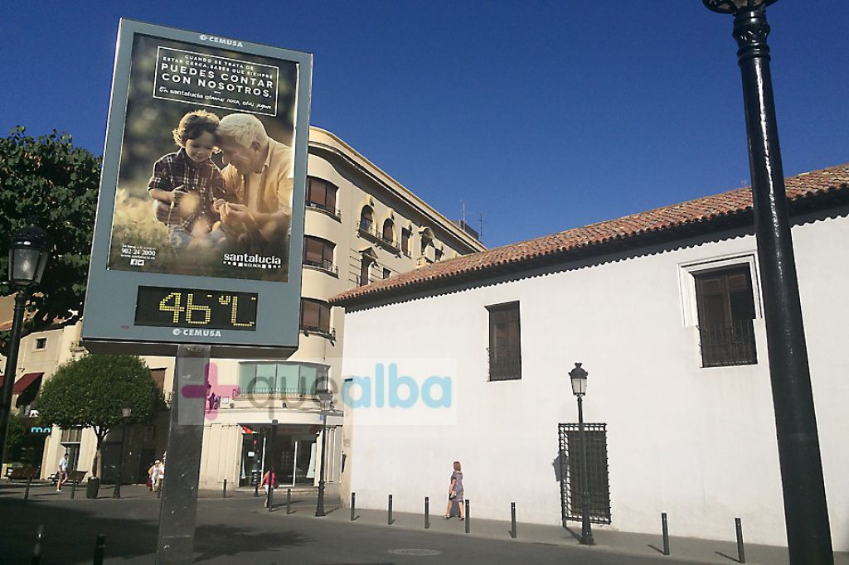
INLAND PROVINCES LIKE ALBACETE
Dry heat in summer, very cold in winter and rainy in autumn and spring, it sometimes snows.

Slide 21
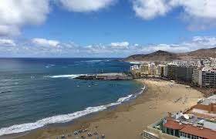
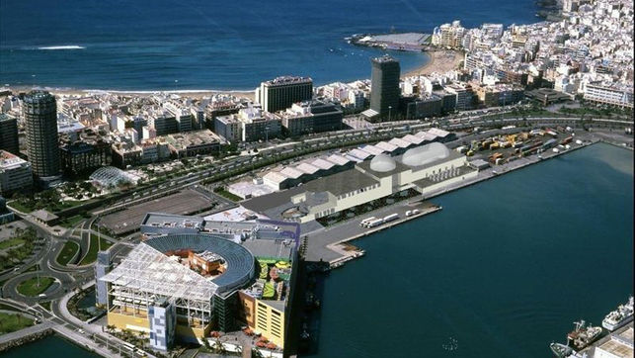
BALEARIC ISLANDS
Temperature similar to the Mediterranean coast, less cold in winter.

Slide 22
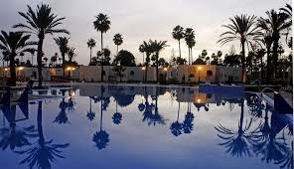
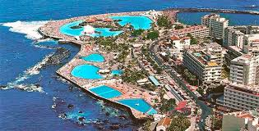
CANARY ISLANDS
The most tropical climate in Spain, it´s always 24 degrees all the year.

Slide 23
THANK YOU VERY MUCH

