Slide 1
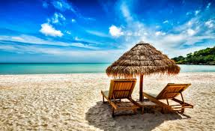
My holidays
My holidays

Slide 2
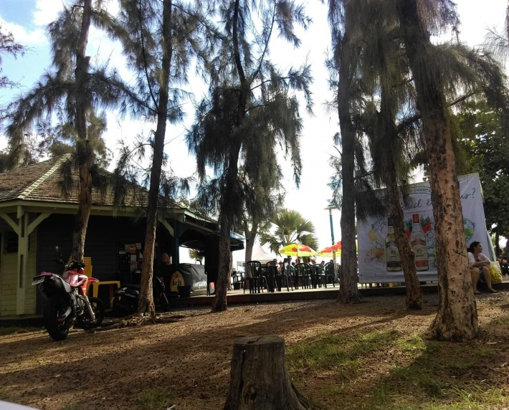
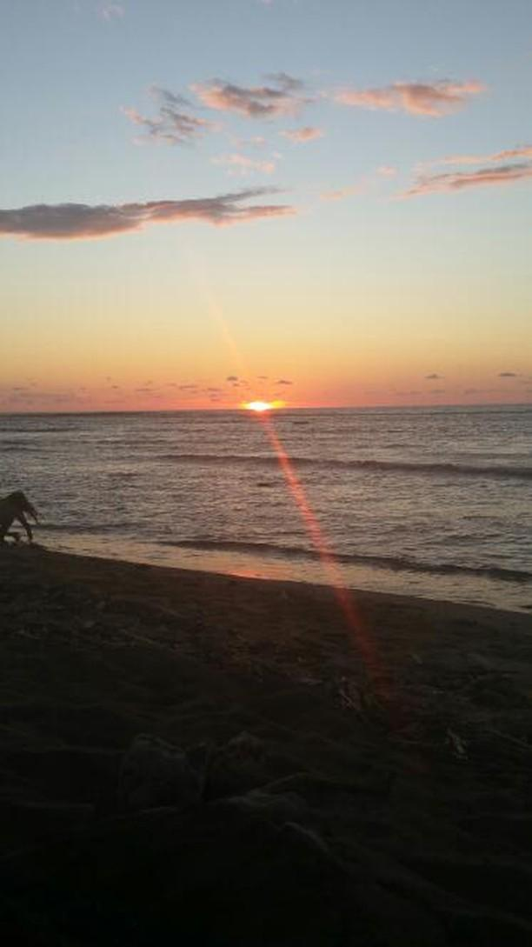
The 30 December 2018
To day, I’m going to st Leu to eat and see the beach and the sunset.

Slide 3
The 31 December 2018
Today, it’s the last day of 2018. I do not go out because I must prepare the eve for the new year. I celebrate the eve with my family.

Slide 4
The first of January 2019
Today, it’s the first day of year, I’m happy because 2019 it’s a new beginning!
I did not take a picture because I am with my family and they do not want.
Sorry

Slide 5
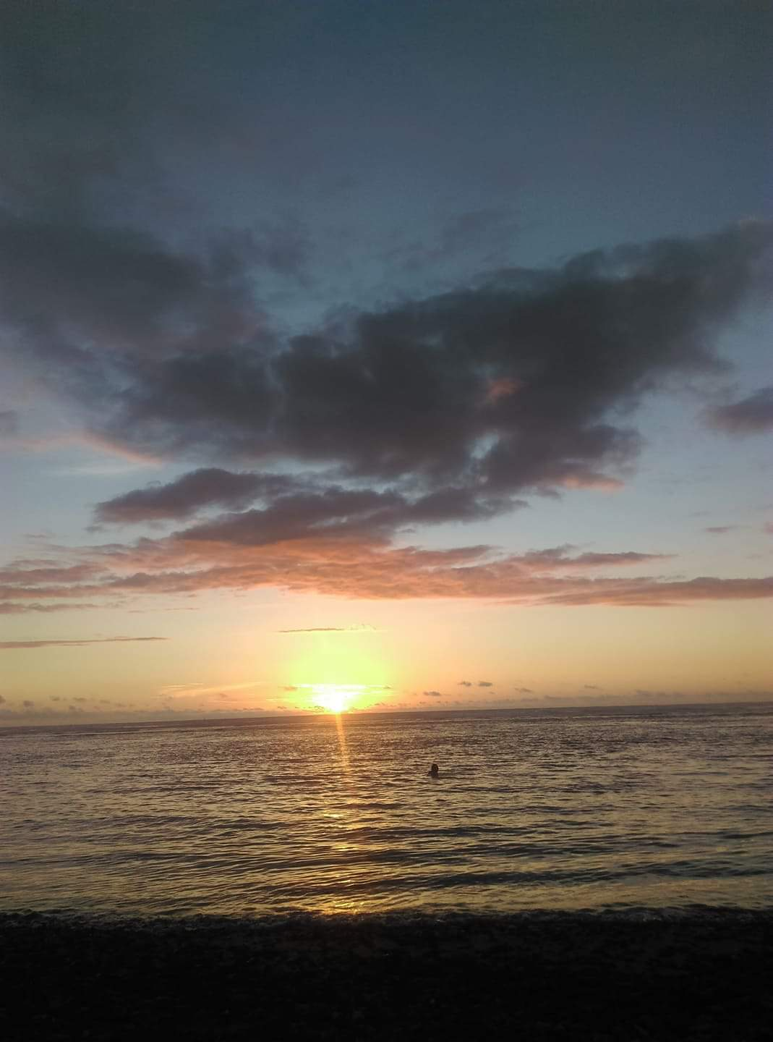
The 2 January 2019
Today I went to the beach with my family and I saw the sunset again.

Slide 6
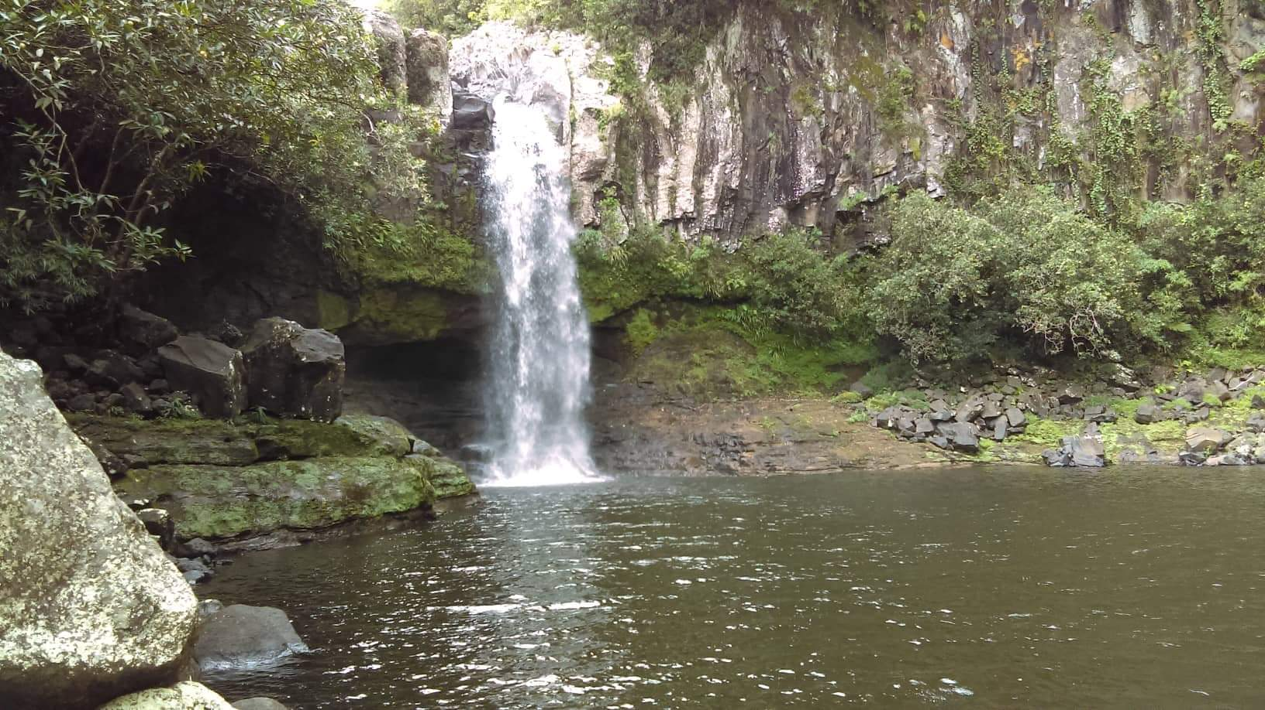
The 3 January 2019
Today, I went to st benoit to go hiking and see the « bassin la mer ».

Slide 7
The 4 January 2019
I went to Auchan and to Leclerc, and after I went to my grandma’s house.

Slide 8
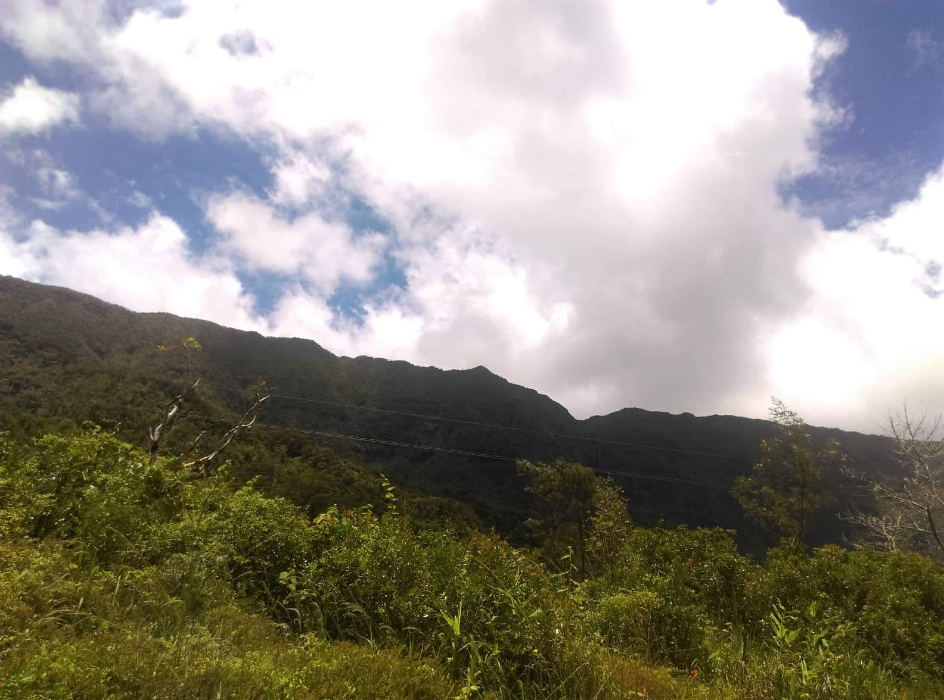
The 5 January 2019
Today, I went to the forest with my family to have a picnic.

Slide 9
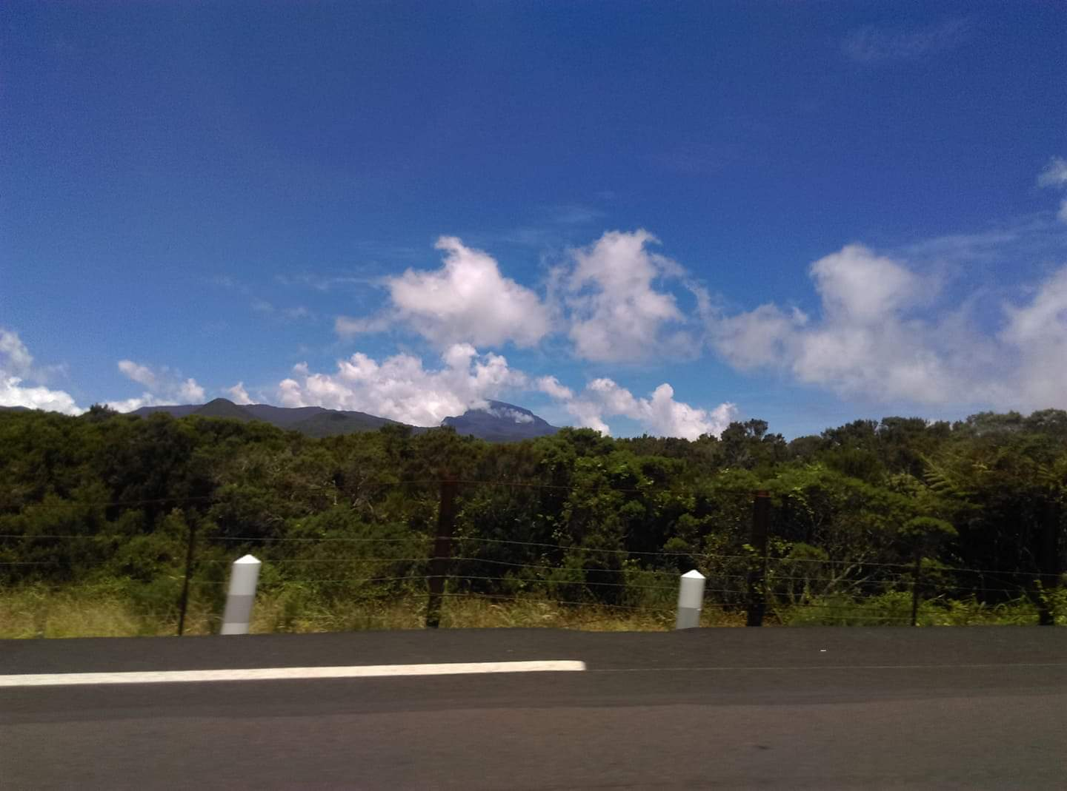
The 6 January 2019
I went to do the 9 nurseries with my family

Slide 10
The 7 January 2019
Today, it's my aunt's birthday and i’m going to my grandma’s house for her birthday, I do not take a picture.

Slide 11
The 8 January 2019
I stayed at home and my cousins ​​came. We ate sandwiches and played.

Slide 12
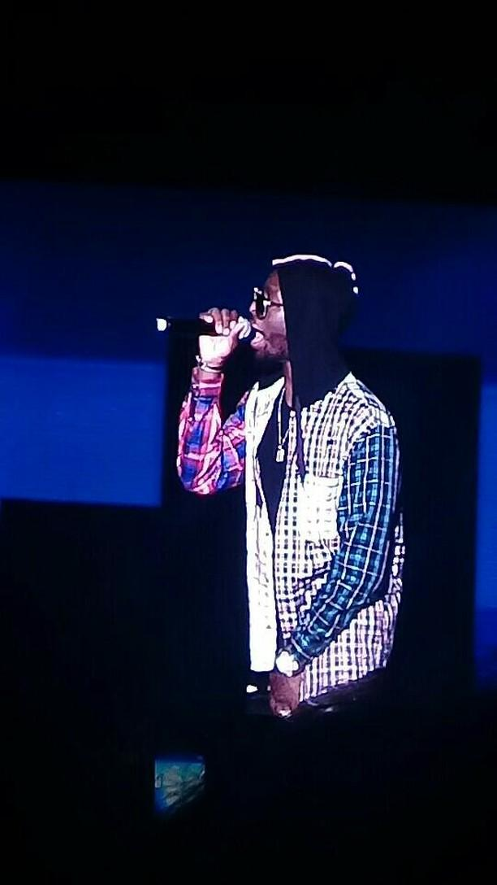
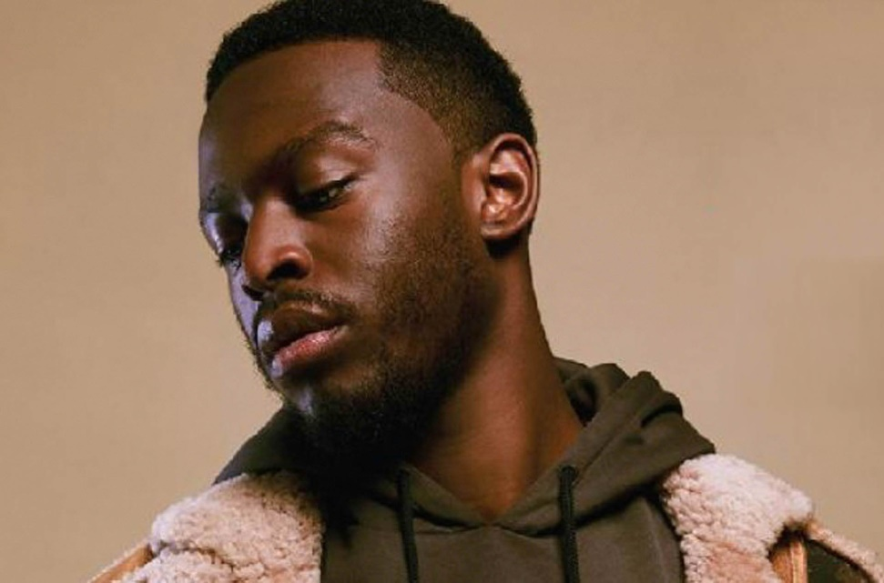
The 9 January 2019
Today , it’s my birthday. I’m thirteen years old. I’m going to the miel vert for see Dadju because I love him!

Slide 13
The 10 January 2019
Today, I went to my godfather.
I watched my little cousine, but I do not take a picture, I’m very sorry.

Slide 14
The 11 January 2019
Today, I have done my homework in my house.

Slide 15
The 12 January 2019
Today, I went to my godmother because there was a party, it was too good. I took pictures but my family is on it, so I do not put.

Slide 16
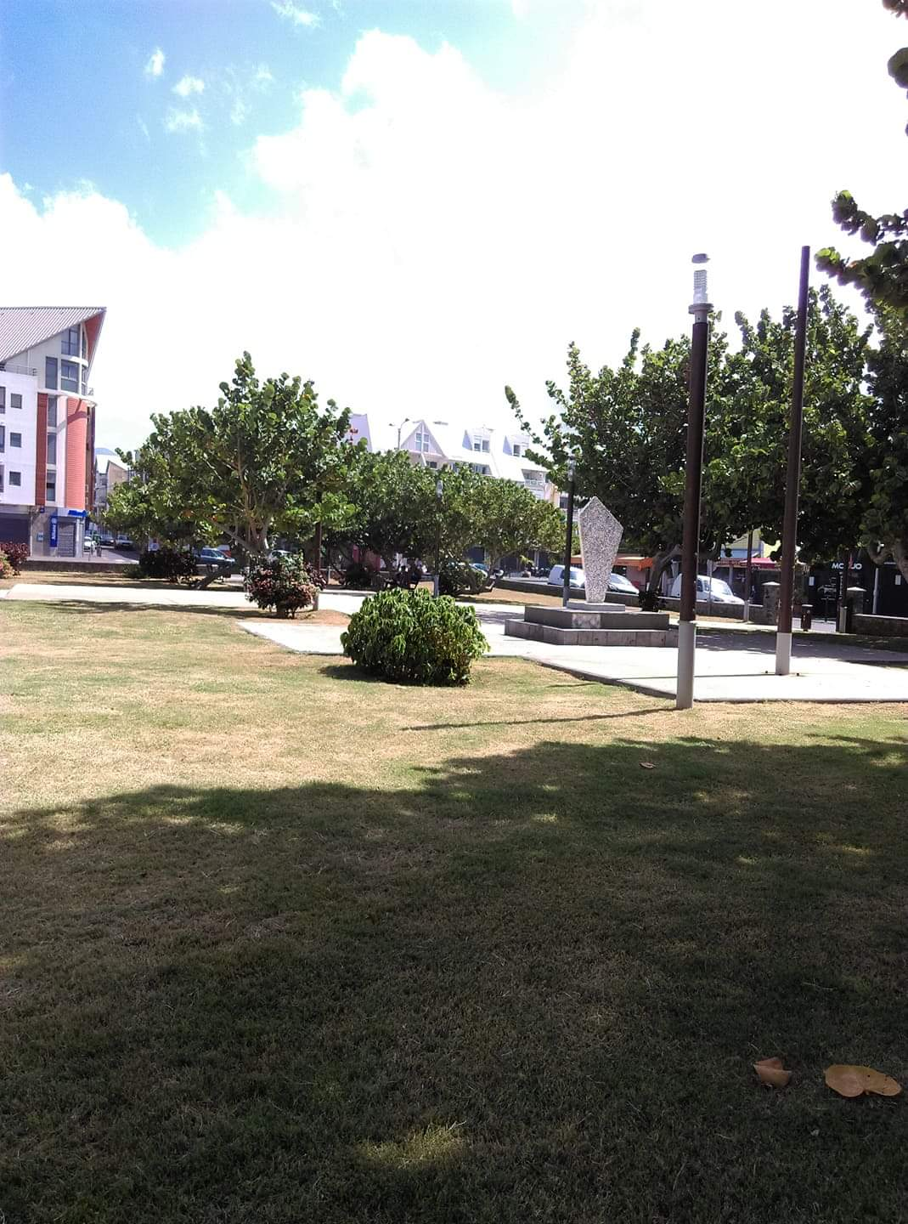
The 13 January 2019
Today, I have been out in St pierre for picnic.

Slide 17
The 14 January 2019
Today, I went back back to St Pierre for doing shopping. I took the picture because I forgot to take another.

Slide 18
The 15 January 2019
Today, my family came to my house for eating. I do not take a picture.
Sorry.

Slide 19
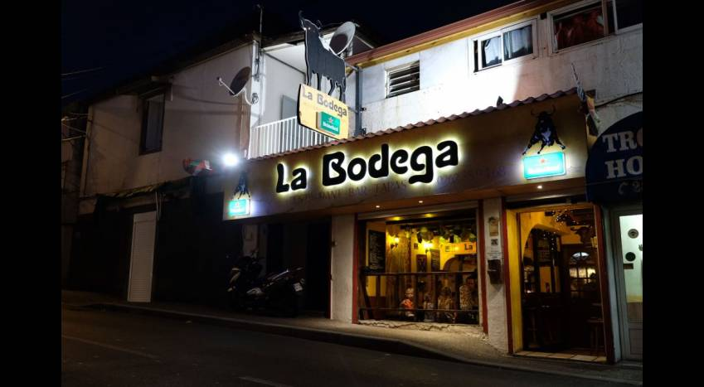
The 16 January 2019
I went to the supermarket, then I went at the restaurant.

Slide 20
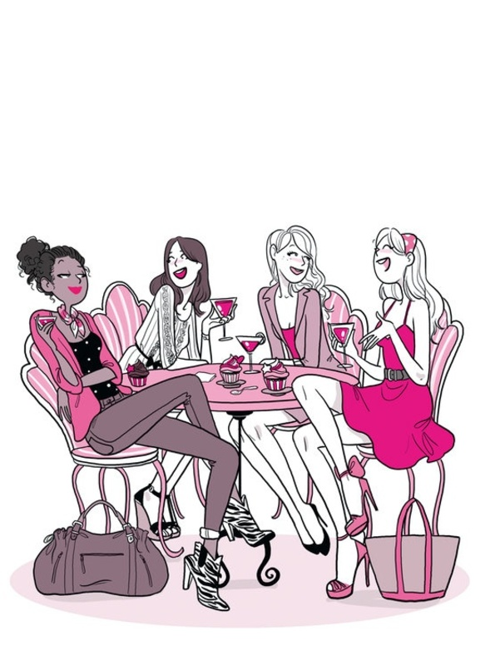
The 17 January 2019
Today, my friends came to my house.

Slide 21
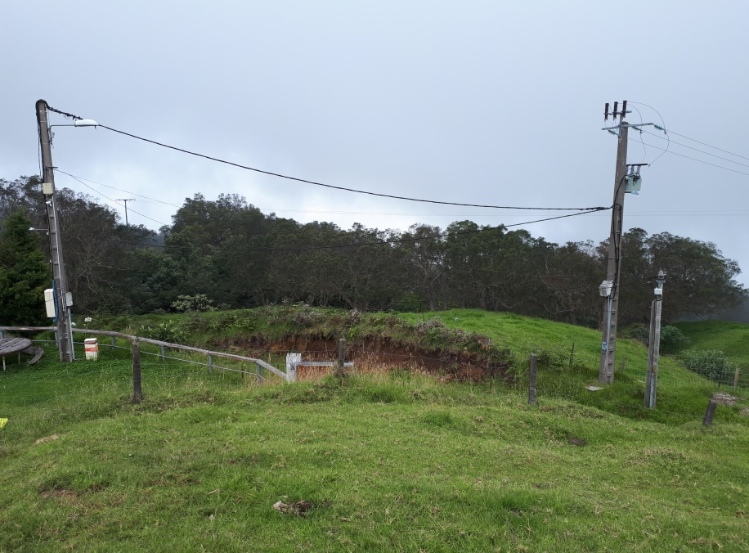
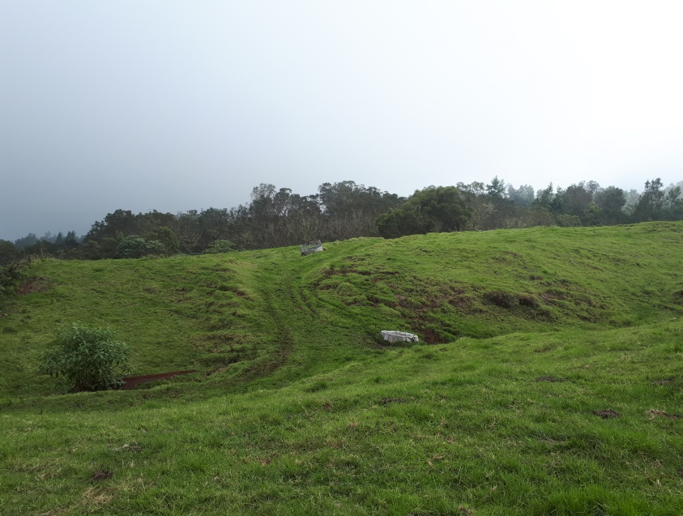
The 18,19,20 January 2019
Today, I’m going to a forest house for the whole weekend until Sunday.

Slide 22
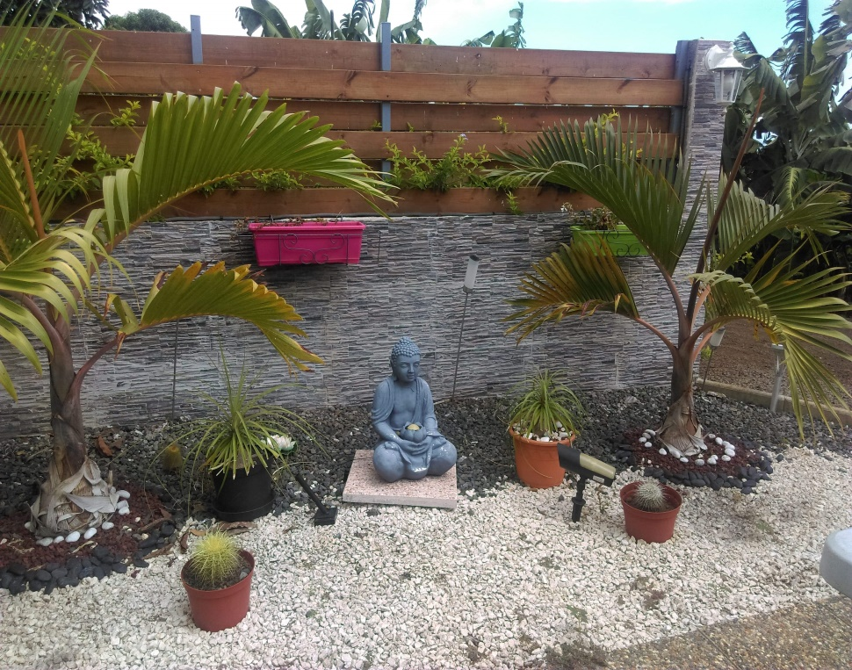
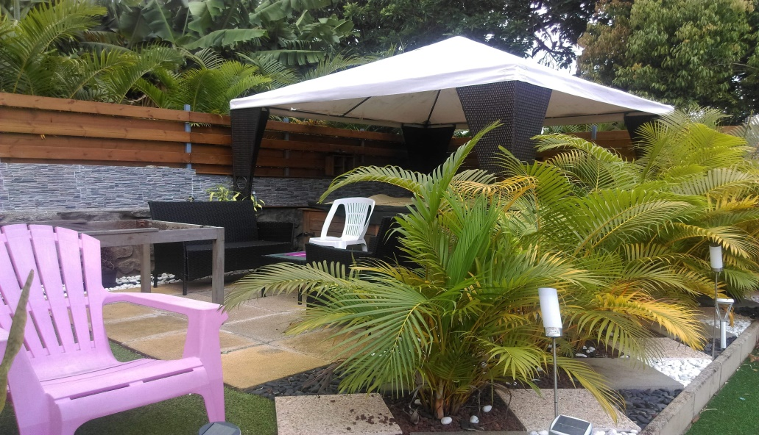
The 21 January 2019
Today, I’m going at my auntie, and there is a jacuzzi.

Slide 23
The 22 January 2019
Today, I’m doing my homework with my friends in the library.

Slide 24
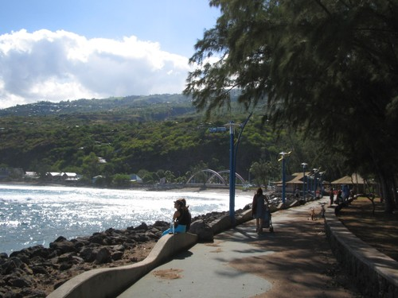
The 23 January 2019
Today, I’m going to St leu for a medical appointment.

Slide 25
The 24 and 25 January 2019
I’m going to the library the Thursday and Friday with my friends because we have not finished our homework.

Slide 26
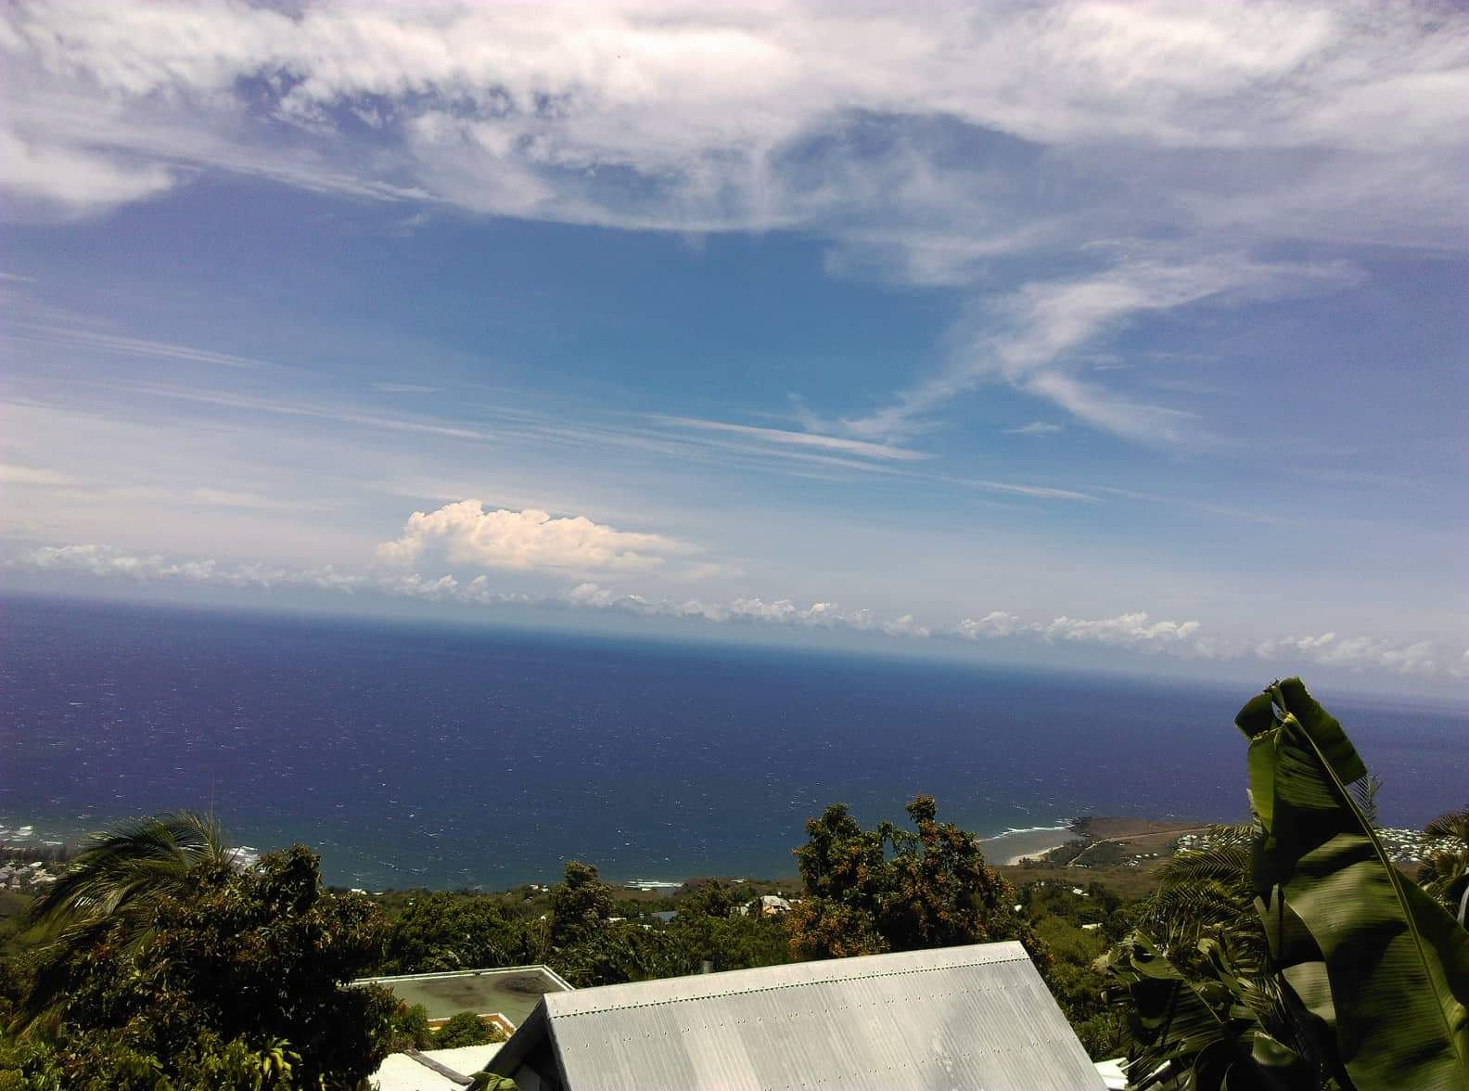
The 26 January 2019
Today, I’m going to St leu for buy the sunglases, then I’m going to my grandma’s house.

Slide 27
This is the end of my holidays, bye!!!

