Slide 1
Erasmus Media Project
A competition

Slide 2
Groups of 8/9 - mixed countries Three Projects
Divide the tasks – take responsibility for your part
Don’t waste any time – you only have two sessions to prepare. Presentation Friday.
Draft ideas, discuss, plan.
High Quality items (Design, word choice, camera angles and framing, clear speaking)

Slide 3
Project 1 - A short documentary film about the heritage of each country (France, Spain, Britain) [All contribute items but 2/3 people edit the film]
Photographs and videos
Commentary
Interviews
Make your film interesting and with a purpose – it has to say something. It’s not just a series of pictures. You may want to point out what would help countries to get along better or what we can learn from each other.

Slide 4
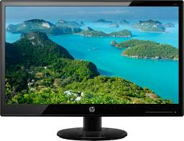
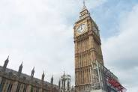
A video advertisement and a leaflet that promotes Diversity between countries. [Two groups of 2/3 – working together – the leaflet and film have a similar look and style]
Bringing Us Together
Asdadadadasd adsfadsfaa dfsdsdf sdfsdfsv sddsdfsd sdsdsd aadadsa asdasda dasd asd a dasd asd asd asdasd adasd ad asd asdas das a as das ad asdad saddasdadsas asdadada asd adds asd asdasdasd we wer wewerwerwe
Asdadadadasd adsfadsfaa dfsdsdf sdfsdfsv sddsdfsd sdsdsd aadadsa asdasda dasd asd a dasd asd asd asdasd adasd ad asd asdas das a as das ad asdad saddasdadsas asdadada asd adds asd asdasdasd we wer wewerwerwe Asdadadadasd adsfadsfaa dfsdsdf sdfsdfsv sddsdfsd sdsdsd aadadsa
Bringing Us
Together
adasd ad asd asdas das a as das ad asdad saddasdadsas asdadada asd adds asd asdasdasd we

Slide 5
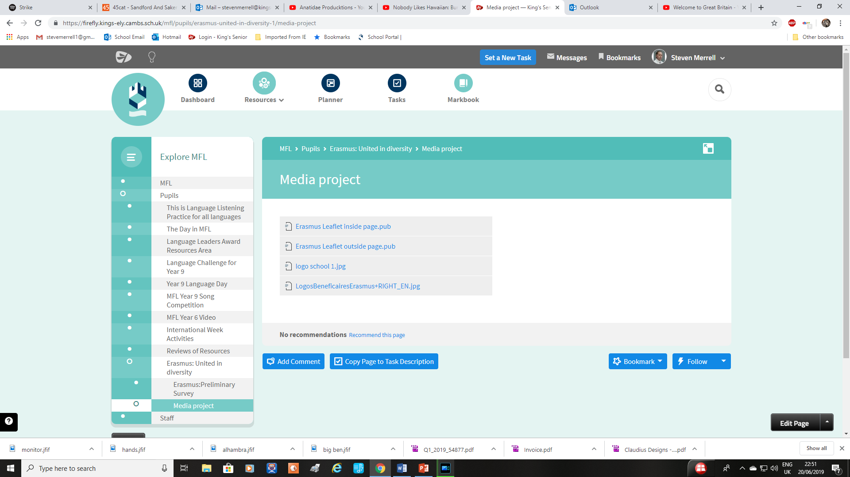

Slide 6
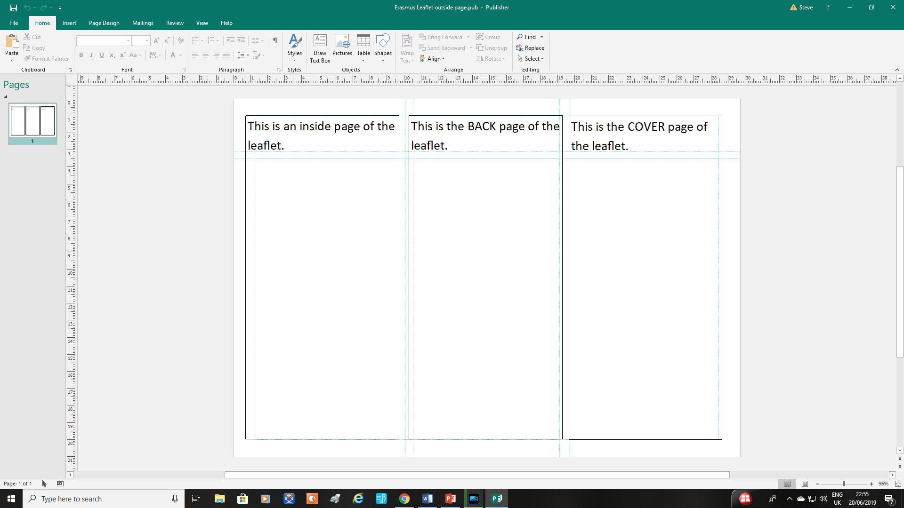

Slide 7
A leaflet that promotes Diversity between countries.
The aim of the advert is to promote the benefits of Diversity, that is, the variety of differences and how these can still bring us together and help us to learn and appreciate these qualities. The leaflet must link to the advert and is two sides of an A4 page (folded). To make it you can use:
Photographs you have taken. You will need to download these ready to import into Windows Publisher. You can use photos you will take on your outings this week. . You can use video and photos from anybody in your group, but only two or three will be doing the leaflet.
Your advert should support the video advert and may use some of the same wording, especially a catchphrase. There may be other links to help make your promotion effective.
The leaflet should be eye-catching, colourful and look professional, carefully spell-checked with wording that supports your messages.
Your leaflet must be linked to the video advert others in your group are making.

Slide 8
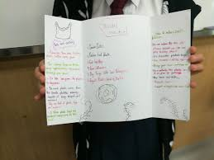

Slide 9
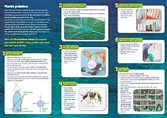

Slide 10
Video Advert that promotes diversity…
‘Welcome to Great Britain’ – a promotional video (picture album style)
https://www.youtube.com/watch?v=BsHnd1M4KsI
What is it telling us?

Slide 11
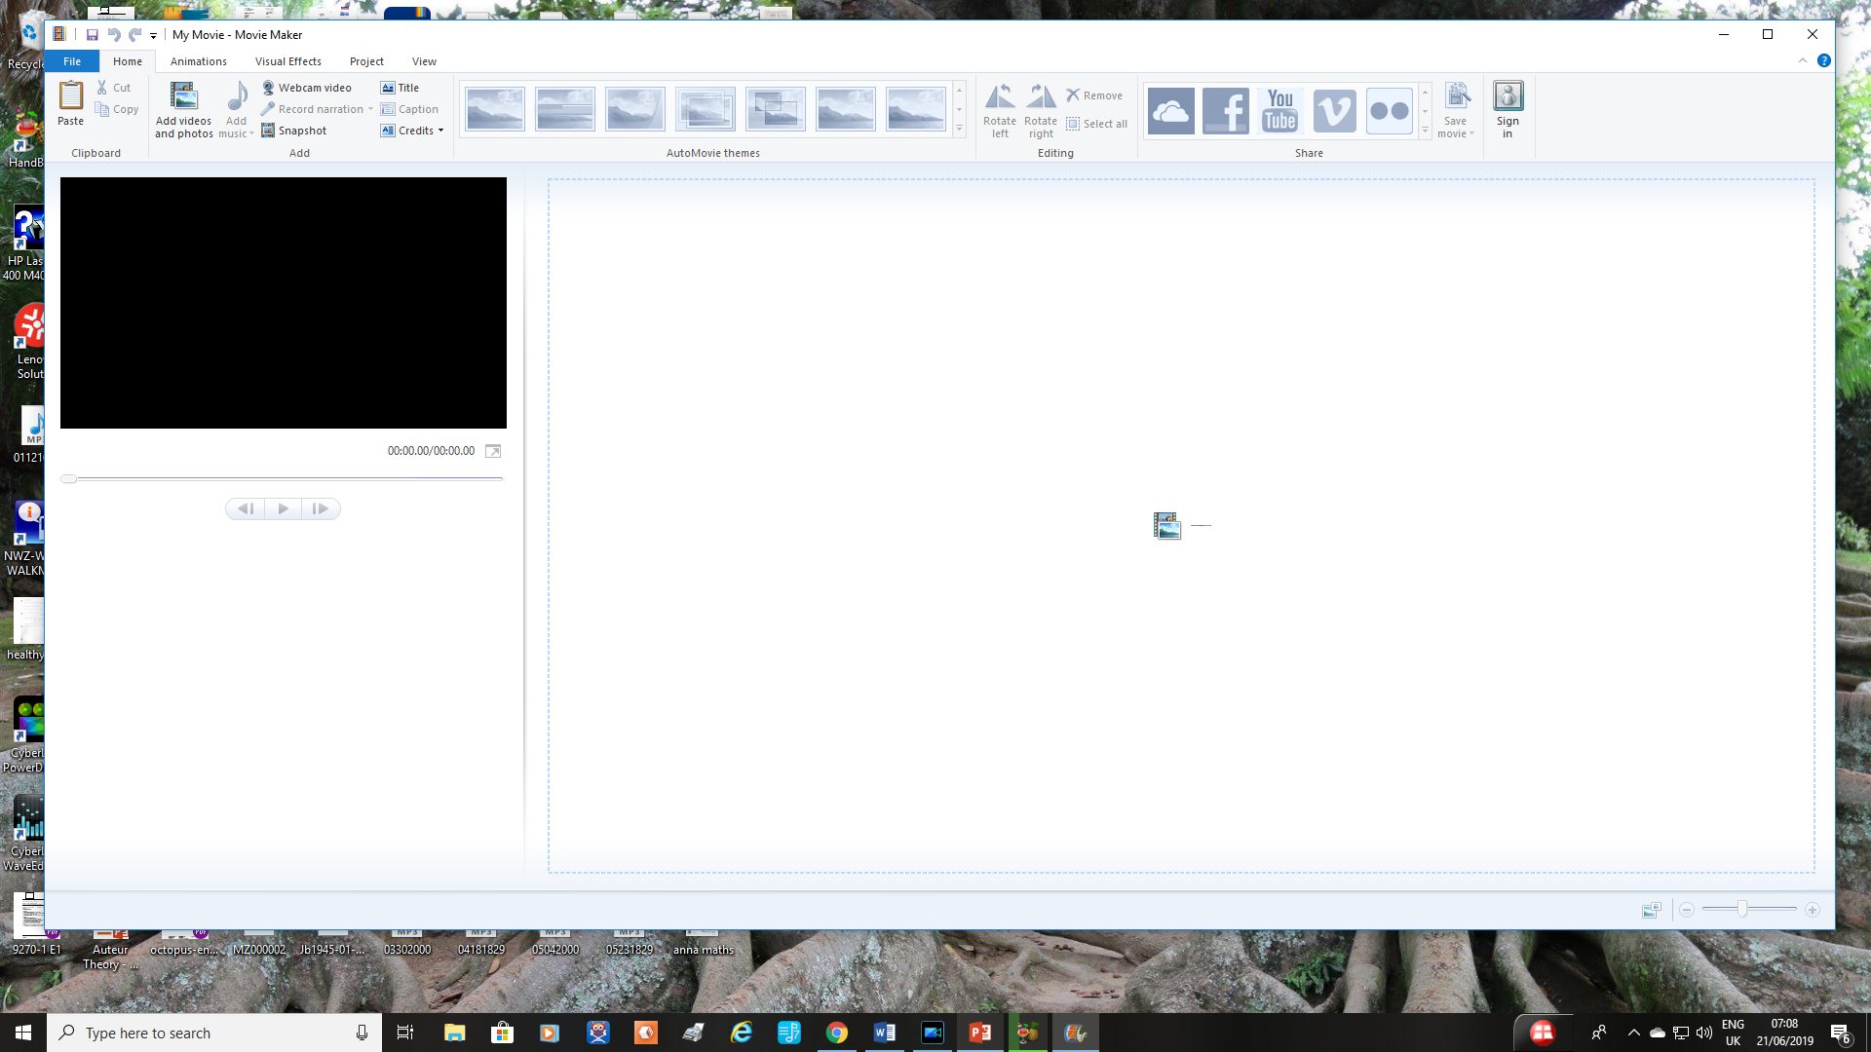

Slide 12
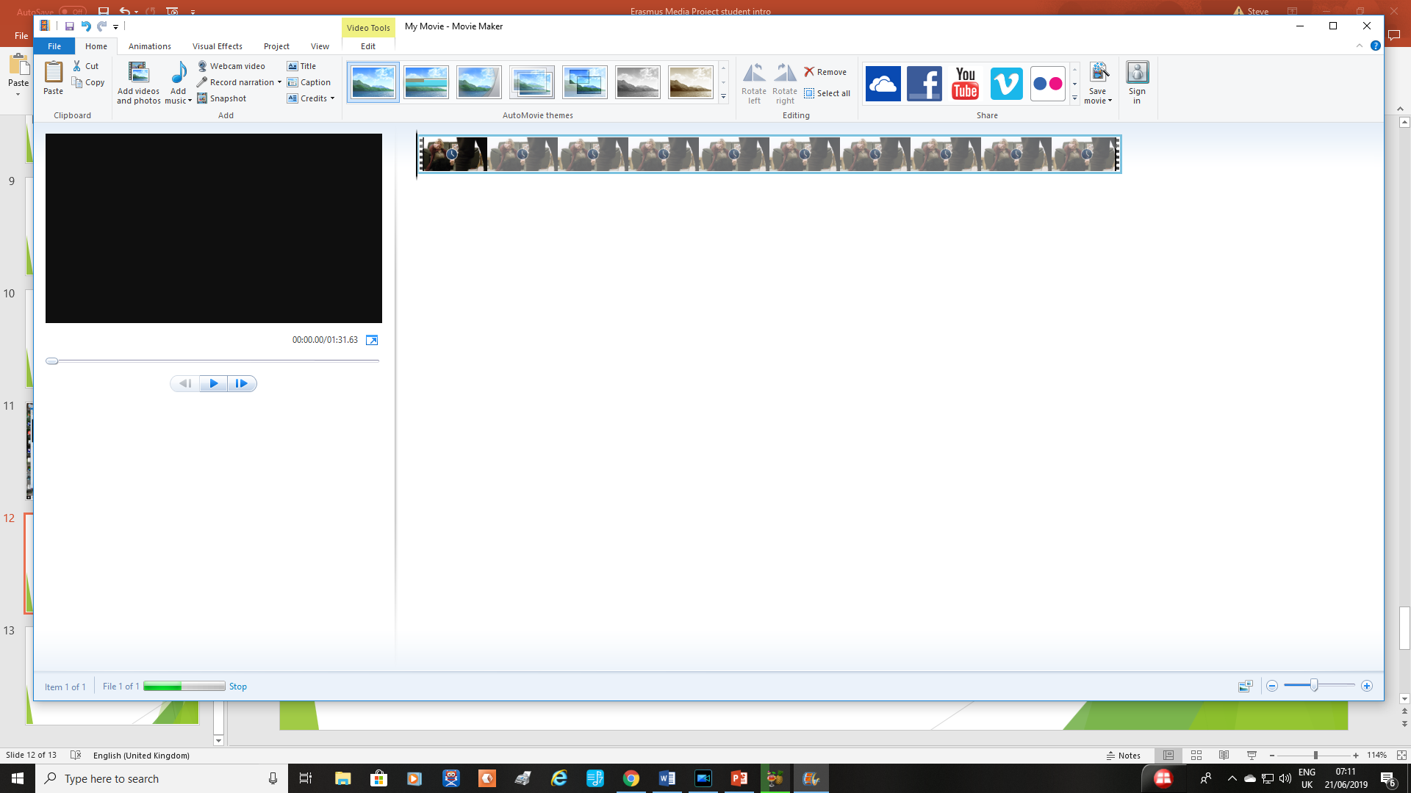

Slide 14
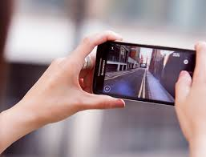
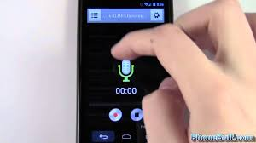
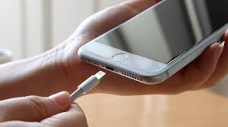
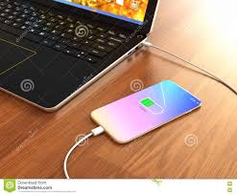

Slide 15
Talking Heads
https://www.youtube.com/watch?v=nqo-XTk1-NQ
Talking to camera
https://www.youtube.com/watch?v=o9gMnWhih44

Slide 16
Don’t forget to include . . .

Slide 17
Getting Organised
Groups and where
Albacete – Ely – Toulouse – Saint-Denis
In OH ICT room
London – Madrid – Saint Leu
In ICT Tech block

Slide 18
Getting Organised
Sessions
Tuesday – 9am – 11am
Thursday – 9am – 11am – all files passed to teacher
Presentation – 9am – 11am
(plus other events)

Slide 19
Good Luck!

