Slide 1
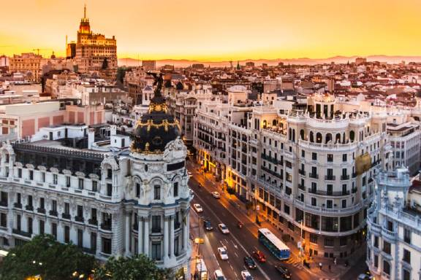
ALL ABOUT SPAIN:
By Silvia Castro

Slide 2
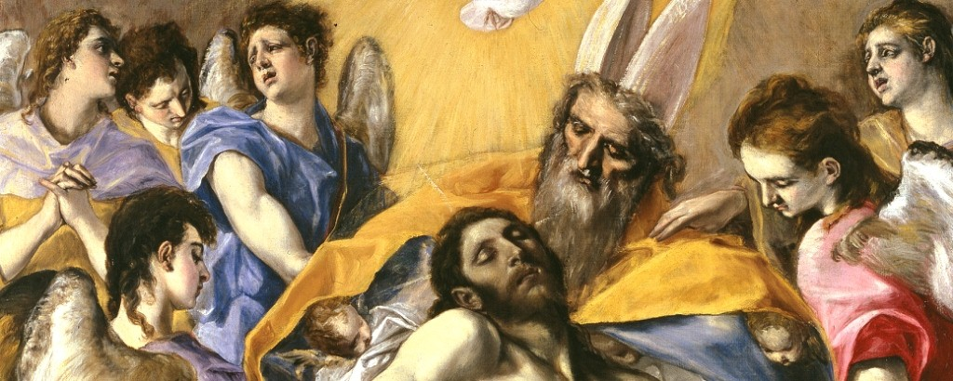
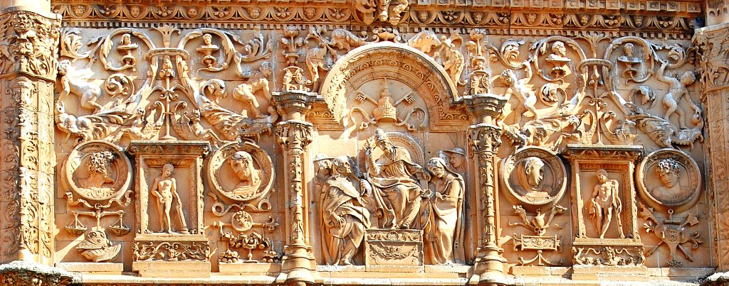
PAINTING AND SCULPTURE
ART IN SPAIN
XVI CENTURY
Penetration and emergence of the Renaissance.
Transition between flamenco taste and Italian style.
Radical break with Spanish Gothic Cultural richness would reach its apogee in the Spanish Golden Age.
TRINIDAD, EL GRECO
FACADE OF UNIVERSITY OF SALAMANCA

Slide 3
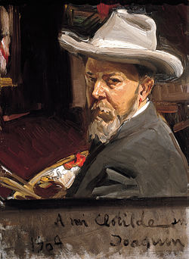
JOAQUÍN SOROLLA Y BASTIDA
IMPORTANT PAINTERS
Spanish painter.
A prolific artist.
2,200 catalogued works.
Impressionist, postimpressionist, and luminist.

Slide 4
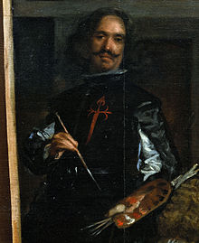
DIEGO RODRÍGUEZ DE SILVA Y VELÁZQUEZ
Known as Diego Velázquez.
Spanish Baroque painter.
Master of universal painting.

Slide 5
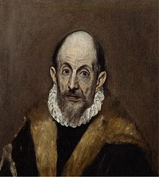
EL GRECO
Late Renaissance painter.
Very personal style in his mature works.
https://www.youtube.com/watch?v=ZrMjG3Hd24c

Slide 6
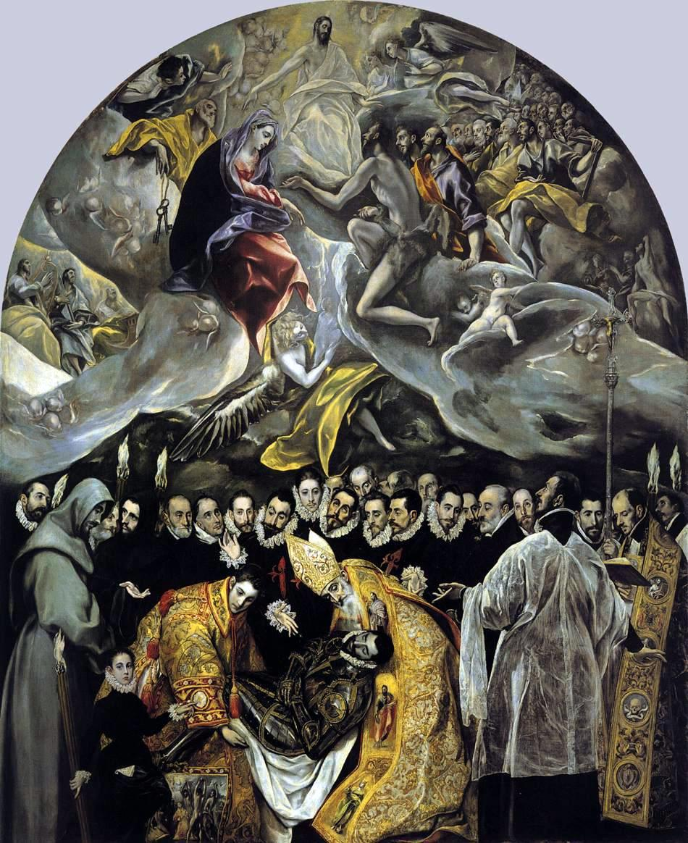
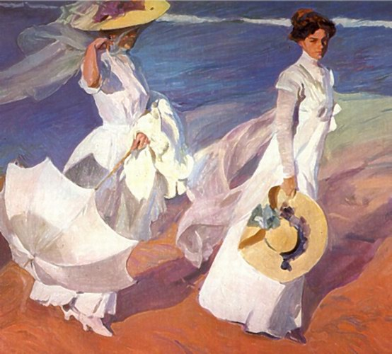
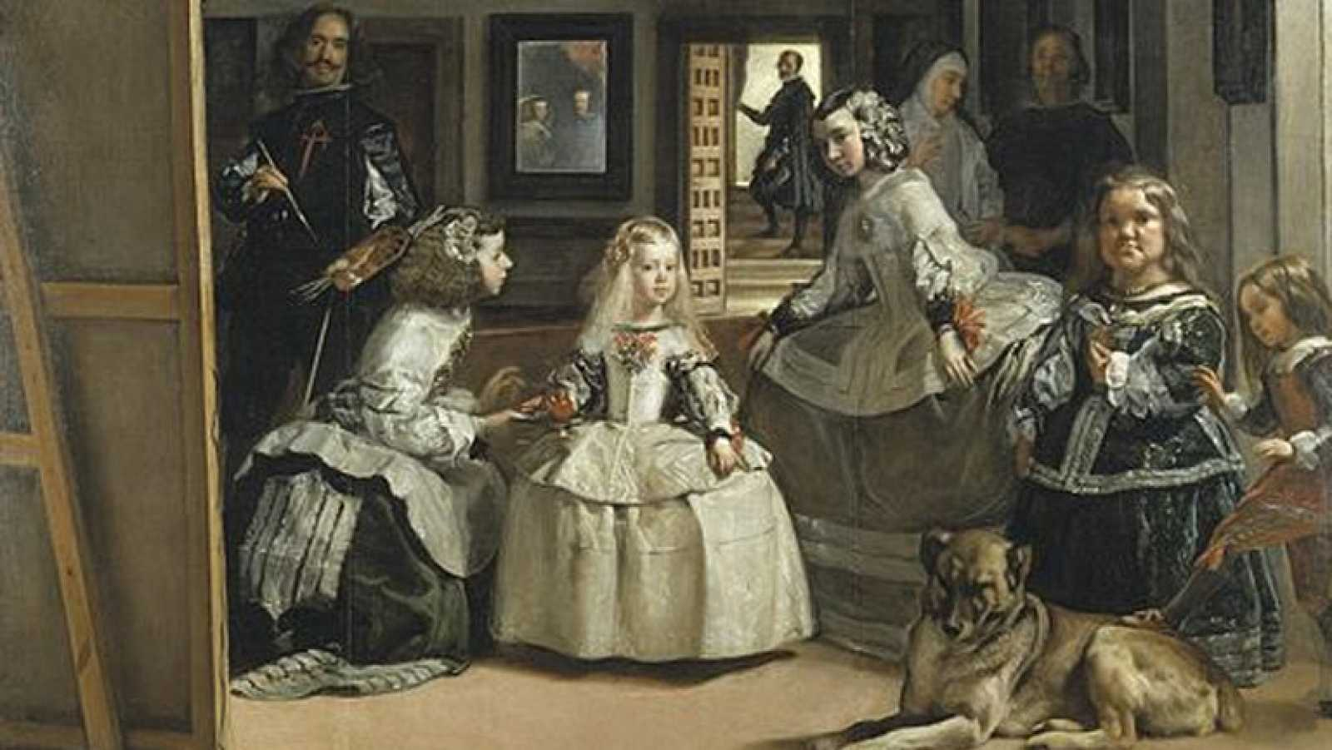
SOME IMPORTANT PAINTINGS:
PASEO A ORILLAS DEL MAR,
SOROLLA
CUADRO DEL ENTIERRO DEL SEÑOR DE ORGAZ, EL GRECO
LAS MENIMAS, VELÁZQUEZ

