Slide 1
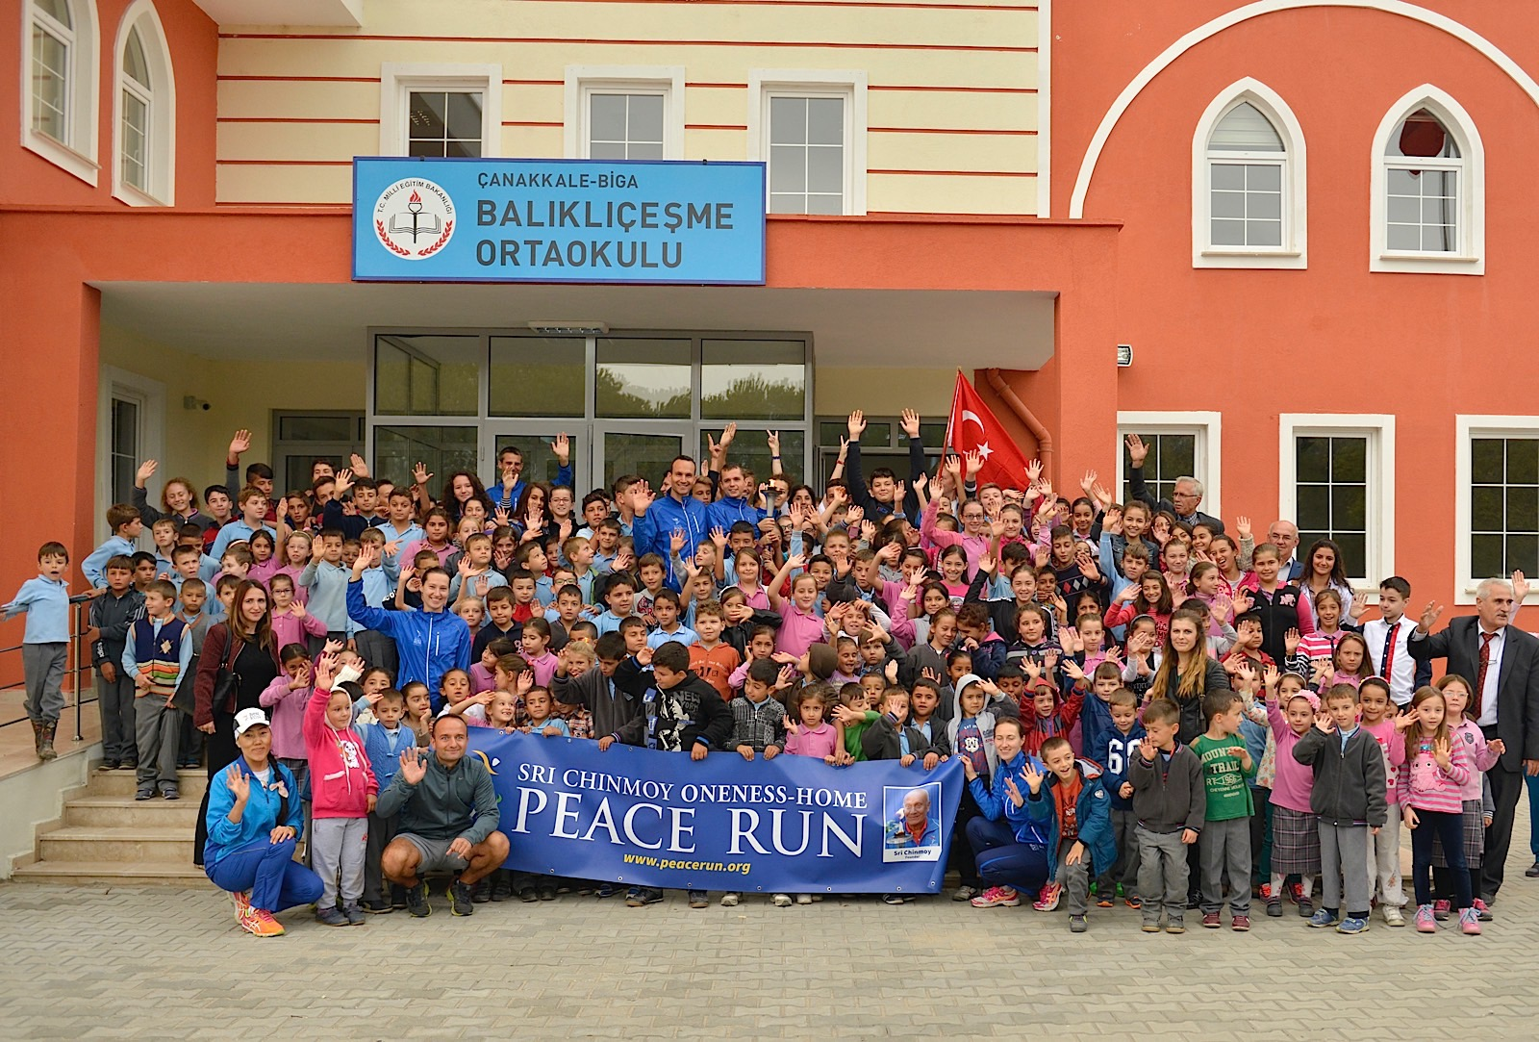
BALIKLIÇEŞME SECONDARY SCHOOL

Slide 2
Our school is in a small town in Çanakkale, TURKEY.
Our school was built last year and starts education this year.
Our students are coming from the villages around our town.

Slide 3
Our students are joining in the sports activities.

Slide 4
We have a lot of projects in our school.
We decide on the cleanest class in the school every week and we give an award to the cleanest of the school.
We prepare e- twinning projects .
Our students joins in the competitions(poem reading, sport activities,…)

Slide 5
One of the class studying on this project

Slide 6
Class 5-A

Slide 7
OUR SCHOOL BILLBOARD

Slide 8
ONE OF THE LETTERS

Slide 9
ABOUT OUR CITY
Canakkale is a city of education, culture, natural splendor and History. History of the region rewinds back to a period, as early as 5,000 years. Fortunately or unfortunately, Canakkale had been the witness of the two of the bloodiest wars in History - the mythological war of Troy and the Battle of Gallipoli.

Slide 10
Owing to its strategic position, Canakkale has always been the strongest point in the defense of Dardanelles; be it the Trojan War or the First World War. Homer immortalized Troy (Truva) and the characters of king Priam, Hector, Pans and Helen, through his legendary depiction in the Iliad. As per the Archaeological excavations, there had been 9 periods of settlement starting from the 3,000 B.C. to 400 A.D.

Slide 11
The battle of Canakkale or the Gallipoli War (1915) took place during the First World War when the Turkish soldiers tried to drive out the Allied Forces from the region, under the leadership of Mustafa Kemal Ataturk. The campaign led by Ataturk was a successful one and Canakkale earned its name as "Canakkale: un-passable". However, 5,00,000 soldiers had to give their lives to achieve the success and in their memory a national park of remembrance has been built here.

Slide 12
ÇANAKKALE

Slide 14
Prepared by BİLGE AKMAN

