Slide 1

I am Lilit Nikoghosyan.

Slide 2
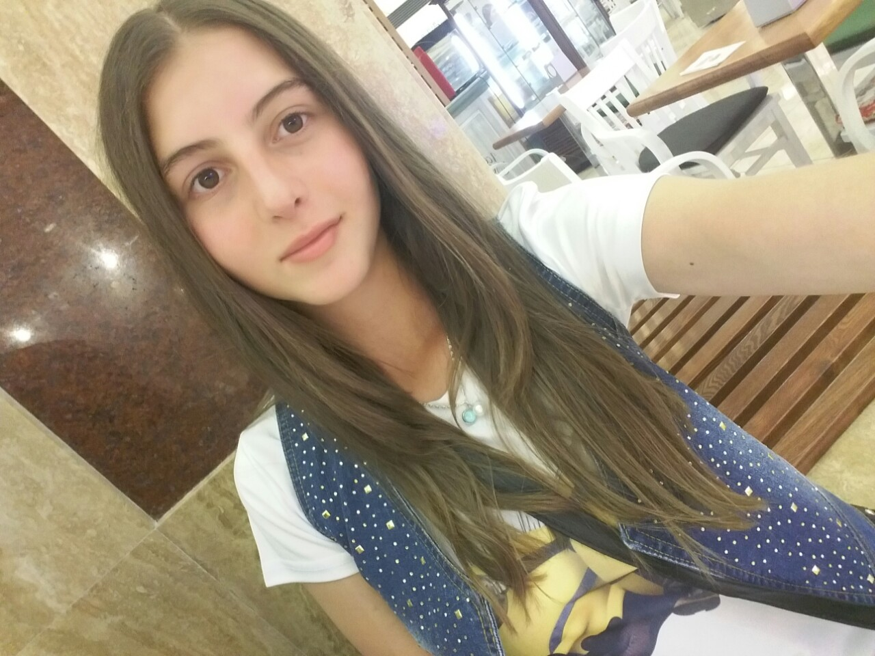

Slide 3
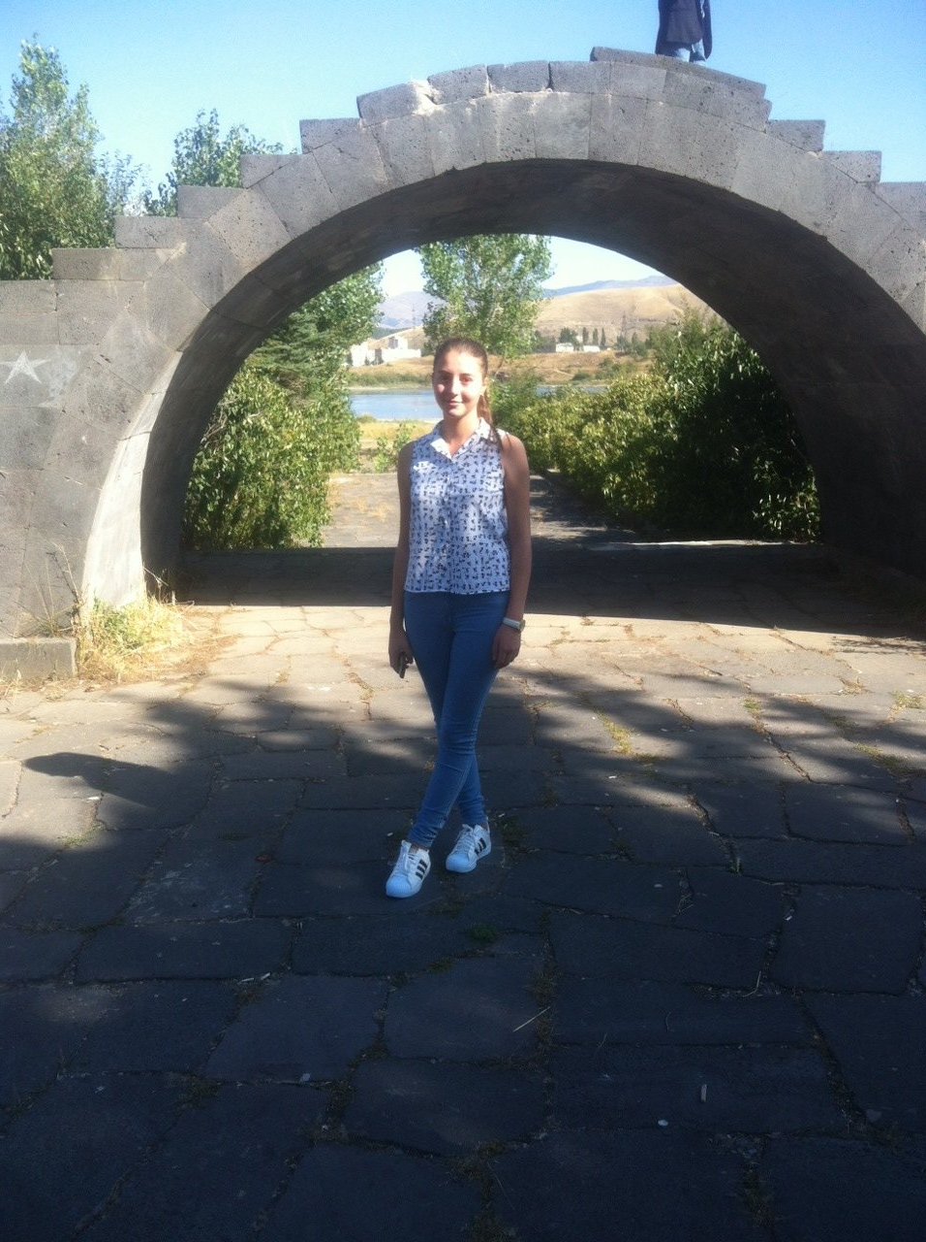

Slide 4
I was born at 2000 in Armenia in Kotayk region in Hrazdan city.I am 16 years old.

Slide 5
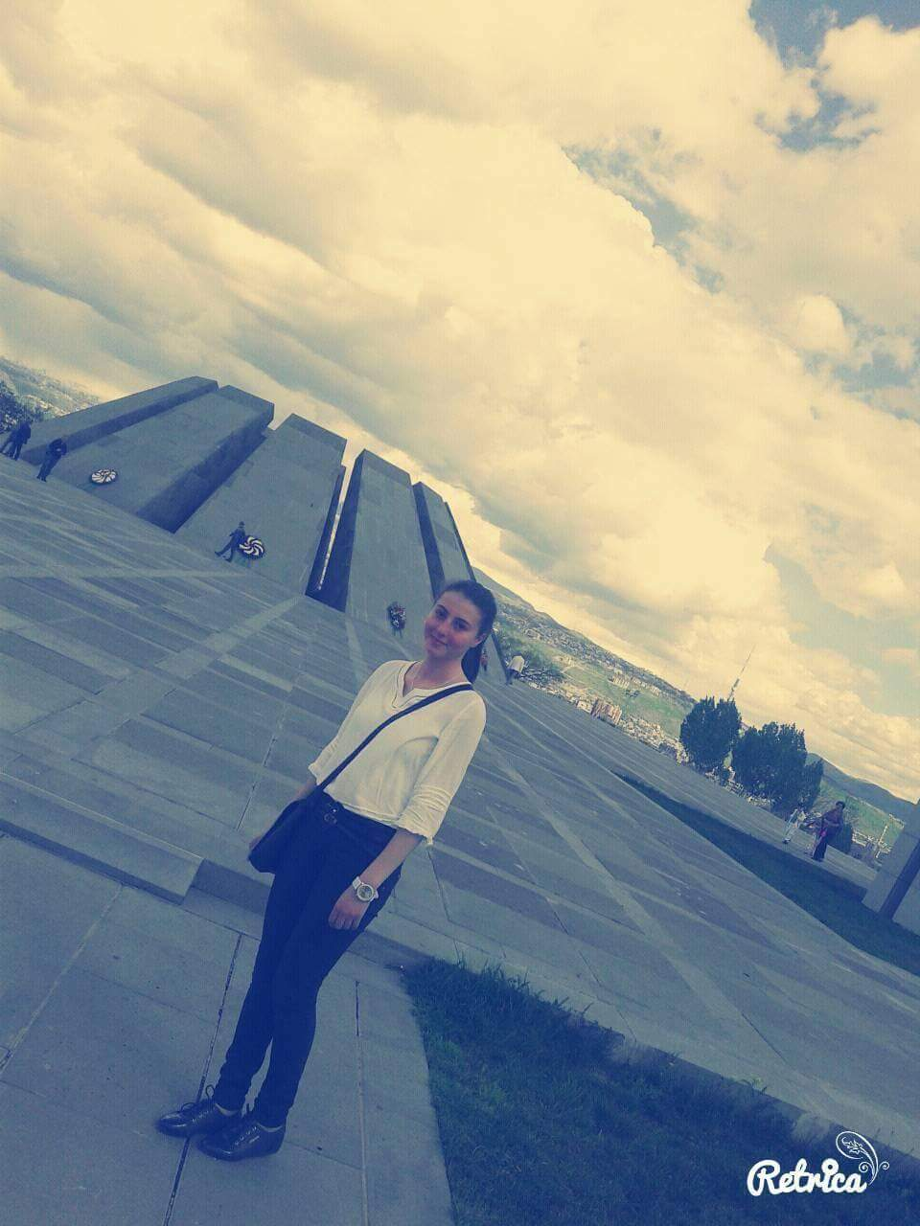

Slide 6
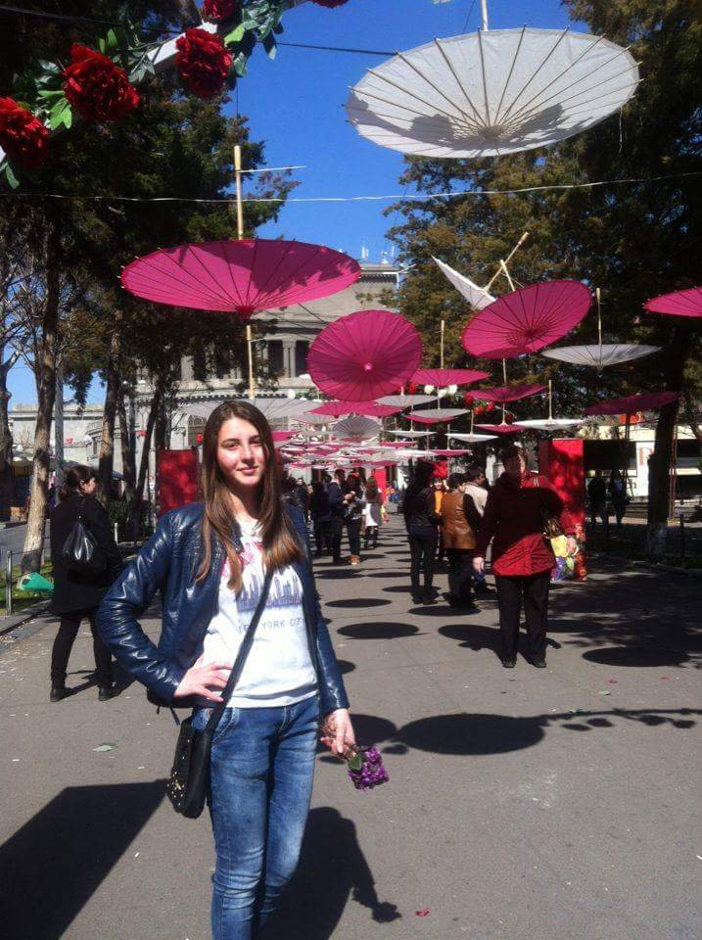

Slide 7
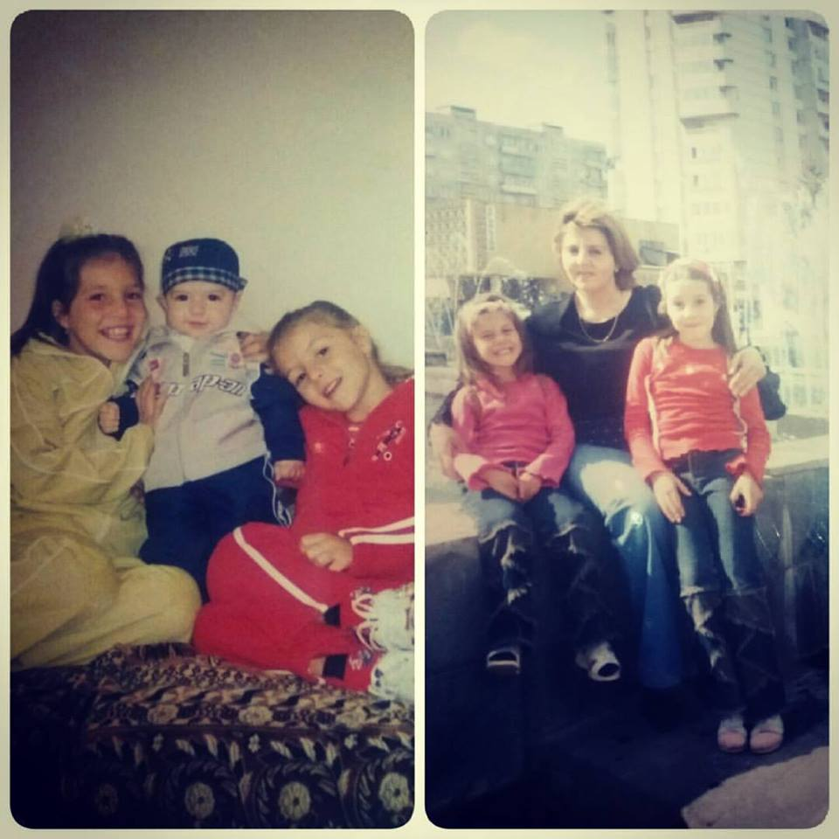
I live with my family

Slide 8
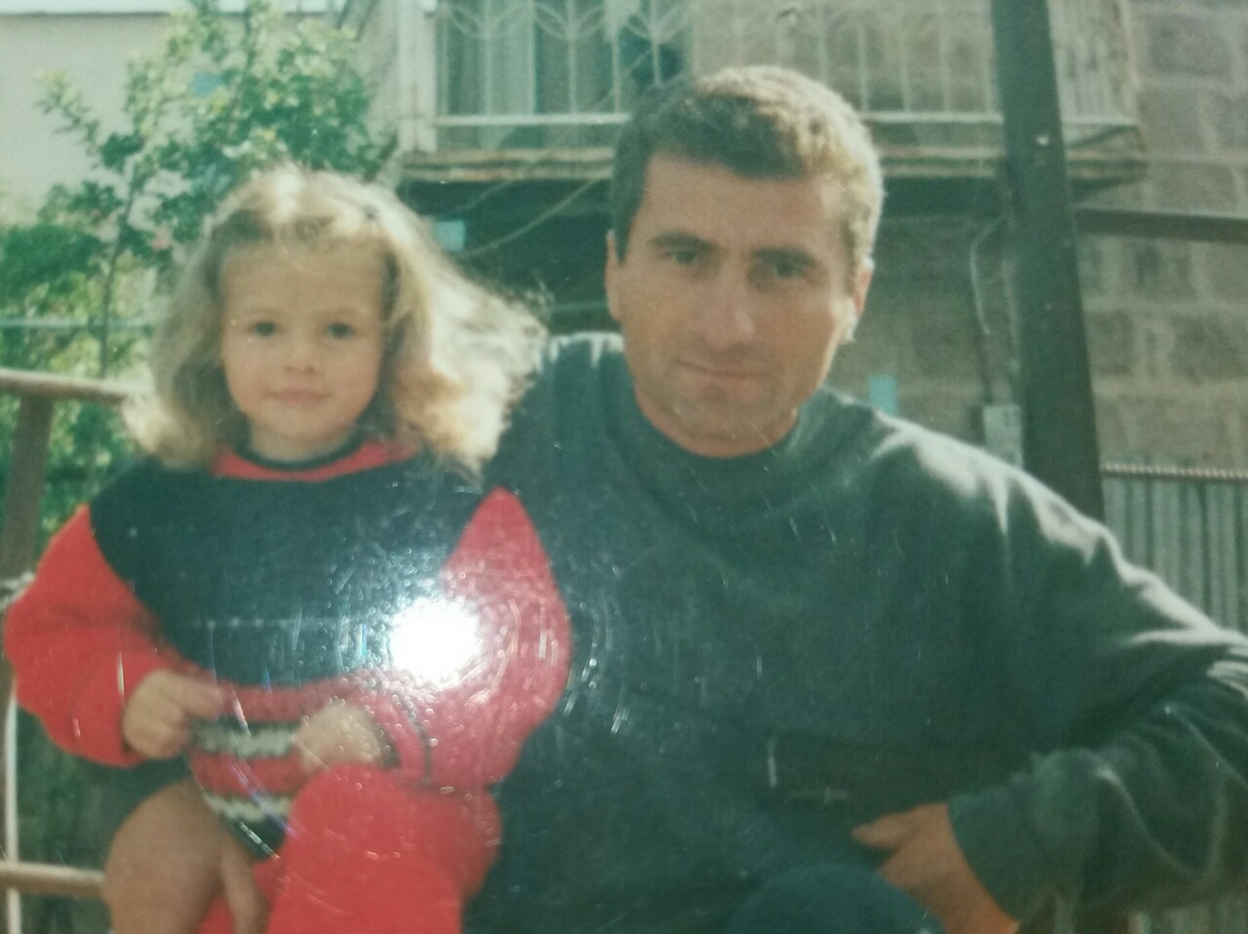

Slide 9
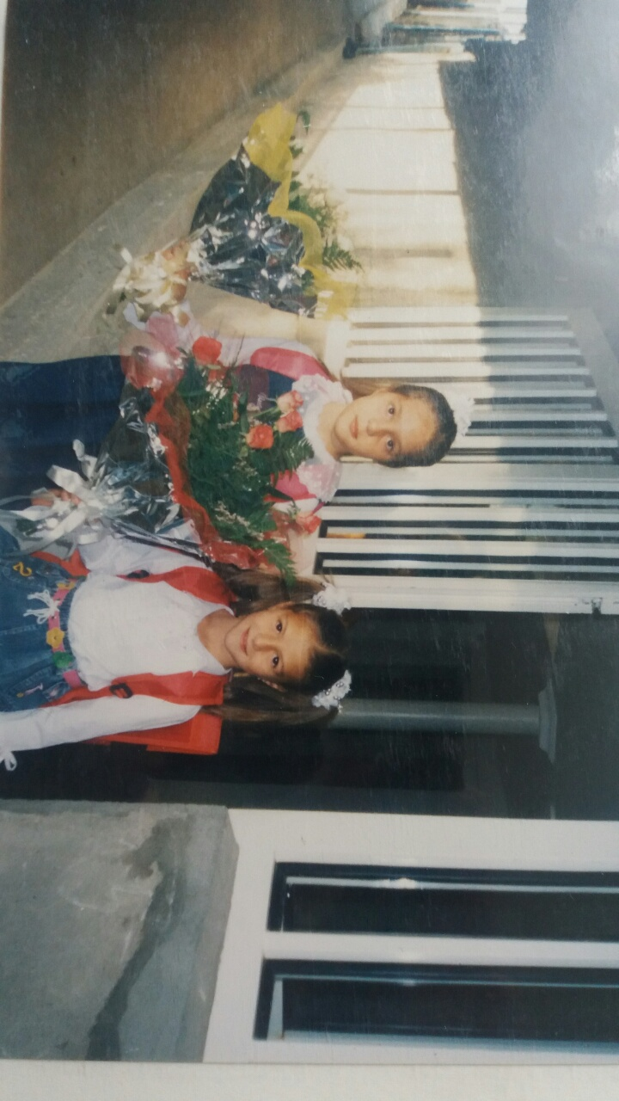
In 2006 I went to school.

Slide 10
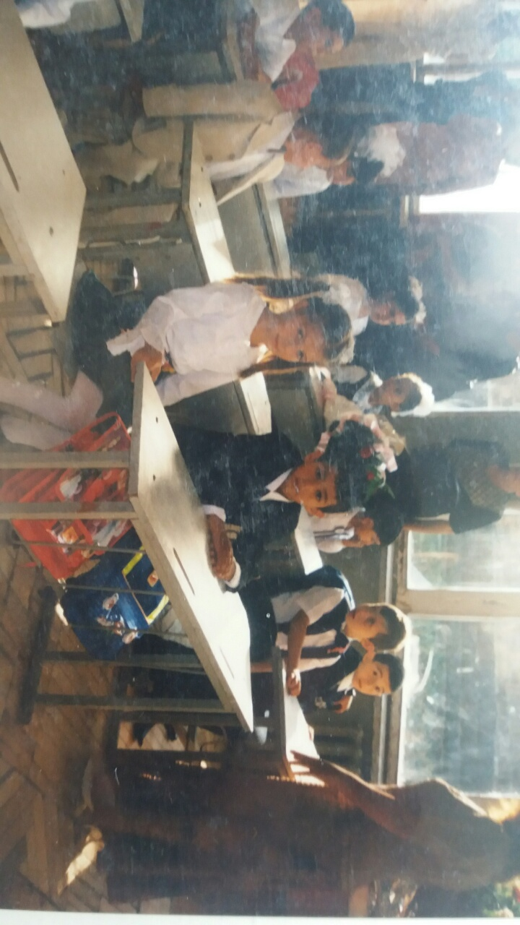
It’s my first day in school

Slide 11
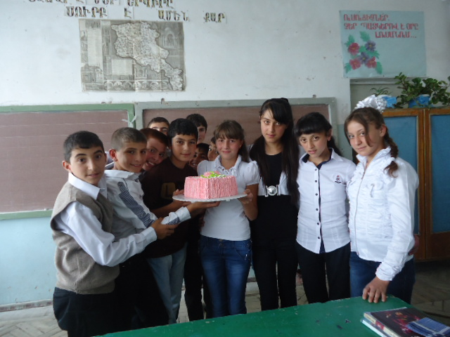
My birthday with my class

Slide 12
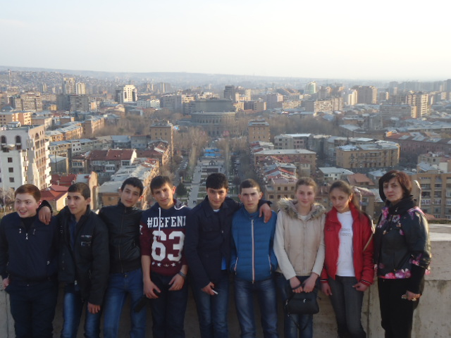

Slide 13
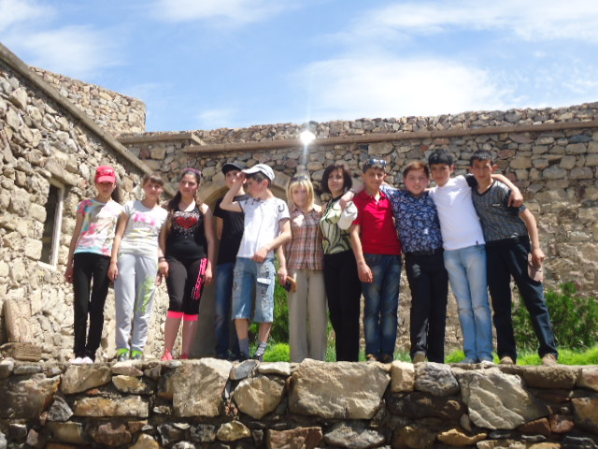

Slide 14
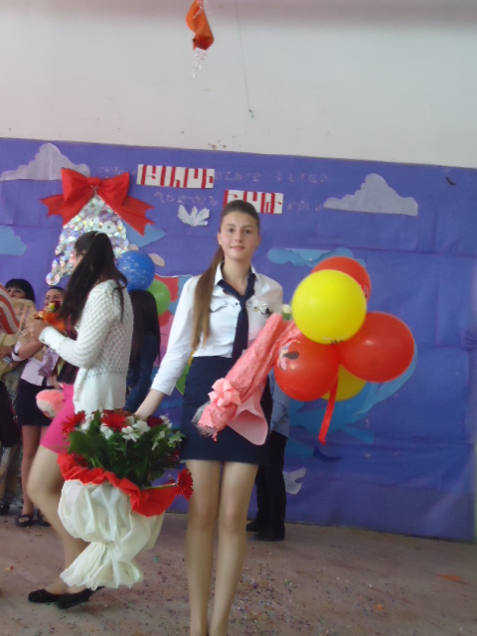

Slide 15
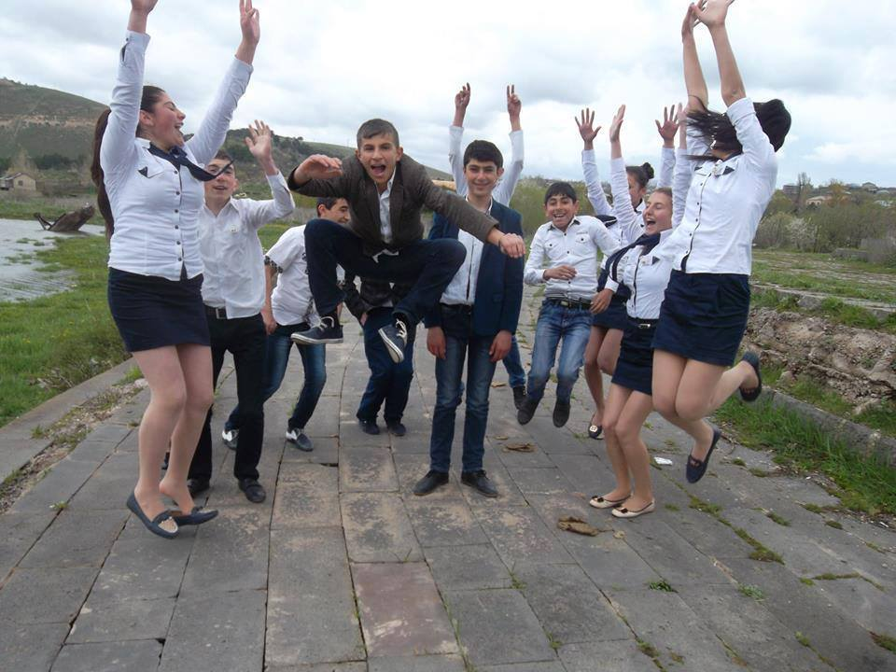
My last call

Slide 16
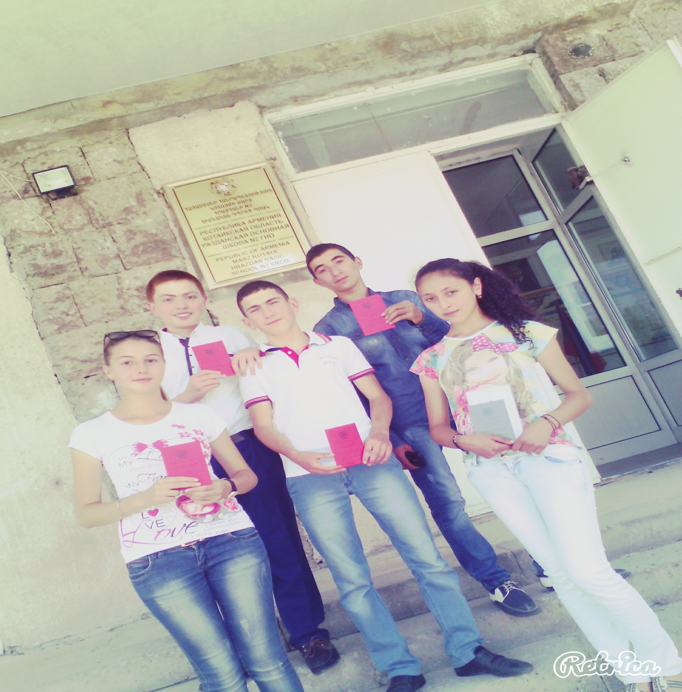

Slide 17
In 2008-2015 I went to musical school

Slide 18
Free time I like to read books, watch movies. I also love to play football and basketball, and I have been involved in our school basketball team, where I had a lot of success.

Slide 19
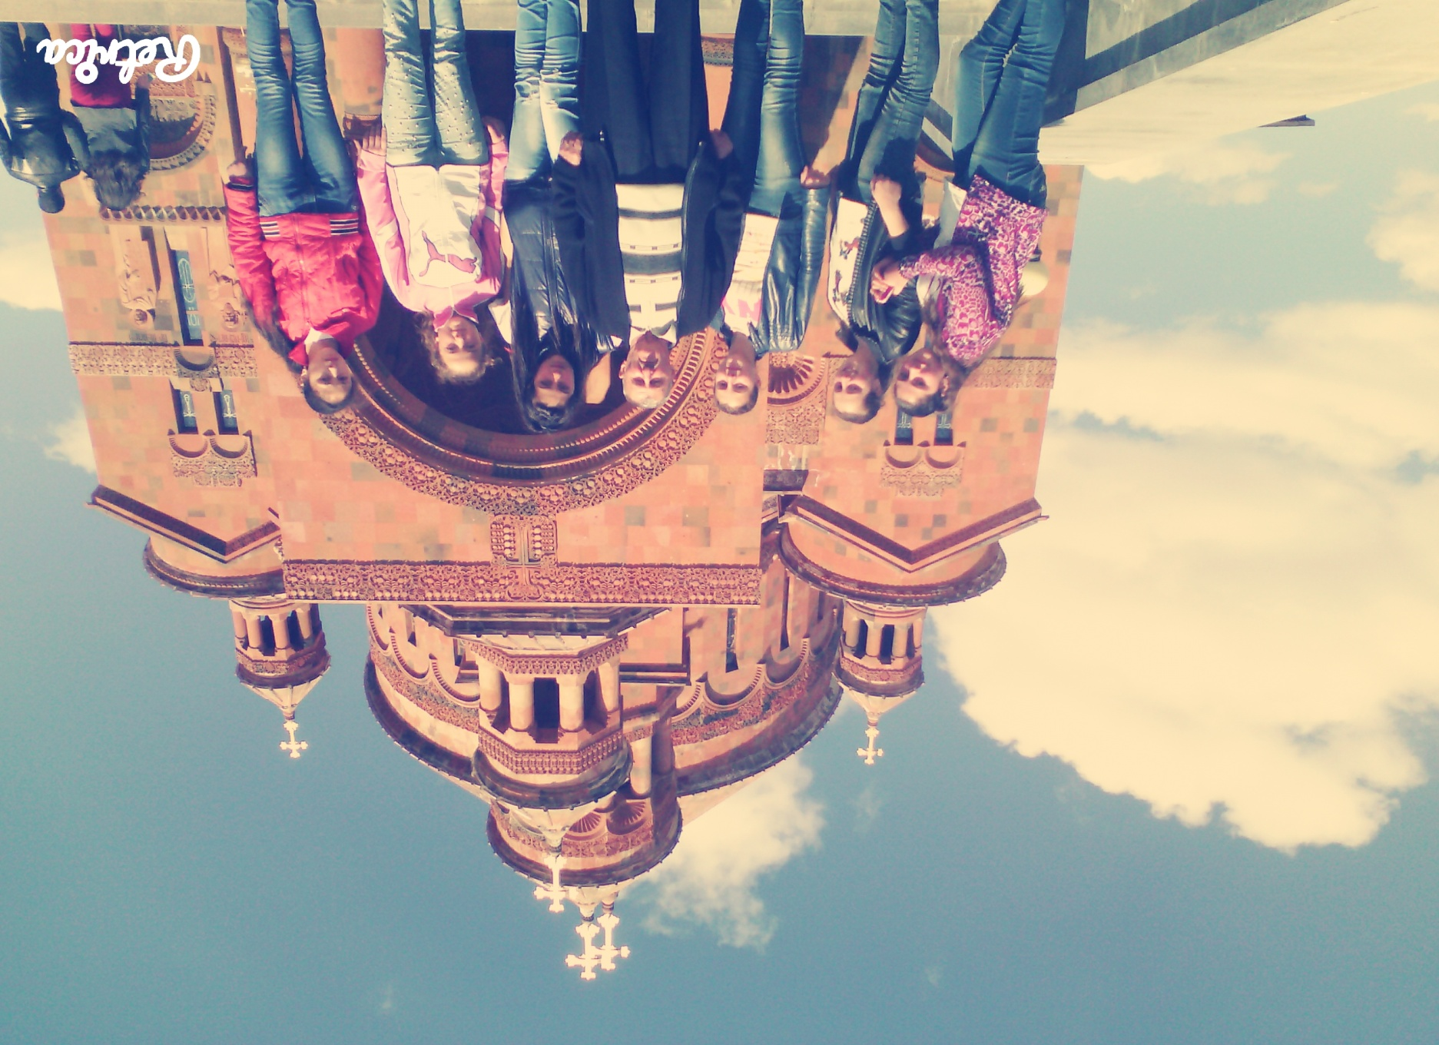

Slide 20
I learned at primary school is excellent and I had a lot of victories.

Slide 21
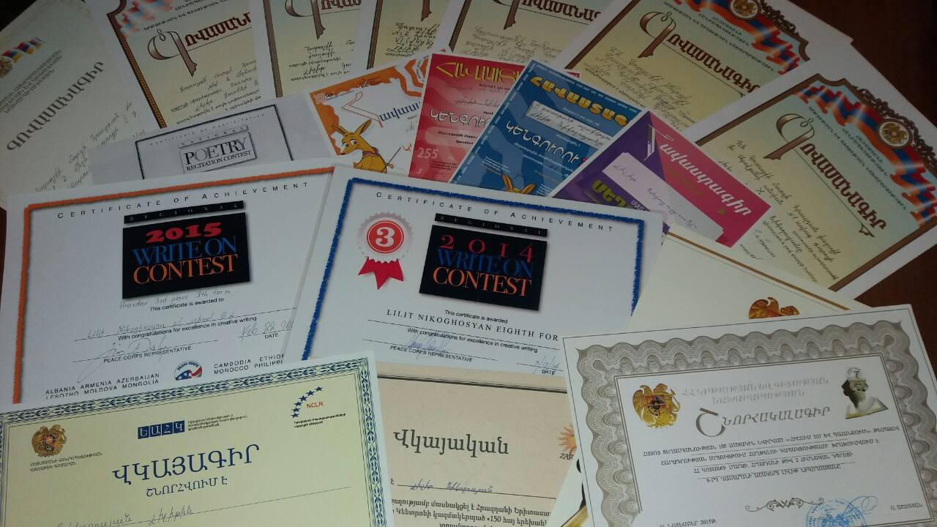

Slide 22
My favourite subjects are mathematiks,english and armenian language

Slide 23
    I wrote a composition about Armenian Genocide and I won first place in the republican stage.

Slide 24
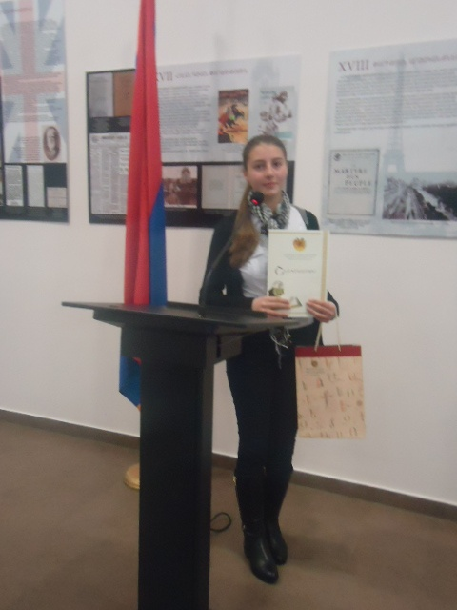

Slide 25
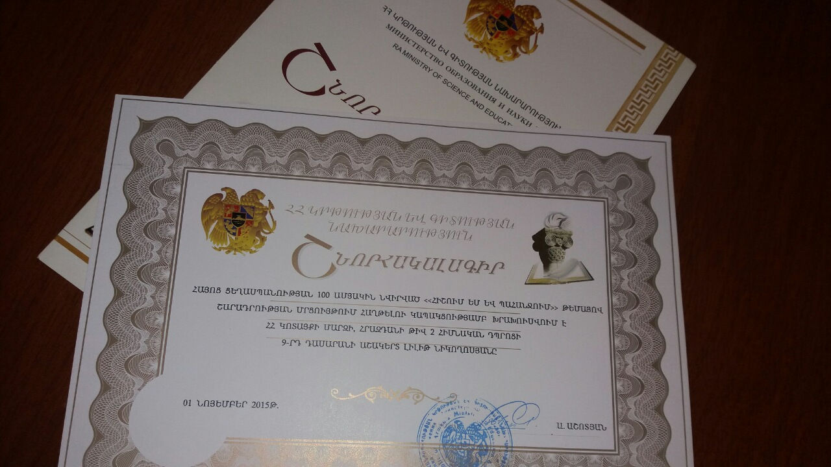

Slide 26
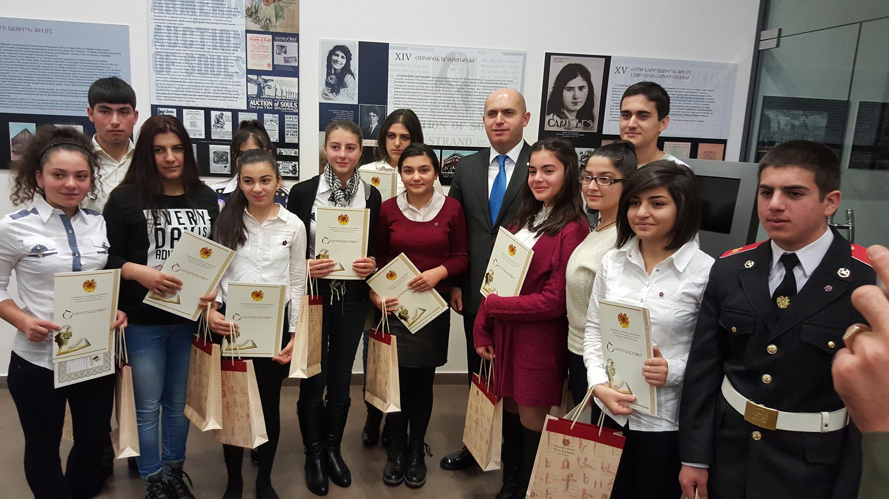

Slide 27
I also participated in various competitions, where I write English essays and held high positions.

Slide 28
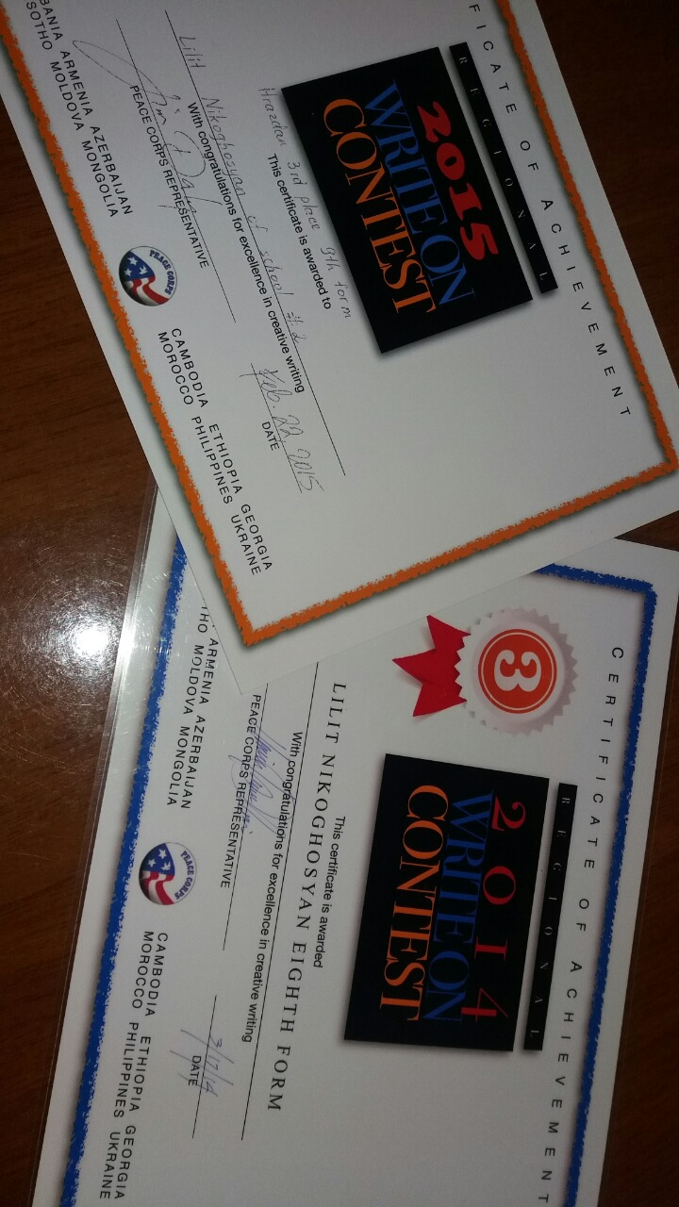

Slide 29
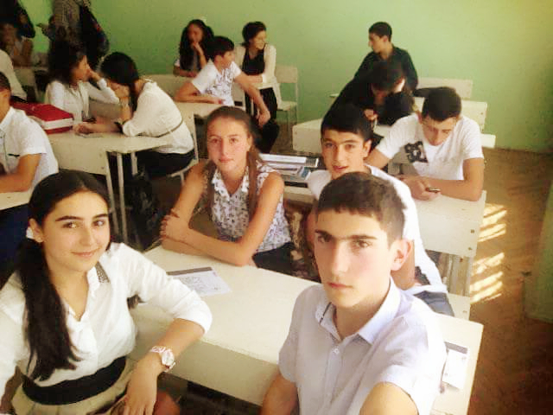
In 2015 I entered to high school.

Slide 30
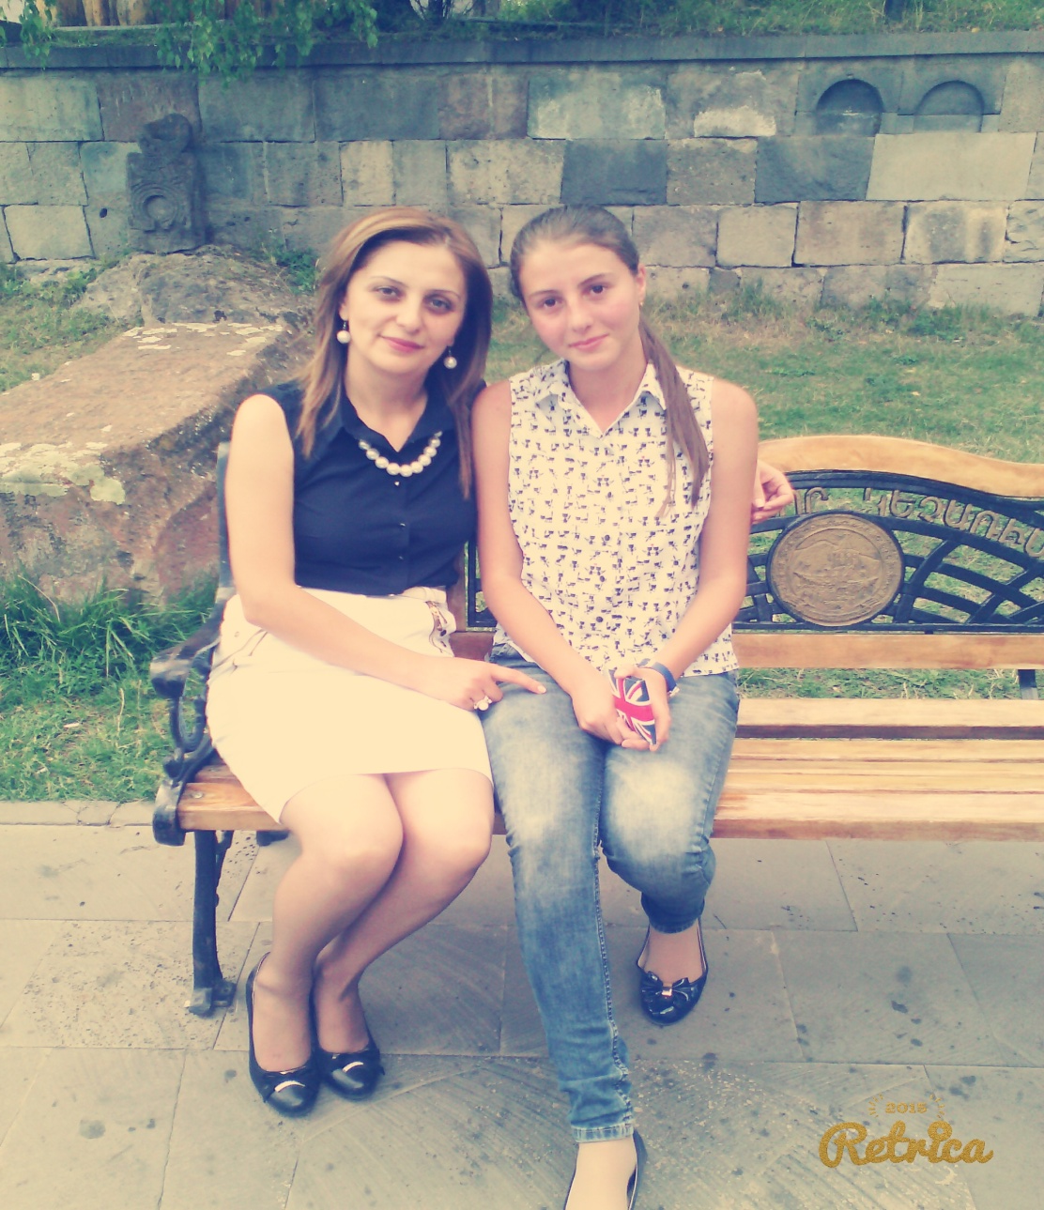
With my teacher

Slide 31
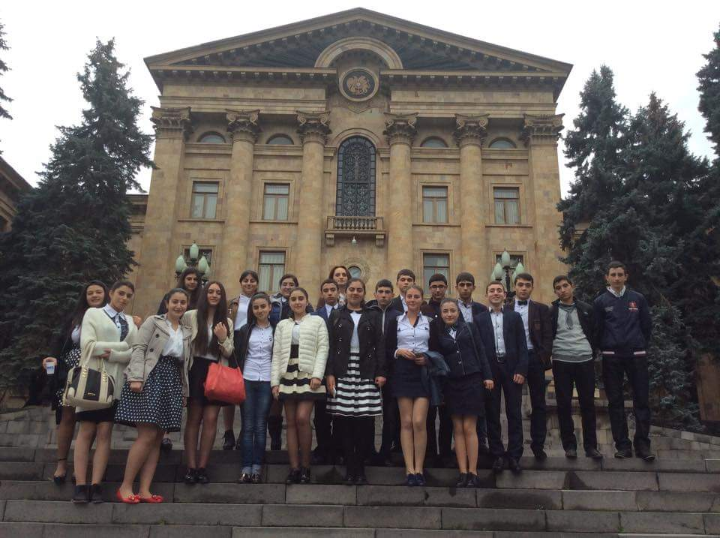
National Assembly of the Republic of Armenia

Slide 32
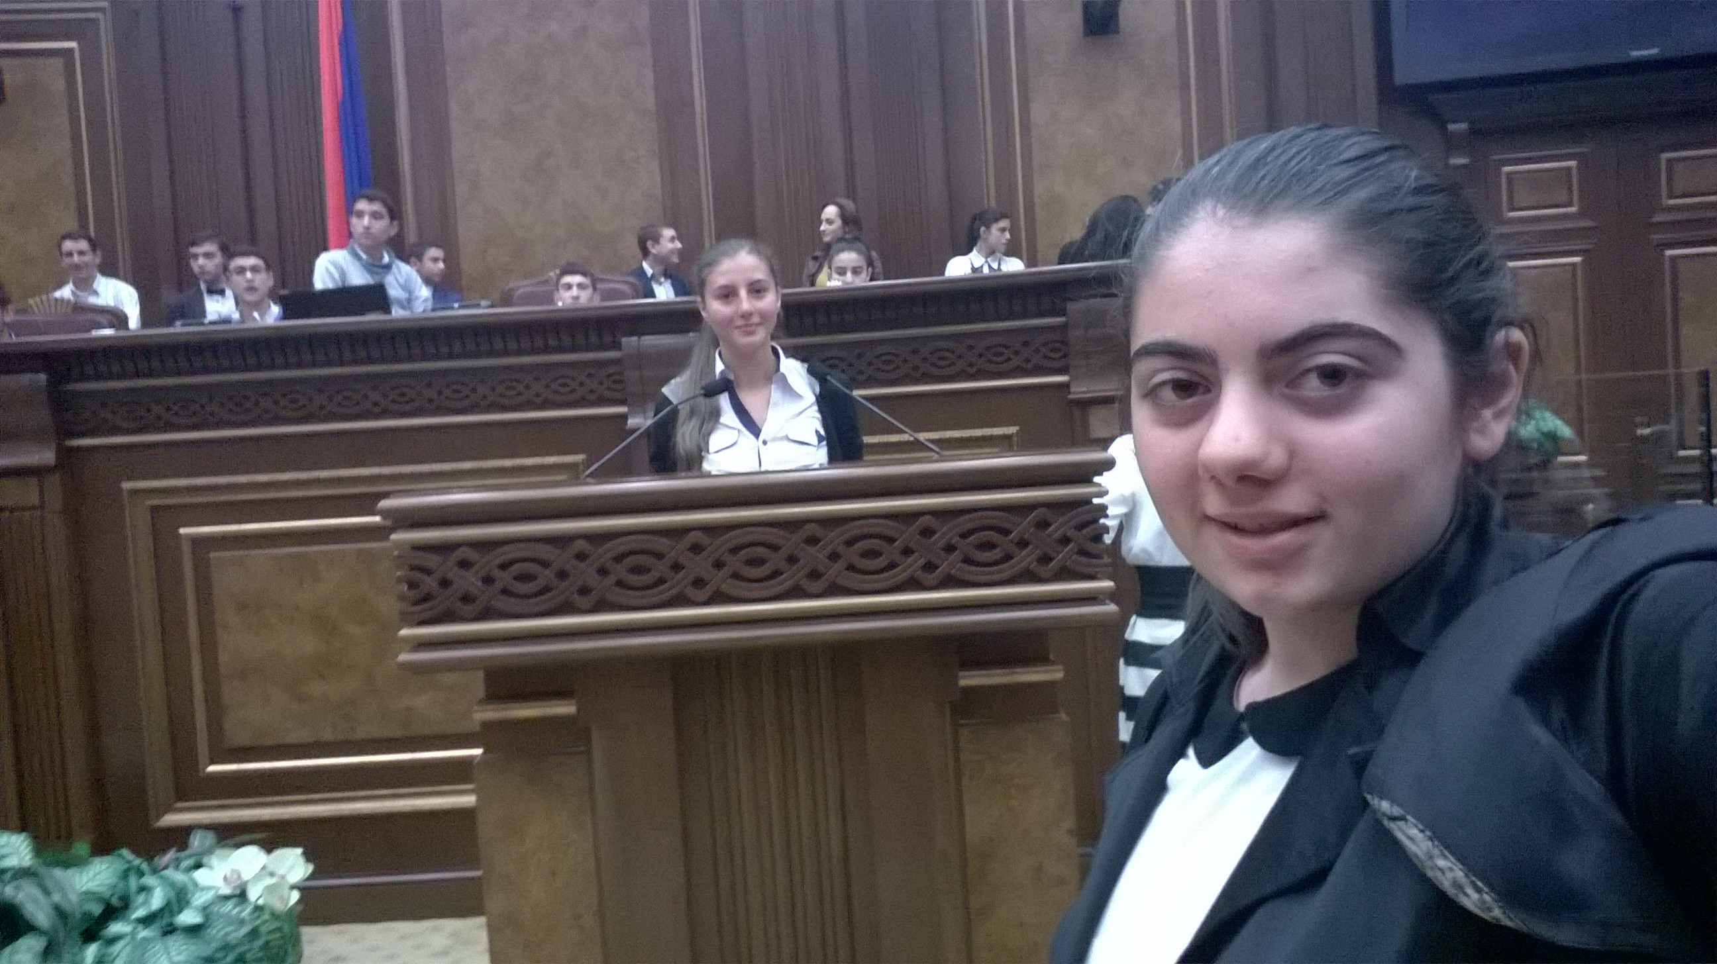

Slide 33
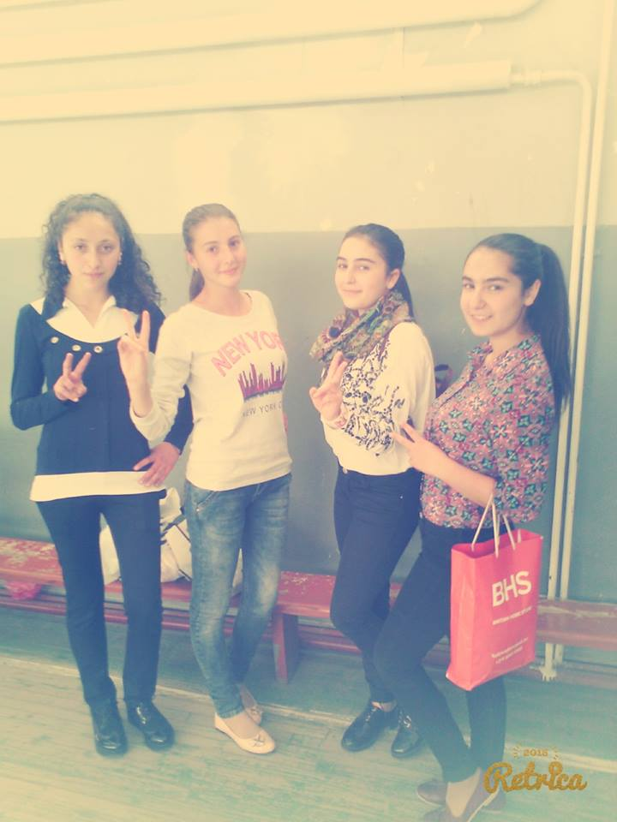
With my friends

Slide 34
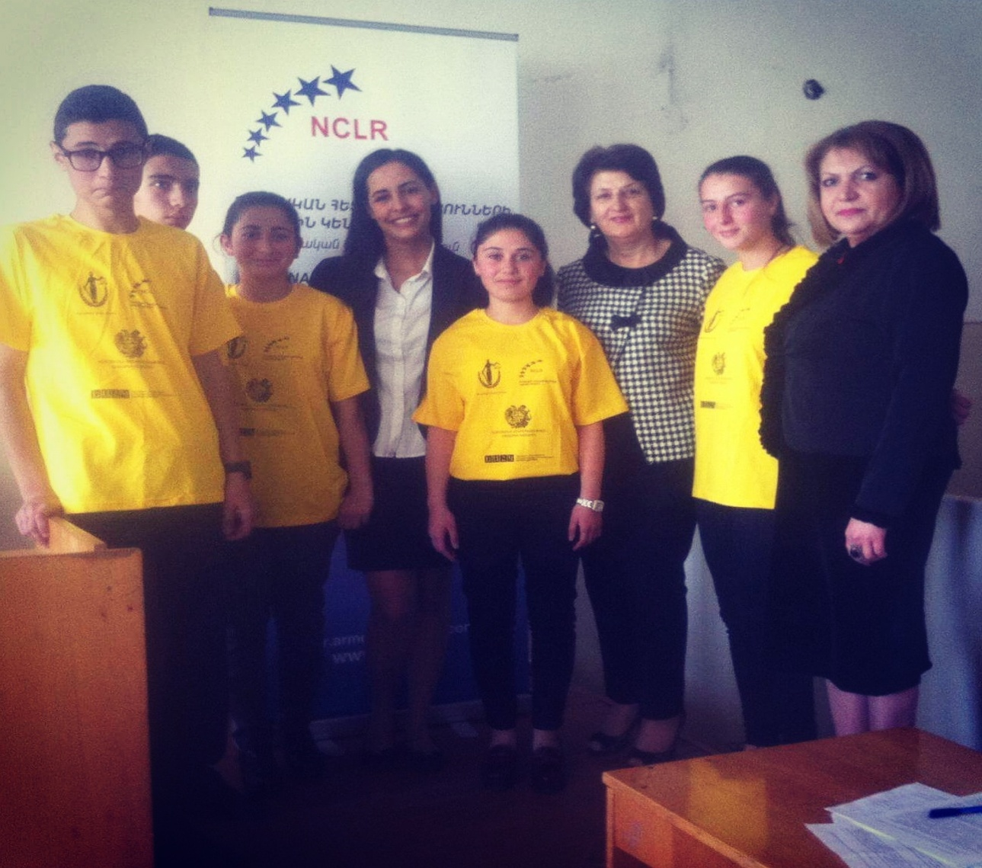
Judicial game

Slide 35
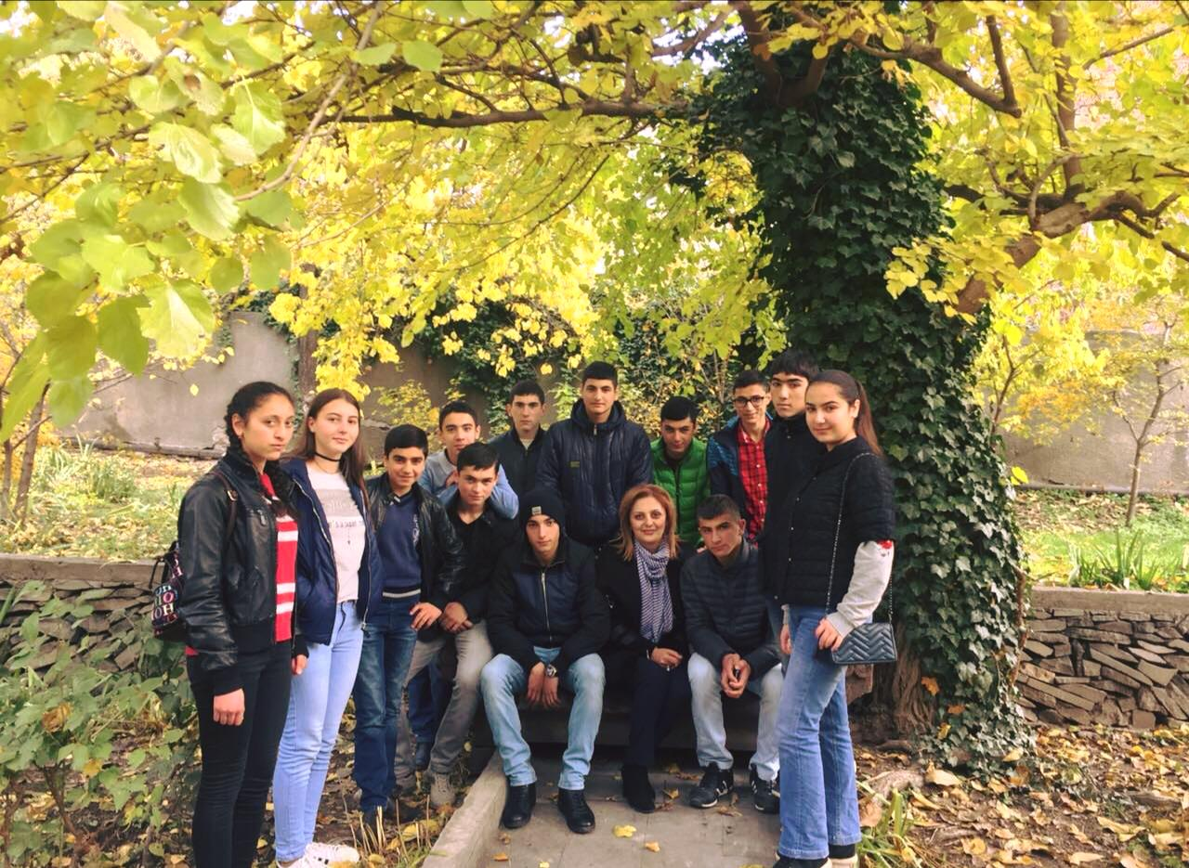

Slide 36
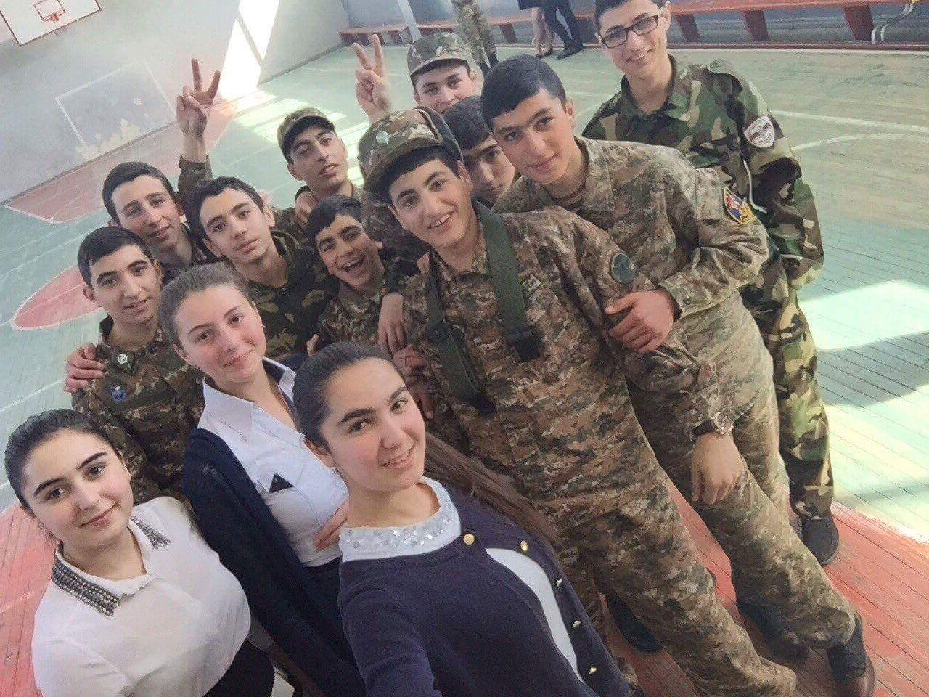
A day dedicated to the Armenian Army

Slide 37
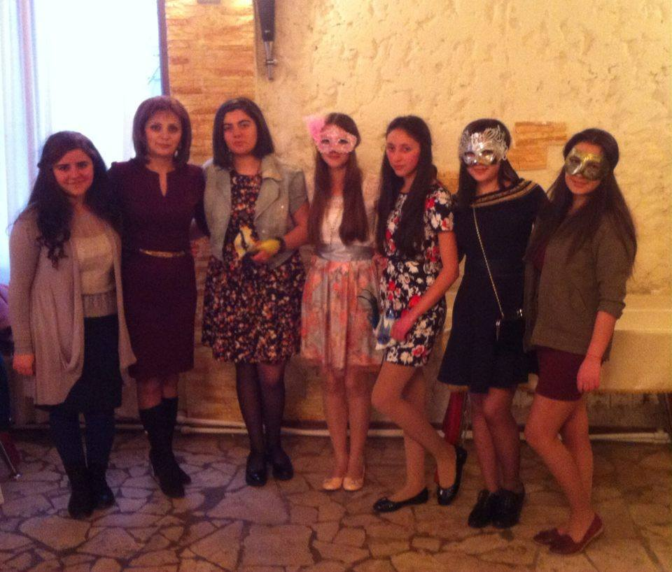
This is our class masquerade

Slide 38
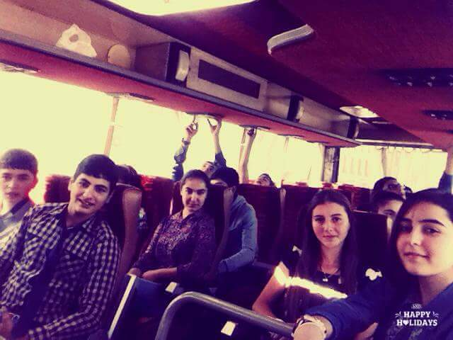

Slide 39
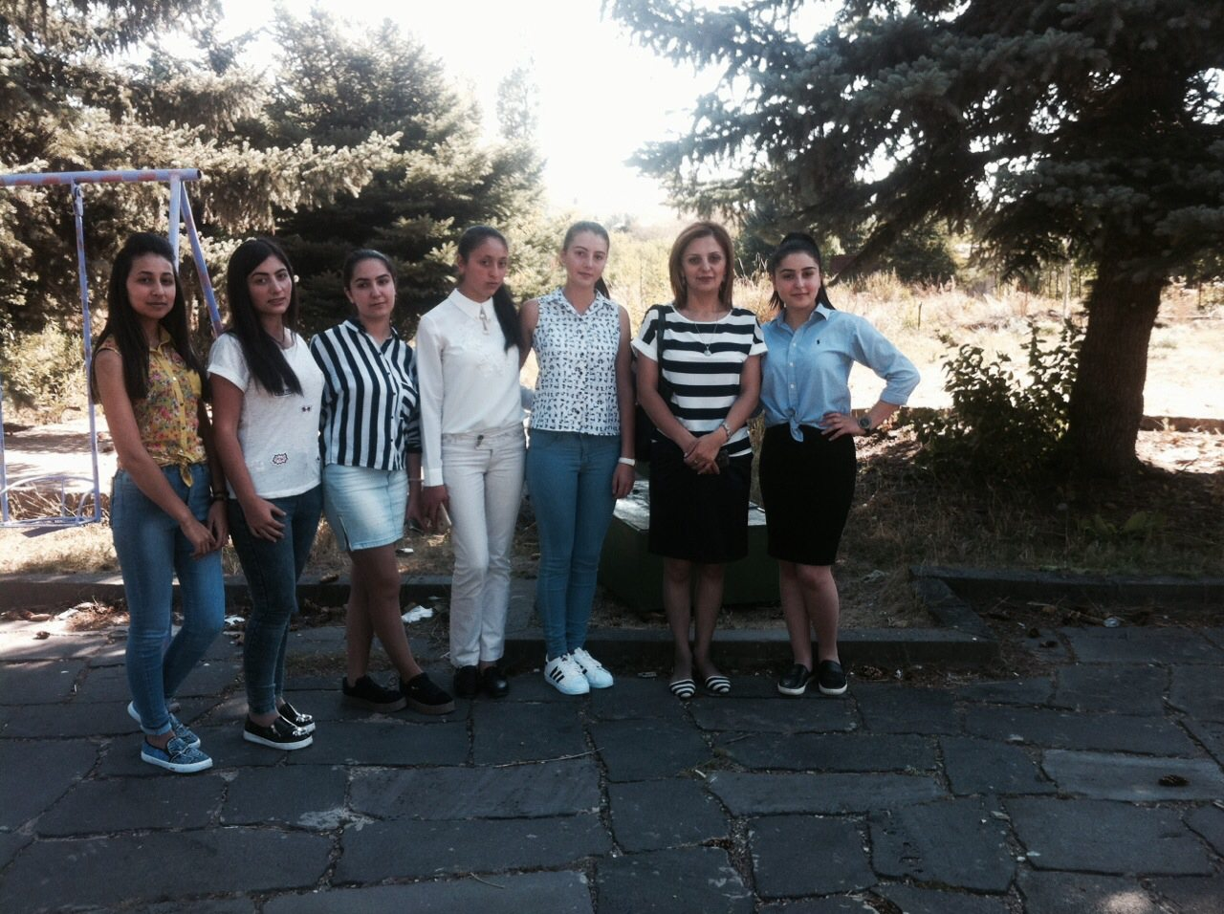

Slide 40
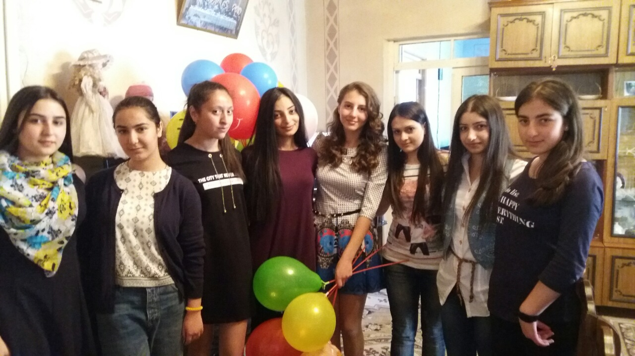
My birthday with my friends

