Slide 1
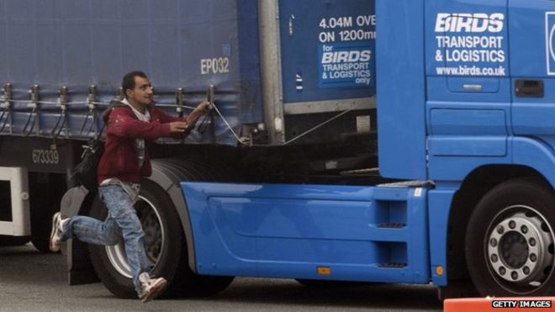
THE MIGRANT AND REFUGEE CRISIS

Slide 2
Learning Objectives
To learn about the migrant and refugee crisis affecting Europe and the UK
To consider arguments for and against migrants and refugees being allowed to stay in the UK
To decide whether migrants and refugees should be allowed to stay

Slide 3
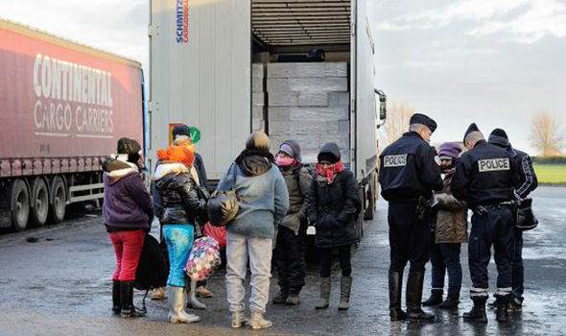
The Migrant Crisis
Hundreds of migrants have drowned in the Mediterranean this year, amid a surge in overcrowded boats heading for Europe from Libya.
The flow of desperate migrants from North Africa hoping to reach Europe is already much higher than in the same period last year.
Italy and Greece are on the frontline and have urged their EU partners to do more to help.
Over the holidays I am sure you have heard about the migrant crisis and may have even been disrupted on your holiday if you have used the Channel Tunnel or a ferry to Calais in France. What do you think should be done about the crisis? Should the migrants and refugees be allowed into the UK?

Slide 4
My understanding at the start of the lesson
POOR
SATISFACTORY
EXCELLENT
In your books mark your understanding of the migrant and refugee crisis at the start of the lesson

Slide 5
CLASS VOTE AT THE START OF THE LESSON: Should the migrants and refugees be allowed into the UK?
YES: | NO:

Slide 6
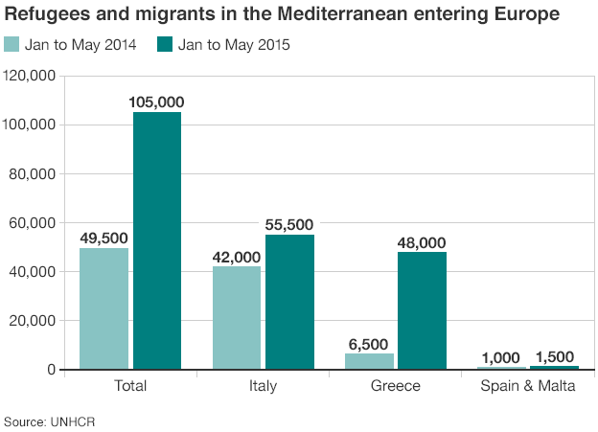

Slide 7
Calais
The port of Calais has been overwhelmed with migrants and refugees trying to get to the UK
Many migrants and refugees have broken into the channel tunnel and jumped on trains to get to the UK
Migrants and refugees have also hidden inside lorries to try to get to the UK
This has led to huge problems at the port
The area where many migrants live in Calais whilst trying to get to the UK is called ‘The Jungle’
BBC NEWS REPORT
BBC NEWS REPORT 2

Slide 8
Migrants or Refugees?
Migrants are usually described as people from poorer countries who want to come to the UK for a better life and standard of living
Refugees are fleeing wars and want to come to countries like the UK so they and their families are safe.
Can you think of any countries where migrants and refugees are coming from?

Slide 9
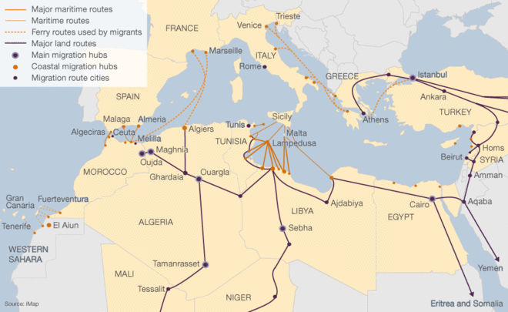

Slide 10
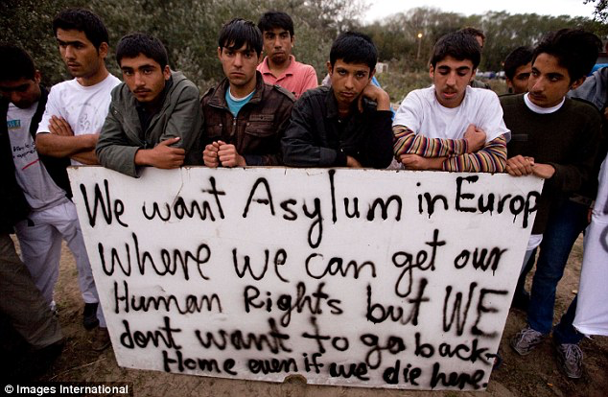
Migrant and Refugee Deaths
Sadly, many migrants and refugees have died trying to escape their country
Thousands have died making the journey across the Mediterranean from North Africa to Greece or Italy
Some have died whilst trying to jump on channel tunnel trains whilst trying to get to the UK

Slide 11
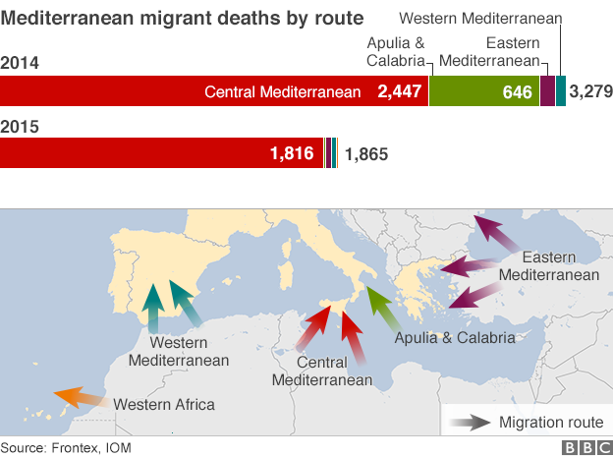

Slide 12
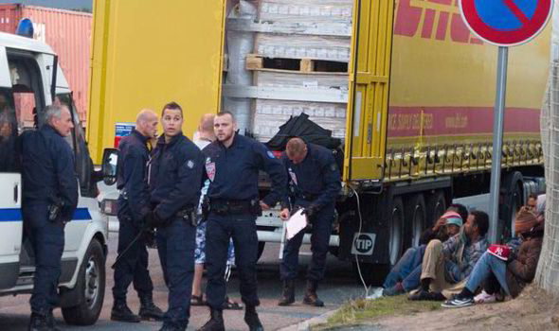
Asylum Status
Refugees who get to European countries like the UK can apply for asylum status
This means they are legally allowed to live in the UK because their own country is unsafe or because their lives are threatened in their own country
In 2014 Germany and Sweden granted the most asylum applications

Slide 13
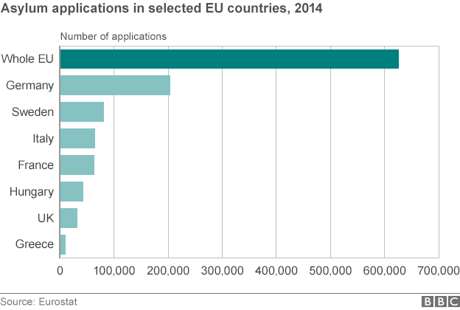

Slide 14
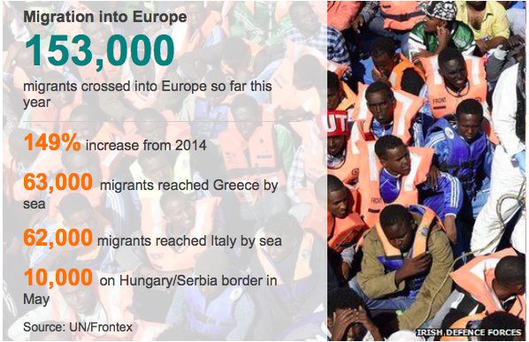

Slide 15
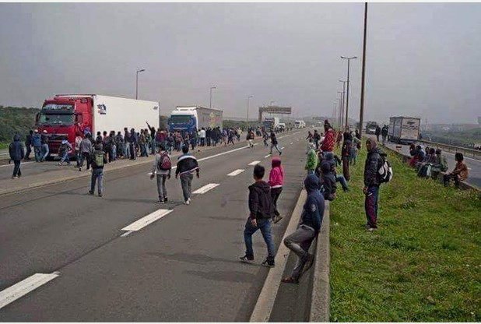
Arguments for and against allowing the migrants and refugees into the UK
On the next slide you will see arguments for and against allowing the migrants and refugees into the UK
Can you sort the statements into arguments for and arguments against?

Slide 16
Arguments for and against allowing the migrants and refugees into the UK:
They just want to scrounge on benefits and use our welfare state (for example, the NHS) | Many of the migrants and refugees speak English as a second language and would feel more at home in the UK. | Migrants and refugees are breaking laws trying to get to the UK so we should not let them in.
The UK has a proud history and tradition of helping refugees so we should help these people | Many migrants and refugees want to work to help their families-they could help the UK economy grow. | They should claim asylum in France.
If they stay in their own country they could be killed. | The UK is full up-we cannot take any more migrants or refugees. | If I was in their position I would do exactly the same to get a better life for my family.
If we let these migrants and refugees in then more and more will come. | If we let the migrants and refugees in then the port of Calais could get back to normal. | The UK should do more-Germany has given asylum status to many more refugees.
EXTENSION: Add to the statements with your own ideas!

Slide 17
My understanding during the middle of the lesson
POOR
SATISFACTORY
EXCELLENT
In your books mark your understanding of the migrant and refugee crisis during the middle of the lesson

Slide 18
CLASS VOTE DURING THE MIDDLE OF THE LESSON: Should the migrants and refugees be allowed into the UK?
YES: | NO:
Has your opinion changed? If so, why?

Slide 19
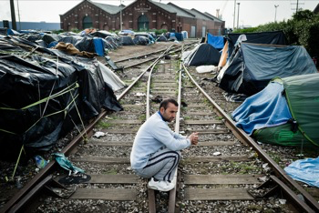
Task
A meeting has been called by British government to address the migrant crisis
In groups you will represent one of the groups on the next slide
You will need to prepare a speech to give at the meeting to represent the views of the group you are allocated by your teacher

Slide 20
GROUP 1: A group of migrants wanting to come to the UK from Mali: Why do they want to come to the UK? What would they say about claims they just want to claim benefits? | GROUP 2: A group of refugees wanting to come to the UK from Syria: Why do they want to come to the UK? What would getting asylum mean to them? What language do they speak? | GROUP 3: Calais residents who are fed up with the problem: What problems might they be experiencing? Whose problem might they view the migrants as? What might they say about ‘the Jungle’?
GROUP 4: A group of British citizens in favour of migration: What reasons might they use to justify allowing the migrants/refugees into the UK How might they criticise the opposite view? | GROUP 5: A group of British citizens against allowing the migrants and refugees to stay: What reasons might they use to justify not allowing the migrants and refugees to stay? How might they criticise the opposite view? | GROUP 6: A British politician trying to stop migration-for example from UKIP Why are they against migrants and refugees? What arguments might they use? How might they criticise the opposite view?

Slide 21
Should the migrants and refugees be allowed access to the UK?
I think the migrants and refugees should/shouldn’t be allowed into the UK because …
Some people disagree with my view because … I think they are wrong because …
My most important reason for my view is… because …
In conclusion .. I think
SUCCESS CRITERIA:
Clearly answers the question
Explains arguments for and against allowing the migrants and refugees to come to the UK
Uses information from today’s lesson
Include a clear conclusion and most important reason
Spelling and grammar
Extension: Self assess your answer-make sure you include x2 WWW and x1 IOTI
Extension: Peer assess another answer-make sure you include x2 WWW and x1 IOTI and include your name in their book

Slide 22
CLASS VOTE AT THE END OF THE LESSON: Should the migrants and refugees be allowed into the UK?
YES: | NO:
Has your opinion changed? If so, why?

Slide 23
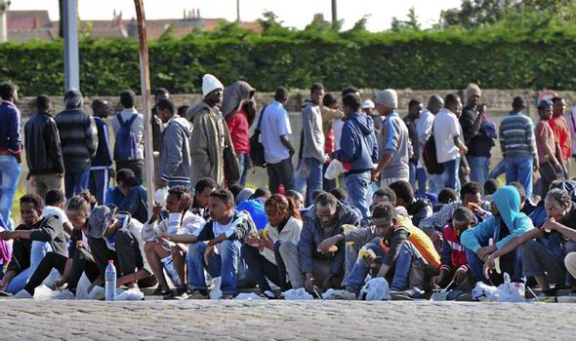
TRUE OR FALSE?
A migrant describes a person from another country who may want to come to a country like Britain to work
TRUE

Slide 24
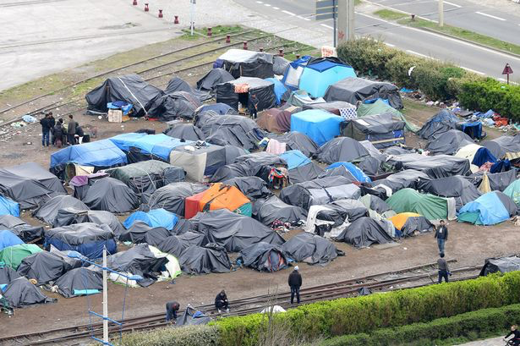
TRUE OR FALSE?
A refugee is a person who wants to travel to a safe country like the UK because they are fleeing a war, for example in Syria
TRUE

Slide 25
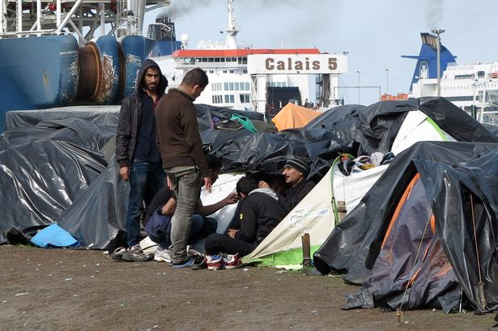
TRUE OR FALSE?
The main port where migrants and refugees are trying to get into the UK is Santander in Spain
FALSE

Slide 26
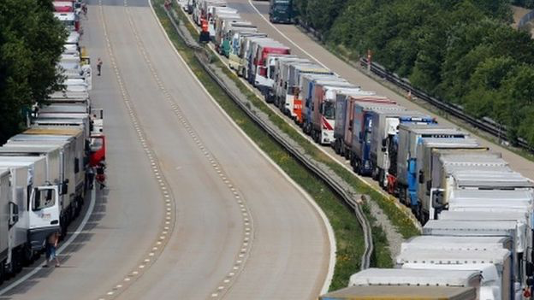
TRUE OR FALSE?
There have been huge tail backs of lorries on motorways on British roads leading to Calais
TRUE

Slide 27
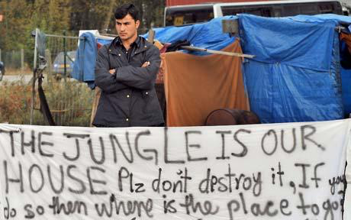
TRUE OR FALSE?
The area in Calais where many of the migrants and refugees live whilst trying to get to the UK is called ‘the Jungle’
TRUE

Slide 28
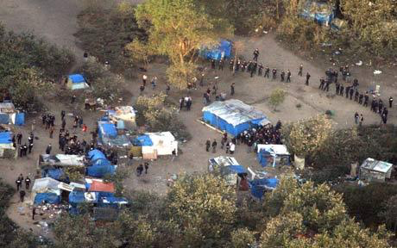
TRUE OR FALSE?
One migrant walked the length of the channel tunnel before being stopped in the UK
TRUE

Slide 29
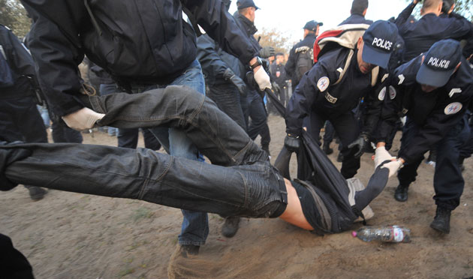
TRUE OR FALSE?
Britain has granted the most asylum applications over the last few years out of all the European countries-this means the refugees are allowed to stay legally in the country they come to
FALSE

Slide 30
TRUE OR FALSE?
Prime Minister David Cameron has pledged more security guards and sniffer dogs to solve the problem
TRUE

Slide 31
TRUE OR FALSE?
Many of the refugees are coming from Syria where ISIS are currently fighting a war against the Syrian government
TRUE

Slide 32
TRUE OR FALSE?
The number of migrants coming into Europe has increased by 149% since 2014
TRUE

Slide 33
My understanding at the end of the lesson
POOR
SATISFACTORY
EXCELLENT
In your books mark your understanding of the migrant and refugee crisis at the end of the lesson

