Slide 1
Romanian Revolution of 1989

Slide 2
The Romanian Revolution of 1989 was a week-long series of violent riots and fighting in Romania. It took place in late December of 1989. The fighting began to end Nicolae Ceauşescu's control of the Communist state.
In 1989, similar revolutions ended Communist governments in other countries in Eastern Europe. Revolutions in Czechoslovakia, Poland, and Albania were peaceful, but in Romania, the revolution was violent and led to the deaths of many, including Ceausescu.

Slide 3
Background
In 1981, Ceaușescu began an austerity programme designed to enable Romania to liquidate its entire national debt ($10,000,000,000). To achieve this, many basic goods—including gas, heating and food—were rationed, which drastically reduced the standard of living and increased malnutrition.
The secret police, Securitate, had become so omnipresent that it made Romania essentially a police state. Free speech was limited and opinions that did not favour the Romanian Communist Party (PCR) were forbidden.

Slide 4
The austerity programme started in 1981 and the widespread poverty it introduced made the Communist regime very unpopular. The austerity programmes were met with little resistance among Romanians and there were only a few strikes and labour disputes, of which the Jiu Valley miners' strike of 1977 and the Brașov Rebellion of November 1987 at the truck manufacturer Steagul Roșu were the most notable. In March 1989, several leading activists of the PCR criticised Ceaușescu's economic policies in a letter, but shortly thereafter he achieved a significant political victory: Romania paid off its external debt of about US$11,000,000,000 several months before the time that even the Romanian dictator expected. However, in the months following the austerity programme, shortages of goods remained the same as before.

Slide 5
The first victims of the Bucharest Revolution were registered in Piața Universității.
Sibiu is the city where the most victims were registered during the Revolution, apart from Bucharest.

Slide 6
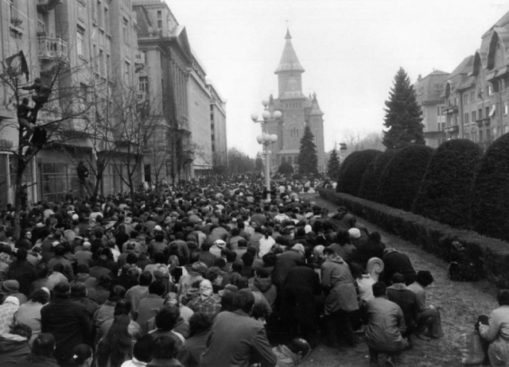
The Romanian 1989 Revolution started in Timișoara
Timisoara was proclaimed the first Romanian city free of communism.

Slide 7
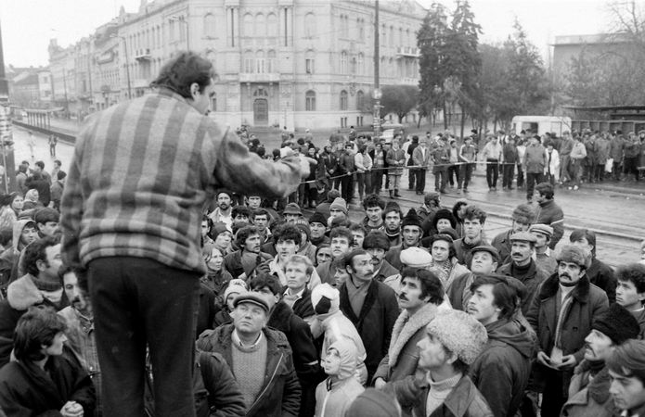
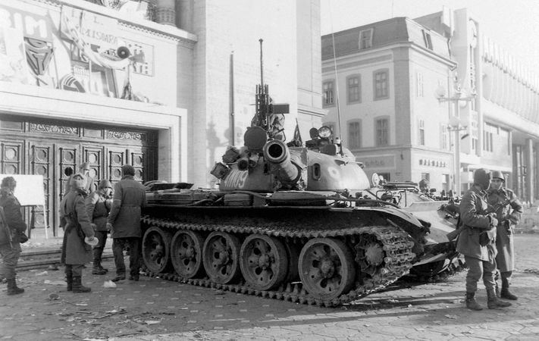

Slide 8
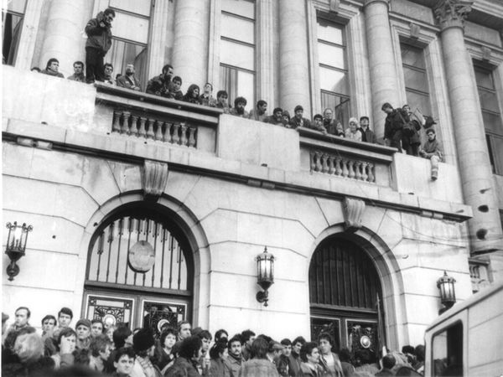
The balcony where Ceaușescu delivered his last speech, overtaken by the crowd during the Romanian Revolution of 1989.

Slide 9
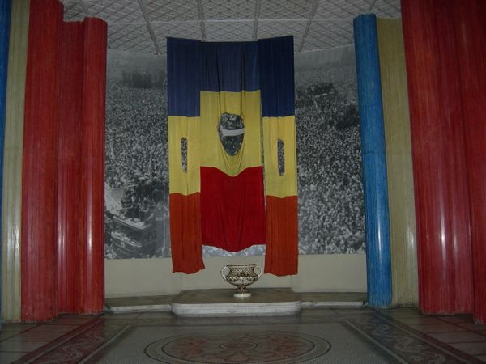
"Empty" Romanian flags, from an exhibit at the Military Museum, Bucharest

Slide 10
The year 1989 marked the end of communist regimes in Central and Eastern Europe, with Romania being the only European country where the switch from totalitarianism to democracy was made though violence and bloodshed and where the head of the communist regime was executed.

Slide 11
Thank you!

