Slide 1
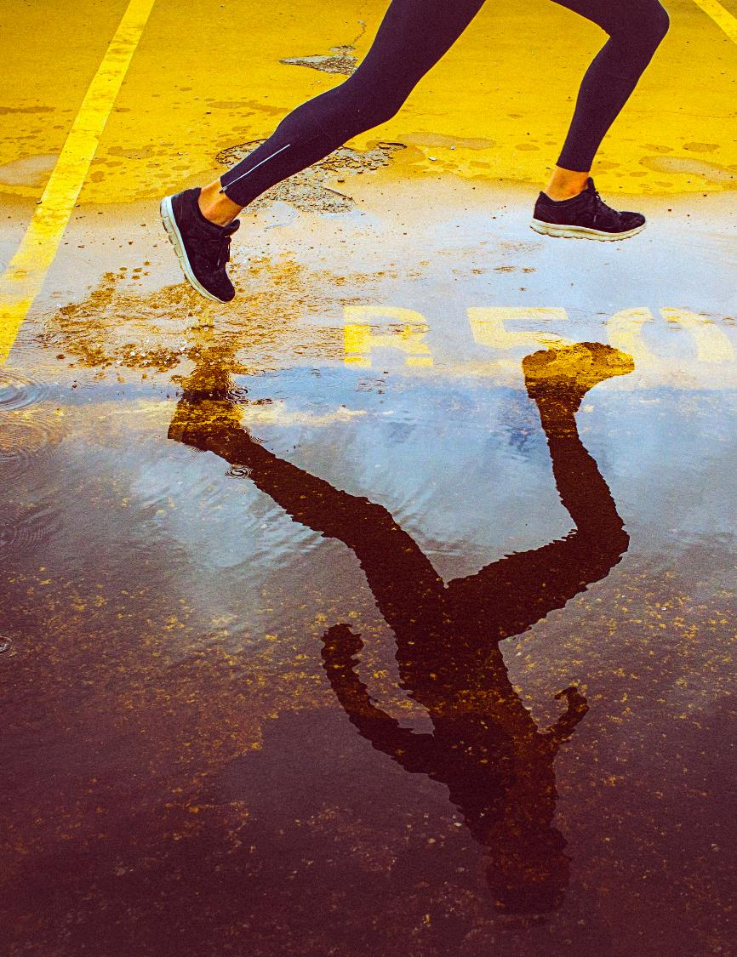
MIGRATION Interview with Mr. Yavor Bonev Junior Police Inspector in the Sofia Directorate of the Interior, Migration Department
The project „Research, Discuss, Grow: Becoming Citizens“
№2020-1-HR01-KA229-077823_4

Slide 2
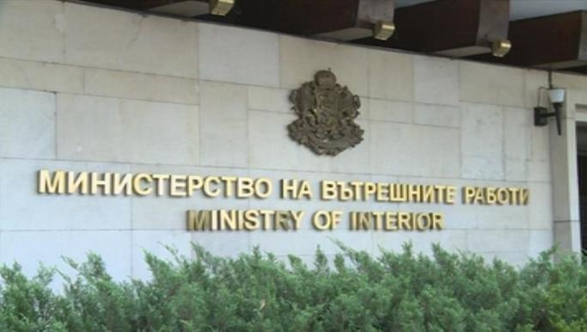
Migration Directorate
The Migration Directorate is a national specialized structure of the Ministry of Interior for regulation and control of the migration processes of foreigners residing in the Republic of Bulgaria and for administrative services to the citizens of the European Union, the citizens of countries - parties to the Agreement on the European Economic Area, the citizens of the Confederation. Switzerland, as well as the members of their families, according to the Law on the entry, residence and departure of the Republic of Bulgaria of the citizens of the European Union and the members of their families.

Slide 3
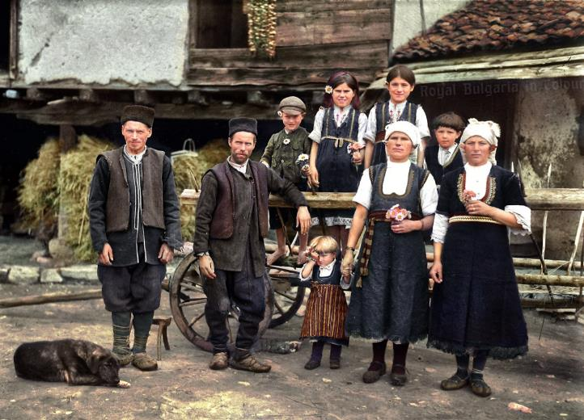
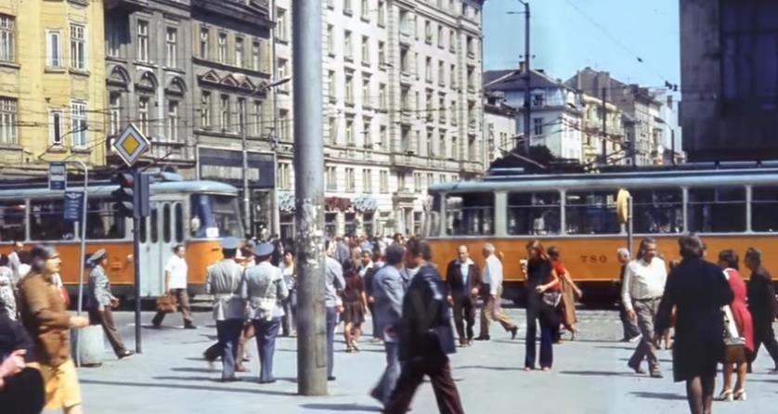
Migration from the village to the city
After the forced collectivization in the villages, farmers remain without land and food. Part of the villagers remain in their villages, while they work in а co-operative farm. A big part of the residents move to cities, where the accelerating industrialization needs labor. The people began to migrate to the big cities, where factories and plants began to be built, as well as large residential complexes.
The needs of younger people for education and realization increased and this was one of the reasons to go to bigger cities.
In the 70s in order to unite agricultural production, the state creates the so-called agro-industrial complexes (AIC)

Slide 4
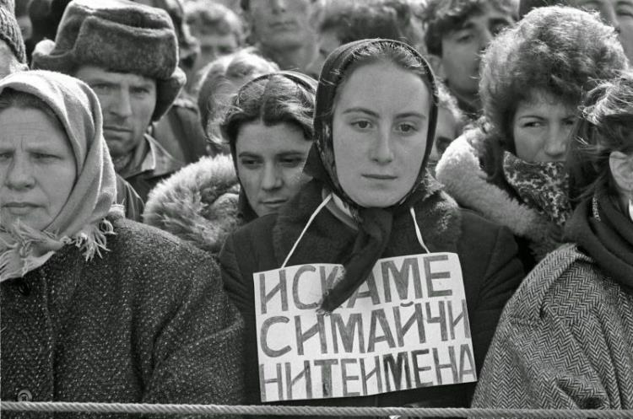
"Revival process" -1984/1989
The revival process was an attempt by the Bulgarian Communist Party to impose the forced assimilation of the Muslim population (Turks, Pomaks and Roma).
This was the name by which the process of systemic repression against these social groups and ethnic groups is known in society. The revival process began in the early 1970s and lasted until the late 1980s.
Measures to implement this policy include forcibly changing Arabic-Turkish names to Bulgarian, restricting the use of the mother tongue by members of these groups, forcibly restricting their traditional customs and rituals, and professing their religion.
This leads to the migration of the Muslim population to neighboring Turkey

Slide 5
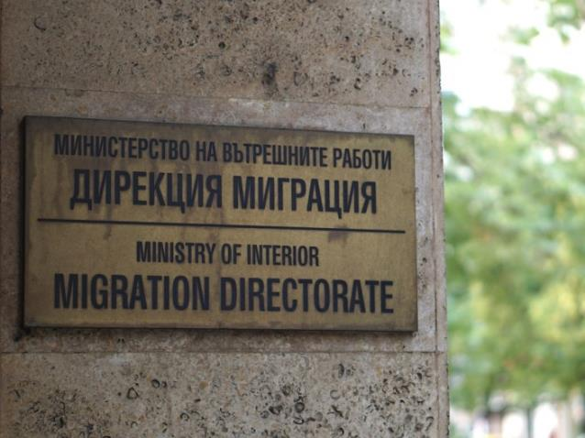
Details of Mr. Bonev's work
The Migration Directorate was established in 2004.
It controls the residence of citizens from so-called third countries.
In recent years, Mr. Bonev has been dealing with the control related to illegal immigrants residing in our country.

Slide 6
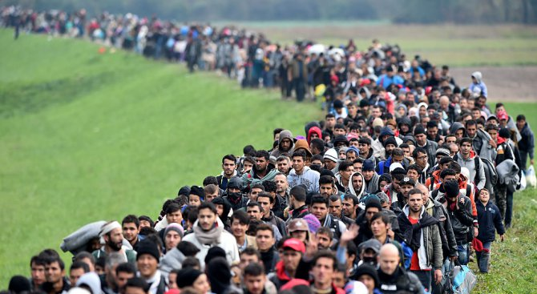
Where do most of migrants in Bulgaria come from?
Illegal immigrants come from the Middle East, Iraq, Afghanistan and Syria.
As legal emigrants in Bulgaria live people from countries close to us such as Serbia, Macedonia, Russia.
People from Brazil, Chile and Venezuela are seeking asylum.

Slide 7
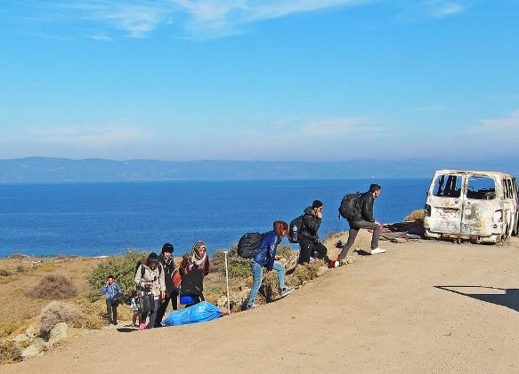
What is their age group?
Mostly men migrate.
As legal and illegal emigrants, young people predominate, who are looking for a change in their lifestyle and better financial realization.
A small part are families with small children.

Slide 8
Why do people migrate?
They are looking for a better economic life.
Military action in their own countries.
They need a good social life.

Slide 9
Why do migrants not stay in Bulgaria?
Bulgaria does not have the financial resources for their integration.
They do not receive social benefits from our country.
Only food is provided in the refugee centers.
They transit through our country because we are in a key position in the transition from one country to another.

Slide 10
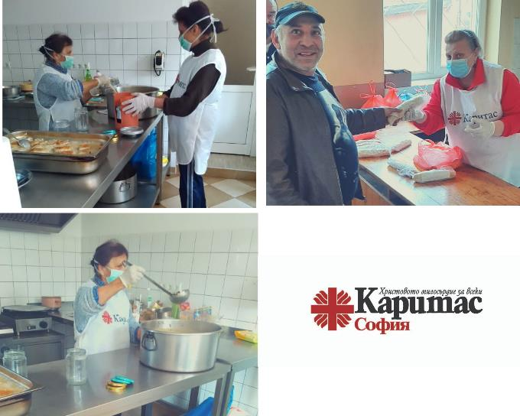
What is Bulgaria's policy towards migration and those who remain?
There is an International Organization for Migration in Bulgaria, which provides minimal assistance from European funds. Our policy is to return to their country of origin.
Caritas Sofia is the largest charity with a center for the integration of refugees and migrants in Sofia. They help migrants receive legal assistance during their stay. They provide food and housing for a short time.

Slide 11
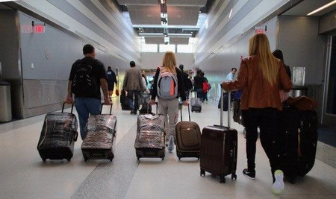
Why do Bulgarians leave the country?
Mostly young people emigrate, looking for better career development, high social benefits, financial security, a calmer life.
Upon completion of higher education in Bulgaria, in order to hire an employee, professional experience is required, which cannot be acquired during the training. Abroad, they are immediately given a chance to work.

Slide 12
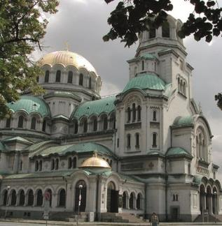
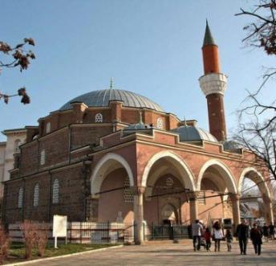
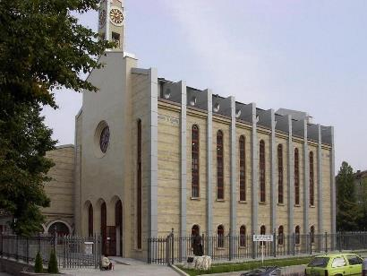
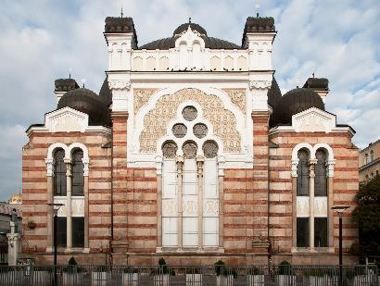
Bulgaria's policy towards migrants
Bulgaria is part of the European Union and complies with the Law on the Entry, Residence and Departure of the Republic of Bulgaria of Citizens of the European Union and Members of Their Families.
Bulgaria is a country that has always been tolerant of all cultures and religions.
Sofia is the only capital in the world where an Orthodox and a Catholic church, a mosque and a synagogue stand close together.
Orthodox Church
Mosque
Catholic church
Synagogue

Slide 13
Thank you for your attention
Presented by Bulgarian students

