Slide 1
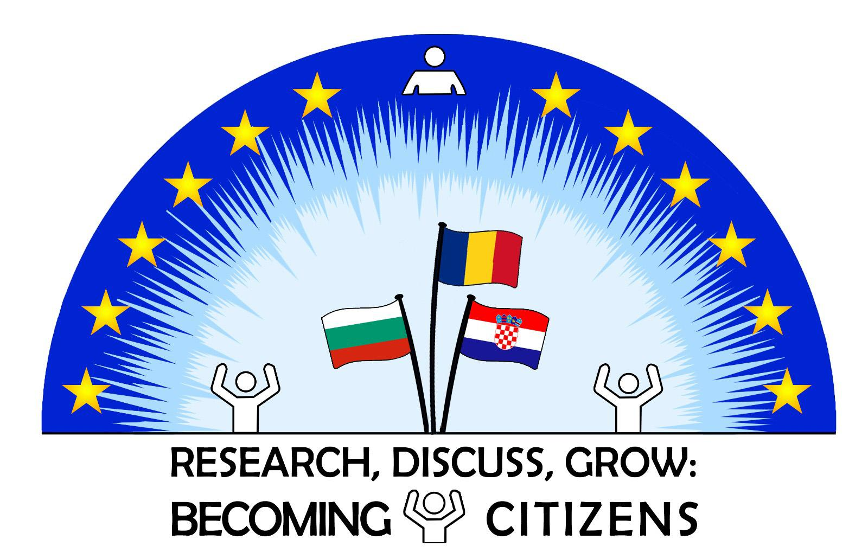
Dads can do anything

Slide 2
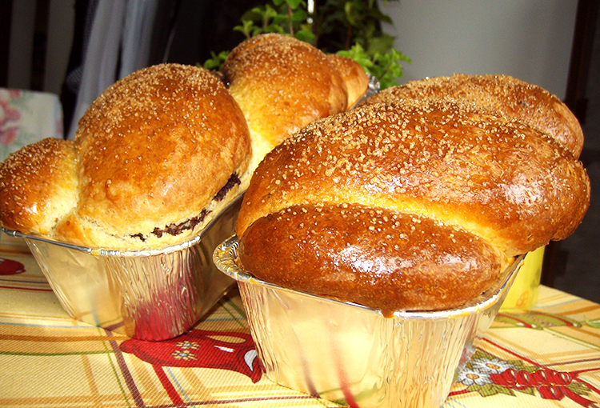
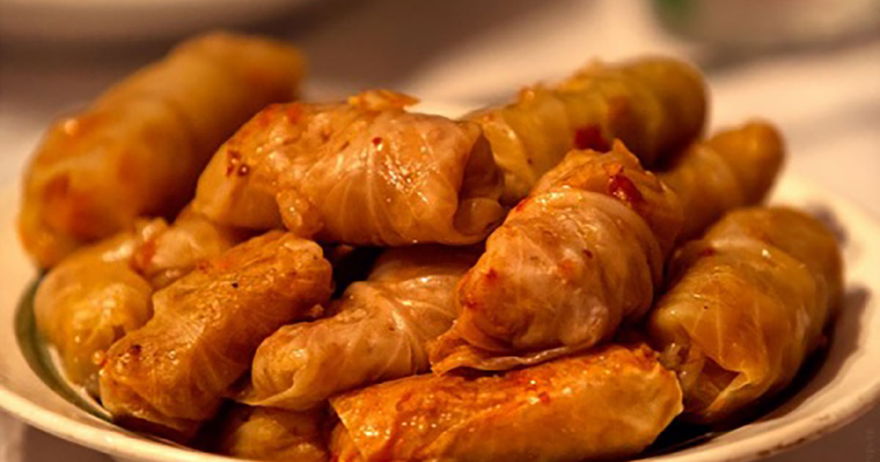
Cooking
My dad likes to cook. His food is very delicious. My dad sometimes helps my mother with doing the dishes, too. They like to cook together sarmale, this is a traditional Romanian food and we like to eat sarmale for Christmas. My dad is the one who makes cozonac because my mum cannot make them. We eat cozonac for Easter.
My both parents are working and they are dividing the house chores according to their working hours.

Slide 3
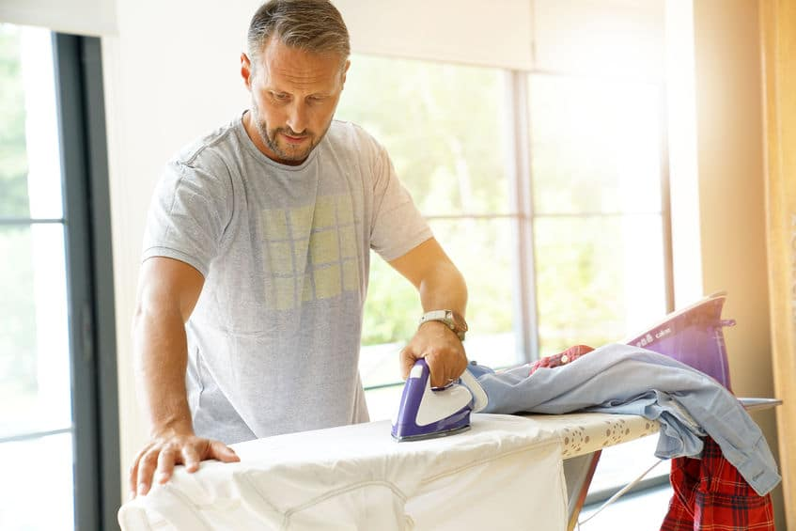
Ironing
My father is the one who irons our clothes because my mother does not like to do it. My father is more patient and he seems to enjoy doing the ironing.

Slide 4
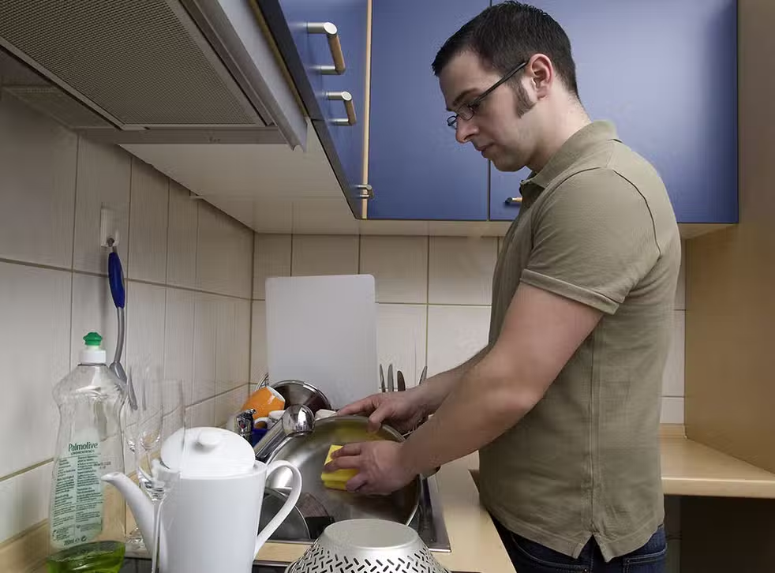
Doing the dishes
We have a timetable for doing the dishes. My mother is the one who cooks and we (my father, my brother and I) help her. However, we all take turns to do the dishes because my mother think we should all contribute when it comes to chores.
My father sings while doing the dishes, this is what makes me think he likes to do it.

Slide 5
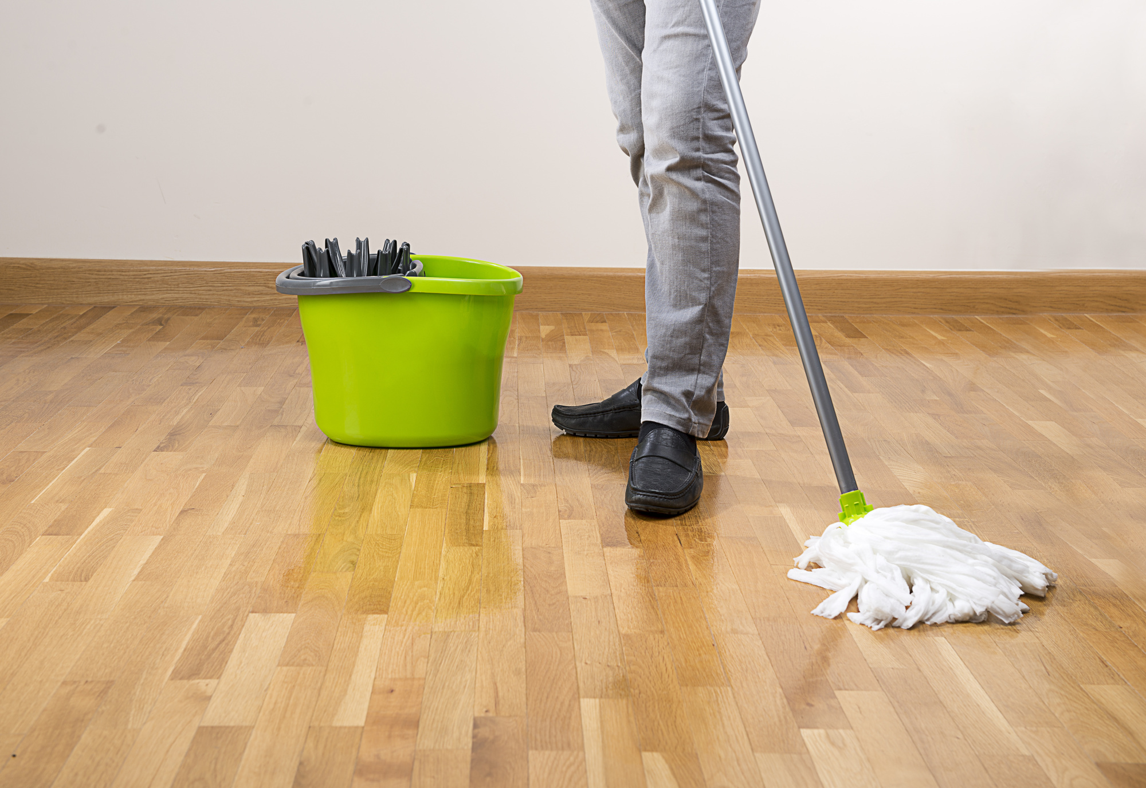
Mop the floor
My father does not really help with chores. He also does not have so much free time because he is working all day, sometimes he works during the night as well. My mum is a housewife and she is at home all day.
From time to time, he helps her and mops the floor.

Slide 6
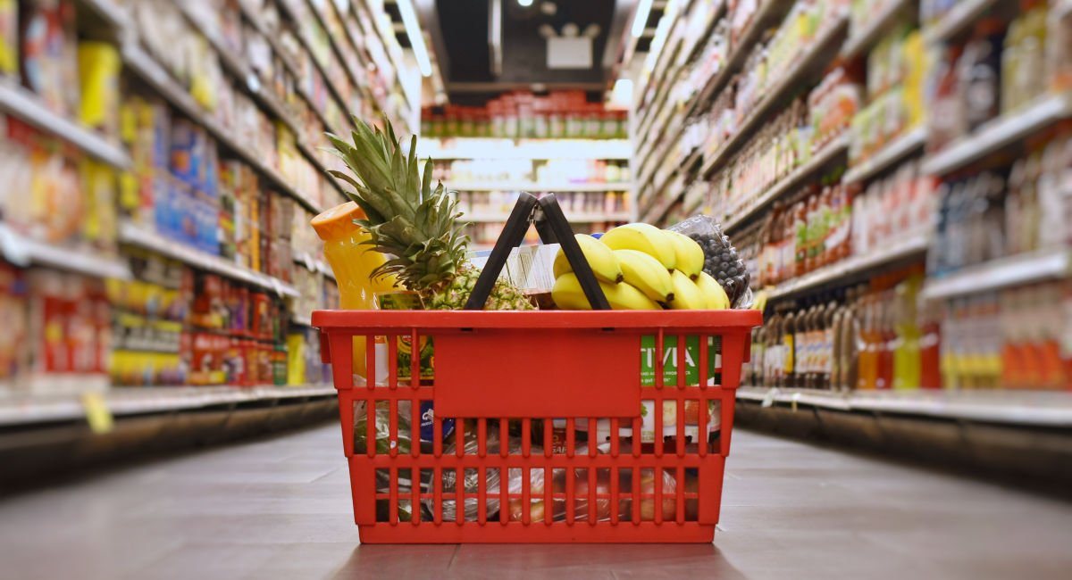
Shopping
My father is the one who does the shopping when it comes to food. My mum makes a list with what he should buy. My father works in the city and there are many supermarkets. On his way home, he stops to buy what is necessary.

Slide 7
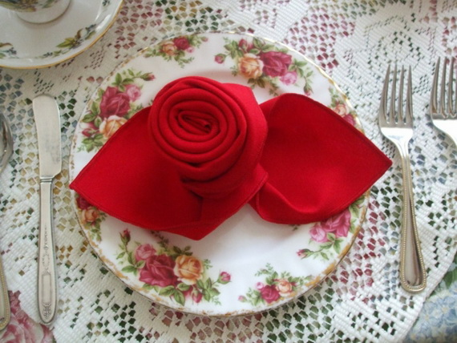
Set the table
My father does not like to cook but he helps my mother in the kitchen. He also sets the table and sometimes does the dishes. When we have guests, he has plenty of elegant setting table ideas. He likes to watch tutorials on youtube to learn how to fold napkins in a creative way. I think he is expert with napkin folding.

Slide 8
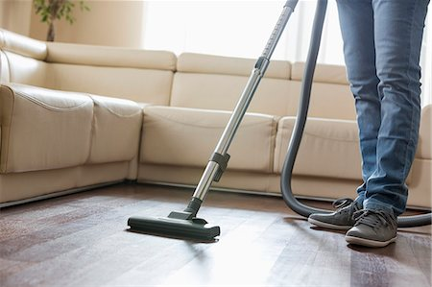
Hoovering
My dad is hoovering the house. He does not cook, but helps when it comes to clean the house.
He like to hoover and to help my mother.

Slide 9
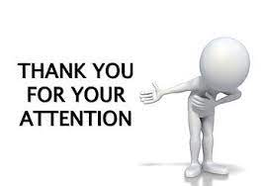
This presentation was done by the students from the 8th grade from Scoala Gimnaziala Romanu.

