Slide 1
Politics in the period from 1960 until now
Hristo Nikolov Zahariev 6th class

Slide 2
The communist regime

Slide 3
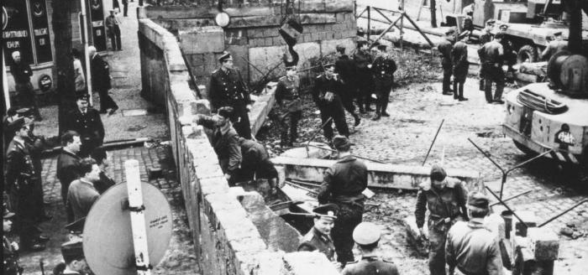
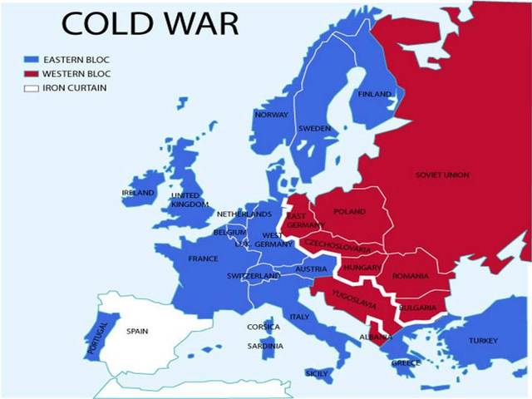
Bulgaria behind the “Iron Curtain”
Since 1944, Bulgaria and 7 other Eastern European countries had fallen into political and economic isolation from the rest of the continent.
The peoples of these countries were forced to be unable to travel freely outside the Eastern bloc and were completely restricted in their human and moral rights.
The symbol of this "iron curtain" was the wall built between East and West Berlin, which divided the German people into two separate states - Germany (Federal Republic of Germany) and the GDR - (German Democratic Republic).

Slide 4
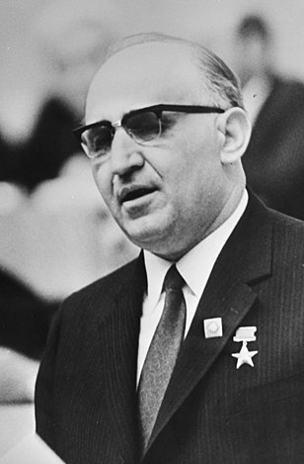
Todor Zhivkov
Todor Zhivkov He was born on September 7, 1911 in the village of Pravets and was the head of the Bulgarian Communist Party and the state from 1954 to 1989.

Slide 5
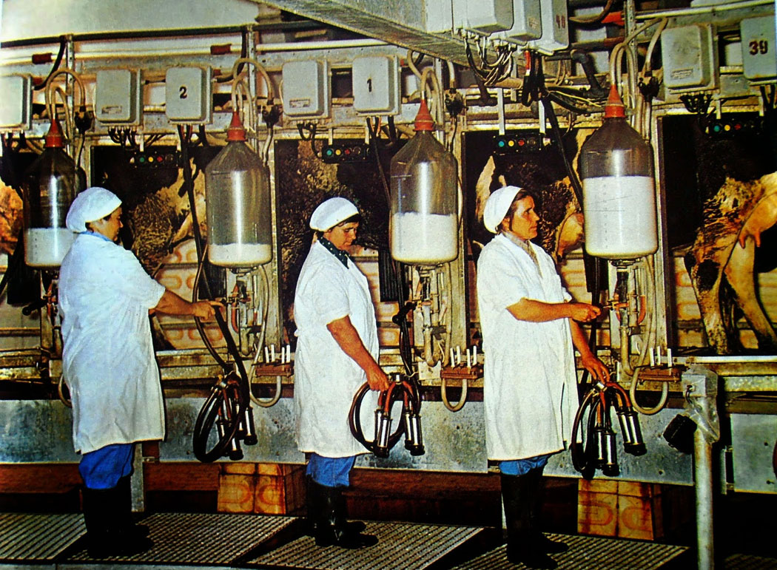
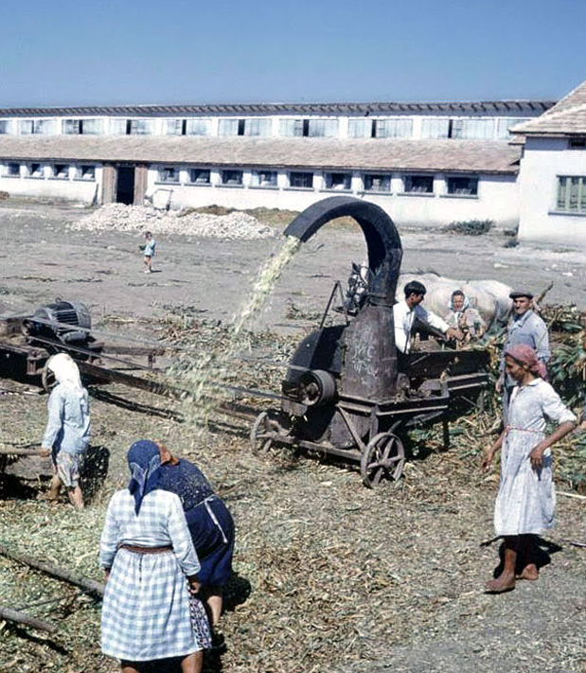
Cooperation in the village - collectivization, cooperative farm (TKZS)
The Labor Cooperative Agricultural Farm (abbreviated TKZS) is an agricultural cooperative in the People's Republic of Bulgaria according to the Soviet model.
The cooperatives were originally set up voluntarily, but the mass collectivization of land often leads to violent measures to socialize the property of many of the rural owners - especially the richest of them.

Slide 6
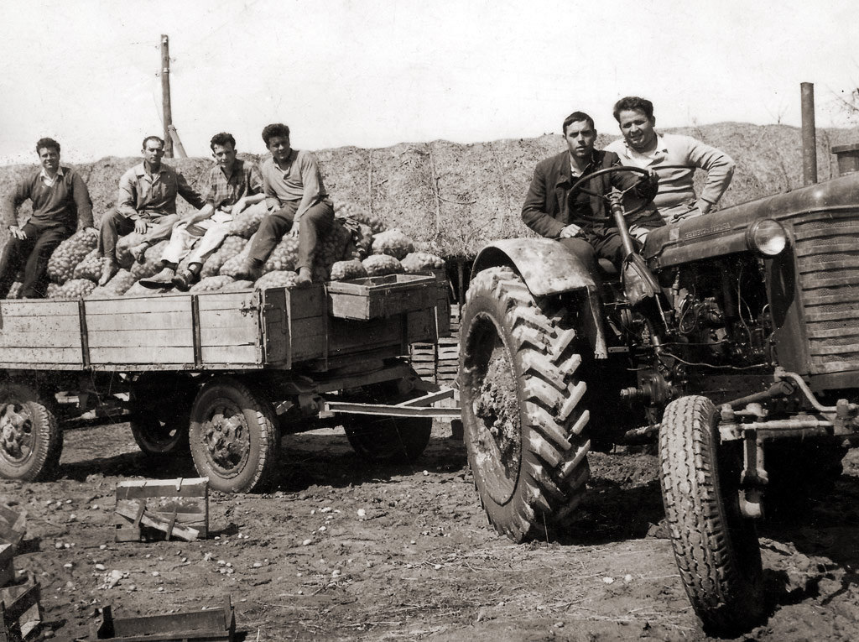
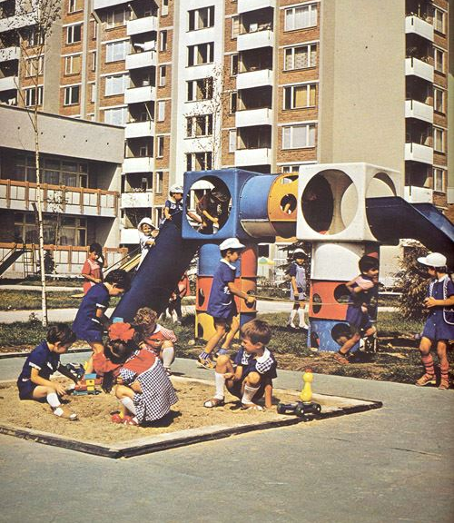
Migration from the village to the city
After the confiscation of private property and the establishment of cooperatives, quite a part of the people began to migrate to the big cities, where factories and plants began to be built, as well as large residential complexes.
The needs of younger people for education and realization increased and this was one of the reasons to go to bigger cities.

Slide 7
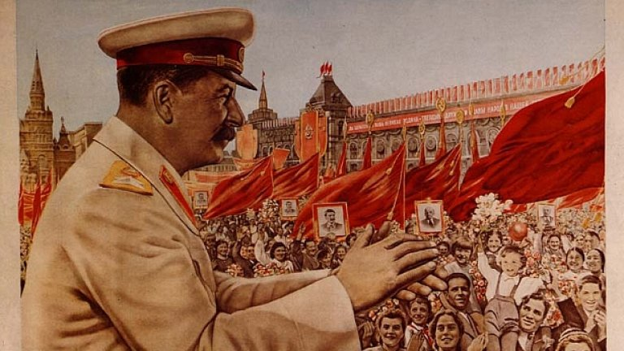
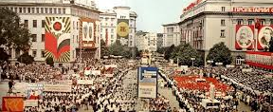
The Soviet model
The introduction of the Soviet model in Bulgaria meant to be introduced and applied violent management methods:
,,People's” courts
Forced labor camps
Confiscation of private property
Prohibition of religion
Forced Macedonianization in Pirin Macedonia

Slide 8
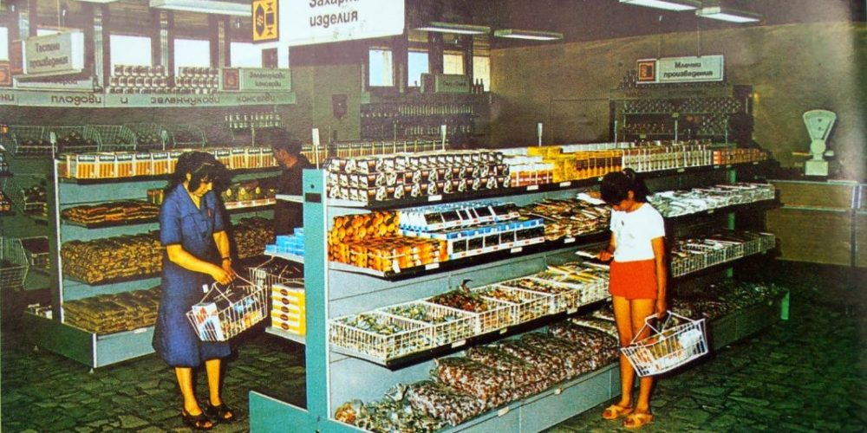
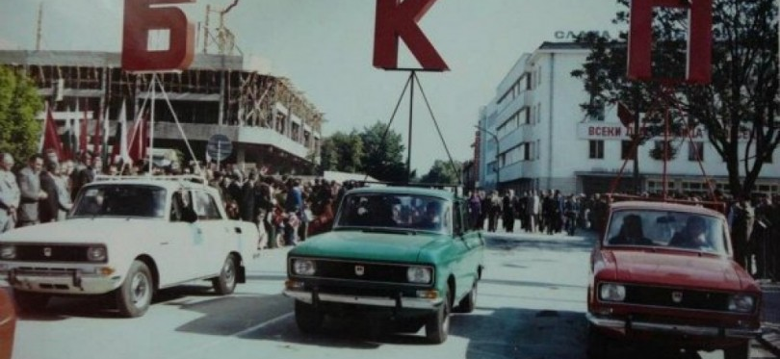
Economic change
By the early 1980s, the trade balance was positive, but in 1985 the trade balance was already negative with a deficit of about $ 1 billion.
By the end of the 1980s, Bulgaria entered an economic crisis, associated not only with a chronic shortage of convertible currency, but also with commodity deficits, which naturally led to rising inflation.
External debt has skyrocketed since the mid-1980s, surpassed GDP in 1987 and reached $ 10.7 billion at the end of 1988, and attempts to obtain foreign loans failed and the country entered a debt crisis.

Slide 9
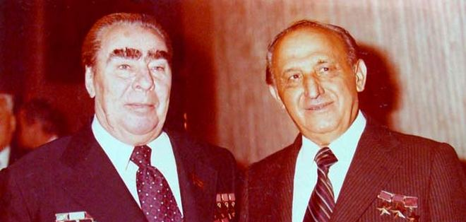
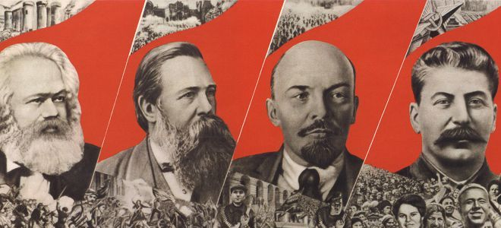
Cult of personality
In the People's Republic of Bulgaria, the communist leader, "Leader and Teacher of the Bulgarian People" Georgi Dimitrov, was a similar example.
Following the Soviet model, he was placed in a mausoleum after his death, just like the Soviet leader Lenin in the USSR

Slide 10
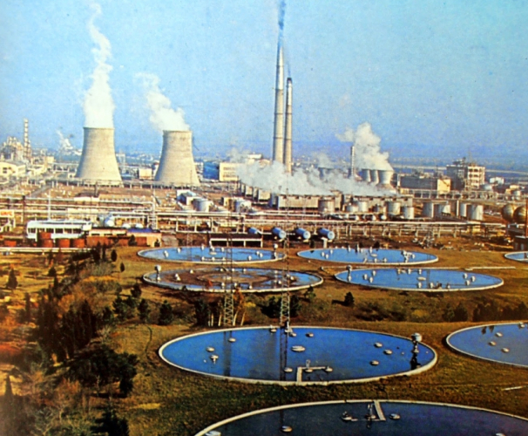
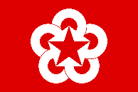
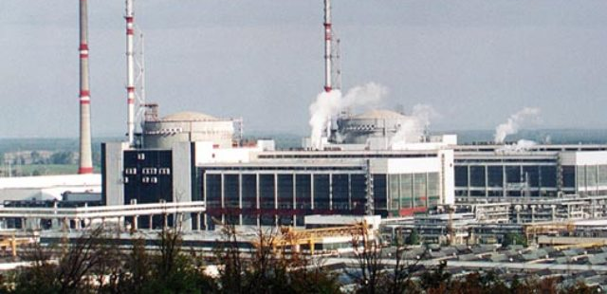
Industrialization of Bulgaria - CIV
CIV (Council for Mutual Economic Assistance) established in 1949 by the USSR and included Bulgaria for decades in a regulated and limited range of economic relations.
The implementation of the planning principle in industrialization was assigned to the State Planning Committee, which prepared 5-year business plans.
The branches of energy, metallurgy, machine building and heavy chemistry were developed.
Thermal and hydroelectric power plants were built. The extraction of iron, lead-zinc and iron increased, ferrous (Lenin plant in Pernik) and non-ferrous metallurgy (Lead-zinc plant near Kardzhali and the Pirdop copper mine) were built.
The chemical industry and the production of construction materials were developed. Coal production also increased significantly.

Slide 11
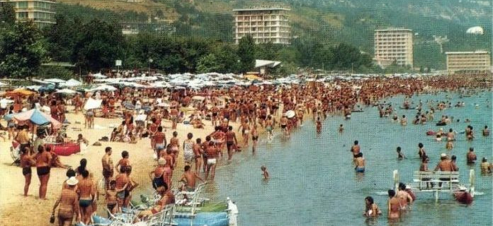
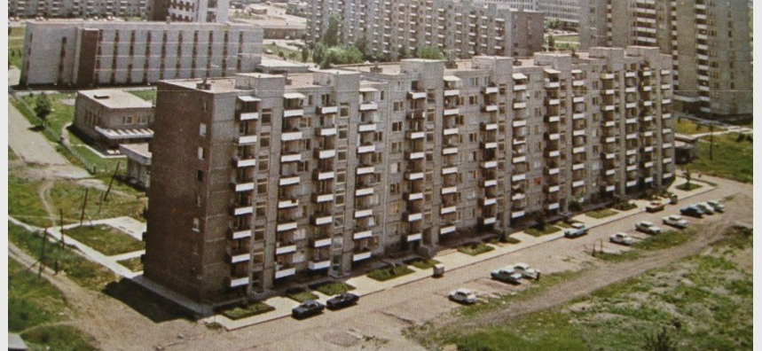
Social change
The policy of the Central Committee of the Bulgarian Communist Party towards its citizens was for them to have a ,,brighter future” and to have everything at their disposal.
Bulgarian citizens had an apartment in a panel building, a Soviet-made car (Lada, Moskvich), an “Electron” TV and an Mraz refrigerator.
The state, in the face of the factories and enterprises in which people worked, provideds a holiday at the sea and the mountains every summer.

Slide 12
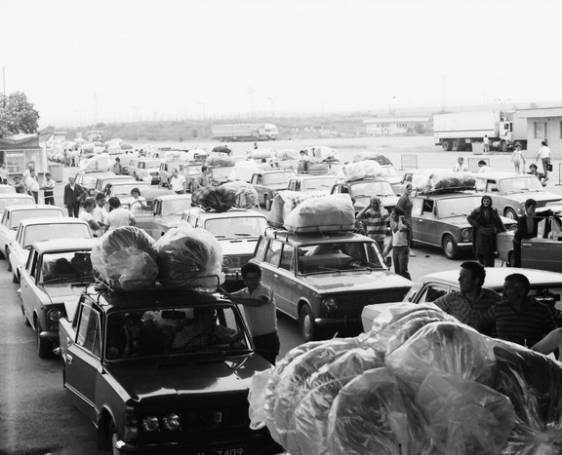
"Revival process" - 1984/1989
The revival process was an attempt by the Bulgarian Communist Party to impose the forced assimilation of the Muslim population (Turks, Pomaks and Roma).
This was the name by which the process of systemic repression against these social groups and ethnic groups is known in society. The revival process began in the early 1970s and lasted until the late 1980s.
Measures to implement this policy include forcibly changing Arabic-Turkish names to Bulgarian, restricting the use of the mother tongue by members of these groups, forcibly restricting their traditional customs and rituals, and professing their religion.

Slide 13
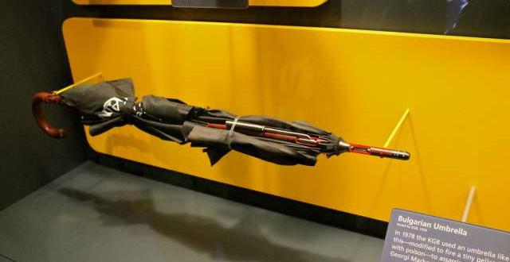
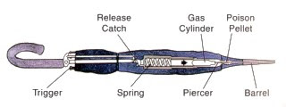
The murder of Georgi Markov - "The Bulgarian umbrella"
Georgi Markov was a Bulgarian writer and dissident, a journalist in the Bulgarian section of the BBC.
The assassination attempt on him took place on September 7, 1978 on the Waterloo Bridge in London, which ended with his death on September 11.
An investigation into Markov's assassination became possible after the fall of the communist regime in Bulgaria in 1989.
According to the investigation, the murder was prepared and carried out by the secret services of the USSR (KGB) and the People's Republic of Bulgaria (DS).
The writer was killed by a poison bullet containing castor oil and fired from a miniature pistol embedded in an umbrella. Hence the case is known as the "Bulgarian umbrella"

Slide 14
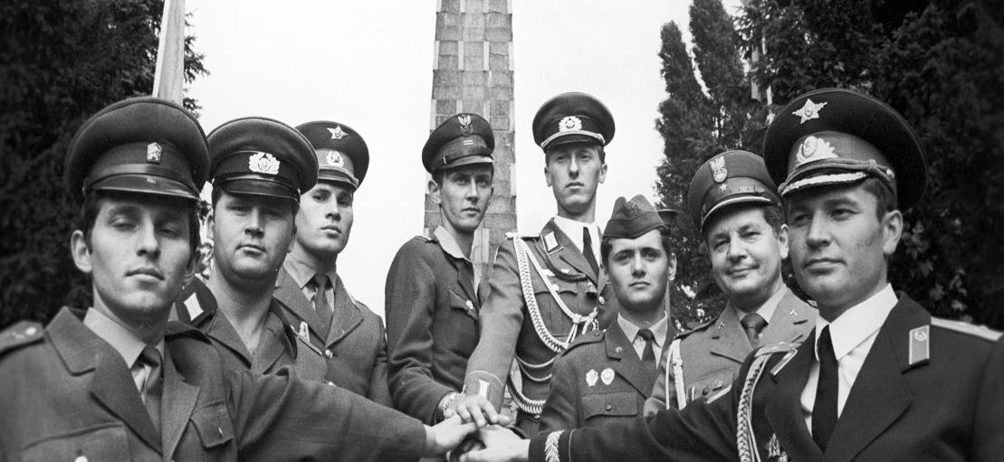
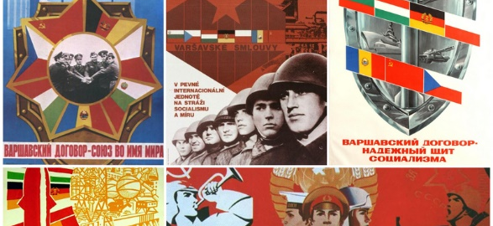
Eastern Bloc - Warsaw Pact
The Warsaw Pact was signed on May 14, 1955, and the purpose of this pact is to reach an agreement on friendship, cooperation and mutual assistance.
Its main function was:
Opposing NATO 's perceived alliance as well as
Protection of the territories of the Member States in the event of an attack on one of them.

Slide 15
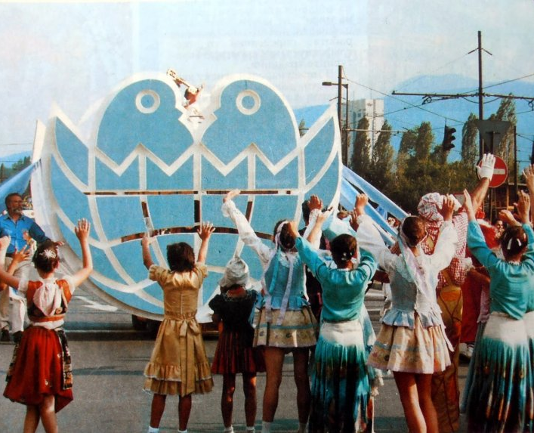
Bulgarian culture until 1989
During the years of communist rule, a great contribution to the development of Bulgarian culture was made by Lyudmila Zhivkova, who created the "Assembly - Flag of Peace".
Bulgaria also celebrates 1300 years of statehood.
Contribution to many other international cultural events.

Slide 16
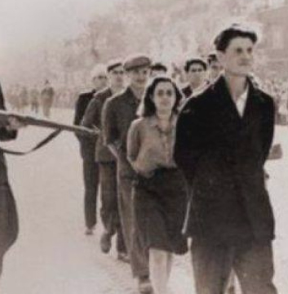
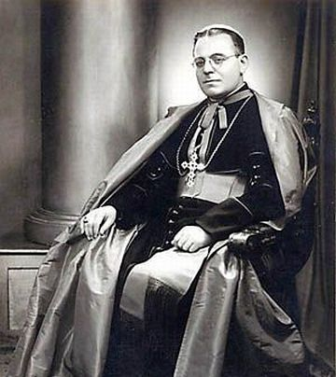
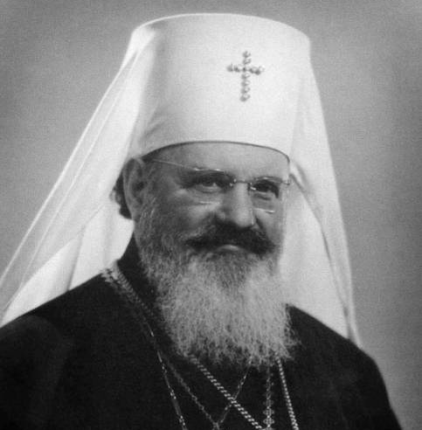
Deprivation of faith, the church
Bolshevism denies faith in the church and imposes a ban and imprisonment on those who profess it
In Bulgaria, hundreds of Orthodox as well as Catholic priests who preached freedom were exiled.

Slide 17
Bulgaria after 1989

Slide 18
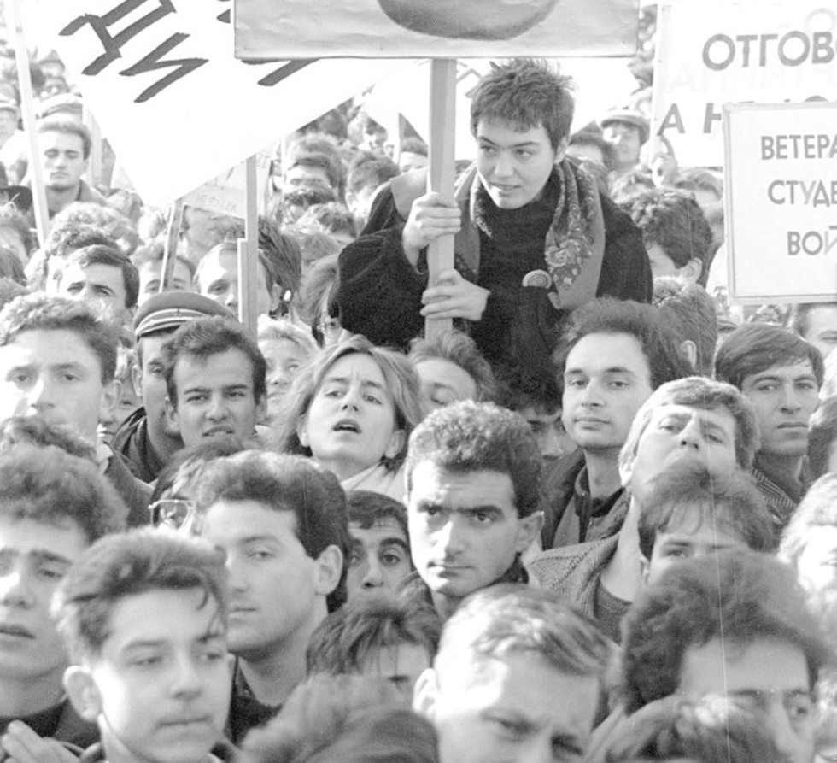
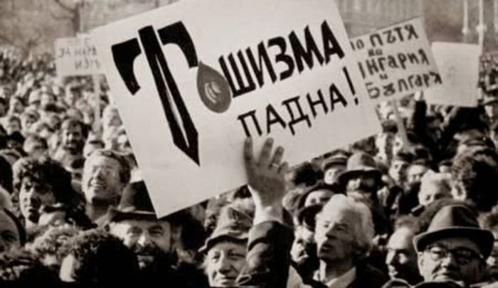
Bulgaria after 1989
After 45 years of dictatorship, Todor Zhivkov was overthrown without blood.
The Bulgarian people wanted freedom, democracy, a new political system and a new constitution

Slide 19
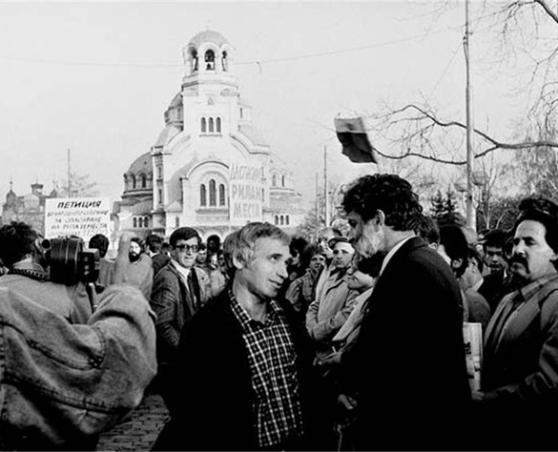
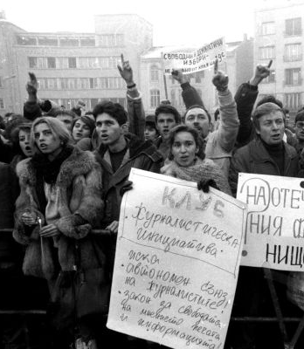
Bloodless regime change - November 10, 1989. Transition. Signs of the economic crisis. Reasons:
After November 10, 1989, the regime changed and elections were scheduled for the Grand National Assembly to change the Bulgarian constitution.
The reasons for the economic crisis in Bulgaria after the fall of the communist government were due to the accumulated state foreign debt.
Crisis of shortage of food, fuel and electricity and devaluation of the national currency.

Slide 20
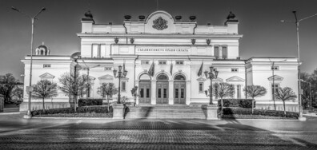
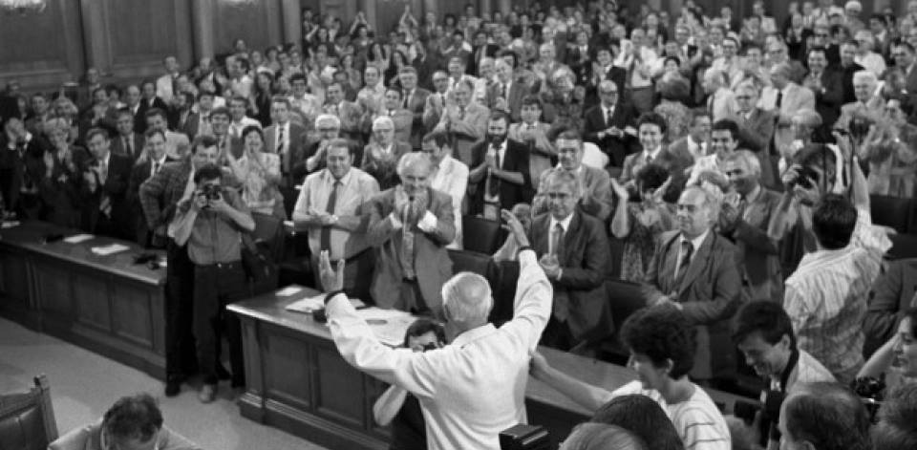
Constitution
The Constitution of the Republic of Bulgaria is the basic law of the Republic of Bulgaria.
It was adopted on July 12, 1991 by the 7th Grand National Assembly. According to it, Bulgaria is a parliamentary republic.
It is a single state in which autonomous territorial entities are not allowed.

Slide 21
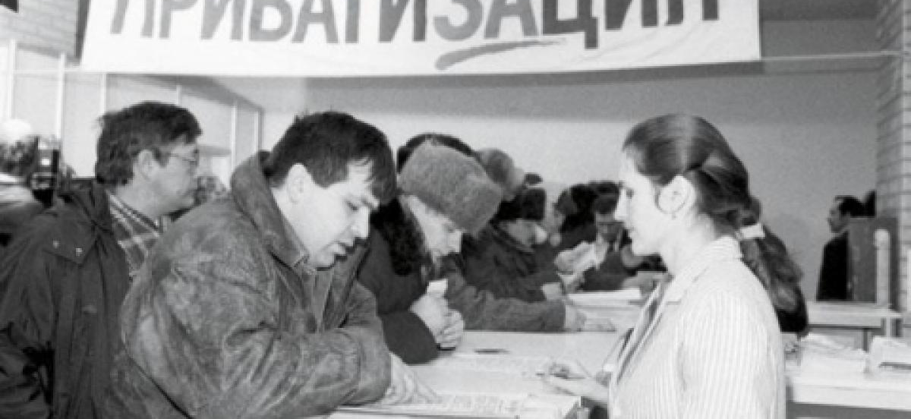
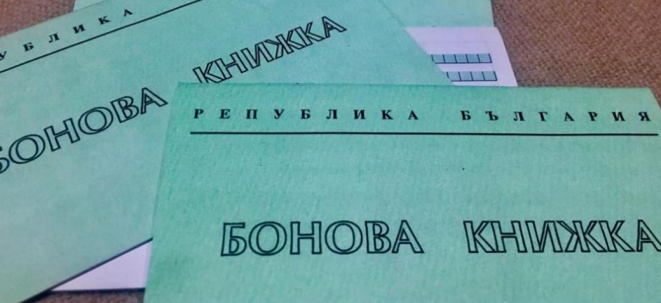
Privatization
Bulgarian privatization and the process of liberation of the state from ownership through its transfer in private hands in the implementation of relevant privatization schemes.
It started with the adoption of the Law on Transformation and Privatization of State and Municipal Enterprises of May 8, 1992.
the beginning of 1989 decree number 56 for the Economic activity through which persons close to the Bulgarian Communist Party and the State Security are placed at the entrance and exit of the state enterprises in private traders to appropriate the profits and to nationalize the losses.

Slide 22
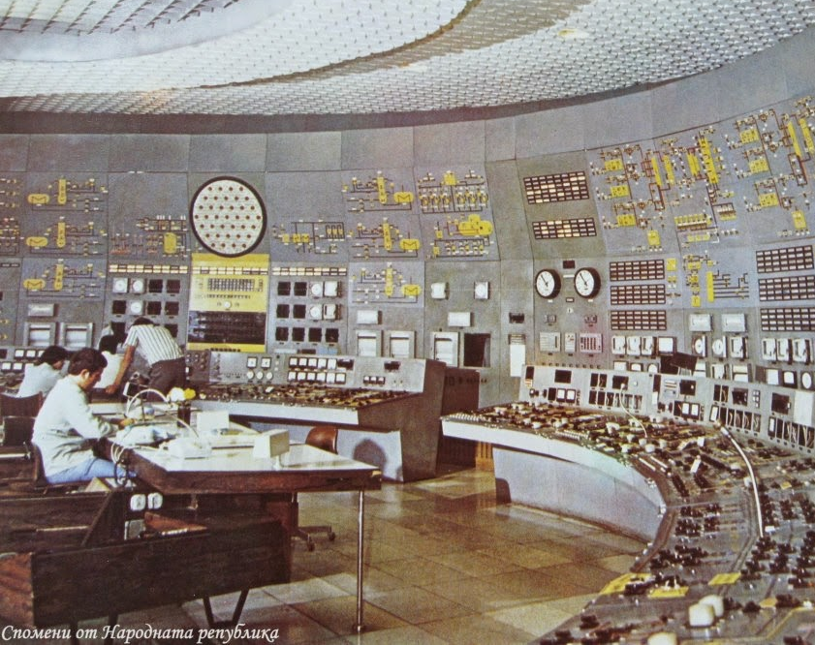
Electricity mode
Bulgaria after 1989. It looks like a disco - in one place it lights up, in another it goes out.
The government introduced it because of the alarming increase in foreign debt and the restriction of Soviet energy supplies. The restrictions continued at different rates until the last regime (3: 1 and 2: 2) in the winter of 1991-1992 during the government of Lyuben Berov.
At that time, all TPPs, several NPP units and a huge number of HPPs were operating. Then, however, the electricity grid was so weak that despite the availability of capacity, there was no way to transmit electricity to end users.

Slide 23
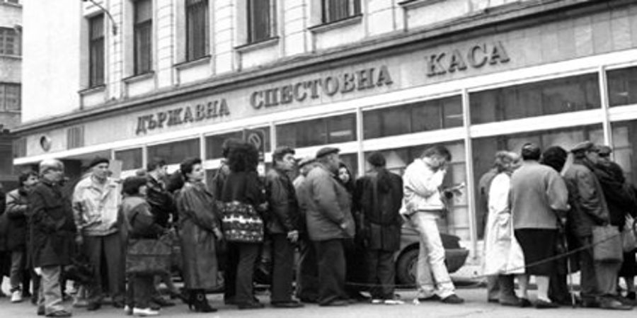
Economic crisis and devaluation of the lev
In the period January - early February 1997, Bulgaria fеll into a deep political and financial crisis. Big cities were engulfed in protests, roads and streets were blocked, and the country fеll into chaos.
At the beginning of February, Bulgaria facеd hyperinflation, after in less than two months the price of one US dollar from 500 reaches BGN 3,000. Inflation is already 300%.
/

Slide 24
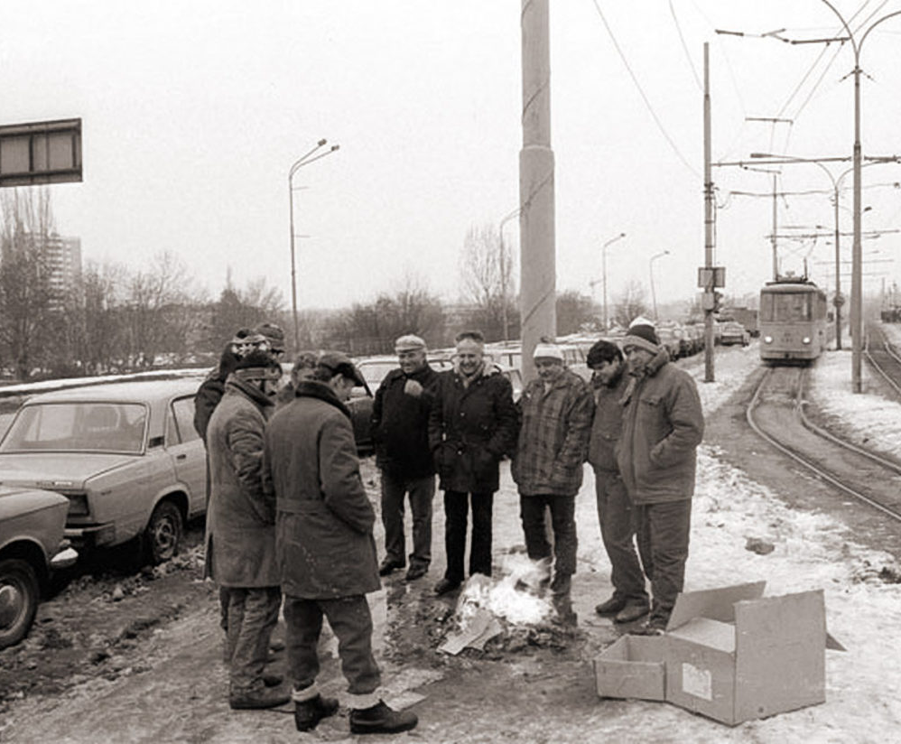
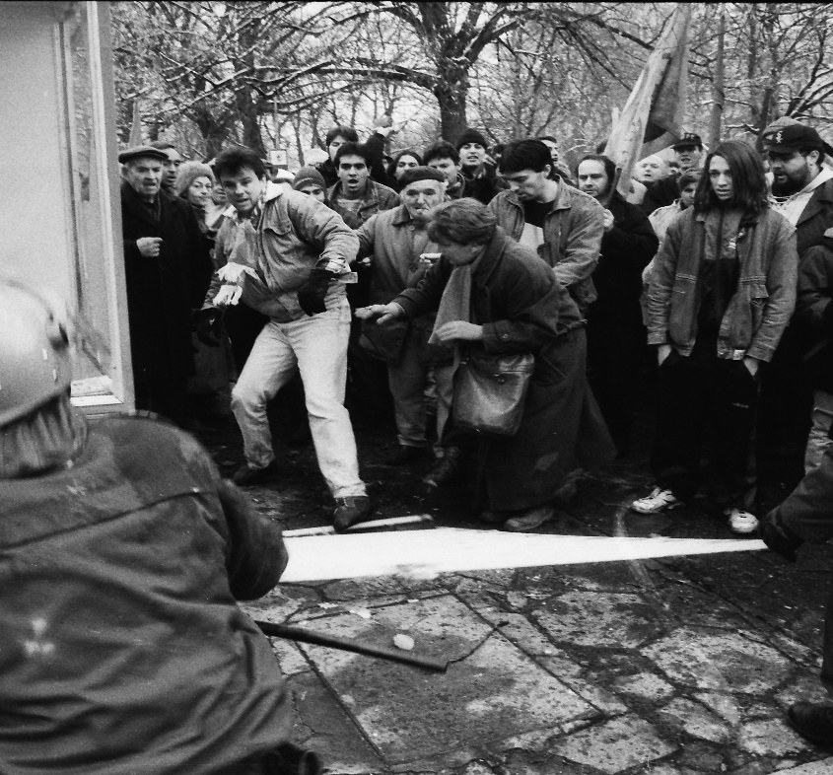
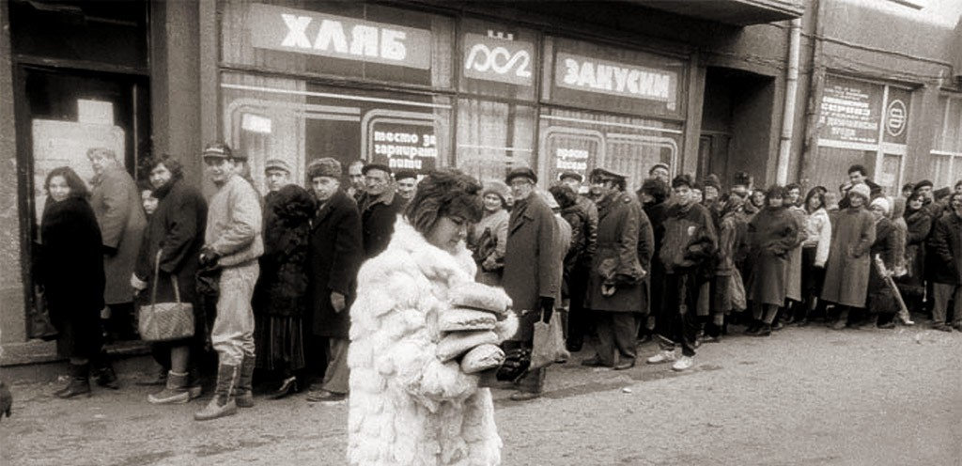
Economic crisis and devaluation of the lev
For the period from April to October, 15 banks had gone bankrupt. The savings of the vast majority of Bulgarians had been destroyed, but the debts of the so-called credit millionaires, who took money from the banks without intending to return it, had been melted down.
The winter of late 1996 was dubbed the "Winter of Viden" because of the sharp decline in food, rising inflation (which turned into hyperinflation in early 1997) and the bankruptcy of many banks.

Slide 25
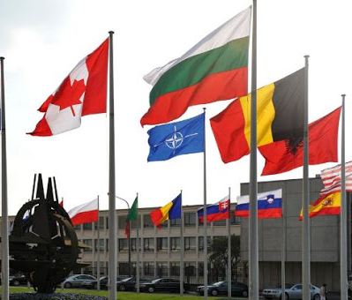
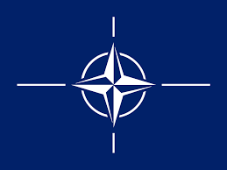
NATO-2004
Bulgaria became a member of NATO on March 29, 2004. With which the country again managed to fully guarantee its national security.
The Bulgarian army became fully professional
Modernization according to NATO standards of the Bulgarian army

Slide 26
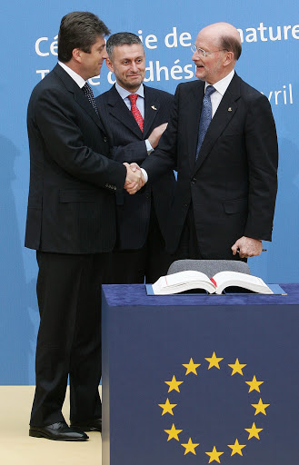
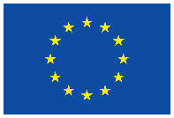
EU – 2007 Joining the EU
On January 1, 2007 Bulgaria became a member of the European Union and with that our country again became part of the big European family after 60 years of injustice.
The signing of the EU membership agreement by President Georgi Parvanov, Prime Minister Simeon Saxe-Coburg and Foreign Minister Solomon Passy.

Slide 27
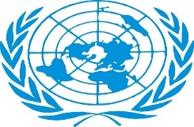
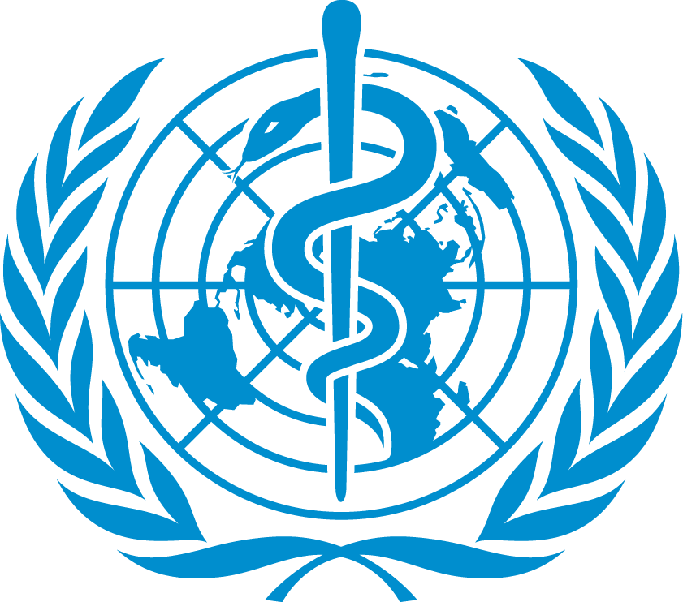
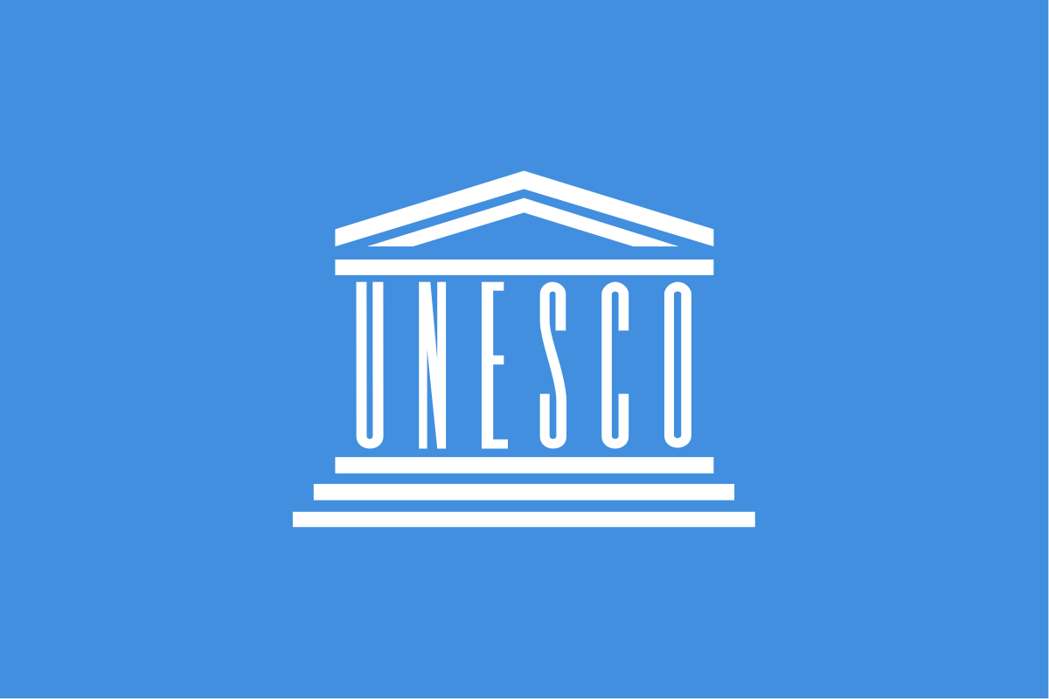
Bulgaria in international organizations
Bulgaria is a member of the UN, NATO, EU, UNICEF, International Committee of the Red Cross, WHO, UNESCO.

Slide 28
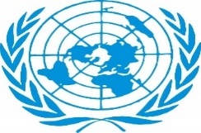
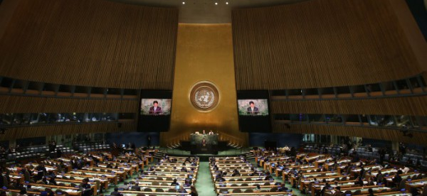
UN
The United Nations is an international organization officially established on October 24, 1945.
The main goal of the UN is to observe peace and security. Based on the principles of equal rights and self-determination of peoples, it also develops friendly international relations.
Bulgaria was accepted as a full member of the UN on December 14, 1955.
The country participated as a non-permanent member of the Security Council three times: in 1966 - 1967, 1986 - 1987 and 2002 - 2003.

Slide 29
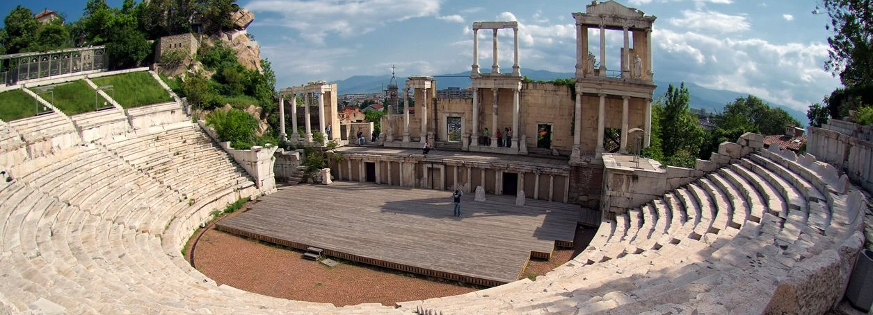
Art - international fame
Bulgaria is very rich in extremely well-preserved Roman architectural monuments such as the ancient theater in Plovdiv / built during the reign of the Roman emperor Mark Ulpius Trajan (98 - 117) AD.
The treasure from Panagyurishte is an extremely beautiful gold set with very rich decoration and ornamentation. It was used either for feasts or for religious sacraments and rituals related to Thracian mythology. It consists of nine vessels made of pure gold with a total weight of over 6 kg.
In June 2010, during excavations on the island of St. Ivan near Sozopol, a team of Bulgarian archaeologists came across a sealed alabaster reliquary containing a tooth, pieces of bone in the hand and the front. But no one still suggests that a serious breakthrough has been made in Bulgarian and world biblical archeology. Scientists later found that the reliquary, found in the altar of the oldest temple on the island, dates from the mid-fifth century, and rely on an inscription. According to him, during the century in question, someone carried Thomas exactly on the birthday of St. John the Forerunner of his holy relics.

Slide 30
Art - international fame
The Bulgarian Louvre was opened on May 25, 2015. In 28 halls on four levels are exhibited 1700 works by Bulgarian and foreign artists from the rich fund of the gallery, which numbers over 42,000 museum items. The beginning of the Bulgarian collection dates back to the 1890s.
Pererikon - this is an early historical, ancient and medieval Bulgarian stone complex in the Eastern Rhodopes, consisting of a large sanctuary from VI - V millennium BC, monuments from antiquity and a medieval fortress. Among the Thracians, Perperikon was a sacred rock city, capital and fortress with a royal palace. Later Romans, Goths, Romans and Bulgarians lived there.
It had been declared a monument of immovable cultural heritage of national importance since 1968.

Slide 31
Opening up society
Aviation began to develop very dynamically with the expansion of Sofia Airport on December 27, 2006 before joining the EU.
Many new airlines opened routes to Bulgaria and contributed to the development of tourism and the economy
Many Bulgarians travel abroad thanks to air connections and relatively low prices
A total of 12 million tourists will visit Bulgaria in 2019.

Slide 32
Tourism in Bulgaria
The tourism - one of the main branches of the Bulgarian economy .In Bulgaria there is an abundance of historical and natural landmarks, museums and monasteries, scattered over a relatively small but easily accessible area.
The main ski resorts are Borovets, Bansko and Pamporovo, and the most popular sea Sozopol, Nessebar, Golden Sands, Sunny Beach and Albena. The mountains Rila, Pirin, Vitosha, Stara Planina and the Rhodopes attract lovers of alternative tourism and climbers.

Slide 33
the appearance of the shopping centers
In Bulgaria, the first shopping center - TZUM - was built in 1957 and until 1998 functioned as a department store, which offers goods from a large number of product groups - perfumes, cosmetics, electronics and others, and after reconstruction in 2000. has been reopened as a shopping center, which houses stores of various brands and chains.
The first Bulgarian mall of modern type (with shops, restaurants, food hypermarket, cinema, parking lots, services and entertainment) was opened on May 12, 2006 in Sofia. About a month later, on June 9, 2006, Mall Sofia opened its doors and after that malls opened in almost all major cities in the country, the largest of which are located in Sofia and Varna.

Slide 34
My view of communism is that the rulers did not treat the people well and deprived them of many things while the other nomenklatura had everything.

Slide 35
Thank you for your attention!

