Slide 1
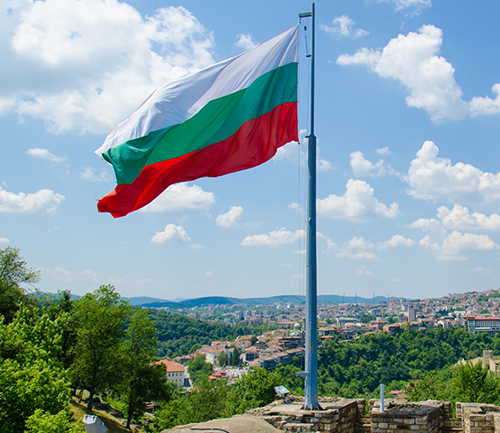
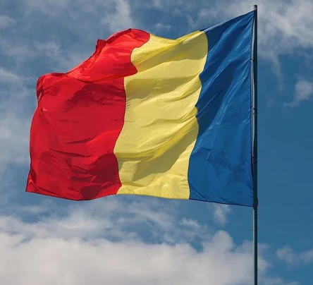
Stereotypes about Bulgarians and Romanians from the Croatian perspective
Luka Matašić
Leon Djaković
Laura gabrić-delić
Vito mazolla knez

Slide 2
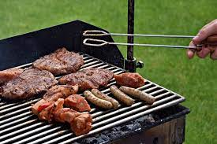
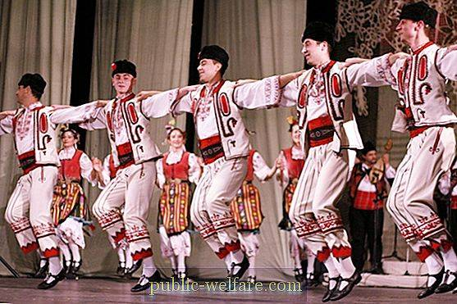
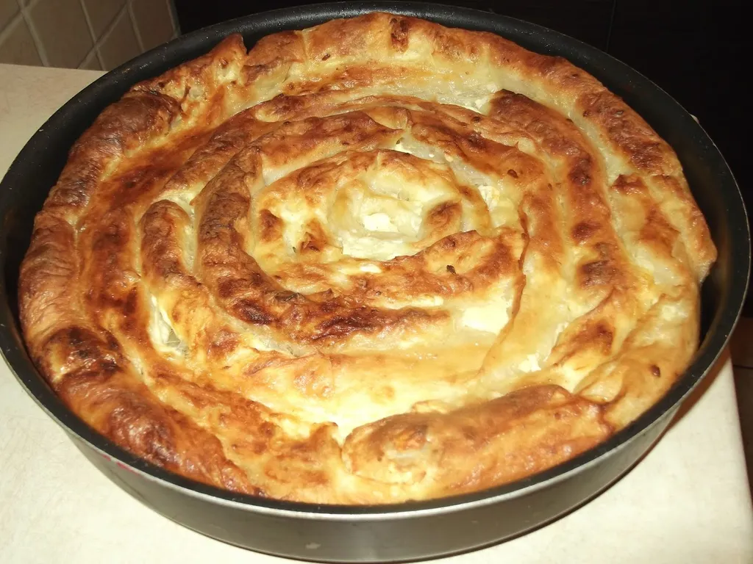
What is average Bulgarian like?
Bulgaria
Bulgarians are very hospitable and they make a great barbecue
Bulgarian women are really beautiful
They are similar to Croats, hospitable
M: I don’t know much about Bulgarian people, but I know that they really love their country music and dances.
F: They love preparing traditional dishes such as banica and musaka.

Slide 3
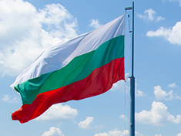
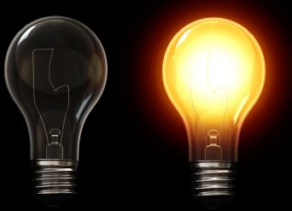
What is the typical Bulgarian like?
M: I’ve heard that Bulgarians like lightness and not the darkness. That’s why all Bulgarians, if they are able, they leave the light on.
F: My personal opinion is that Bulgarians are unsociable. Bulgarians are known for agriculture, especially farming.
I think Bulgarians are generous.
They look like a happy nation.
I don't know much, but I heard that they are really diligent.

Slide 4
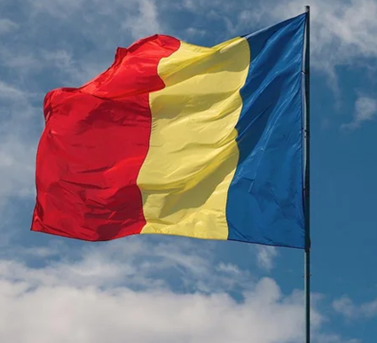
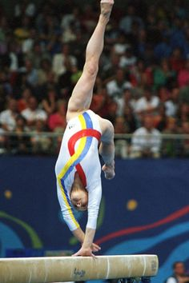
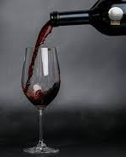
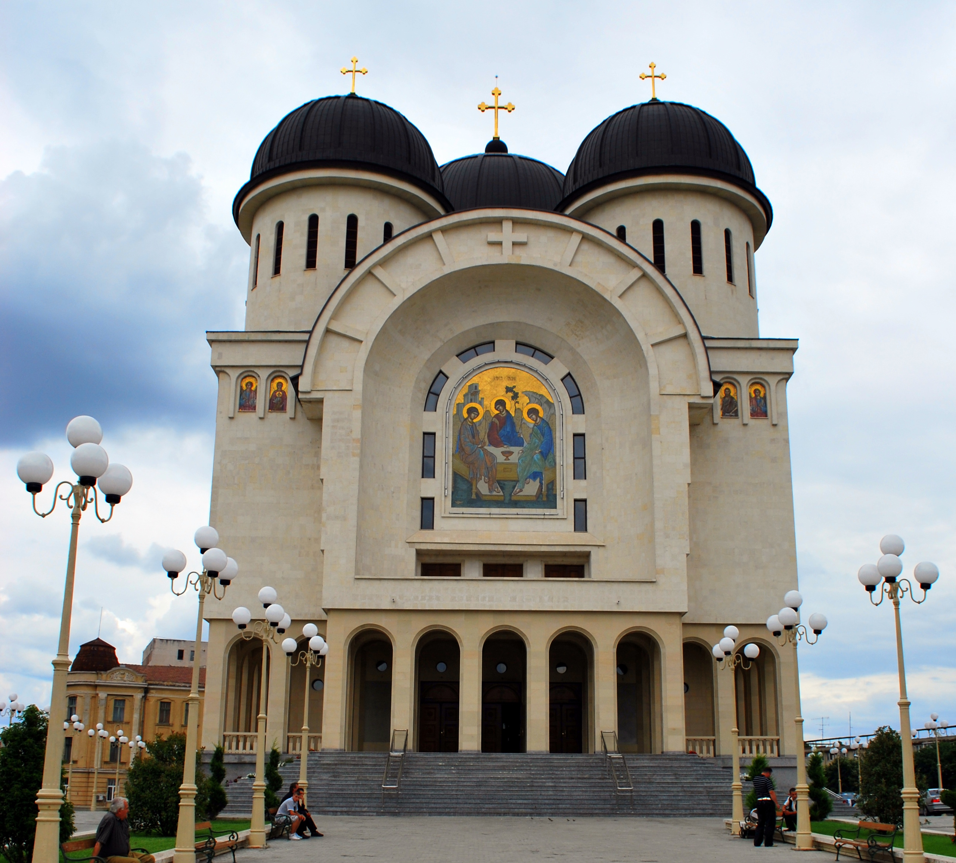
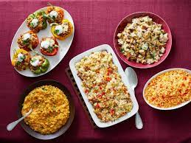
What is average Romanian like?
Romania
Romanian people are positive, very hospitable/welcoming and polite
A little freaky and cheerful
They like drinking wine
Talented athletes
Religion is very important to them
M: Romanian people are very simular to Bulagarian people.
F: Every Romanian women really, really likes making dishes.

Slide 5
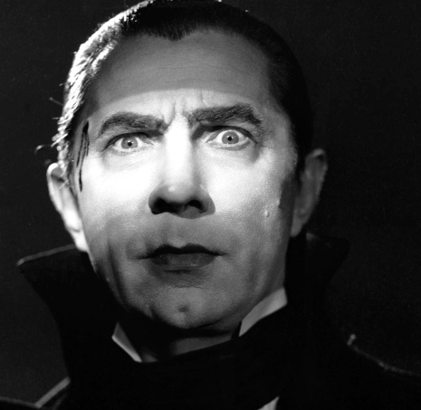
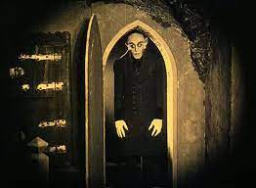
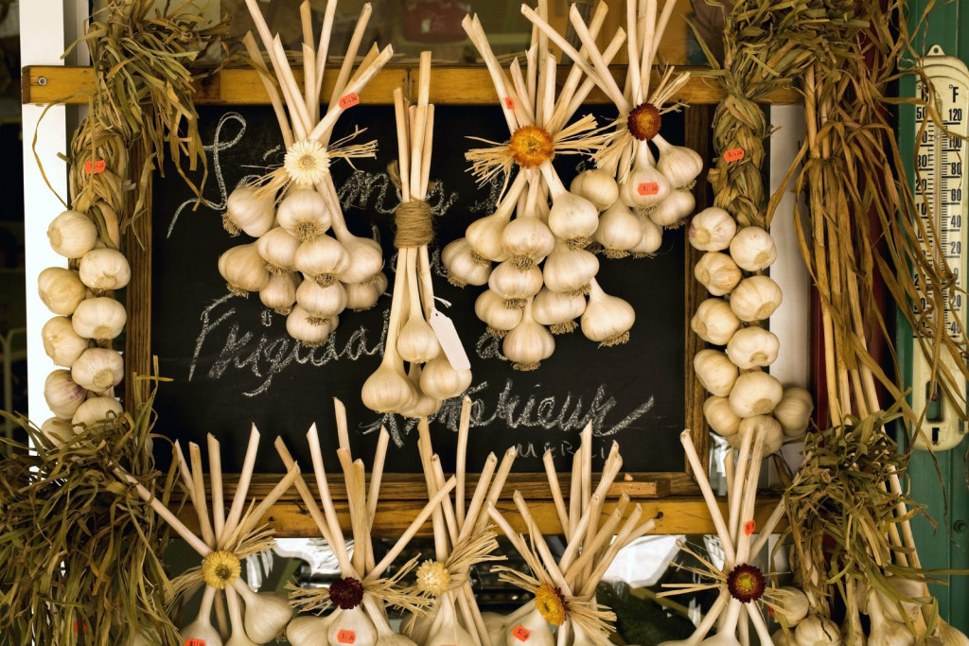
What is the typical Romanian like?
Romania
I know almost nothing, but my first association would be Count Dracula and vampires.
They are similar to Croats, most of them have dark hair and dark eyes
M: I’ve heard that Romania is poor country, but I can’t confirm that. I read that Romanians have garlic hanged in their home to protect themselves from vampires.
F: Typical Romanians are mean. I’ve heard somewhere that they like to steal, especially, taxi drivers.

Slide 6
PICTURES
https://www.coe.int/documents/11046033/0/bulgaria-flag-870.jpg/c4e994b8-4a7a-e807-67df-5c093b307a18
https://external-preview.redd.it/xgiWMX8HG4cWtVNbnJECXufxM89q-AVyW4DPYJvq2Es.jpg?width=640&crop=smart&auto=webp&s=9d9a200ceac35fcfa97a207e60e5127de7f211fb
https://podravkaiovariations.azureedge.net/bf51fa74-6389-11eb-8bb9-0242ac120058/v/f2b1f6a6-64bc-11eb-b6c2-0242ac130010/1024x768-f2b21802-64bc-11eb-a115-0242ac130010.webp
https://i.public-welfare.com/img/novosti-i-obshestvo/40/bolgarskij-narodnij-tanec-i-ego-osobennosti-2.jpg
https://encrypted-tbn0.gstatic.com/images?q=tbn:ANd9GcTpnKTfvno4f1UofZhkJ9VwA2rw3NXJfJF_GMot53oX4xcwttF8jABf22VhGbZPz-SpXts&usqp=CAU
https://static.jutarnji.hr/images/slike/2020/06/04/k_7822403_640.jpg
https://geek.hr/e-kako/wp-content/uploads/sites/34/2011/03/kako-el-zarulja-daje-svjetlost.jpg
http://archive.6yka.com/upload/images/Oktobar%202012/Annex%20-%20Lugosi%20Bela%20Mark%20of%20the%20Vampire_02.jpg
https://image.dnevnik.hr/media/images/1024xX/Feb2018/61465047.jpg
https://upload.wikimedia.org/wikipedia/commons/0/03/TAXI.jpg
https://i.pinimg.com/236x/7c/cc/00/7ccc004bb7e872a6bd6b644295a6c7a3.jpg
https://upload.wikimedia.org/wikipedia/commons/f/fb/Holy_Trinity_Cathedral_-_Arad_-3.jpg

