Slide 1
MY REGIONAL IDENTITY
Fran Radić, 7.a

Slide 2
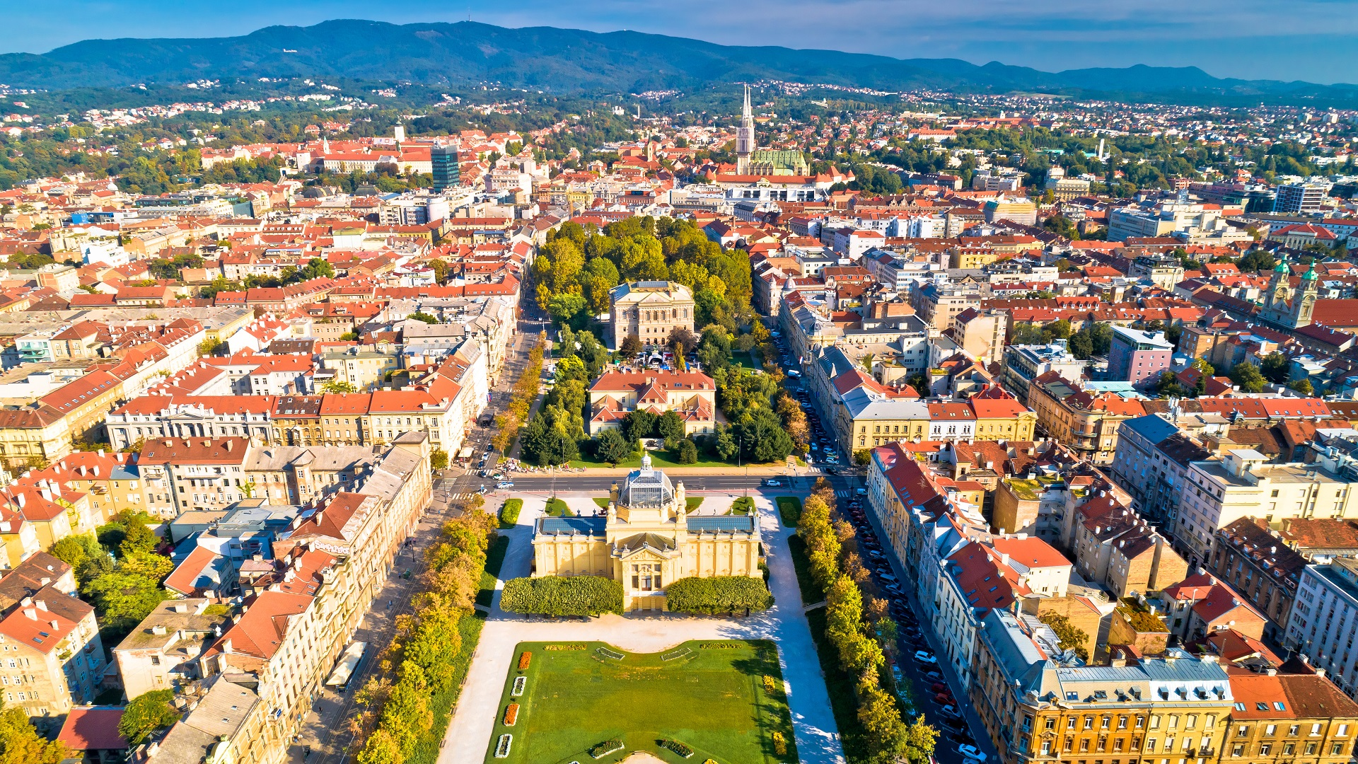
What is my regional identity?
City of Zagreb official website
https://www.zagreb.hr
I consider myself a citizen of Zagreb because I was born in Zagreb, and on my mother's side of the family I am the 6th generation born in Zagreb.

Slide 3
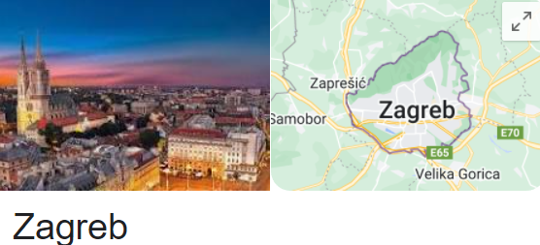
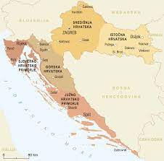
My background
My father was born in Slavonia and he considers himself to be Slavonic. I don't think I am Slavonic because I was born and I have spent all my life in Zagreb, and I only go to Slavonia to visit relatives.

Slide 4
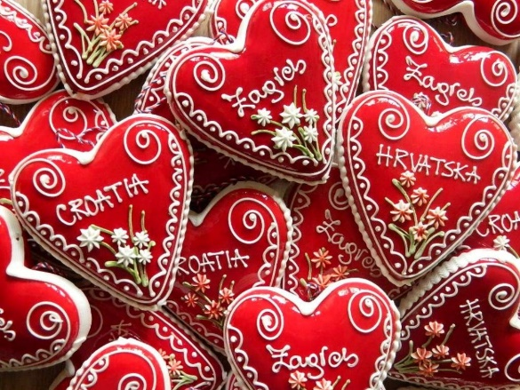
What is Zagreb famous for?
Conversation with a person from another part of Croatia
My grandfather's brother from Slavonia has said that Zagreb is famous because it is the capital of Croatia. He also said that Zagreb is famous for its souvenirs Licitar hearts and red umbrella from Šestine, and Croatia's most famous and successful football club Dinamo Zagreb.

Slide 5
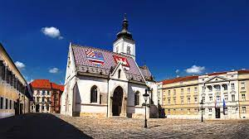
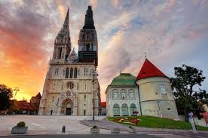
Famoust buildings in our city
He has said that Zagreb is also famous for some old churches in the city; some of them are St. Mark's church, and Zagreb Cathedral. I also asked him to compare Zagreb with other cities from Croatia. He has said that the chances of getting a job in Zagreb are higher than in the rest of the country and the availability of medical care is much better and faster.

Slide 6
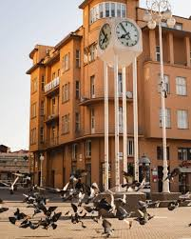
What stereotypes of the people from my region are there?
When I asked this question he has said to me that he thinks people from Zagreb are always in hurry, and that they hate being late.
A clock on the main square in the city of Zagreb

Slide 7
My opinion
I agree with him that people in Zagreb are in a hurry because of their way of living, but they are still managing to find some time to spend with their friends and family. Also, I agree with him that people from Zagreb don't like being late because I also don't like that, but some people don't mind sometimes if they are late (my aunt), but it's their way of living.

Slide 8
Prejudice about Croatia and people from Croatia
When I had a conversation with people from other countries that live in Croatia or people that are here on holiday I had asked them what they think about Croatia, people, our way of living. I asked them to tell me their honest opinion about what they like and dislike in my country and if they have heard some prejudice.
They have said to me that they heard that Croatia is a very clean country, they had read about it in some blogs on the internet.

Slide 9
They also heard that we drink a lot of coffee and like to spend a lot of our time in coffee shops. Some of them said that Croatia is only famous for its coastline and athletes. But they all agree that we are a very friendly nation.

Slide 10
To have prejudice about anything is very wrong! It is better to create our opinion about people, countries or things that we encounter in our life.
Thank you for your attention! ☺ Благодаря за вниманието!

