Slide 1
Life in the 60's
Denis Angelov 6v

Slide 2
Dear grandparents, tell me about your childhood and youth passed in the years of the last century, the time of socialism?
Oh, time flew by so fast, my life passed imperceptibly in the second half of the last century, which sounds a little sad… My memories are so many, they invade like a storm in my mind. We grew up in a quiet time when there were no crimes, thefts, violence. My childhood was spent in carefree games outside until late at night, summer even after midnight undisturbed by anyone. We played hide and seek, queen, national ball, guards and Apaches, chilik, etc.

Slide 3
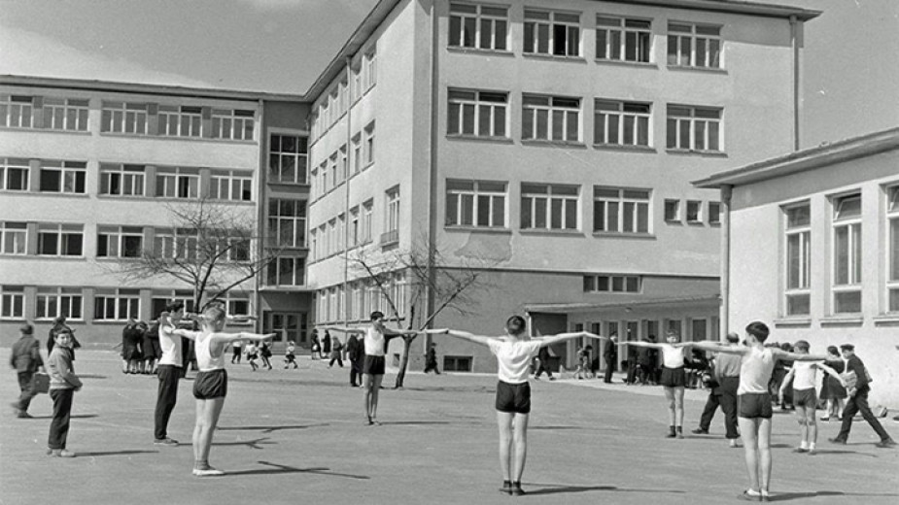
And what will you tell me about school?
There was great discipline, we loved and respected our teachers. During class we all listened carefully, not like you now…. After school we participated in clubs - different, according to everyone's preferences. I was in the math class and played rhythmic gymnastics, participated in competitions, Olympiads. In the morning we had a mandatory exercise. I want to say one more thing about education - of course for free. Anyone who had a desire after difficult candidate student exams entered the desired university. Although without a father who died when I was 9 years old, I graduated in medicine at HMI-Varna for free, I even had a scholarship for excellent success. After I became a doctor with my great desire to study and improve, I took 2 specialties - Internal Medicine and Endocrinology.

Slide 4
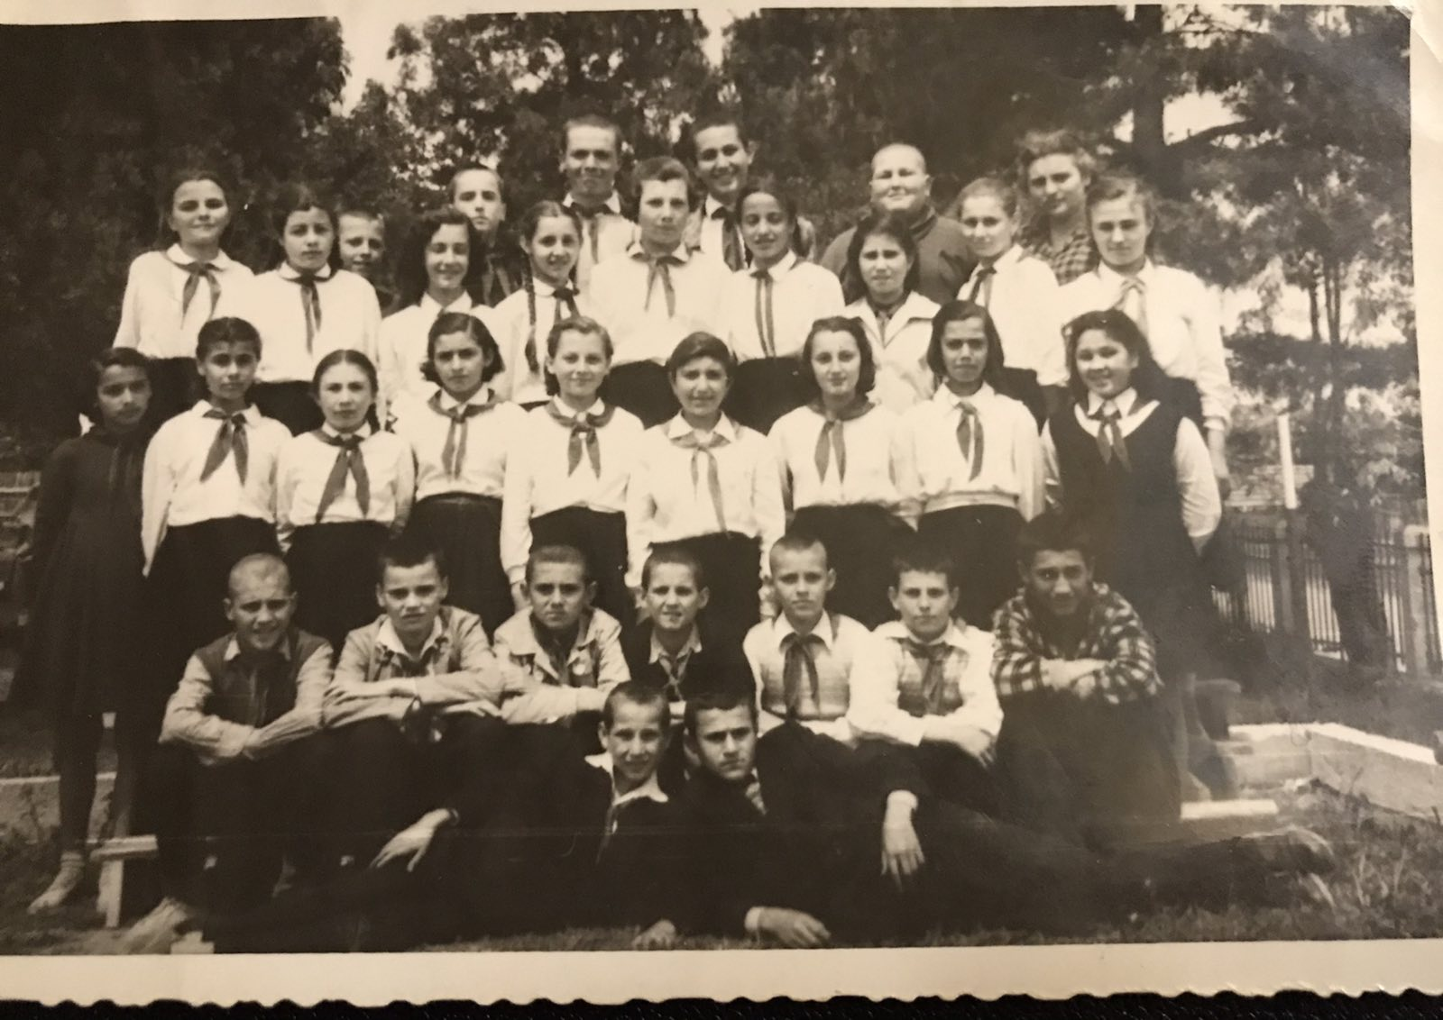

Slide 5
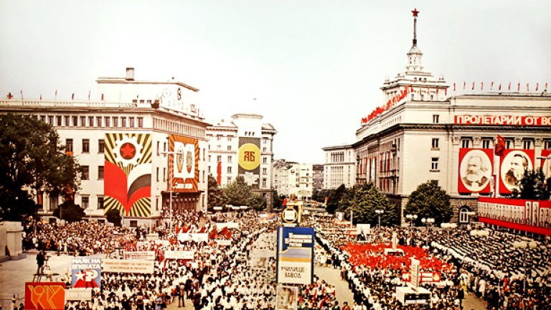
Manifestations
On the occasion of our national holidays - September 9 and May 24, demonstrations were held. On them with posters, flags, songs and many flowers we marched through the streets and in front of the stands where the party leaders were.

Slide 6
What did you do during your vacations and free time?
There were no mobile phones or computers then, and we read a lot of books, which in most cases we took from the library - even for some we waited in line . We didn't have TV as children, only when I graduated we bought a black and white TV on which we watched only one TV channel. There were Russian shows and movies on Friday. We often went to the movies - when we were little there were screenings in the morning from 10.00, and as older and from 18.00. In my hometown G. Oryahovitsa there is a community center, where theaters from other cities visited, we watched famous plays, there were often operas and operettas.

Slide 7
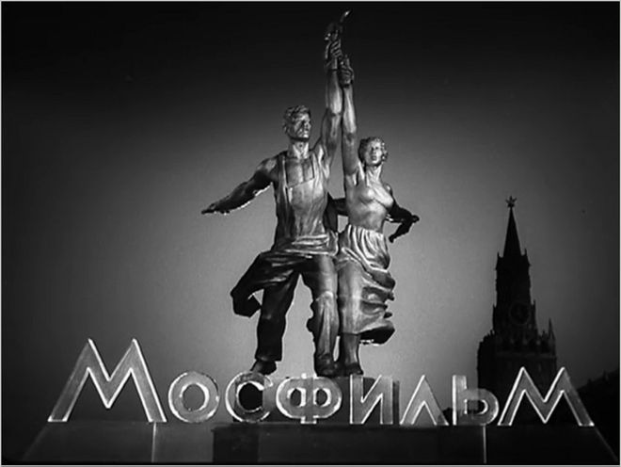

Slide 8
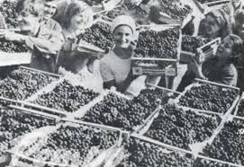
Brigadier movement
In high school in the summer and autumn we went to brigades to help harvest the rich harvest in the surrounding villages - we picked tomatoes, corn, grapes. I went to the National Brigade in the Rhodopes - Chaushev Chark - afforested with small pines

Slide 9
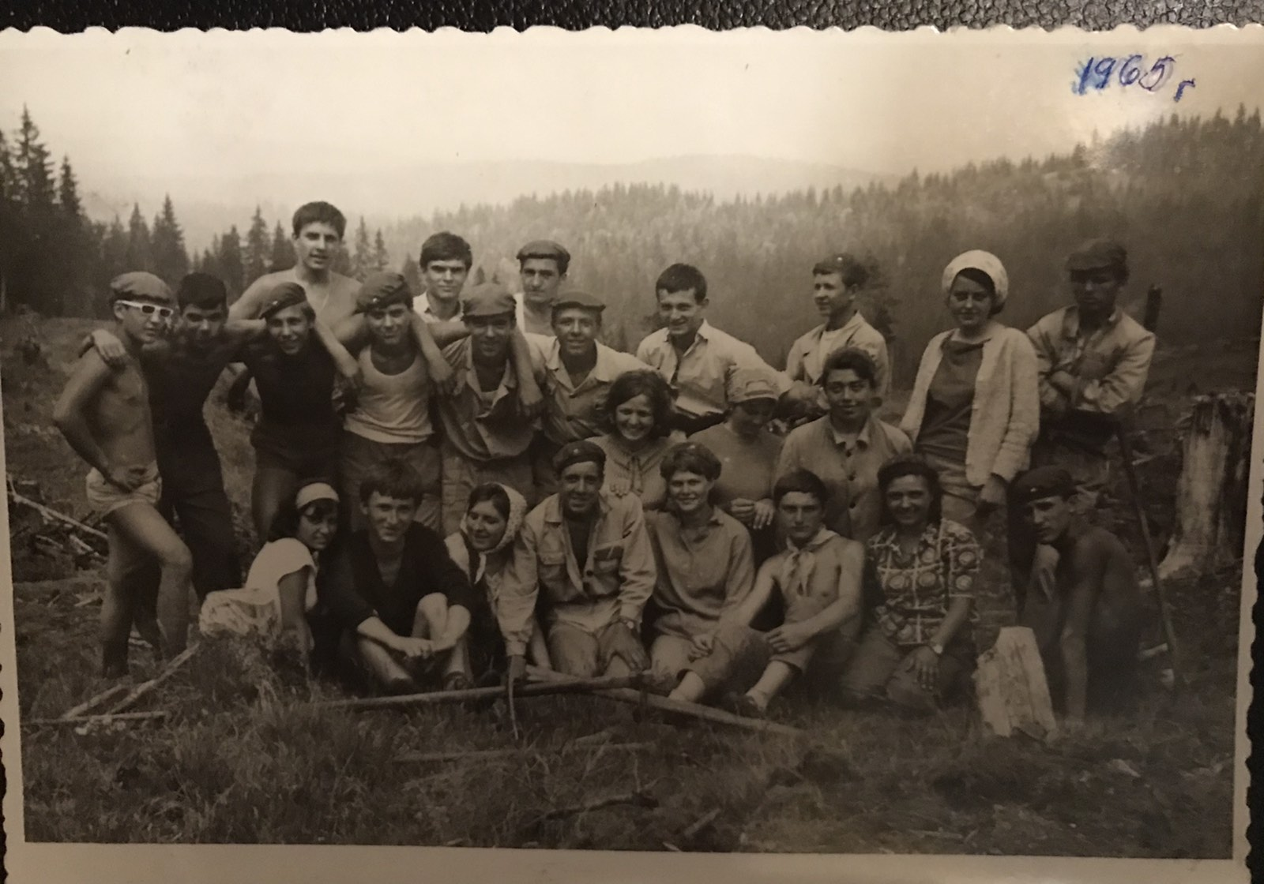

Slide 10
How about the shops?
There were many quality goods, at affordable prices, Bulgarian production, without GMOs and preservatives - there were no harmful foods, chips and more. That's probably why there weren't that many obese children. Prices were the same everywhere and did not change for years. The variety was not as great as now, without exotic fruits, there were bananas only on holidays, for which queues were twisted… Imported goods were available only in specialty stores - Corecom, where they shopped with dollars.

Slide 11
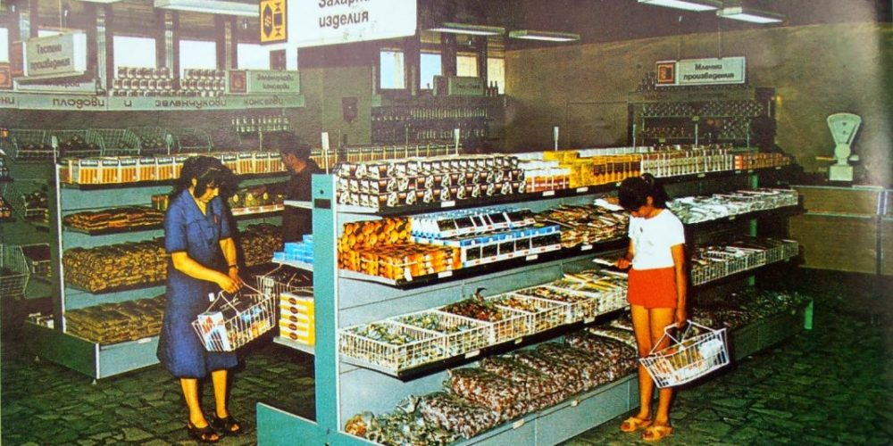

Slide 12
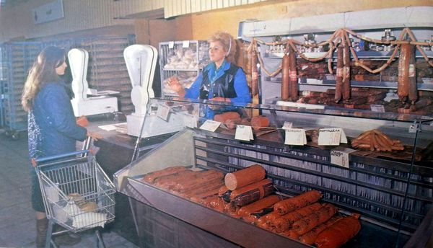

Slide 13
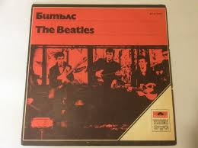
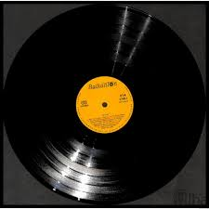
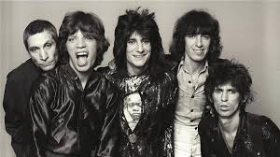
And what music did you listen to?
We listened to music both by Bulgarian authors and performers and by foreign ones. We dug gramophone records, and later cassette players with rollers. We listened to the Beatles, the Rolling Stones, Italian music. Every year in the summer in Sunny Beach was held a music festival, "Golden Orpheus", which was attended by performers from Bulgaria and abroad.

Slide 14
Thanks you for attention !

