Slide 1
Bulgarian political life 1960-2020

Slide 2
Contents
1
Bulgaria at the stage 1960-1971
2
Bulgarian political course
and its consequences 1971-1989
3
Bulgaria 1989-2020
4
5

Slide 3
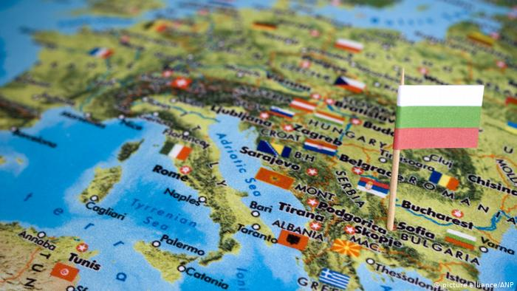
The last 60 years of the Bulgarian political life were filled with varied, contradictory and often determinant developments, which influenced on the complete life of our society.

Slide 4
Bulgaria at the stage 1960-1971

Slide 5
As a part of the Eastern Bloc, the Peopleʼs Republic of Bulgaria was governed from only one party – Bulgarian Communist Party (BCP).

Slide 6
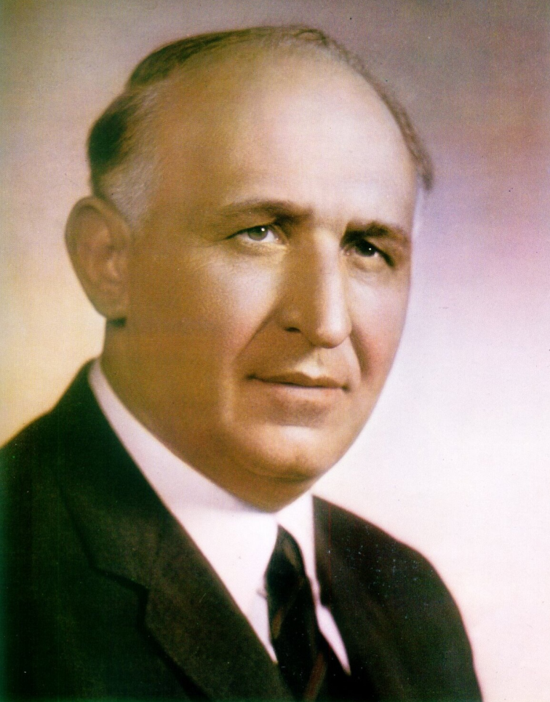
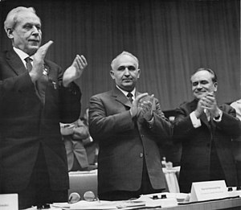
Todor Zhivkov became First Secretary of the Bulgarian Communist Party in 1954, served as Prime Minister from 1962 to 1971 and from 1971 - as Chairman of the State Council, concurrently with his post as First Secretary. He remained in these positions for 35 years, until 1989.

Slide 7
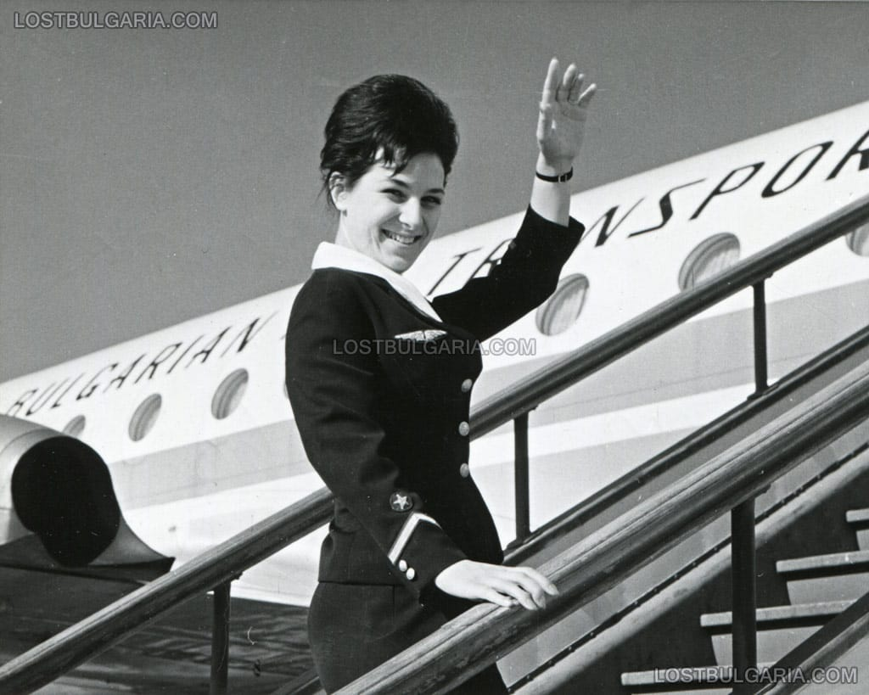
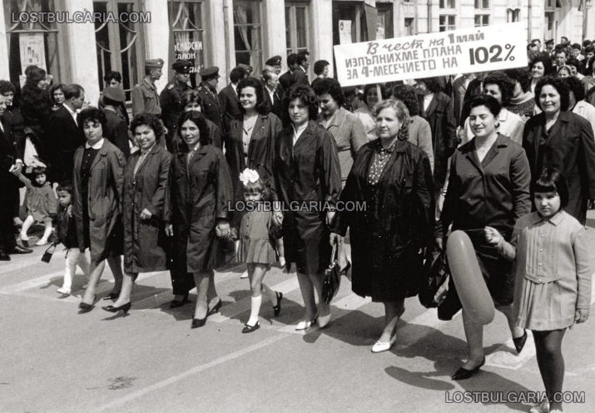
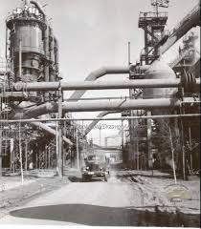
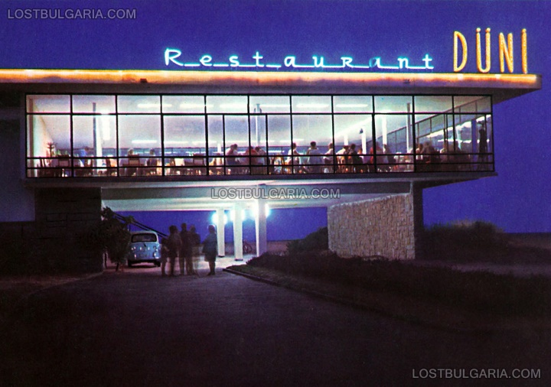
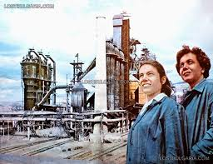
The Bulgarian economy developed successfully within Council for Mutual Economic Assistance. The country became the most popular tourist destination for people in the Eastern Bloc.

Slide 8
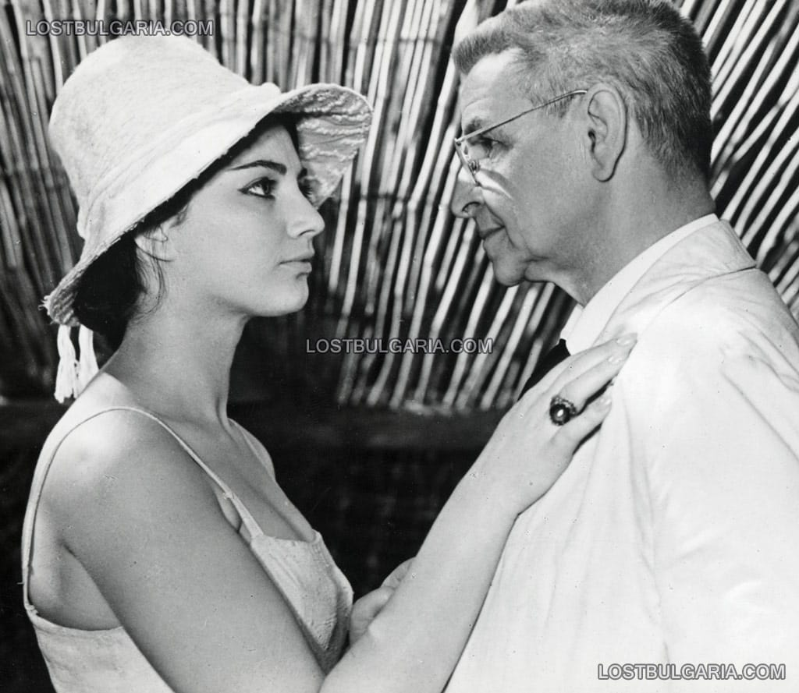
Bulgarian art and literature developed despite the ideological tendency to confirmation of socialistic view of life.

Slide 9
Bulgarian political course and its consequences 1971-1989

Slide 10
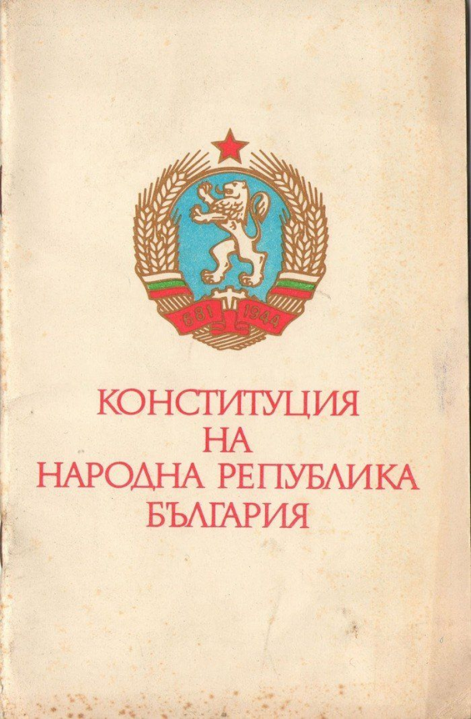
In 1971 the new Constitution added so-called. "Article 1", which grants the PA as the sole ruling a "leading force of society and the state."

Slide 11
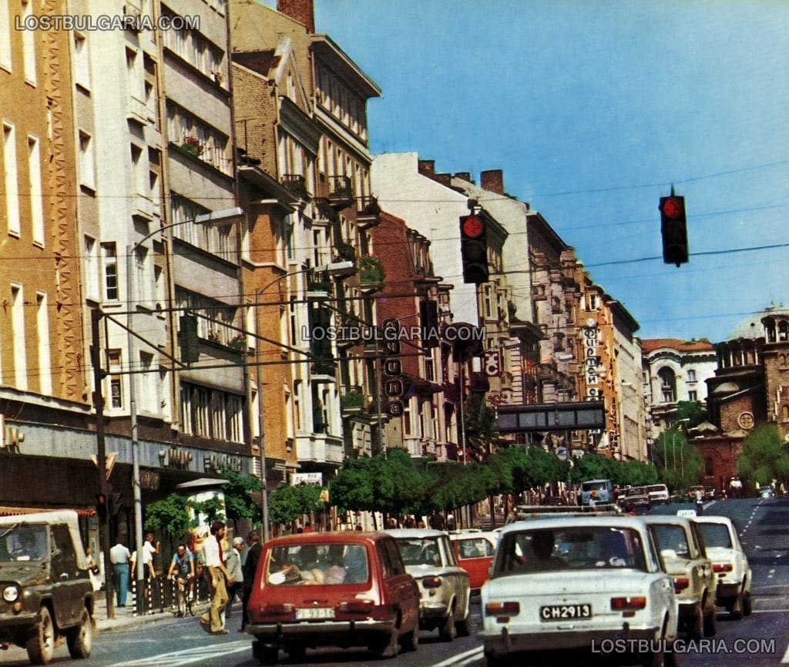
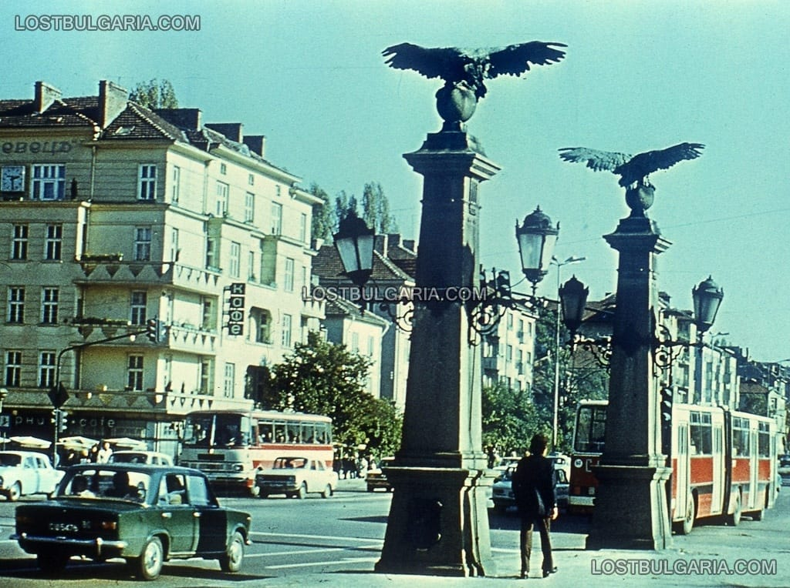
In the late 1980s, the Communists, like their leader, had grown too feeble to resist the demand for change. Liberal outcry at the breakup of an environmental demonstration in Sofia in October 1989 broadened into a general campaign for political reform.

Slide 12
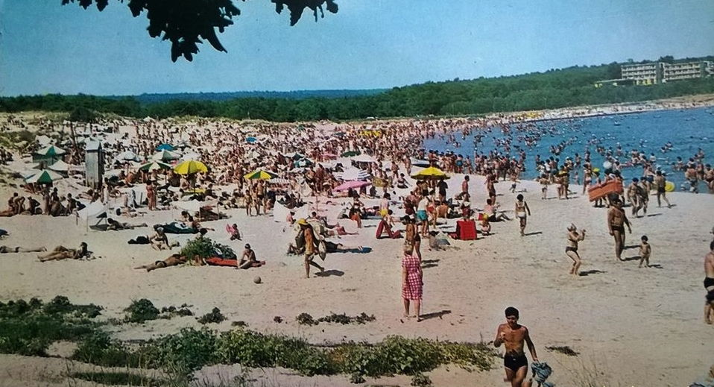
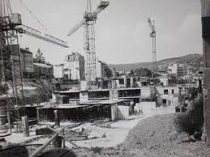
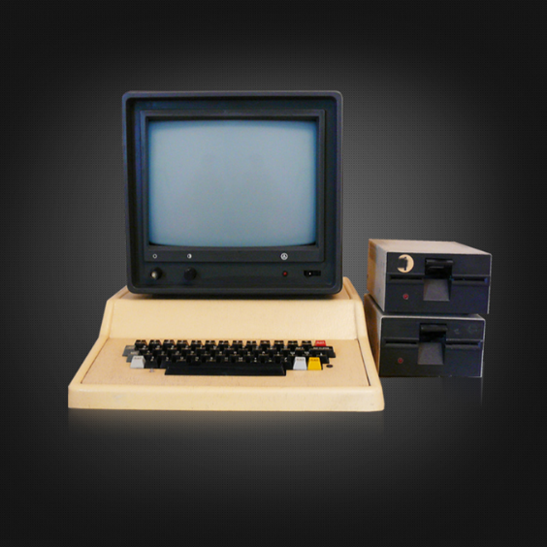
Zhivkovʼs regime put emphasis on light industry, agriculture, tourism, as well as on Information Technology in the 1970s and the 1980s.

Slide 13
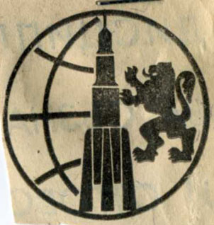
Bulgaria wanted to reach the space. The Bulgarian cosmonaut program refers to human spaceflight efforts by the People's Republic of Bulgaria.

Slide 14
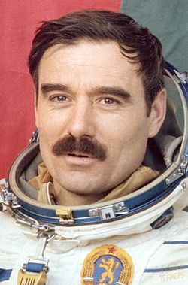
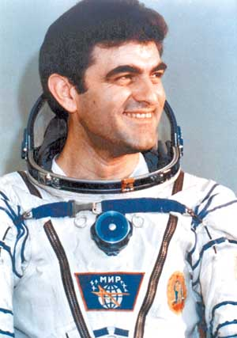
Under Interkosmos, Bulgaria sent its first cosmonaut, Georgi Ivanov, to the Salyut 6 space station in 1979 and became the sixth country in the world to have a citizen in space. A second Bulgarian cosmonaut, Aleksandar Aleksandrov, spent ten days on the Mir Space Station in 1988 and performed a variety of scientific experiments.

Slide 15
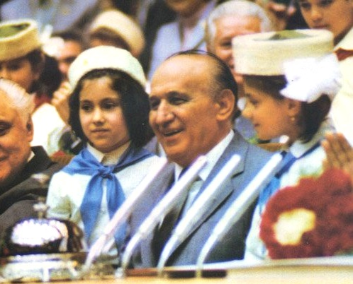
Zhivkov's extensive campaign of cultural restoration provided at least some common ground between him and the Bulgarian intelligentsia.

Slide 16
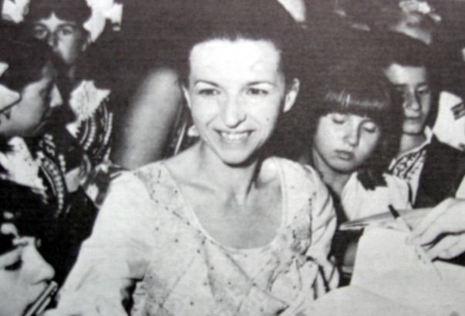
From 1975 to 1981, Lyudmila Zhivkova led the Committee for Art and Culture. In this powerful position, she became extremely popular by promoting Bulgaria's separate national cultural heritage.

Slide 17
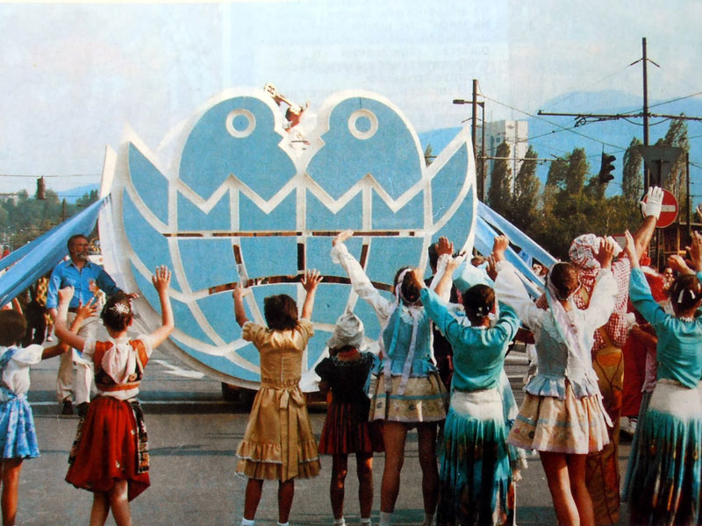
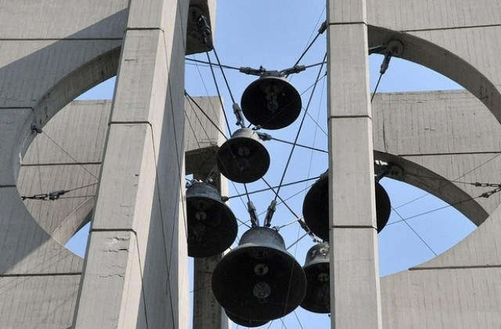
In 1976, the UN General Assembly proclaimed 1979 as the International Year of the Child. Bulgaria supported that decision and through the proposal of Lyudmila Zhivkova the preparation for the First International Children’s Assembly “Banner of Peace” got started.

Slide 18
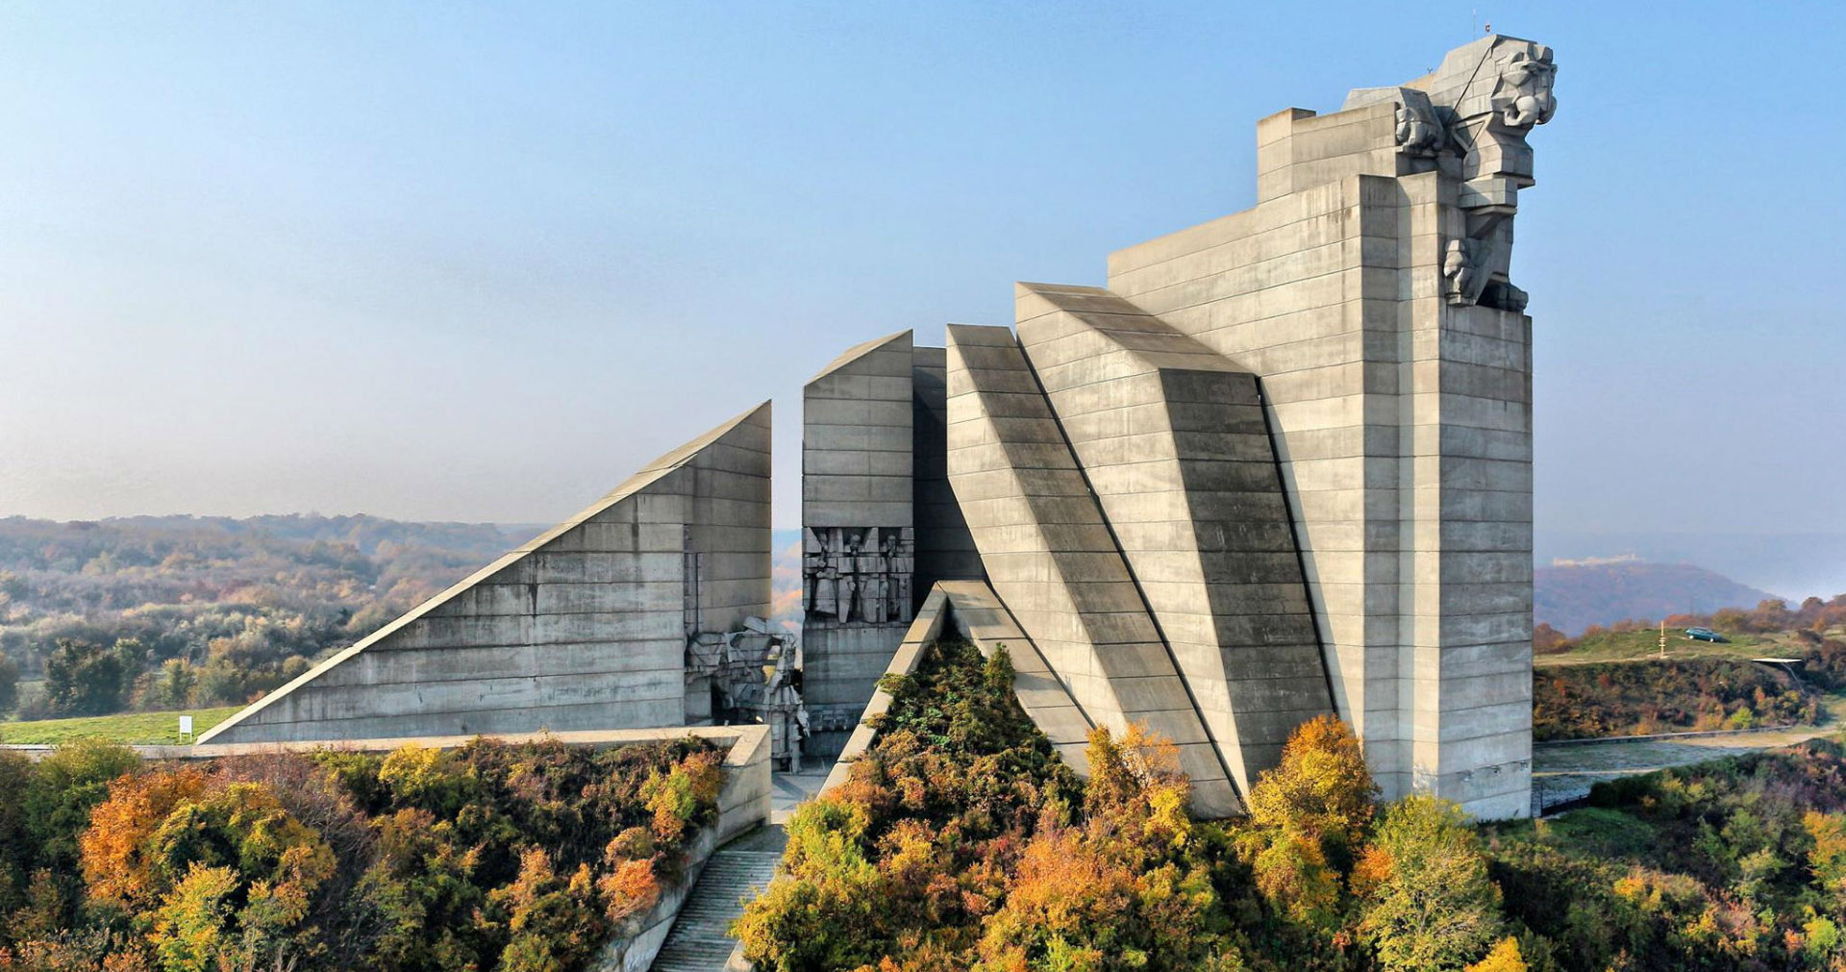
The yearlong 1300th anniversary celebrations of the Bulgarian State took place in 1981 to commemorate the establishment of the First Bulgarian State in 681. There were 23,000 events connected with the anniversary, including a military parade and the creation of a monument in Shumen.

Slide 19
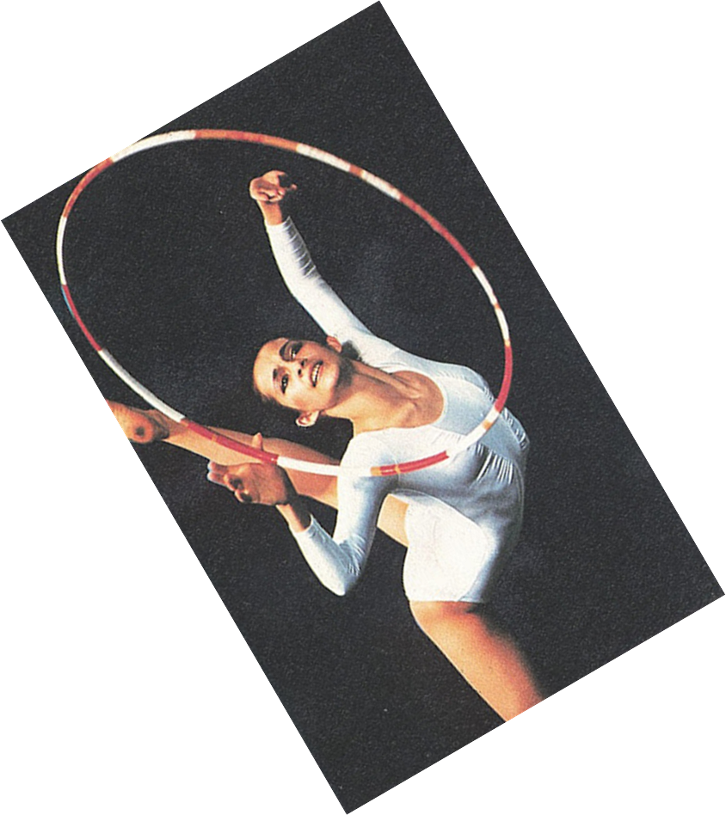
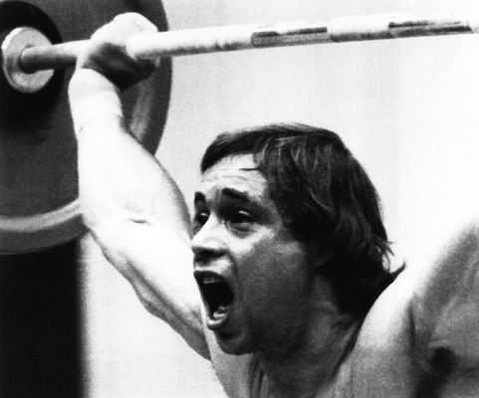
Sports prospered. From 1956 to 1988, Bulgaria won an unprecedented 153 Olympic medals and numerous European and world competitions in sports as diverse as volleyball, rhythmic gymnastics and wrestling.

Slide 20
Bulgaria 1989-2020

Slide 21
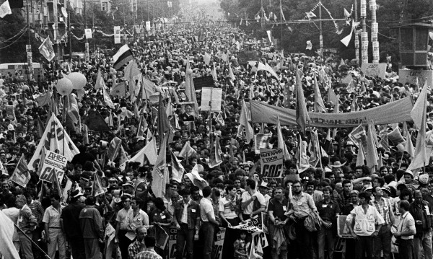
Todor Zhivkov resigned on 10 November 1989, under pressure by senior BCP members. Within a month of Zhivkov's ouster, Communist rule in Bulgaria had effectively ended.

Slide 22
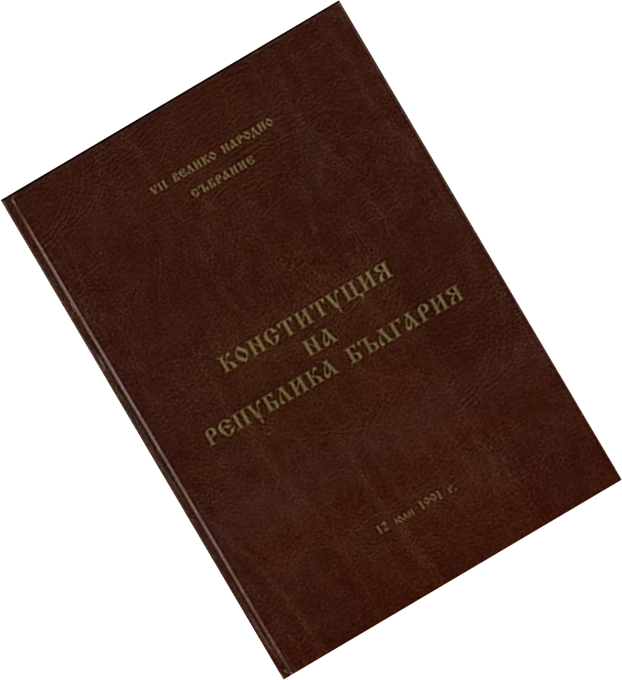
Bulgaria's 1991 constitution, which established a parliamentary republic, provides for a multiparty parliamentary system and free elections with universal adult suffrage.

Slide 23
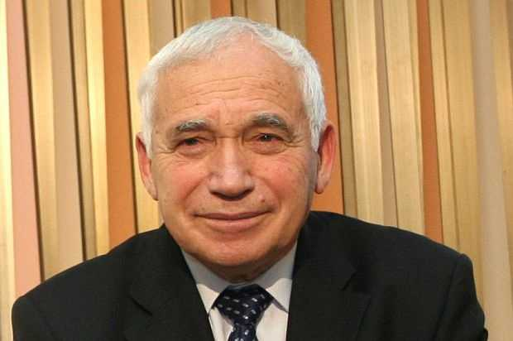
Zhelyu Zhelev was the first democratically elected president of the Republic of Bulgaria.

Slide 24
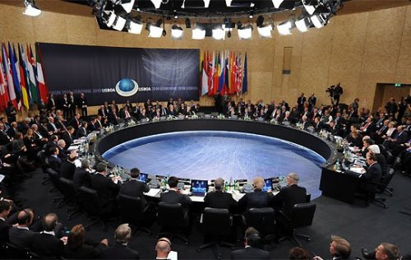
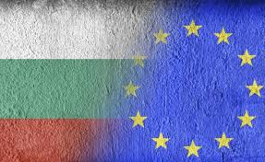
Bulgaria joined NATO in 2004 and the European Union in 2007.

Slide 25
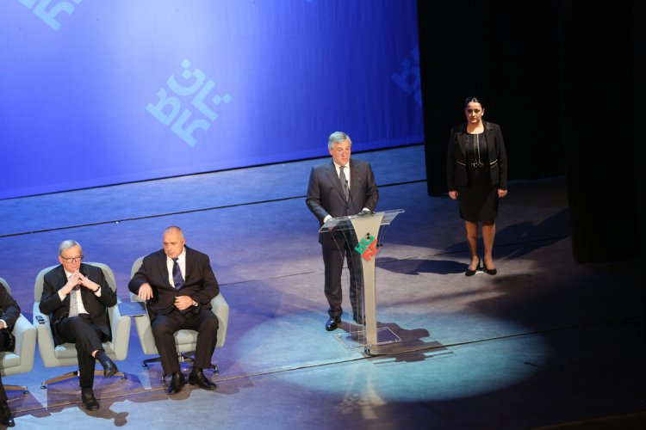
The Bulgarian Presidency of the Council of the European Union was in 2018.
„The EU Bulgarian Presidency achieved concrete results to improve the lives of European citizens.“
Joseph Daul, The President of the European People’s Party

Slide 26
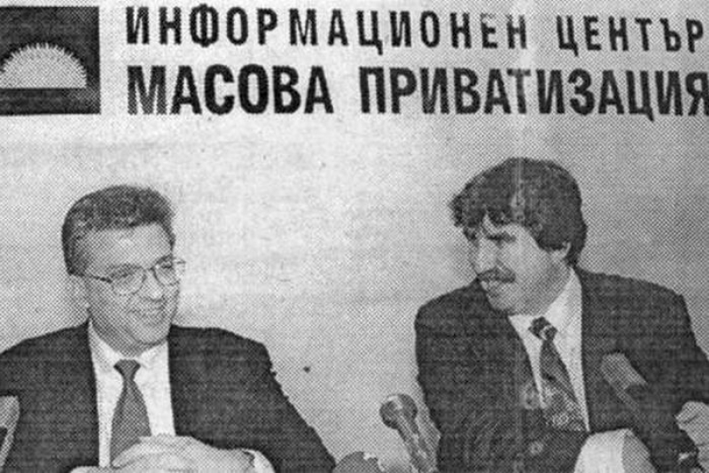
The economy of Bulgaria was transformed from central planning to a market-based system.

Slide 27
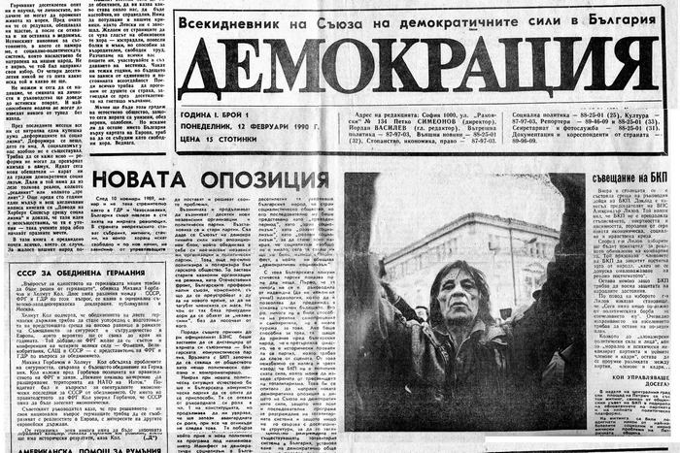
Censorship in the field of culture and art was abolished. Since the end of 1989, mass media, including printed matter, have not been censored, and free media outlets flourished.

Slide 28
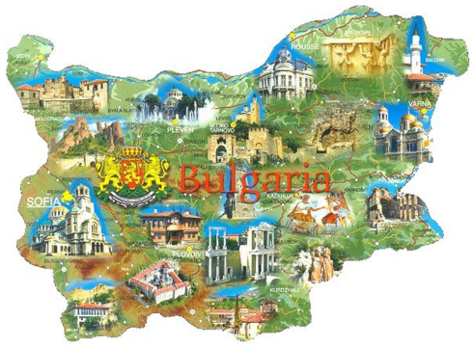
These 60 years were years of despair and hope, of disappointment and promises, of stagnation and advance, of everlasting pursuit of a better world.

Slide 29
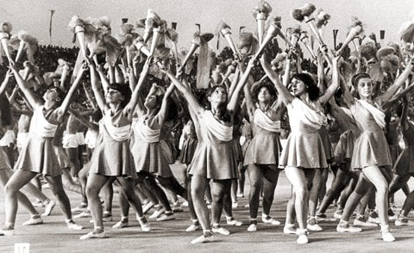
Thank you for your attention!

