Slide 1
WHAT IS CULTURE ?

Slide 2
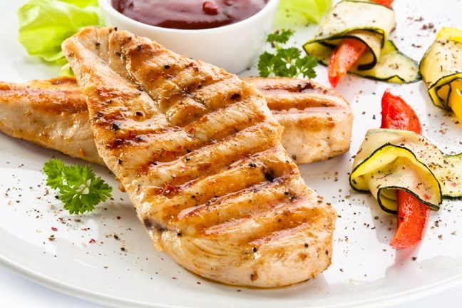
FOOD

Slide 3
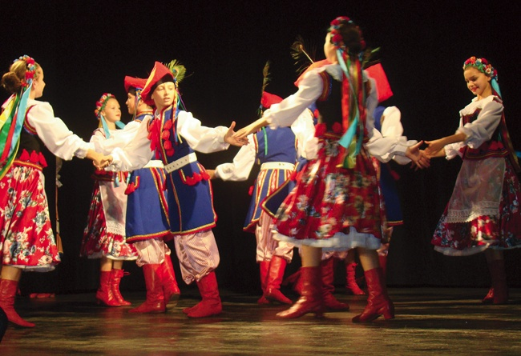
DANCE

Slide 4
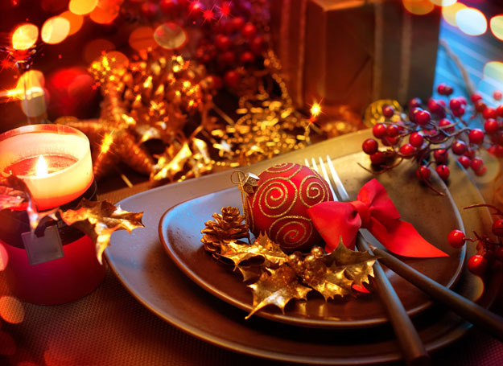
HOLIDAYS

Slide 5
HISTORY

Slide 6
PEOPLE

Slide 7
MUSIC

