Slide 1
Our interests

Slide 2
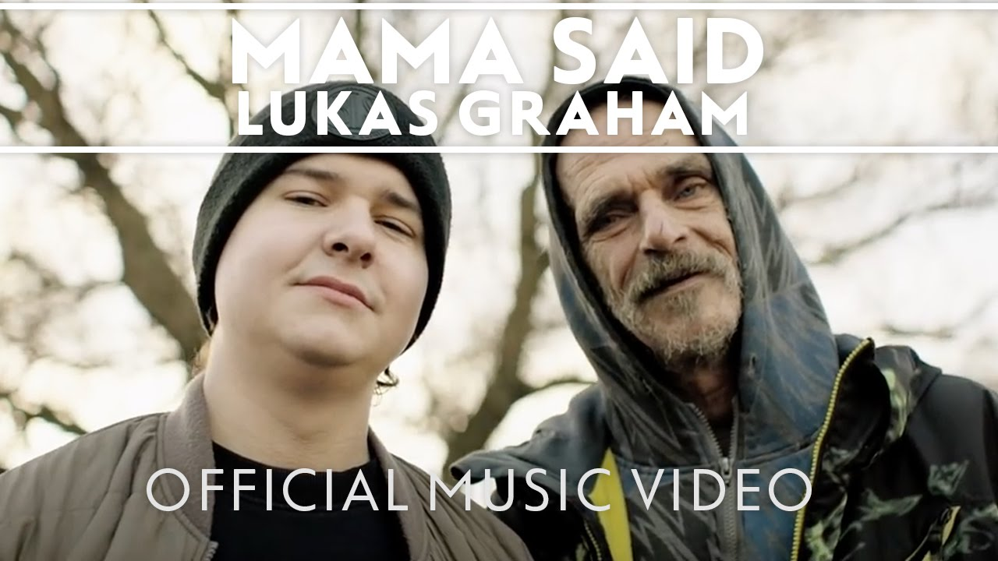
Music
,,Please tell Rosie’’ ,,Mama Said’’

Slide 3
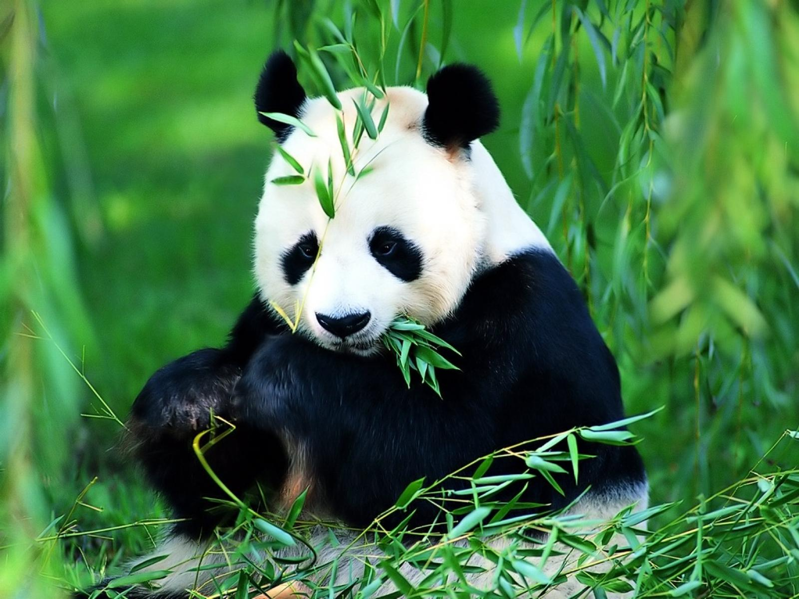
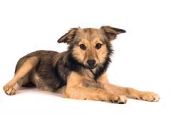
Animals
Panda bear
My favourite animal is panda bear!
It is black and white and it loves bamboo.
Dog
My favourite animal is dog. My dream dog is waiting for me in the shelter for dogs. Her name is Lisa. I love her!

Slide 4
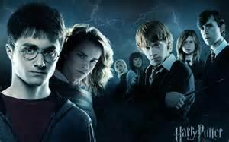
Movies
My favourite movie is ,,Harry Potter’’.
My favourite movie is ,, There was a dog’’

Slide 5
Books
My favourite book is ,,Anne of Green Gables’’
My favourite book is ,, There’s no singing tree”

