Slide 1
Culture is . . .
Primary School of Nestorio, Greece

Slide 2
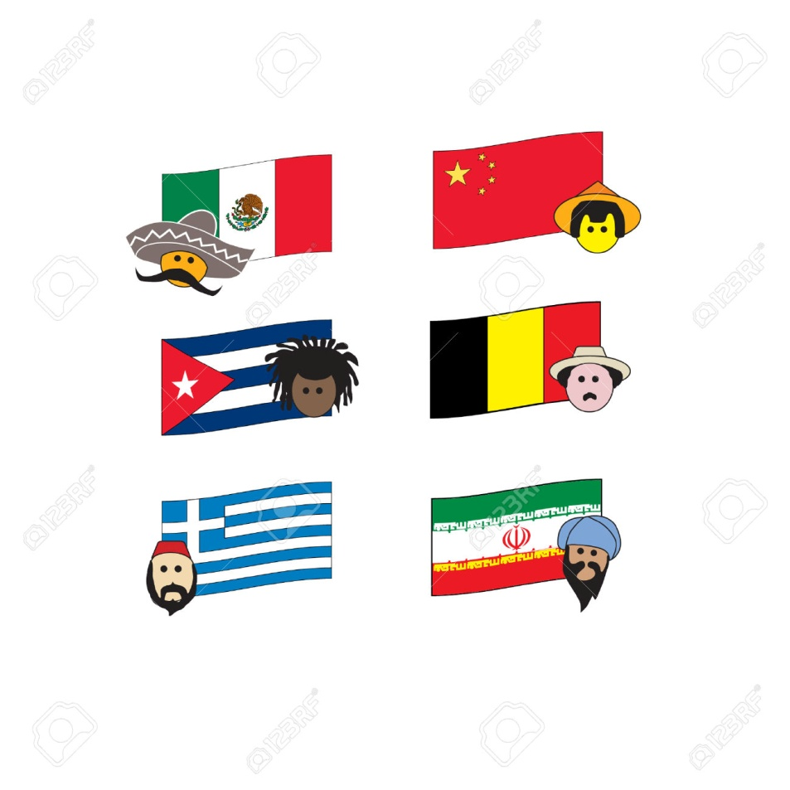
nationality

Slide 3
Style & Character

Slide 4
Humour

Slide 5
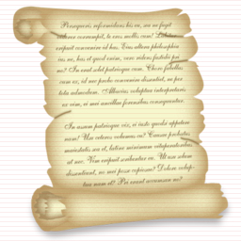
History

Slide 6
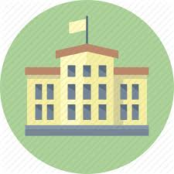
Education

Slide 7
Dances &
Customs

Slide 8
Fashion

Slide 9
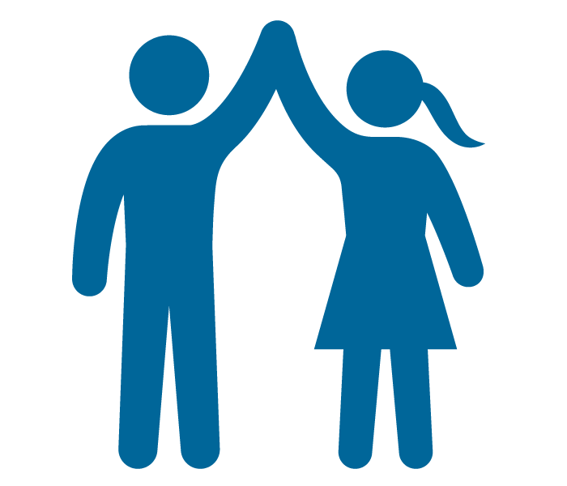
Friends & Laughter

