Slide 1
My interests
Alan Cybul 5D

Slide 2
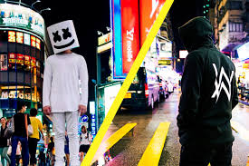
My favorite musicians are Alan Walker and Marshmello

Slide 3
Information about them
Alan Walker was born in Northampton UK. He currently lives in Bergen, Norway. He is interested in electronic dance music. There was, among other things during the Eska Music Awards (2016)

Slide 4
Marshmello's identity remains unknown, although it has been heavily suggested he is American DJ Chris Comstock, also known as Dotcom, as they are both alleged to have the same first names, birthdays, tattoos as well as similar music styles.

Slide 5
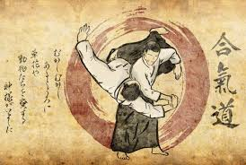
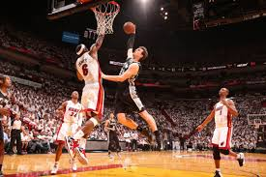
My favourite sports are aikido and basketball

Slide 6
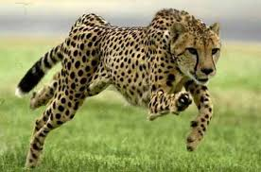
My favorite animal is cheetah

Slide 7
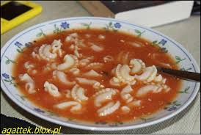
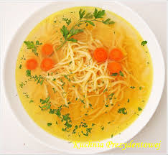
MY favorite soup is tomato soup and chicken soup

Slide 8
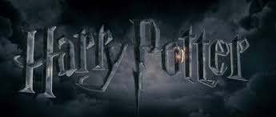
MY favorite movie is Harry Potter

