Slide 1
HOBBIES
by Erni and Barti

Slide 2
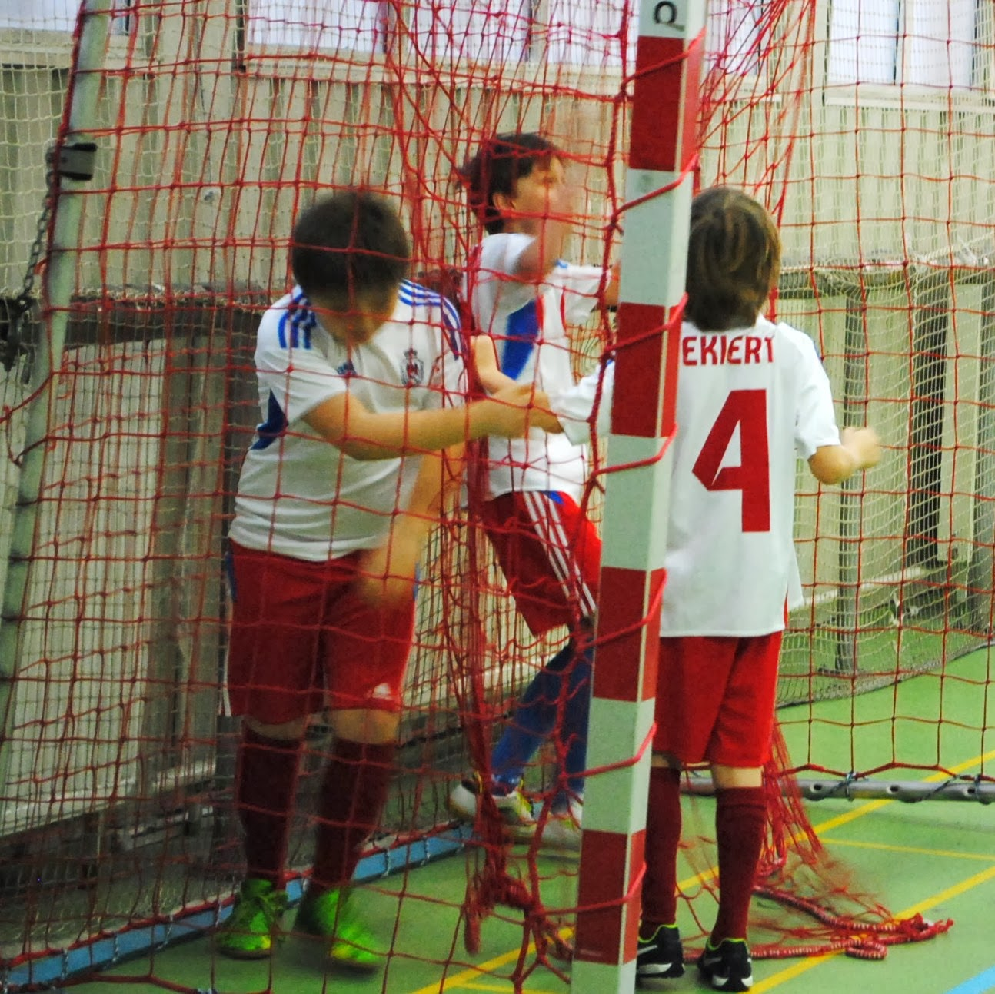
We are kin on football.

Slide 3
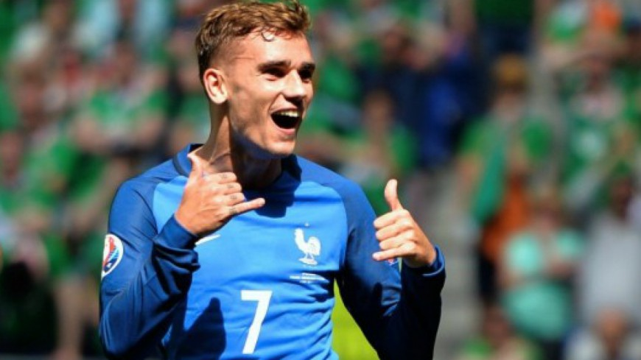
Our favourite footballer is Antonie Griezmann.

Slide 4

We like pop music.

Slide 5

Our favourite book is Harry Potter.

Slide 6
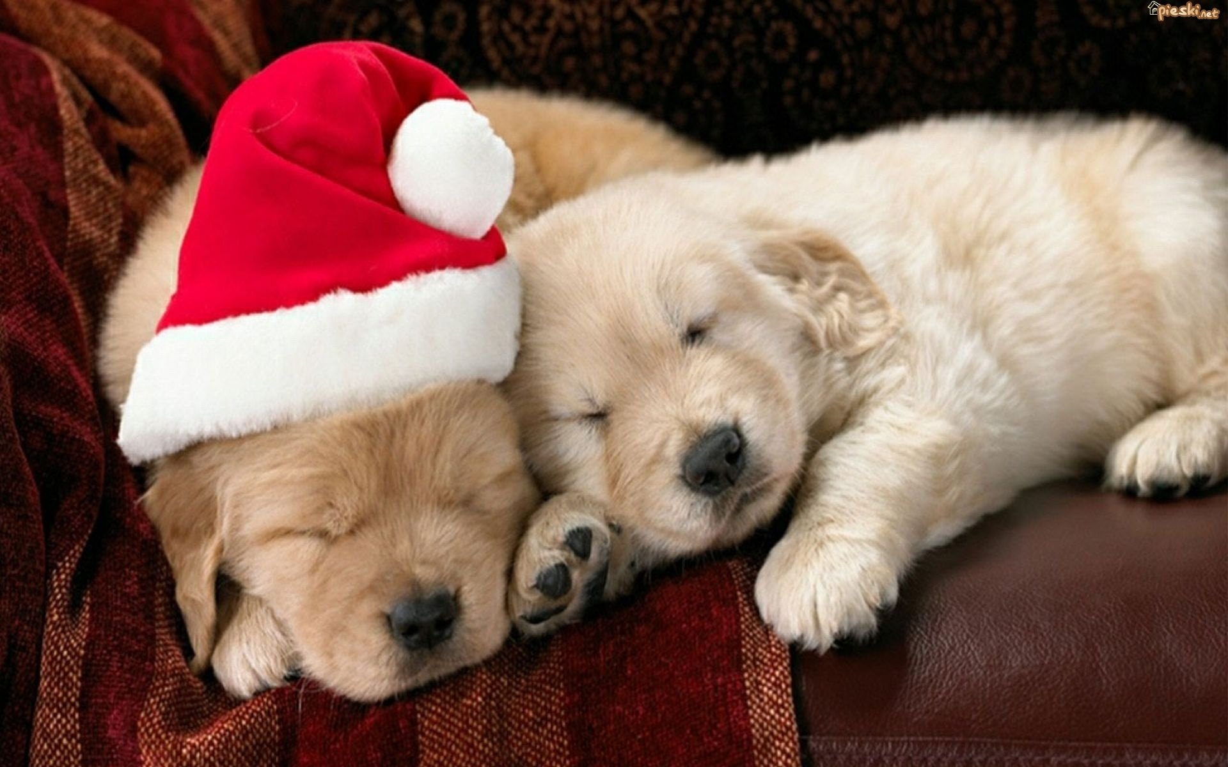
We really like dogs.

