Slide 1
MY INTERESTS

Slide 2
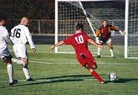
MY INTERESTS
My favourite sport is football.
My favourite footballer is Robert
Lewandowski.

Slide 3
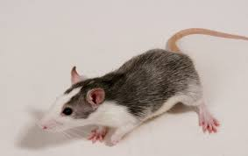
MY FAVOURITE ANIMAL.
My favourite animal is rat.

Slide 4
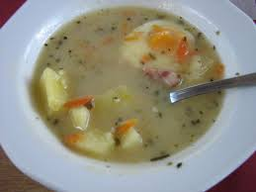
MY FAVOURITE SOUP
My favourite soup is sour soup.
In this soup are : eggs,
potatoes,sausage.

Slide 5
MY FAVOURITE BOOK
My favourite book is
„ The boys from the Square of Weapons’’

Slide 6
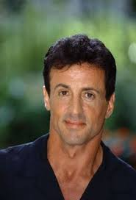
MY FAVOURITE ACTOR
My favourite actor is Sylvester Stallone.

Slide 7
By Janek Turowicz

