Slide 1
Our primary school no 336 in Warsaw
That is Our school. This presentation is a tour around school.

Slide 2
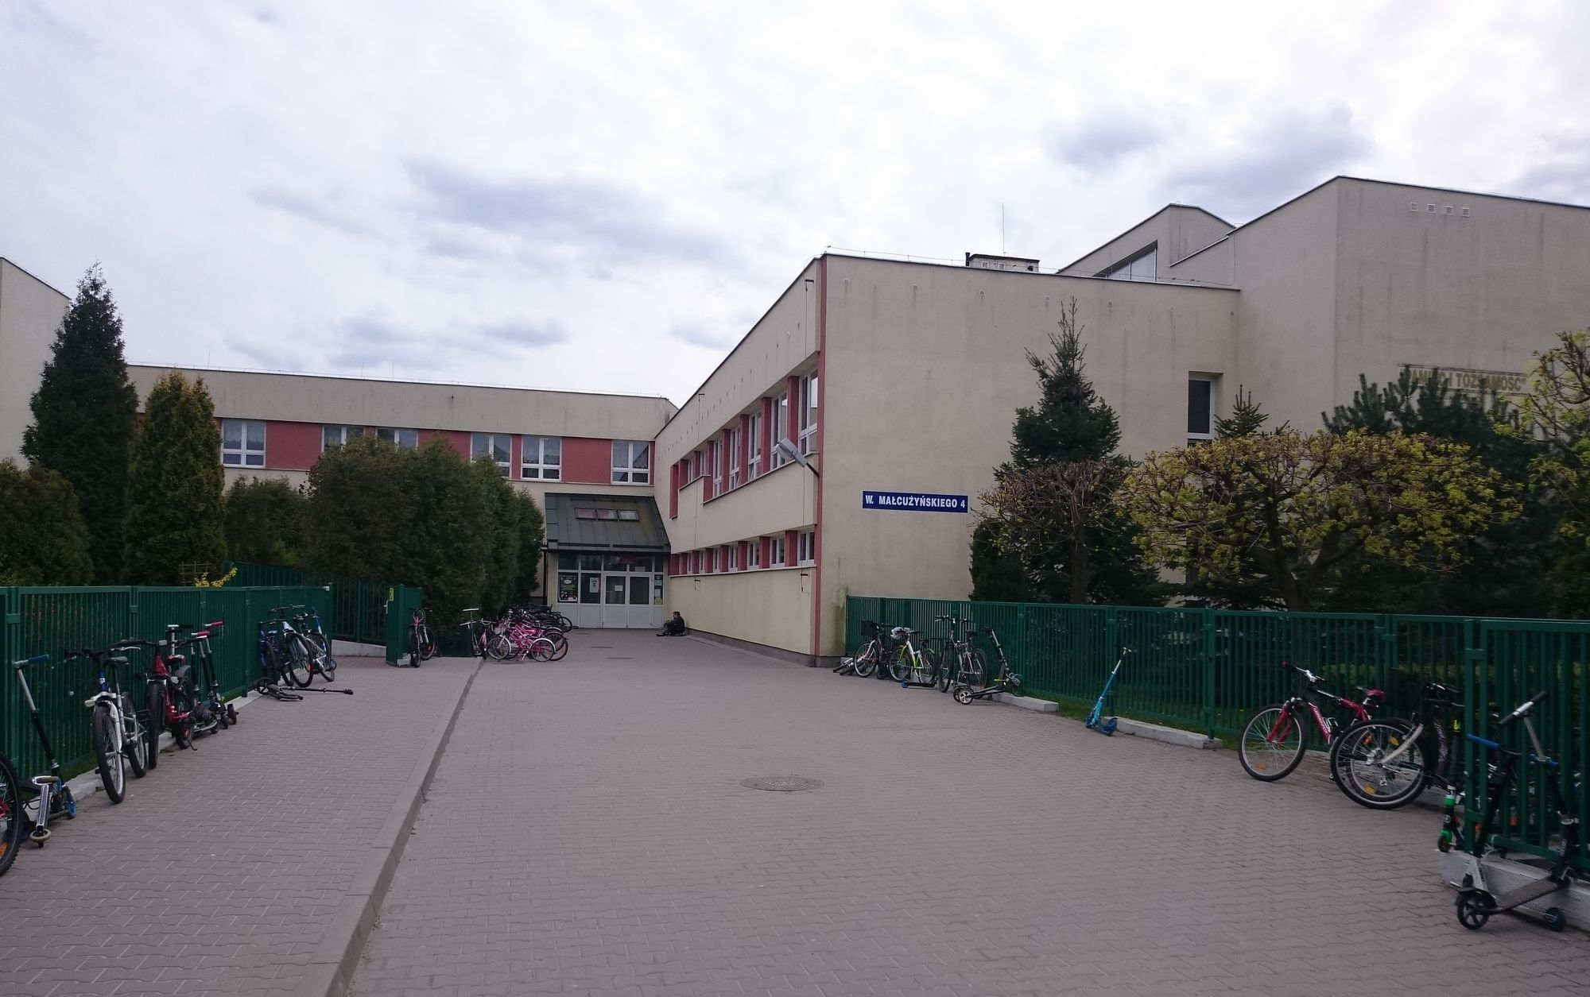
View of school 336(that’s our school ☺)

Slide 3
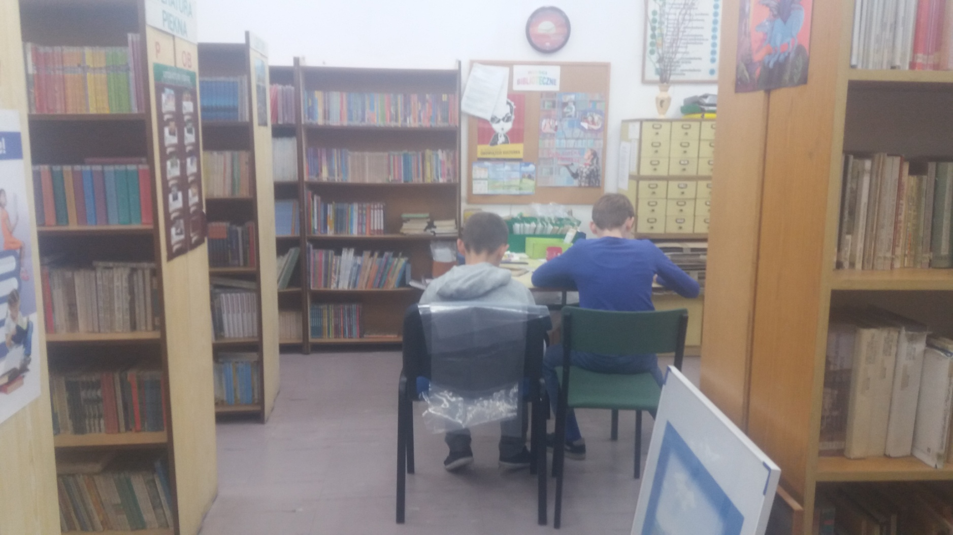
Library in the library there are 3 computers for students and A lot of Books and magazines.

Slide 4
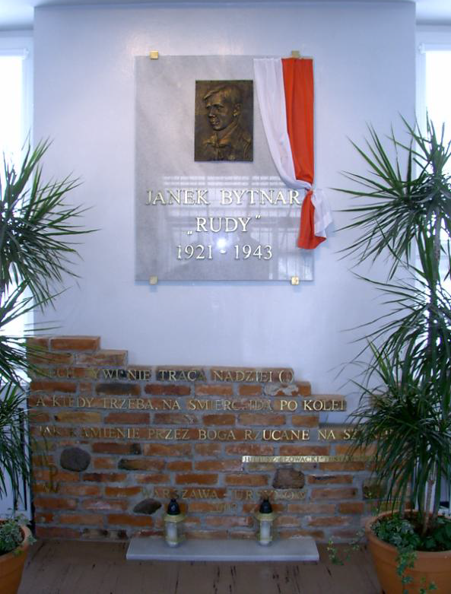
We have two monuments in the school. They are dedicated to Janek bytnar.

Slide 5
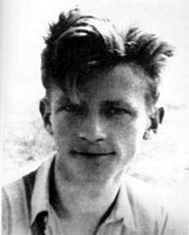
Our school patron is Jan bytnar
He was a Conspirator.
He conspired against Germany in the year 1914

Slide 6
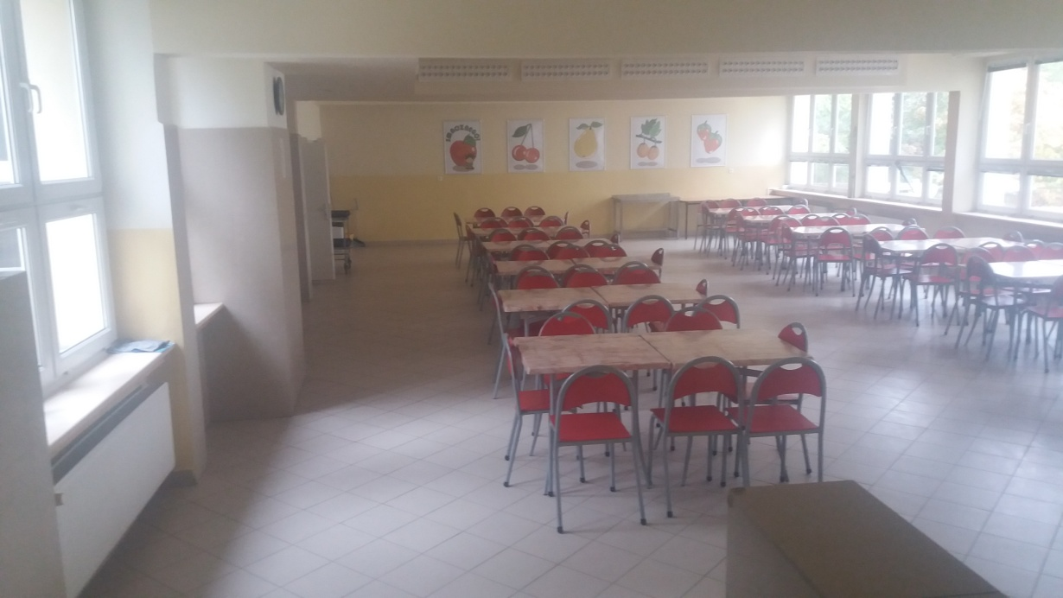
School canteen
Our canteen is very big.
But in our school there are a lot of children.
So lunch is at diferent times.

Slide 7
Presentation made by
Leopold Kuciński & Jan Turowicz-Kwiatkowski

