Slide 1
QUIZ
All about Poland.

Slide 2
What was the first capital of Poland?
Kraków
Gniezno
Warszawa

Slide 3
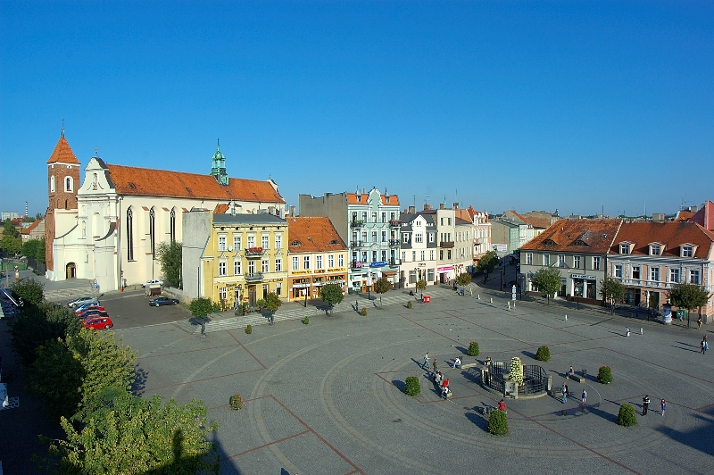

Slide 4
What is the highest mountin in Poland?
Giewont
Skrzyczne
Rysy

Slide 5
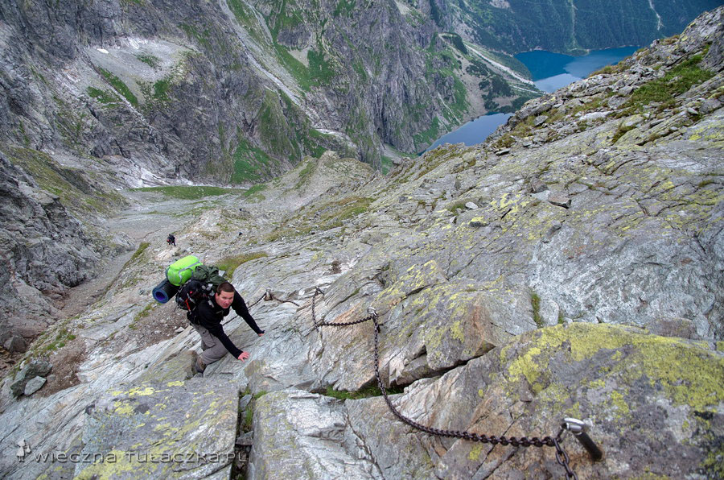

Slide 6
What is the oldest national park in Poland?
Białowieski P.N
Wigierski P.N
Kampinoski P.N

Slide 7
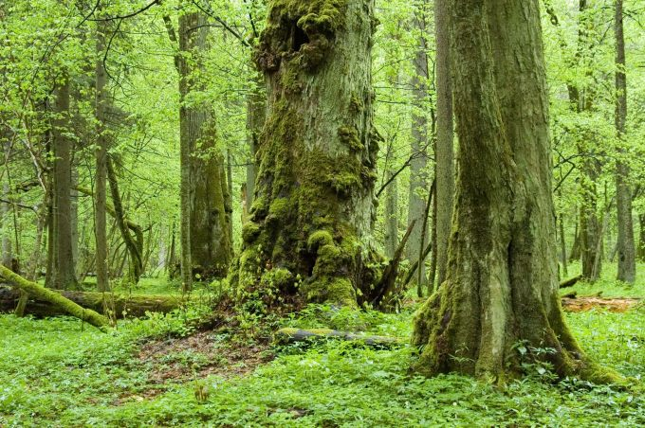

Slide 8
THE END ERNEST.E BARTEK B

