Slide 1
My village…
…Nestorio

Slide 2
Nestorio from above

Slide 3
The students of this class live in different villages: Nestorio, Kranohori, Agia Anna, Ptelea, Melanthio. But they all go to school in Nestorio.

Slide 4
Nestorio is a small and beautiful village. It is quiet and it has got a lot of trees and flowers.

Slide 5
There is a long river, Aliakmonas. By the river, there is a big party every summer.

Slide 6
There is an old castle and a myth about a dragon’s cave.

Slide 7
Also, there are parks, churches and courts.
And very beautiful paths to walk.

Slide 8
It has got two Primary Schools but only one of them is open.

Slide 9
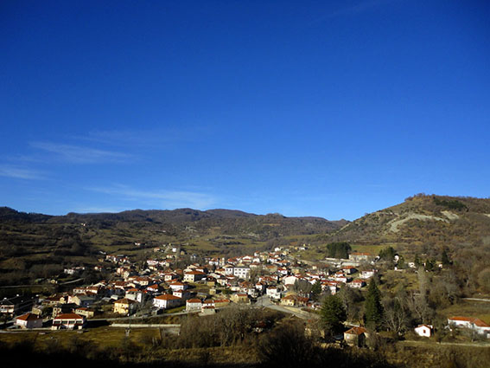
We like this village very much

