Slide 1
Our school
Named Jan Bytnar ,,Rudy’’
Notes:
My school is named John Bytnar Rudy.He born in the village Kalbuszowa in 6 May 1921 year.The second name was the mother's brother,who died fighting in the ranks of the Second Brigade

Slide 2
brief information about the patron of school
My school is named Jan Bytnar ,,Rudy’’.He was born in the village Kalbuszowa in 6 May 1921 year.The second name was the mother's brother,who died fighting in the ranks of the Second Brigade.

Slide 3
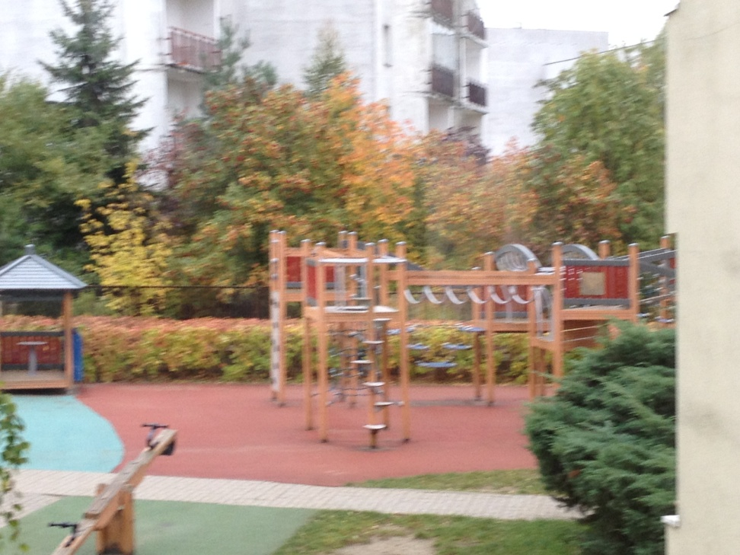
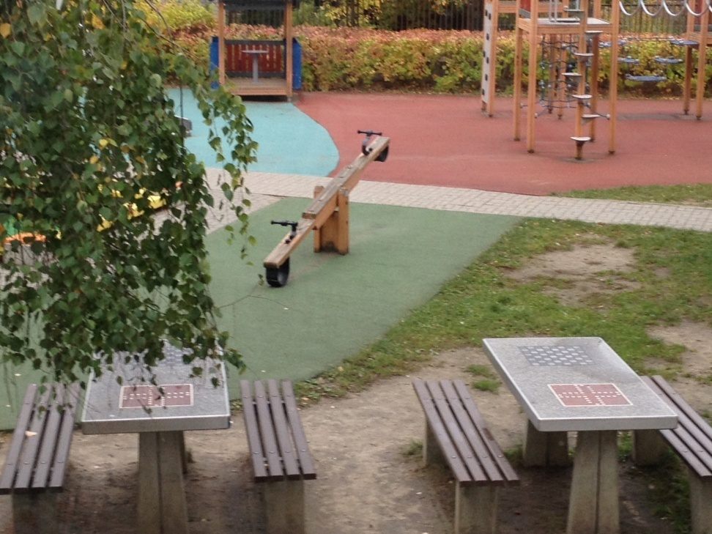
playground

Slide 4
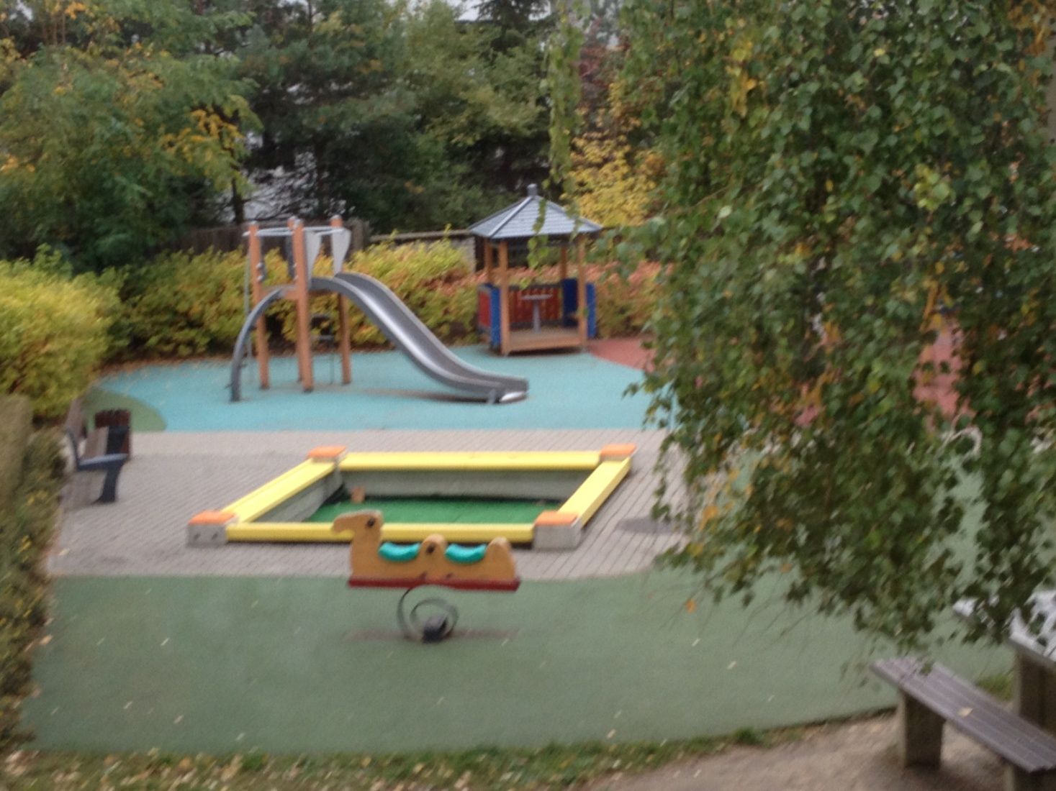

Slide 5
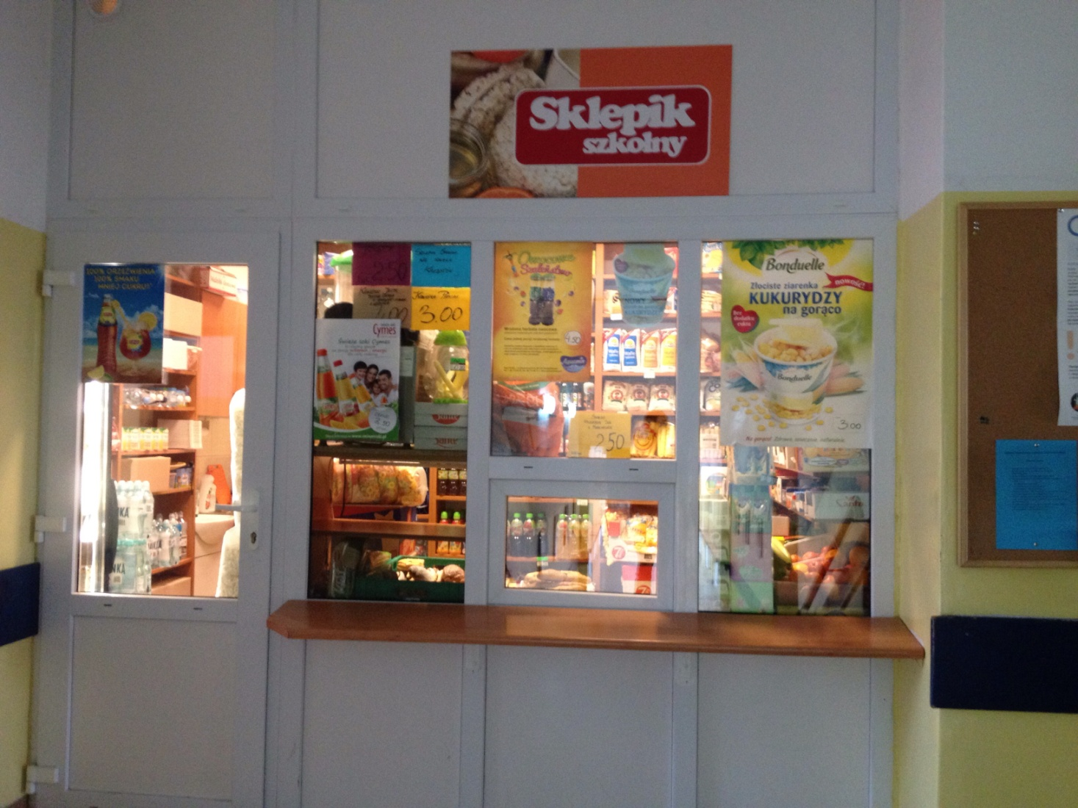
school shop

Slide 6
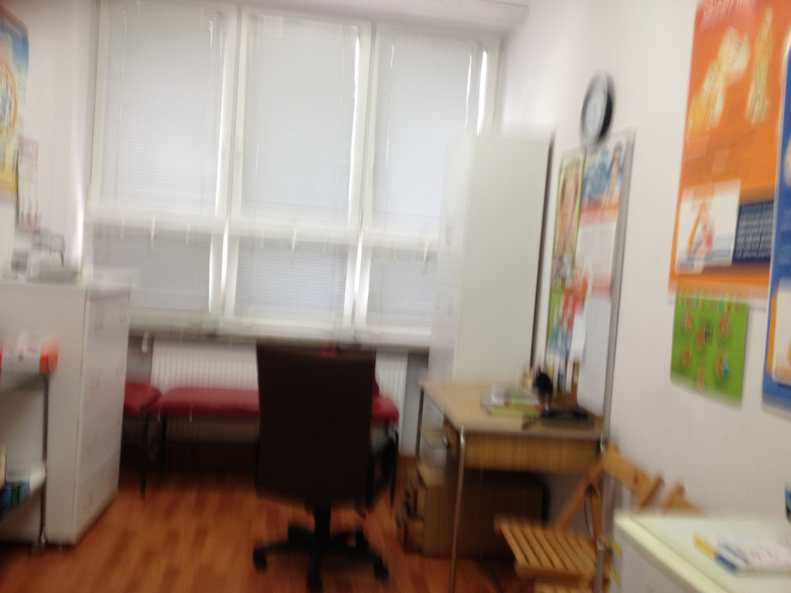
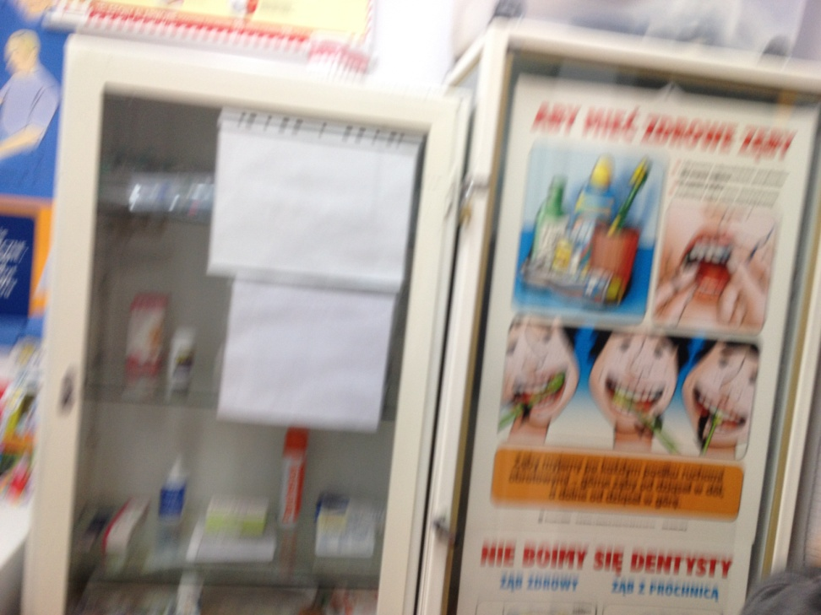
nurse’s room

Slide 7
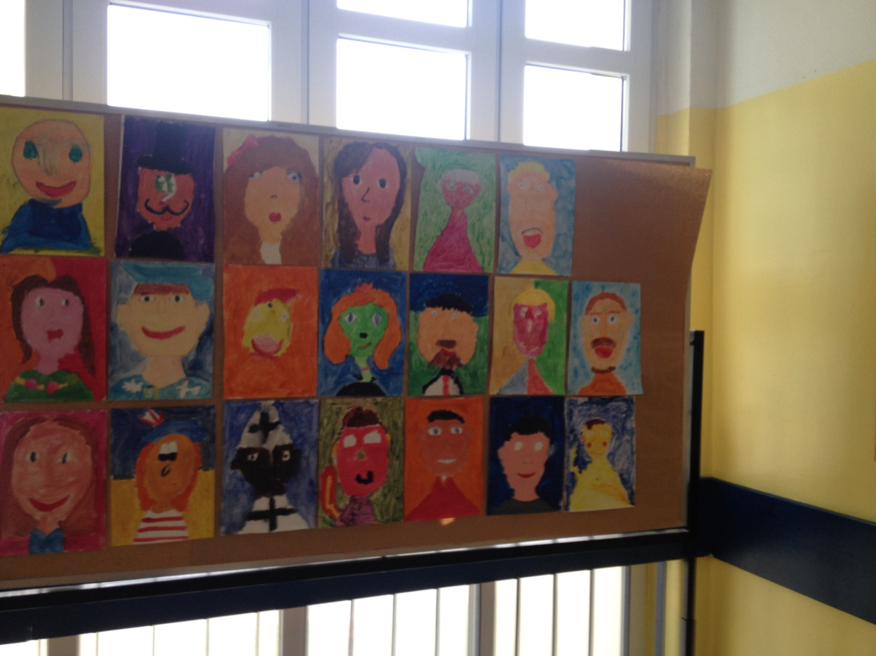
the work done by young children

Slide 8
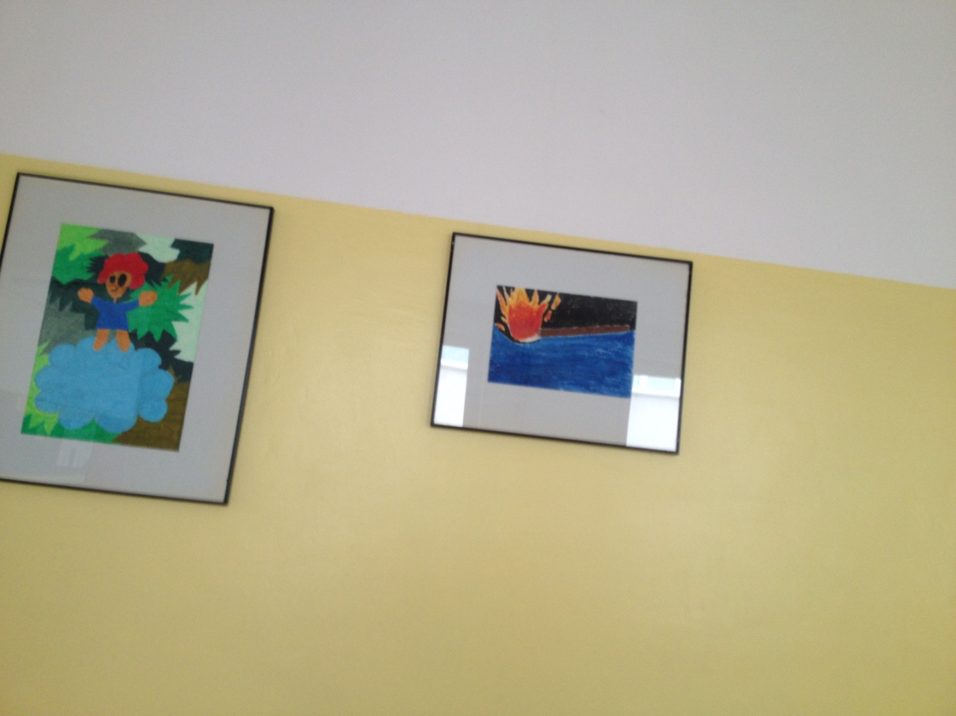

Slide 9
Thank you for watching
Alan Cybul 5D

