Slide 1
This is our School

Slide 2
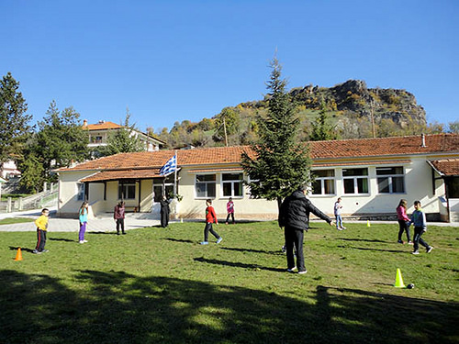
Our School is in Nestorio

Slide 3
Our school is beautiful. There is a big playground with a new wooden kiosk. We play football, basketball, handball and volleyball in our playground. There is a football pitch and a basketball court. There are trees, grass and we planted little trees and flowers.

Slide 4
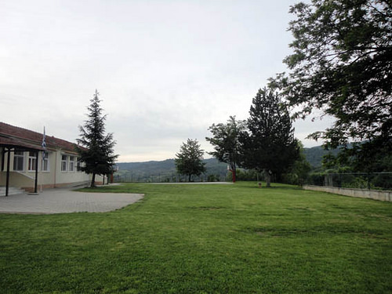
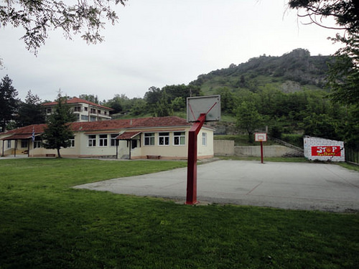
Our schoolyard

Slide 5
But there isn’t a park, a swing or a slide. There is a big hotel opposite our school.

Slide 6
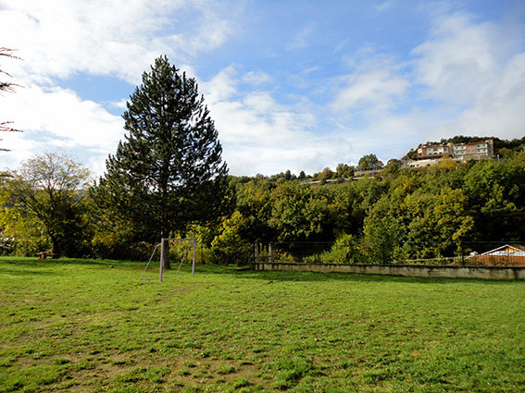

Slide 7
Our school has got five classrooms. There is also a computer room with 7 computers. There is a bookcase in every classroom and one library.

Slide 8
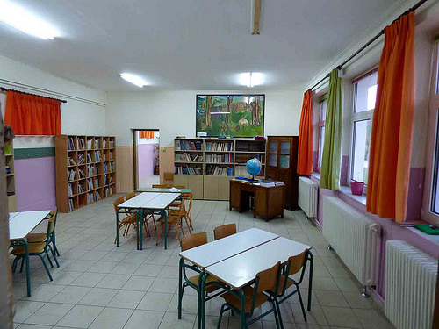

Slide 9
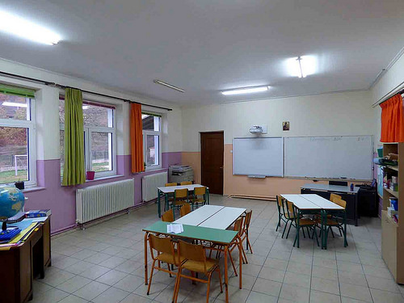
There are flowers in our classroom. There is one big picture with animals. Also, there is an interactive board.

Slide 10
we like our school

