Slide 1
Our city, Warsaw
Warsaw is the biggest city in Poland and it is the capital. It has
1 478 916 residents. This is a very beautiful city.

Slide 2
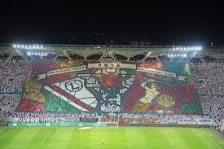
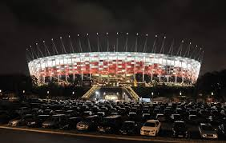
Warsaw’s stadiums
Legia Stadium
National Stadium

Slide 3
Football clubs from Warsaw
Legia Warszawa
Legia Warszawa and Polonia Warszawa are from Warsaw.
Polonia Warszawa

Slide 4
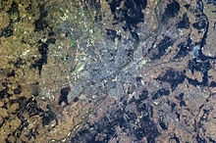
Warsaw seen from the International Space Station

Slide 5
Songs about Warsaw
https://www.youtube.com/watch?v=ePNUSmH3dMI – Dream About Warsaw (Polish version)
https://www.youtube.com/watch?v=t815V9viQeU – A song about Infantry

Slide 6
Warsaw Uprising 1944 year
1st August 1944 year. This is one of the crucial wars. Poland was invaded by the Germans and Russians. Poland was totally broken.

Slide 7
Legends about Warsaw
The most popular legend about Warsaw is the legend of Wars and Sawa. A popular legend is also a legend of the Warsaw Mermaid. Another one is the legend of the dragon Basilisk.

Slide 8
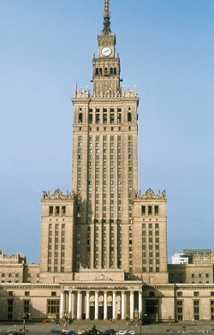
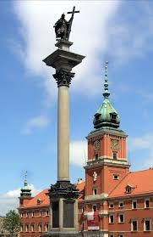
Beautiful buildings in Warsaw
The Royal Castle and
Kolumn Sigismund II
Palace of Culture and Science

Slide 9
Made by: Jan Kaczmarski and Szymon Lasiewicz
Resoureces:Google

