Slide 1
OUR CITY
WARSAW

Slide 2
History
Warsaw is the capital of Poland.
That’s the biggest city in our country. In Warsaw there was a
Second World War. In 1944 Poland decided to do the Warsaw Uprising. From 1945-1952 we were building Warsaw one more time.

Slide 3
WARSAW TODAY
Now Warsaw is modern and very big. The most famous places in it are the Palace of Culture and Science, the PGE Narodowy stadium and The Royal Baths.

Slide 4
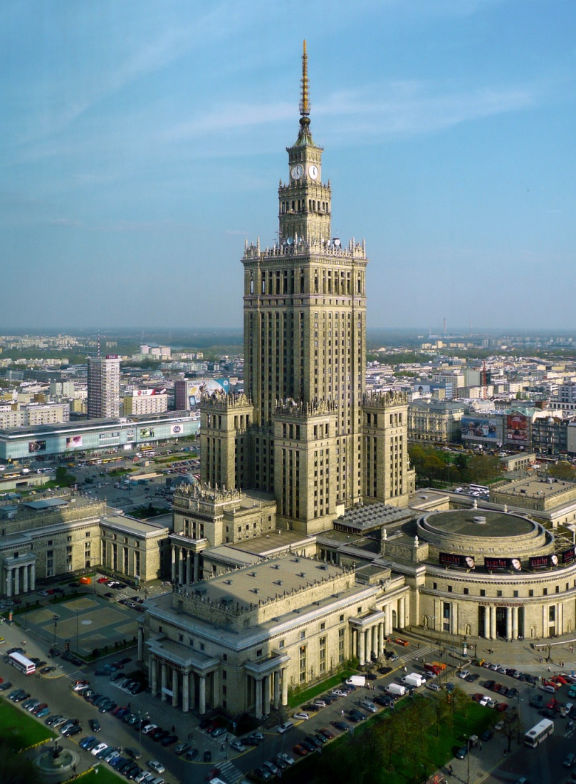
The Palace of Culture and Science.

Slide 5
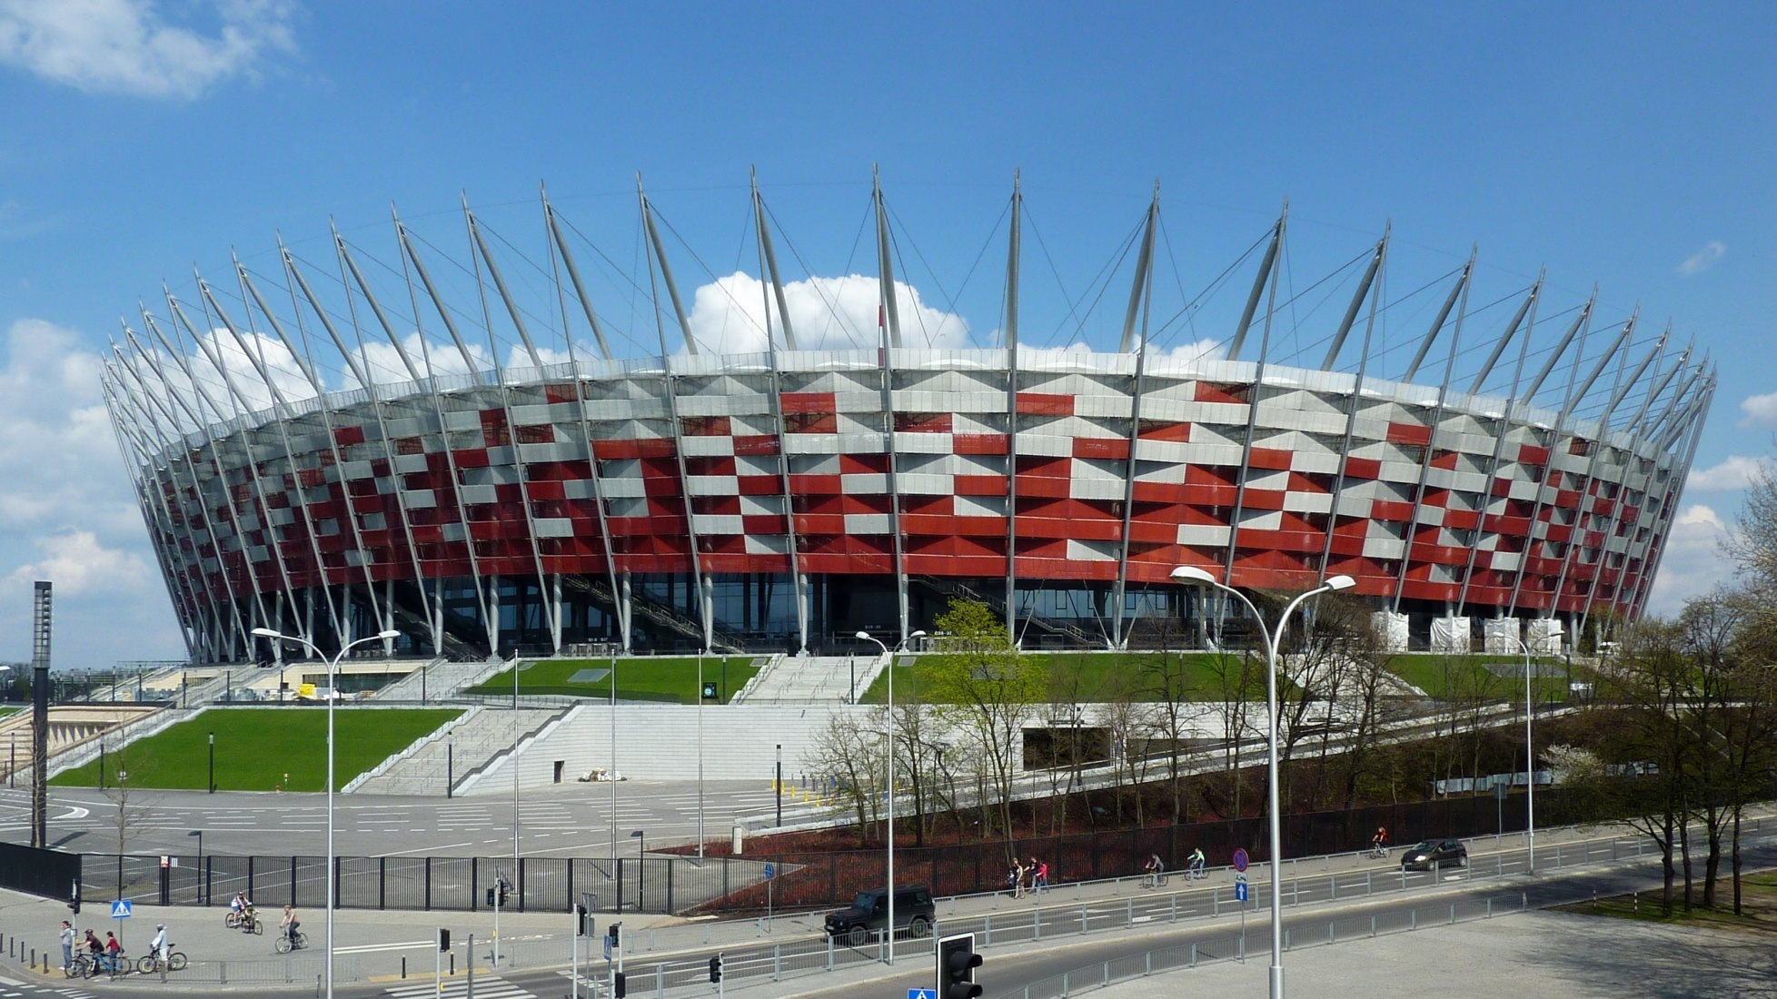
PGE National Stadium

Slide 6
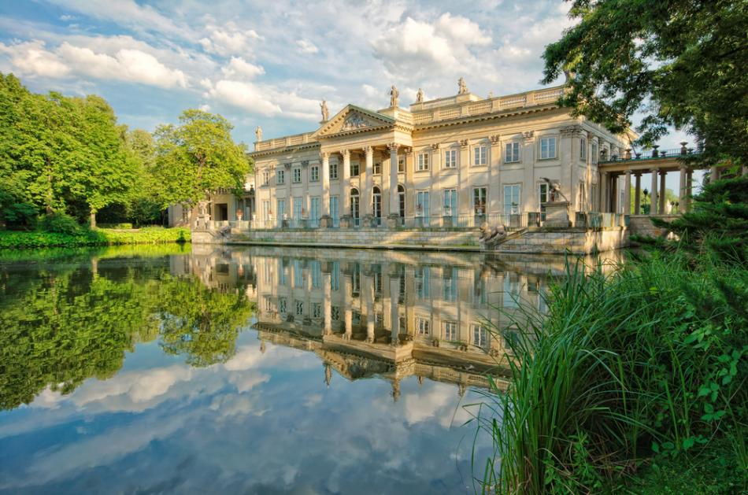
The Royal Baths

Slide 7
The Old Town
I think The Old Town is the most famous place in the whole Warsaw. It’s beautiful.

Slide 8
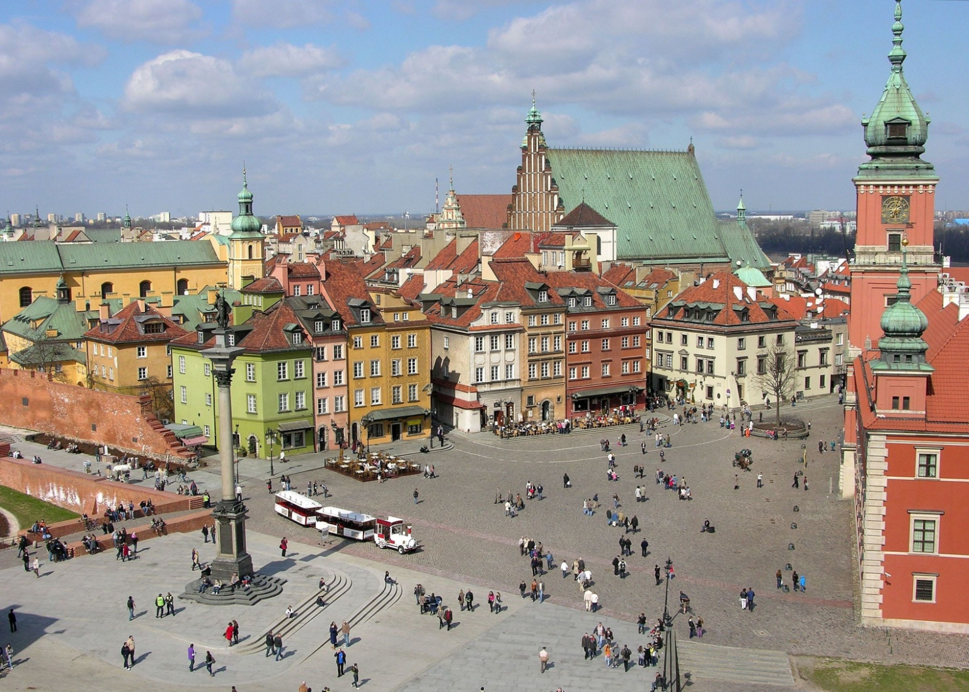
The Old Town.

Slide 9
Our opinion
We think the Warsaw is the most beautiful city in the world. It has got an interesting history and places we really like.

Slide 10
Presentation made by
Ernest.E i Bartek.B
sources: google

