Slide 1
Our company structure

Slide 2
MAnagement
Teams
Management: Marco Scheutwinkel, Jonas George
Personnel department: Max Orthey, Jann Rohpol, Lisa Kaus
Storage: Lilly Heidrich, Max Gosch, Amrei Krabbe
Sale and Distribution: Lena Mithöfer, Hannah Lück, Evi Mengen
Marketing: Alina Jujka, Lore Fehlings, Anna Balster, Ravza Bakici
Design: Marvin Jäntsch, Jannik Pütz
Bookkeeping: Eric Wenzel, Jana Ludwig, Jaqueline Kiehnel
Objectives:
work together honestly
promote fair trade
wake up society
coordinate other teams

Slide 3
Development-Design
Method #1:
Method #2:
We provide:
potential colours
potential motives
Customers choose:
combination of
colour
motive
We provide:
kind of top
colours
265 for motives
4 to 5 for primary colour
motive
Customers:
choose from possible combinations

Slide 4
Purchasing & Storage
number of t-shirts
agreement with the group
marketing and sale
transport to schools
storeroom
inventory management
agreement with bookkeeping

Slide 5
Marketing
flyer
advertisement via website
target group: everyone
location: fairtrade shops in the four participating countries,…

Slide 6
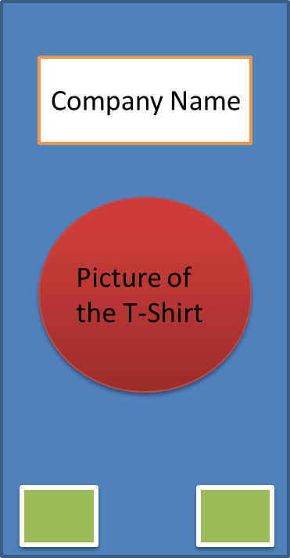
Marketing-Flyer
Front
Content
Back
What is fair trade?
„Any questions? Please contact us!“
Why is it good?
Information about
„drei Freunde“
Schools´ logos
Designs

Slide 7
Sale & Distribution
HOW?
Where?
at school
kiosk
in shops
fairtrade shops
When?
once a week
during the break
at school events
Who?
teams (2Pers.)
students of the Erasmus project
schedule
to organize the sale
Agreement with…
marketing team
appereance of our stall
design
success or failure
purchasing
amount of t-shirts
storage
time to get the t-shirts
bookkeeping
earnings

Slide 8
Bookkeeping
Our tasks:
open a bank account
keep track of bank statements
arrange a cash bank for keeping money
bank statements in folders
regular finance reports to the management
Our expections:
bills have to be brought in to be accounted for
close communication before spending
no extra costs
compare different offers from different companies
Things we need:
portfolios
storage room
a cash register machine
laptop

Slide 9
Staff
To do:
training, meetings, schedules, good working atmosphere,
good working conditions

