Slide 1
ResulTs OF OUR WEEK
REZULTATY NASZEJ PRACY W CIĄGU TEGO TYGODNIA

Slide 2
Company name-Nazwa Marki
T-shirts 4 all

Slide 3
organigramm
Whatsapp
International management
stucture
Communication
Trello
2 Switzerland
3 Germany
2 Poland
3 Spain
Management
Communication with other groups
4 Marketing
4 Management
Trello
4 Staff
4 Storage
4 Distribution
4 Bookkeeping

Slide 4
Departments – Podział obowiązków
Management - Administracja
Bookkeeping - Księgowość
Staff group - Personel
Desing group – Grupa projektowa
Purchasing and Storage – Nabywanie i przechowywanie
Sale and Distribution – Sprzedaż i Dystrybucja

Slide 5
Trello
Our comunication platform is TRELLO and now we are going to show you how it works:
Naszą platformą komunikacyjną jest portal TRELLO a teraz pokażemy Wam jak to działa:
https://trello.com/b/lfMLKYTh

Slide 6
Marketing and distribution
Flyer
Businesscard
Facebook
Ulotki
Karta Biznesowa
Facebook

Slide 7
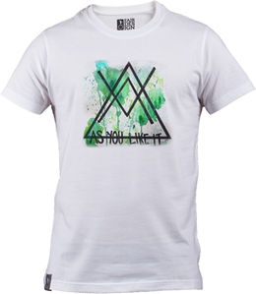
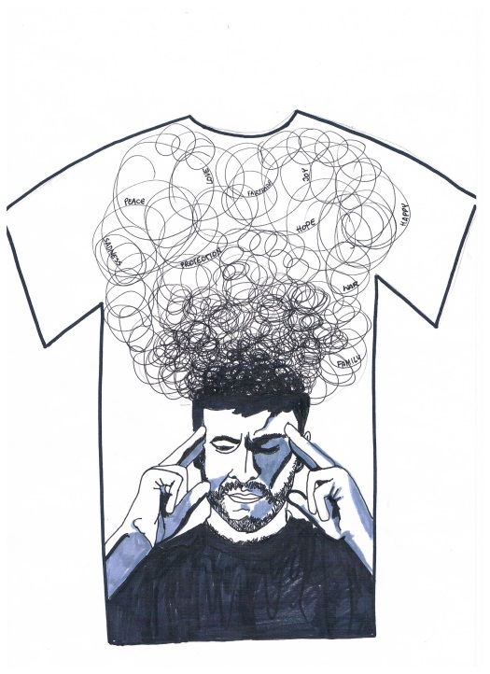
DESIGNS:
T4ALL

Slide 8
What is Fair Trade?
Fair trade guarantees fair pay for the workers in the producing countries .There is a minimum price for fair trade work. If the market price is higher, they will even get a higher profit. Futhermore the workers will do their work under better conditios than usual. There won´t be any child labour and local projects are supported as well.
Information about T4ALL
Erasmus+ is a charitable school project with participants from four different countries: Spain, Poland, Switzerland and Germany. In this project we want to support development aid. By selling shirts, we help Indian cotton farmers and factory workers to get fair pay and a better life.
Information about “3Freunde”
3-Freunde is an organization from Germany which was founded by three friends in 2006. Their goal is to create the perfect T-shirt: good quality and fair trade. In 2007 they realized the first carbon neutral T-shirts. Since 2008 they have produced their shirts with organic cotton. Every cotton farmer working for 3-Freunde earns enough money to afford the basic needs for their family.
For more information: http://3freunde.de/home/about
Any questions?
Please contact us!
Contact:
Alina Jujka
Marco Scheutwinkel
Jonas George
Address:
Gesamtschule Brühl
Otto-Wels-Straße 1
50321 Brühl
Germany
EMAIL:
erasmus@myself.com

Slide 9
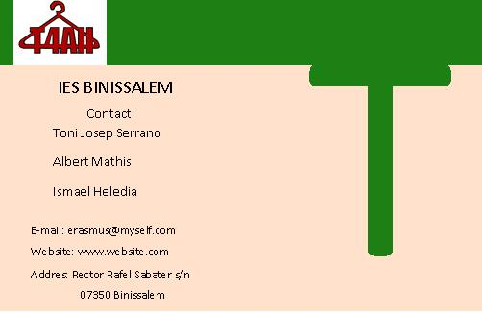

Slide 10
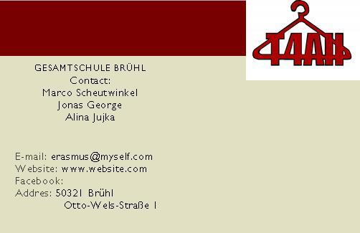

Slide 11
FACEBOOK
http://www.facebook.com/Erasmus-Plus-1078573528844155/

Slide 12
Common work wspólna praca
Polish/polska: Kamiha
Swiss/ Spanish/
szwajcaria: Hiszpania:
Aline Monica
German/Niemcy: Evi

Slide 13
OUR IDEAS-sustainibility
Polish ideas
*party Fair Trade
*club mixed
German ideas
*work group Erasmus+
*inform classes
*students company
Spanish ideas
*concience the people
*study trip
Swiss ideas
*SOM (student organisation)
*T-shirt selling in school

Slide 14
Nasze pomysły- trwałość
Polskie pomysły
*Imprezy z Fair Trade
*Klub sprawiedliwego handlu
Niemieckie pomysły
*Grupa Erasmus+
*lekcje informacyjne
Hiszpańskie pomysły
*Wpłynąć na sumienie ludzi
*Sprzedaż koszulek w szkole
Szwajcarskie pomysły
*organizacja studencka
*Sprzedaż koszulek

