Slide 1
Kreissparkasse Birkenfeld
Informations about the KSK Birkenfeld
and
Cashless Payment in Europe

Slide 2
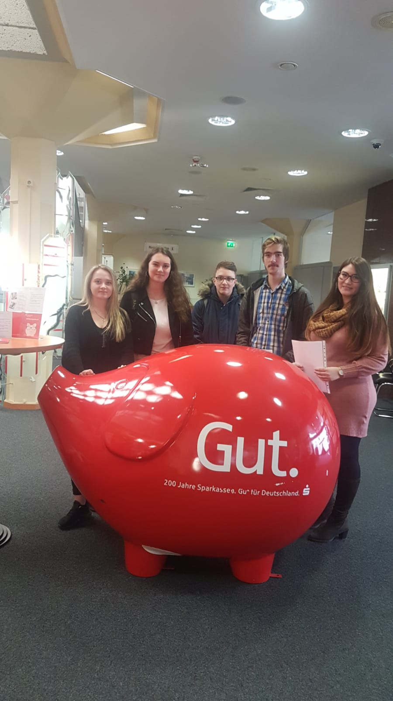
Planning
topic “finance”
→ main topic “Cashless payment in Europe”
visit to regional bank “Kreissparkasse Birkenfeld”

Slide 3
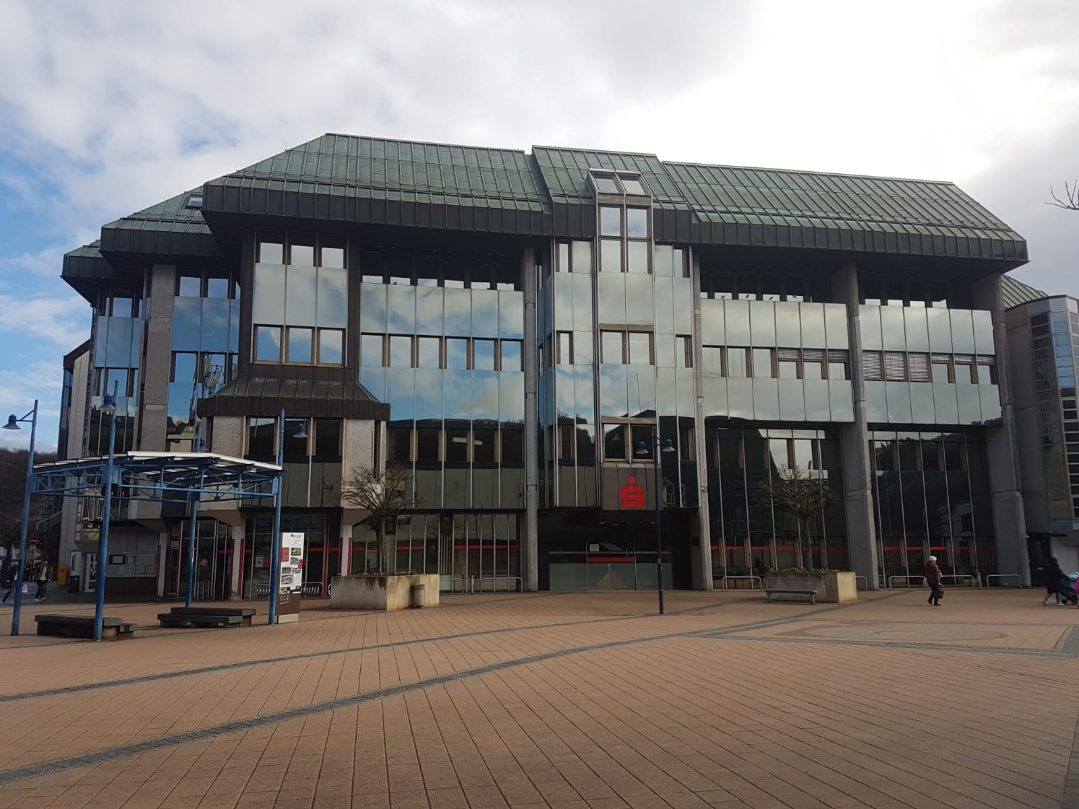
Informations about the KSK Birkenfeld
since 1842
400 business locations
15,000 branches
350 employees in the KSK Birkenfeld
50,000 current accounts

Slide 4
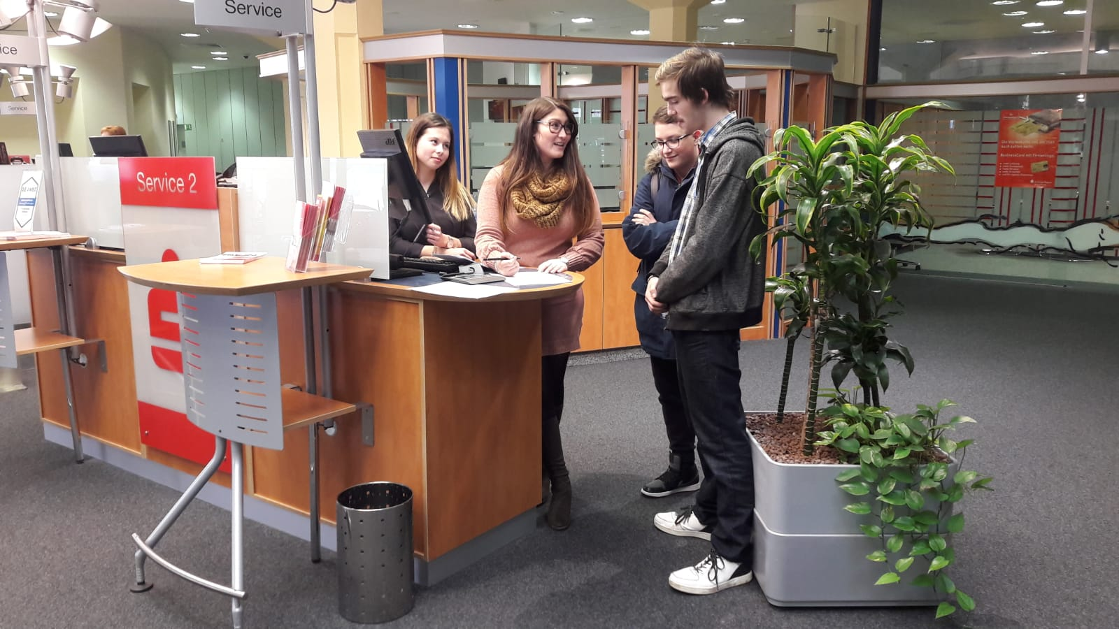
Apprenticeship at KSK Birkenfeld
in 3 years ca. 15-20 apprentices
of which ca. 5-10 annually
every year new apprentices

Slide 5
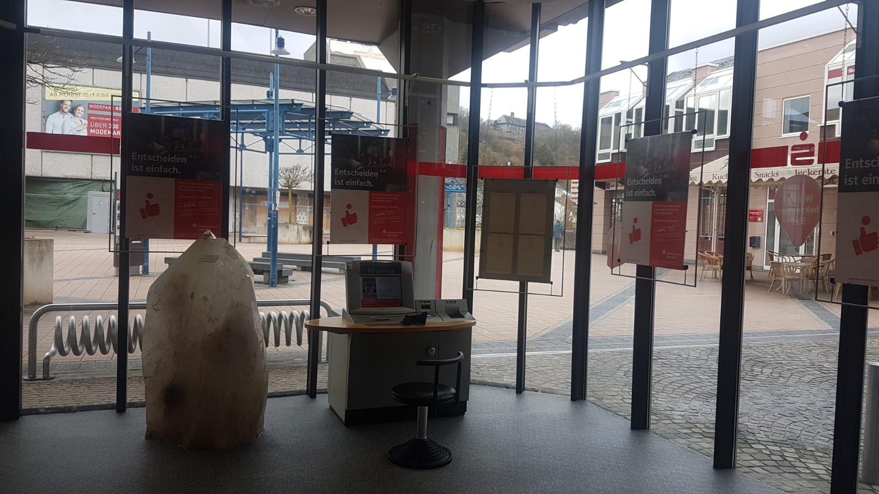
Cashless Payment – What?
customers don’t always trust the security
use of online banking is increasing
is getting saver
in every shop that has cashless payment

Slide 6
Cashless Payment – How?
information is stored on the chip in your card
most supermarkets use scanners to read the information
thus you can pay without cash
money will be deducted from your account
there are limits set by the Sparkasse

Slide 7
Thank you for your attention.

