Slide 1
Media in the Czech Republic
Krejčová, Otrusinová

Slide 2
Newspapers
is the oldest kind of media
people like reading newspapers:
for get more information
sometimes just for relax
We distinguish between two types of newspaper:
tabloids –
- They have lots of stories about famous people, short articles
Blesk, Šíp
2) broadsheets –
- are serious, long article with details
- MF dnes, Lidové noviny, Právo

Slide 3
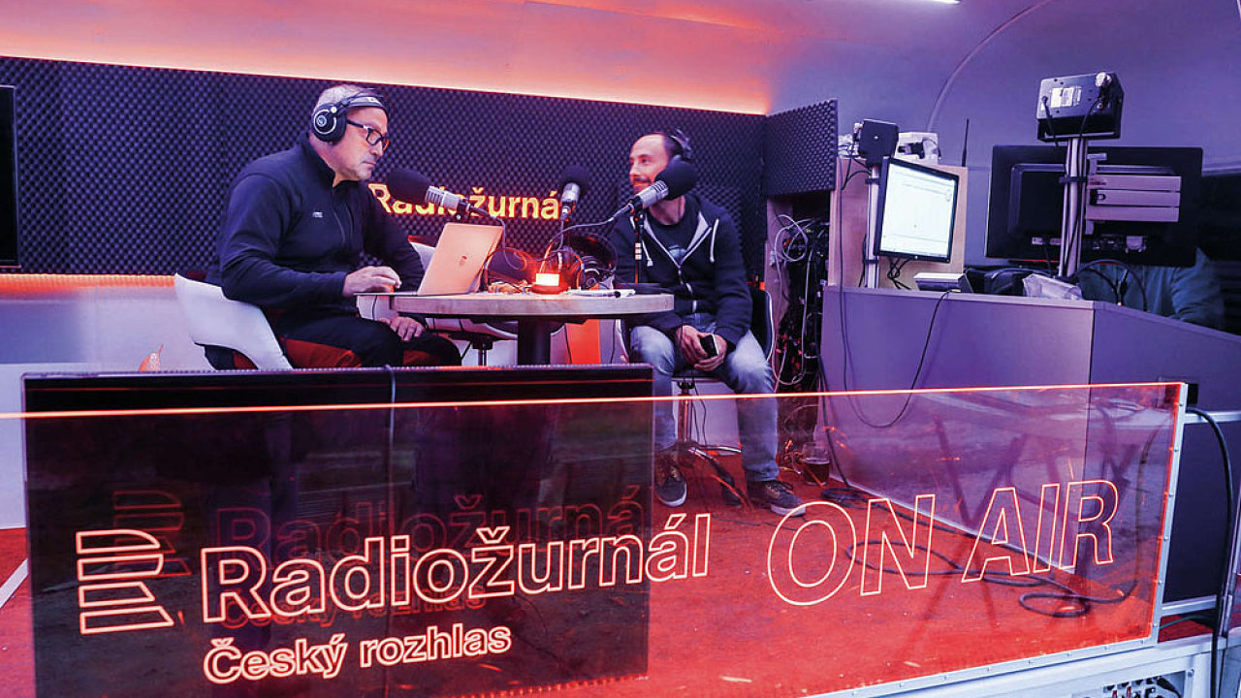
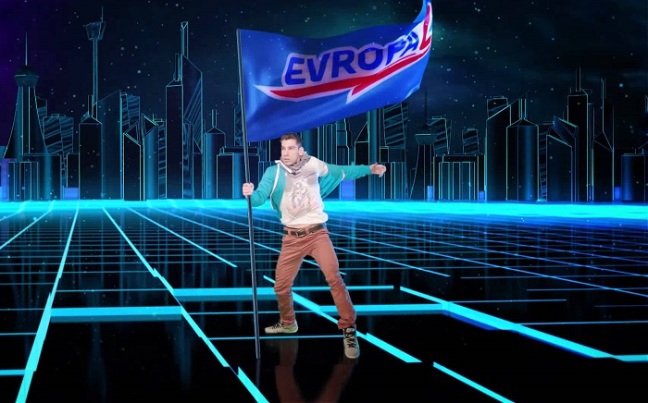
Radio
includes news, music, advertising or some funny programmes
In the Czech Republic there are many radio station
Two groups:
state stations - Radiožurnál
private stations - Europa 2
There are local radios
Lots of specialist stations - classical music, rock music or sport
Popular is listening to the radio during driving

Slide 4
TV
This media is very young
3 groups:
state channels - Czech Television 1 and 2
private channels - Nova and Prima
satellite channel – HBO
During the day we can watch various kinds of programmes
- films, soap opera, weather forecast, news

Slide 5
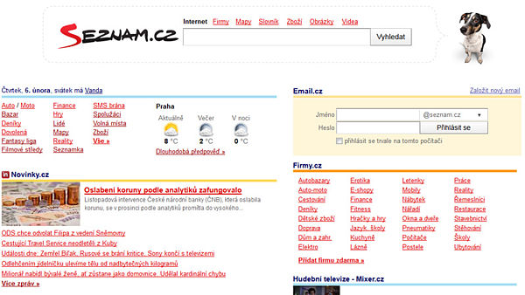
Internet
It is international network of computers
You can find there a lot of information according to keyword and in 2 seconds
internet search engines: Seznam, Google, Explorer

Slide 6
Zdroje obrázků
https://www.periodik.cz/predplatne/img/titulka.php?titul=100826&rok=2016&vydani=47
http://img.floowie.com/img.php?type=medium&hash=00dac0fcc13fafc29d3cd12115fcb27d2a25502b4e6a932b720659a4c98a7de0fde656c4606a1ef3024dc11a22ce&page=1
https://www.pravo.cz/upload/uploads/titulka.jpg
https://img.ihned.cz/attachment.php/200/71914200/O2zSaCgM4crL1eiFqAdKk7hEG5tbUIHy/19_lnek-1.jpg
https://mediagurucdneu.azureedge.net/media/2387/evropa-2.jpg
https://encrypted-tbn0.gstatic.com/images?q=tbn:ANd9GcTlaArFqORtmn4hFwb3kxq4RicD3LzFQROqdAjSvxj64oBJ3B0T
http://img.cz.prg.cmestatic.com/media/images/600x338/Jan2012/929458.jpg?d41d
https://www.multichannel.com/.image/c_limit%2Ccs_srgb%2Cq_auto:good%2Cw_620/MTU0MDY0ODk0MjgzNDkwMzg2/hbo-logo2-400x300jpg.webp
https://media.novinky.cz/474/414743-top_foto1-jbq0t.jpg?1452153601
https://upload.wikimedia.org/wikipedia/commons/5/51/Google.png

