Slide 1
Social literacy
Projekt ERASMUS+ „Four shades of literacy“

Slide 2
Aims of the workshop
understand disability-related needs in the workplace and in society
practise skills of self-advocacy
develop a sense of responsibility and an awareness of human dignity

Slide 3
Ice-breaker
Have you ever had a summer job?
If yes, how did you apply and was it difficult to get it?
Where can you find information about jobs?
What disabilities can poeople suffer from?
What kind of barriers that people with disabilities may face when applying for a job?

Slide 4
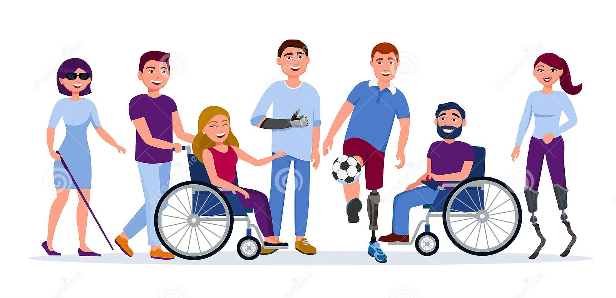
Workshop – I want to work
you will be role playing a series of interviews for a job of office assistant in the customer service department of a small company
each of the applicants has a disability
each role player chooses one or two friends to help them develop their role, you will have 10-15 minutes to prepare
the interview should be brief, max. 5 minutes
Role cards

Slide 5
Evaluation
How did you feel during the simulation?
What did you like or not like?
How well do you think you coped with your role? What was the most difficult thing?
Could these situations happen in real life?
Did the interviewers show respect and consideration for the people they were interviewing?
What can you say about disabled peoples' right to work? Do you think their right to work is guaranteed in practice?
What do you think are the main reasons for high unemployment rates among people with disabilities? Is this fair?

Slide 6
Facts and figures about disability from the European Disability Forum
Disabled people represent 65 million people in the European Union.
Disabled people are two to three times more likely to unemployed than non-disabled people.
Only 16 % of those who face work restrictions are provided with some assistance to work.
Many disabled people are "discouraged workers" and don't even attempt to enter the labour force. They are therefore classified as inactive.
The more severe the degree of disability, the lower the participation in the labour force. Only 20% of people with severe disabilities work, compared to 68% for those without disabilities.
Across Europe, 38% of disabled people aged 16-34 have an earned income, compared to 64% of non-disabled people. Disabled people's income is dramatically lower than the income of non-disabled people.

Slide 7
Follow-up – Workshop - Can you
You will be given a role card, do not share it with anybody
The teacher will ask differrent questions, if you can answer "yes" to the statement, take two steps forward, make one step if you feel it may potentially be possible, do not move you feel it is impossible
Role cards

Slide 8
Questions
Can you use public transport?
Can you play football easily?
Do you feel safe going home alone at night?
Have you ever encountered any serious financial difficulty?
Do you have decent housing with devices like television, refrigerator etc.?
Do you feel welcome at your local youth club?
When you enter a club full of white men: will you stay?
If you are competing with people of similar qualifications for the same job, do you feel you have an equal chance of getting it?
Do you see people similar to yourself represented on TV?
Can you easily adopt a child?
Do you feel that people listen to you?
Would you get a job as a nanny easily?
Do you think you would receive fair treatment from the police?
Do you feel you can study and follow the profession of your choice?
Do you think your language, religion and culture are respected?
Do you feel comfortable moving into a shared house?

Slide 9
Reflection
How did the students feel stepping forward – or not?
For those who stepped forward often, at what point did they begin to notice that others were not moving as fast as they were?
How easy or difficult was it to take over the different roles? How did they imagine what the person they were playing was like?
How did the students know about the character whose role they had to play? Was it through personal experience or through other sources of information (news, books, and jokes)? Are they sure the information and the images they have of the characters are reliable?
Did anyone feel that there were moments when their basic human rights were being ignored?
Can people guess each other's roles? (Let people reveal their roles during this part of the discussion.)

Slide 10
Video
Who is perfect
https://www.youtube.com/watch?v=cam0wLRIwBw

Slide 11
Sources
http://www.aces.or.at/can-you
https://www.coe.int/en/web/compass/i-want-to-work-

