Slide 1
Gender-related clichés in advertising
Projekt ERASMUS+ - Four shades of literacy

Slide 2
Aims of the workshop
analyse stereotypes and gender roles in advertisements throughout the 20th century
identify gender-stereotypes of young adults
discuss the relationship between gender roles in society and in advertising

Slide 3
Ice-breaking
Do you watch/read advertisments? Where? How often?
Do you know any advertising slogans?
Do advertisements influence you when shopping?
What makes a good advertisement?
What do you dislike about advertisements?

Slide 4
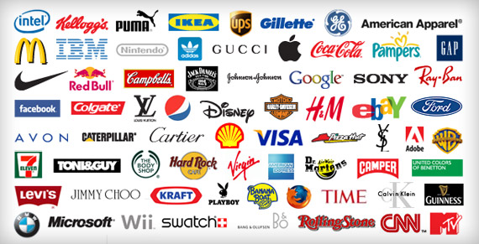
Quizz – What products do the brand names represent?

Slide 5
Workshop
take a seat at one of the 5 tables, at each table, there is a poster with 3 pictures of advertisements from a decade between 1959 and 2000
at each table, there is a set of numbered adjective cards
play with adjectives - examine the advertisements and list 10 adjectives which relate to the illustrated men and women in the advertisements
collect the lists of adjectives on your poster, you can also add your own adjectives

Slide 6
Discussion
What is the relationship between gender roles in society and in advertising?
Do advertisements just reflect the ‘reality’ in society; or do they ‘influence’ the shaping of realities in societies?
What do you consider to be the major differences between role stereotypes and gender-related clichés in advertisements of the 1950s and the ads nowadays?
When do you suppose that these changes happened? Why?
What is the concept of womanhood and manhood about nowadays?

Slide 7
Surprise
The adjectives which are numbered with odd numbers are related to stereotypes about men; and the adjectives which are numbered with even numbers are related to women. The outcomes of the posters are likely to show this trend!

Slide 8
Souces
http://www.aces.or.at/gender-related-clichs-in-advertising
Annex 1: Numbered adjective cards
Annex 2: Posters with pictures of advertisements categorized by decades

