Slide 1
THE MASS MEDIA OF HERAKLION CRETE
In Heraklion there are many ways to get informed such as:

Slide 2
Newspapers, Magazines, Radio, Television and e-media.
In our city we can choose
National media or Local media
In our presentation we will deal with the local media

Slide 3
The leader of Mass Media is Television because combines
Color/picture
Movement
Music
Radio combines
Music and speech and it is cheaper than TV but reaches less people.
Newspapers is the first mass media. Is cheaper, you can explain something in depth, but its quality of picture is poor.
Magazines have better quality in pictures, with color but they reach specialized audience.

Slide 4
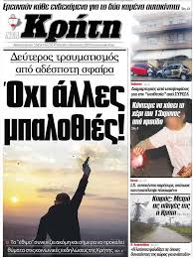
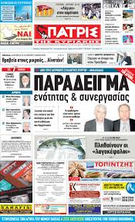
NEWSPAPERS
PATRIS (ΠΑΤΡΙΣ)
Nea Kriti (Νέα Κρήτη)
Tolmi (Τόλμη)
Mesogios (Μεσόγειος)

Slide 5
MAGAZINES
National voice
DOPE.gr
MIKRO
Candia News
Tolmi
Patris/Apiko

Slide 6
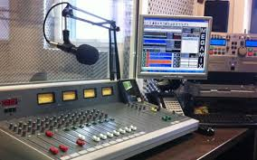
RADIO
Radio Kriti (Ράδιο Κρήτη 101,5)
Neo Radiofono (Νέο Ραδιόφωνο 97,9)
ΕRT (Ε.Ρ.Τ. 97,5)
ALFA Radio Iraklio (ALFA Ράδιο Ηρακλείου 106,2)

Slide 7
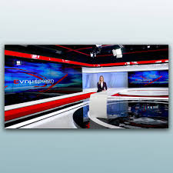
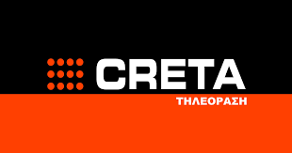
TELEVISION CHANNELS
Kriti TV (Κρήτη TV)
Creta Channel
Kanali 4 (Κανάλι 4)
KYDON TV (ΚΥΔΩΝ TV)
NOTOS TV
\

Slide 8
It is also worthy to consider the contemporary way of getting informed which is digital TV and digital newspaper.
Kriti TV, Patris, e-kriti, Cretalive, Candianews
ekriti
Creative Crete

