Slide 1
ILIAHTIDA’s [sunbeam] IDENTITY
The Nonprofit Association “Iliahtida” was established in 1992 in Heraklion by a group of responsive citizens. Its objective is the financial, moral and psychological support of children with neoplastic diseases, as well as the support of their families. The Association is solely supported by the voluntary work of its members and aware citizens who are willing to offer. Its revenue comes from subscriptions, donations, sponsorships and social and cultural events organization.

Slide 3
Medical Care - Stay in the Clinic
Focusing on psychological support :
On a daily basis in the clinic, there is a qualified psychologist, who helps the patients and their families accept and adjust to their new reality.

Slide 4
When it comes to financial support, Iliahtida :
Covers all the expenses of outpatient medical tests and transfers to hospitals in Greece or abroad for specialized surgeries.
Deals with the daily practical problems and needs that the young patients and their families may face during their stay in the clinic.
Financially supports the families and covers as many of their needs as possible.

Slide 5
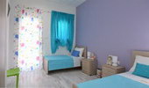
Children’s Guest House “Iliahtida”
Children’s Guest House “Iliahtida” –Exists within the premises of the University Hospital of Heraklion (Pa.G.N.I.).
This Guest House, was created to provide free hospitality for the children who suffer from neoplastic diseases and are being treated in the University Hospital and their families. It is a state-of-the-art building of 700sq.m. with 6 fully equipped rooms and can accommodate up to 12 people.

Slide 6
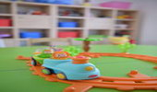
Furthermore, the Association :
1. Encourages volunteerism and organizes daily visits to the clinic playground, where our volunteers help the children occupy themselves with creative activities.
2. Contributes significantly to the improvement of the living conditions of the children in the clinic, by purchasing and maintaining equipment for their rooms, as well as toys and educational materials for the playground.

Slide 7
3. Organizes recreational events and celebrations on a regular basis (Christmas – Easter – Carnival), and birthday parties for all the children.
4.Supports the work of the Medical and Nursing staff of the Pediatric Hematology - Oncology Clinic of the University Hospital of Heraklion (Pa.G.N.I.).
5.Cooperates with similar Associations in Greece and abroad, which support other Pediatric – Hematology & Oncology Nursing Units of the country.

Slide 8
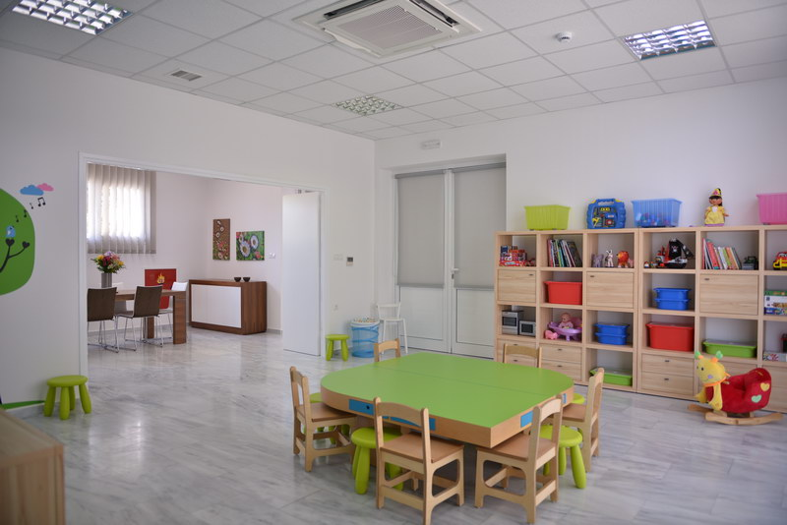
“Iliahtida’s” Objectives 1
The ongoing and smooth operation of the Guest-House
The construction of a turnkey classroom within the clinic for the proper education of the hospitalized children by a qualified teacher.
The full renovation of the Pediatric Hematology - Oncology Clinic.

Slide 9
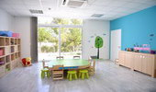
“Iliahtida’s” Objectives 2
The assurance of top-notch nursing services for children.
The constant motivation of volunteers and the organization of a multi-action volunteer group.
The non-stop responsible campaigns for the information and awareness of the local and the general public.

Slide 10
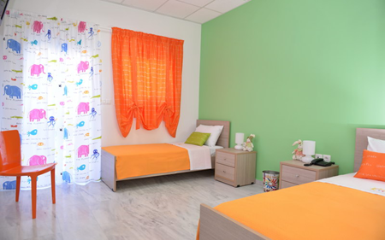
“Iliahtida’s” Objectives 3
The triggering of state support on issues regarding the treatment and the stay of the children in the Hospital.
The cooperation with all the Associations in Greece and abroad that support other Pediatric – Hematology & Oncology Nursing Units.

Slide 11
ILIAHTIDA CREATES….
A new Psychosocial Support Structure .
A structure that operates under the scientific supervision of the Department of Psychology of the University of Crete.
It aims at improving the child's mental health and family structure balance by providing free systematic weekly sessions to children and all members of their families.

Slide 12
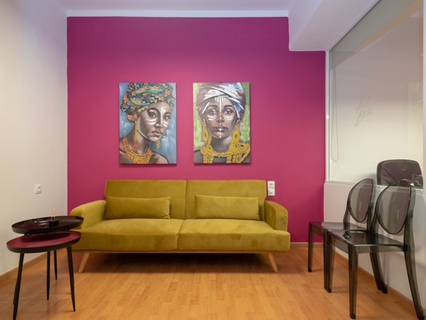
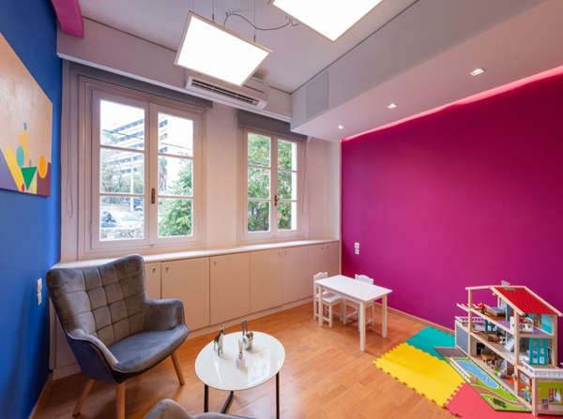
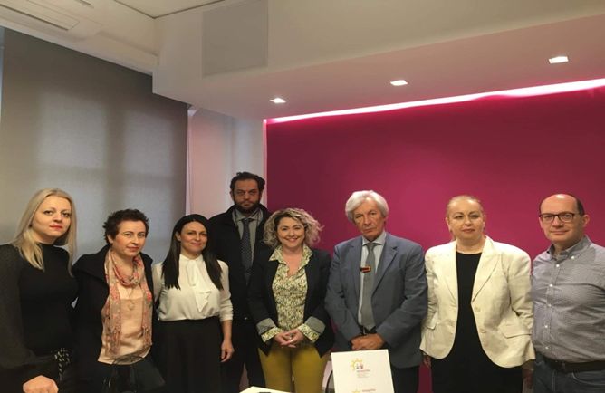
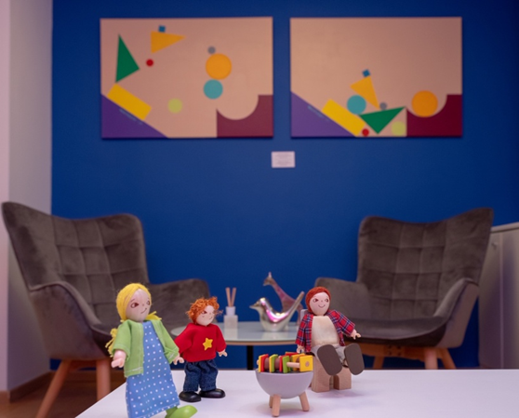

Slide 13
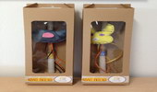
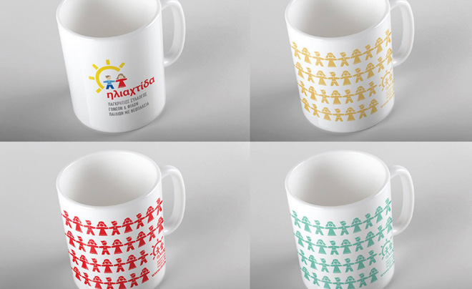
Volunteers-Sponsors-Supporters
The volunteer group of Iliahtida is one of its most important and vital components. There are over 20 members participating in the group right now, while at the same time they help in organizing events for the support of the association.
In order to cover its expenses, Iliahtida, apart from donations and sponsorships, creates and sells products, like calendars, address books, invitations, wristbands, mugs, pencils, pens, Easter and Christmas cards, notebooks, Easter candles etc.

Slide 14
