Slide 1
Pancreta Cooperative Bank

Slide 3
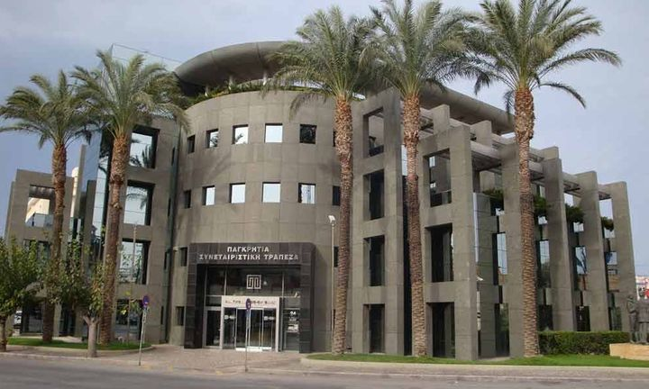

Slide 4
Pancreta Cooperative Bank
Pancreta Coop Bank was founded in 1993. It is the biggest co operative Bank in Greece, with its headquarters based in the island of Crete.
It has more than 85.000 shareholders and it cooperates with more than 240.000 customers. It also operates through a network of 52 branches, out of which 45 are located in Crete. It employs almost 400 people.

Slide 5
Pancreta Cooperative Bank
What a Cooperative bank is?
First of all, a cooperative bank cooperates with its shareholders, individuals or legal entities who have acquired a number of shares, thus they own a stake of its capital.
Cooperative banks, by definition, operate locally and they are supervised by the Bank of Greece as the other Commercial banks, and they follow the same core regulatory framework.

Slide 6
Pancreta Cooperative Bank
When a Cooperative Bank firstly appeared?
Cooperative banks have been created almost 25 years ago, in Greece. At that time, the loan interest rates were extremely high, meaning that individuals and entrepreneurs were primarily excluded from transactions within an ordinary banking system.
Indeed, cooperative Banks filled this gap in the market by offering advantageous interest rates to their customers, not only in loans but in deposits as well.

Slide 7
Pancreta Cooperative Bank
The Contribution To The Local Economy
Is supported by and supports small and medium-sized enterprises by developing collaborations and joint actions with them
Collaborates with international organizations in order to finance SMEs
Has an active role in the field of Social Economy
Supports export growth
Provides free information and advisory support to its members

Slide 8
Pancreta Cooperative Bank
Major Projects in progress
The bank is upgrading its banking services to its customers, using new technologies and digital innovations.
Major projects are being implemented, either autonomously, or in partenship with well-known partner companies.

Slide 9
Pancreta Cooperative Bank
STRATEGIC OBJECTIVES
• Enhancement of Bank’s capital base.
• Loans’ portfolio remediation.
• Preservation of low operating costs.
• Improvement of profitability.
• Establishment of the Bank as a modern, flexible, efficient and friendly financial institution in the Greek banking system.
• Increase in the financing of the local economy.
• Maintenance and expansion of partnerships with international and local financial institutions.
• Provision of SME consulting support towards innovation and extroversion.
• Gradual expansion in selected areas outside Crete

Slide 10
Pancreta Cooperative Bank
OPERATIONAL OBJECTIVES FOR THE YEAR 2019
• Restructuring of branch network.
• Increase in loans & in Deposits.
• Cash management optimization.
• Reduction of NPLs.
• Creation of innovative products and services.
• Simplifying procedures to optimize customer service.
• Modernization of Corporate Governance.
• Upgrade of Risk Management and Internal Audit systems.

Slide 11
ORGANIZATIONAL CHART

Slide 12
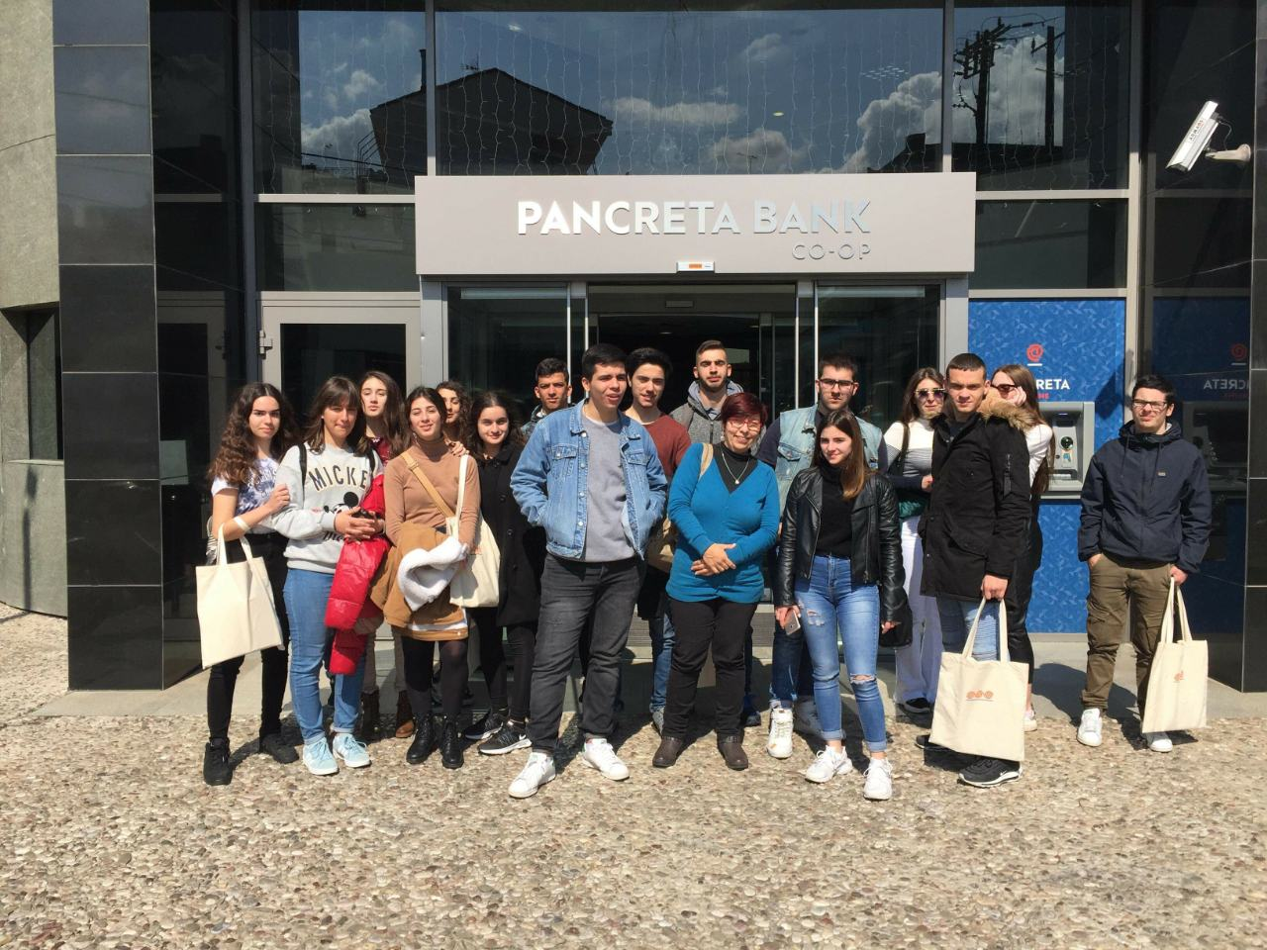

Slide 13
Our visit to Pancreta Cooperative Bank March 4, 2019
The Vice President and the team of Managers gave us a grand tour of the bank. They introduced their bank, told us when it was founded, how many branches and members they have, how they helped the growth of the local economy etc.
Each manager introduced his department and explained its operations.
The Human Resources Manager explained what are the qualifications that a candidate employee must have. He emphasized the importance of the Personality and Communication Skills that the candidate employee must have apart from the University degree.

Slide 14
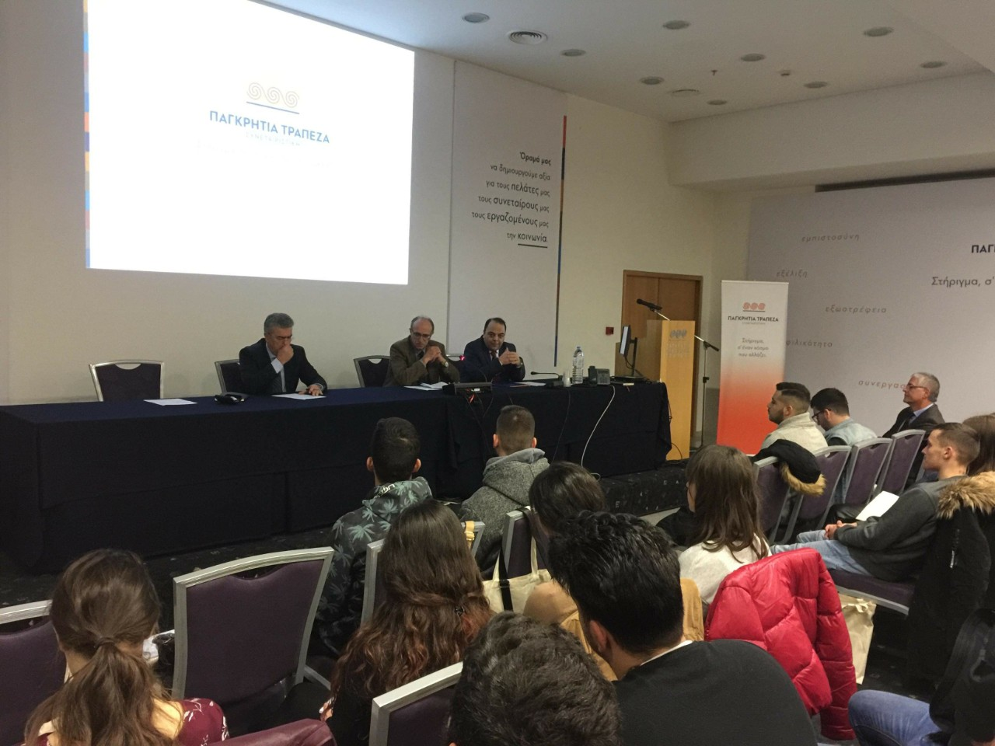
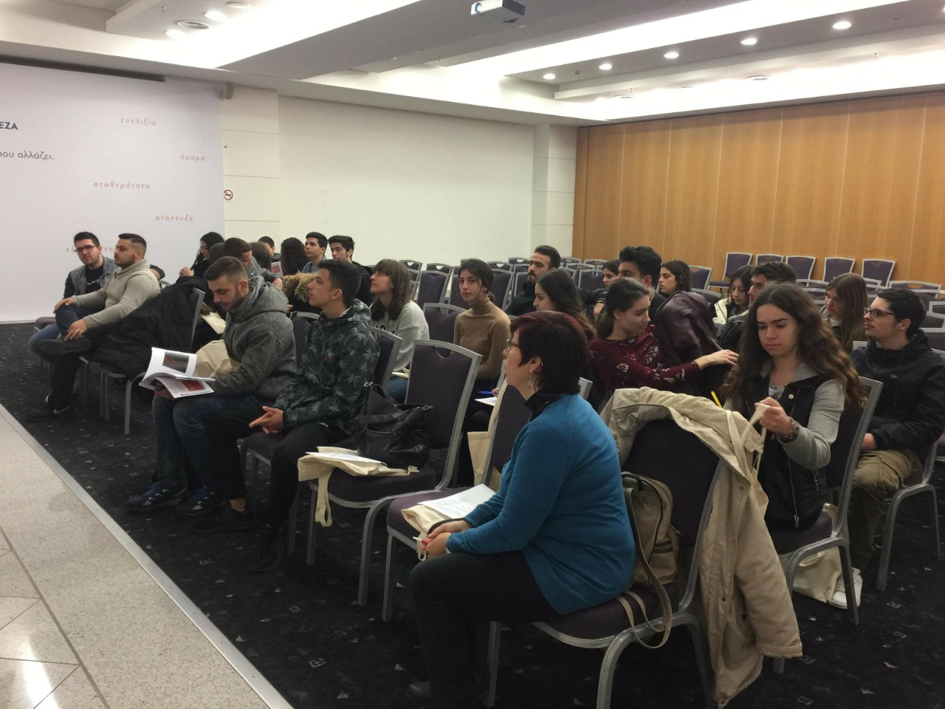
Our visit to Pancreta Cooperative Bank

