Slide 1
Cultural literacy
Projekt ERASMUS+ „Four shades of literacy“

Slide 2
Aims of the workshops
deepen an understanding about the term “culture”
explore different cultures through the “iceberg-concept” of culture
understand how prejudices and stereotypes are being created and how to overcome them

Slide 3
Ice-breaker
think 5-10 things which are typical for your culture

Slide 4
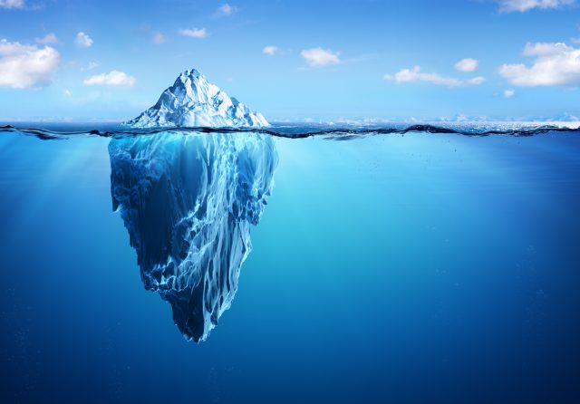
Workshop - I – YOU – WE: My culture – your culture – our culture
What do you know about icebergs?

Slide 5
Workshop
in your group collect as many aspects of culture as possible and write them down on post-it notes
think abou the aspects of culture which are clearly visible and others that are not, some are just below the surface and might be glimpsed but are not well known, others are way below the surface and are only known to members of that culture
put your notes to the correct part of the ice-berg

Slide 6
Some more ideas
use the given cards and put them to the correct part of the ice-berg
justify your choice

Slide 7
Reflection
How did you like the activity?
Which aspects were surprising to you?
What did you learn about prejudices?
Have you found out anything that you didn’t know before?

Slide 8
Video
https://www.youtube.com/watch?v=u37t0u-4BTI
https://www.youtube.com/watch?v=woP0v-2nJCU
https://www.youtube.com/watch?v=a9Z83I_g4Hw

Slide 9
Workshop - Euro-rail á la carte
You are boarding the train from Athens to Oslo, normally, the journey takes 45 hours, but since there are heavy works on the railroads, it will take almost four days to get to Oslo. You are travelling in a compartment which you have to share with three other people, with whom of the following passengers would you prefer to share it?
Annex: List of passengers

Slide 10
firstly, select individually three first choices of the people whom you would like to travel with the most and three you would like to travel with the least, you have 5 minutes to do this
after that, in groups of three persons, share your choices and discuss the reasons, which led to your decisions, you have 15 minutes for this part of the activity
present the results of your group

