Slide 1
Four shades of literacy social issues
Problems of teenagers in the Czech Republic

Slide 2
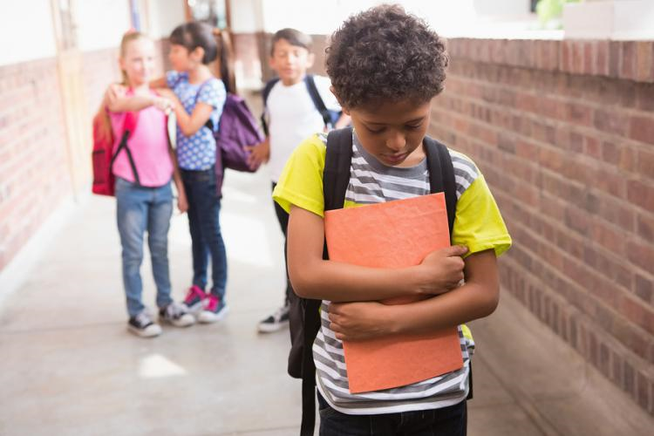
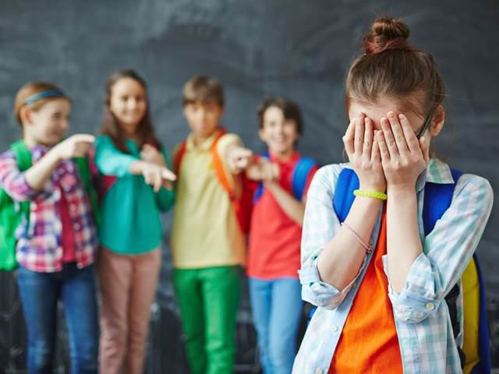
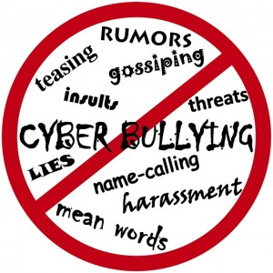
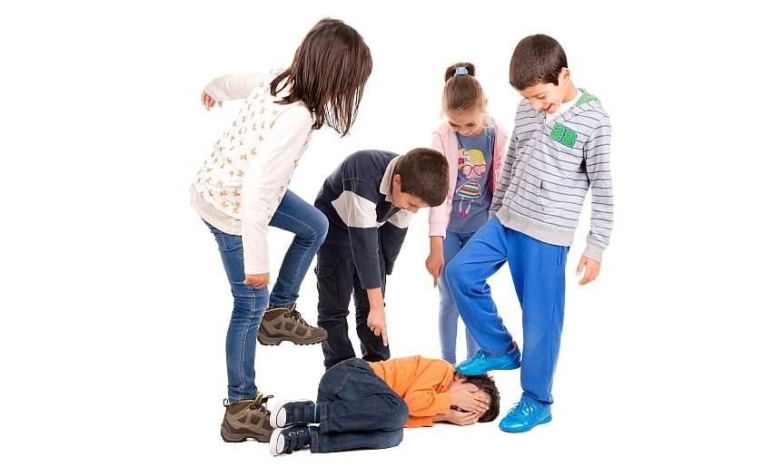
Bullying
Bullying is a serious problem and has many forms
Physical
Psychobullying - Bad words, vulgarismus
Cyberbullying – social networking, facebook, instagram

Slide 3
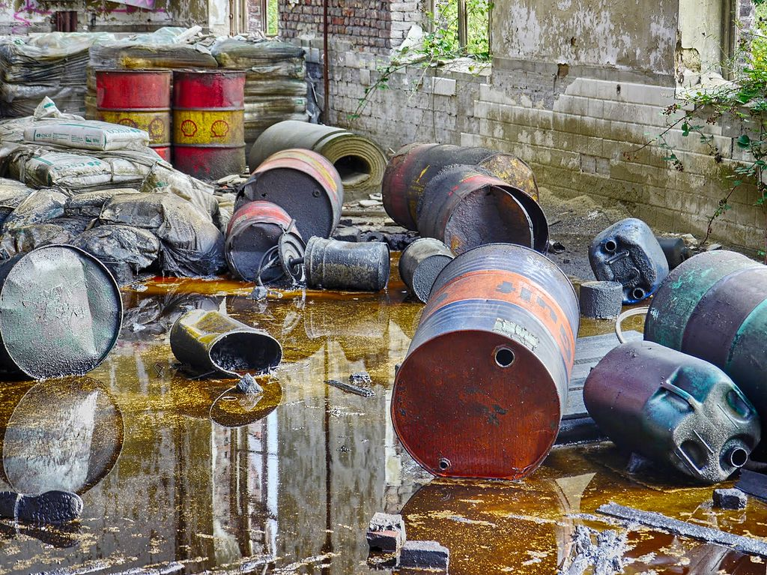
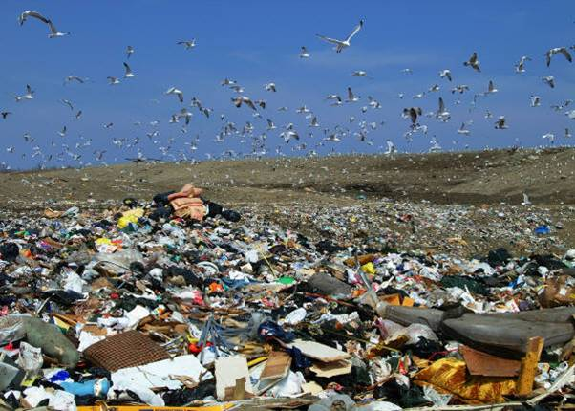
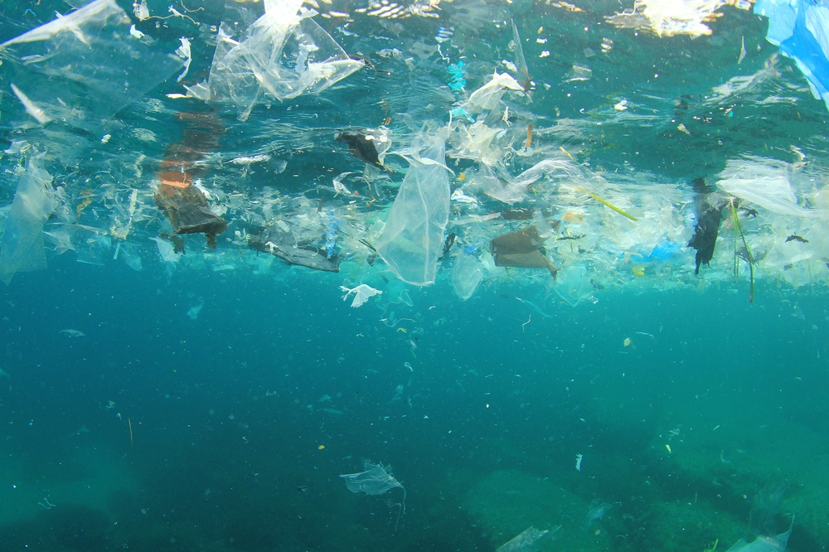
Environmental issues
Pollution
Litter
Using plastics

Slide 4
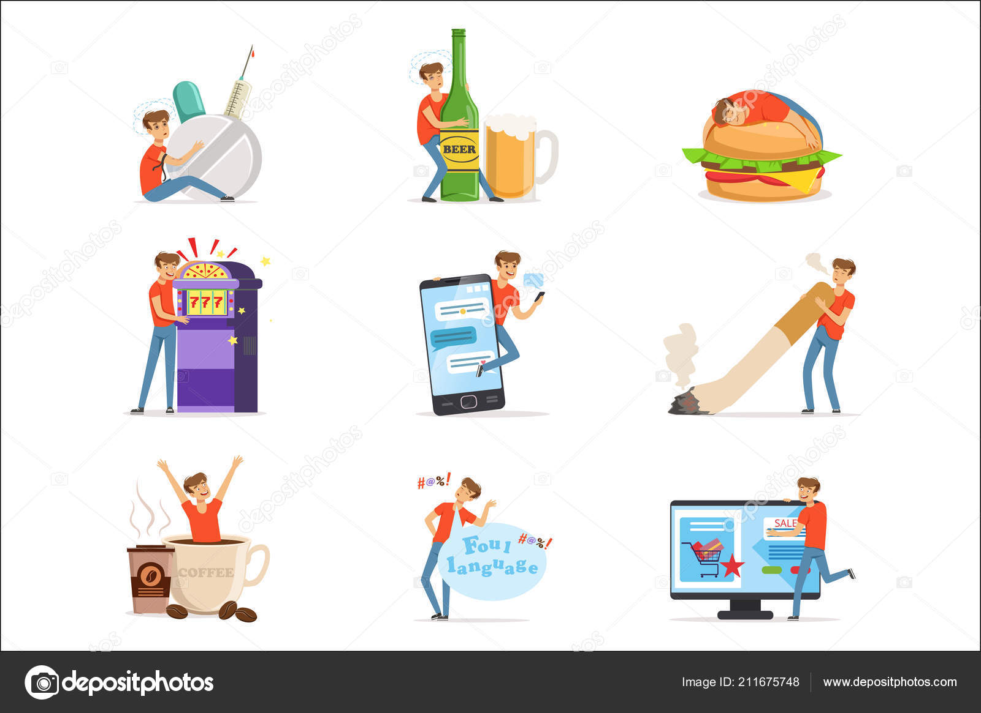
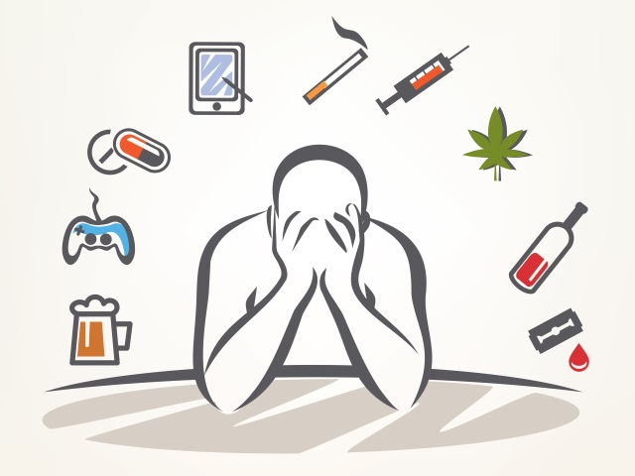
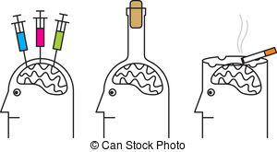
Addiction
Drugs
Alcohol
Internet
Social networking sites
Mobile

Slide 5
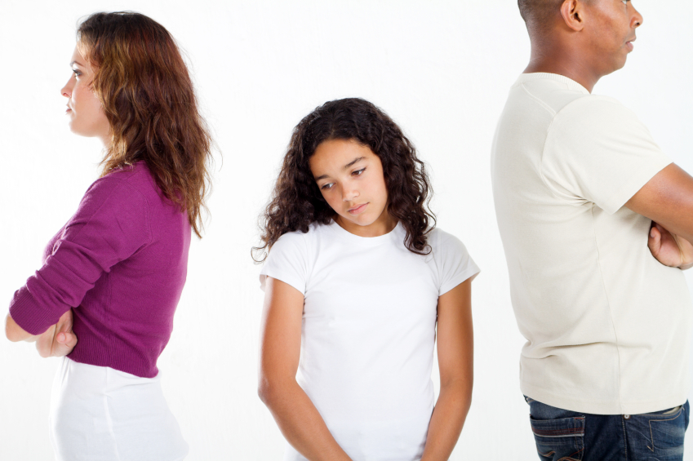
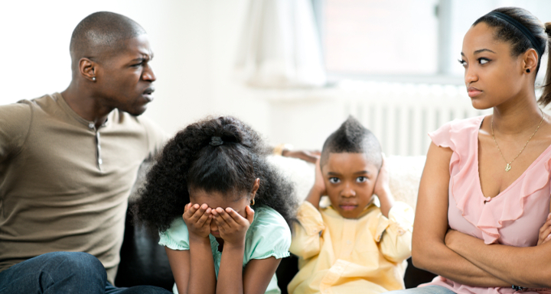
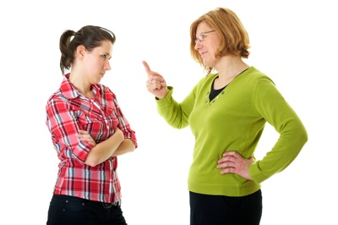
Bad relationships in family
Divorced parents
Arguements with parents
Violence
Lack of support
Lack of interest of parents

Slide 6
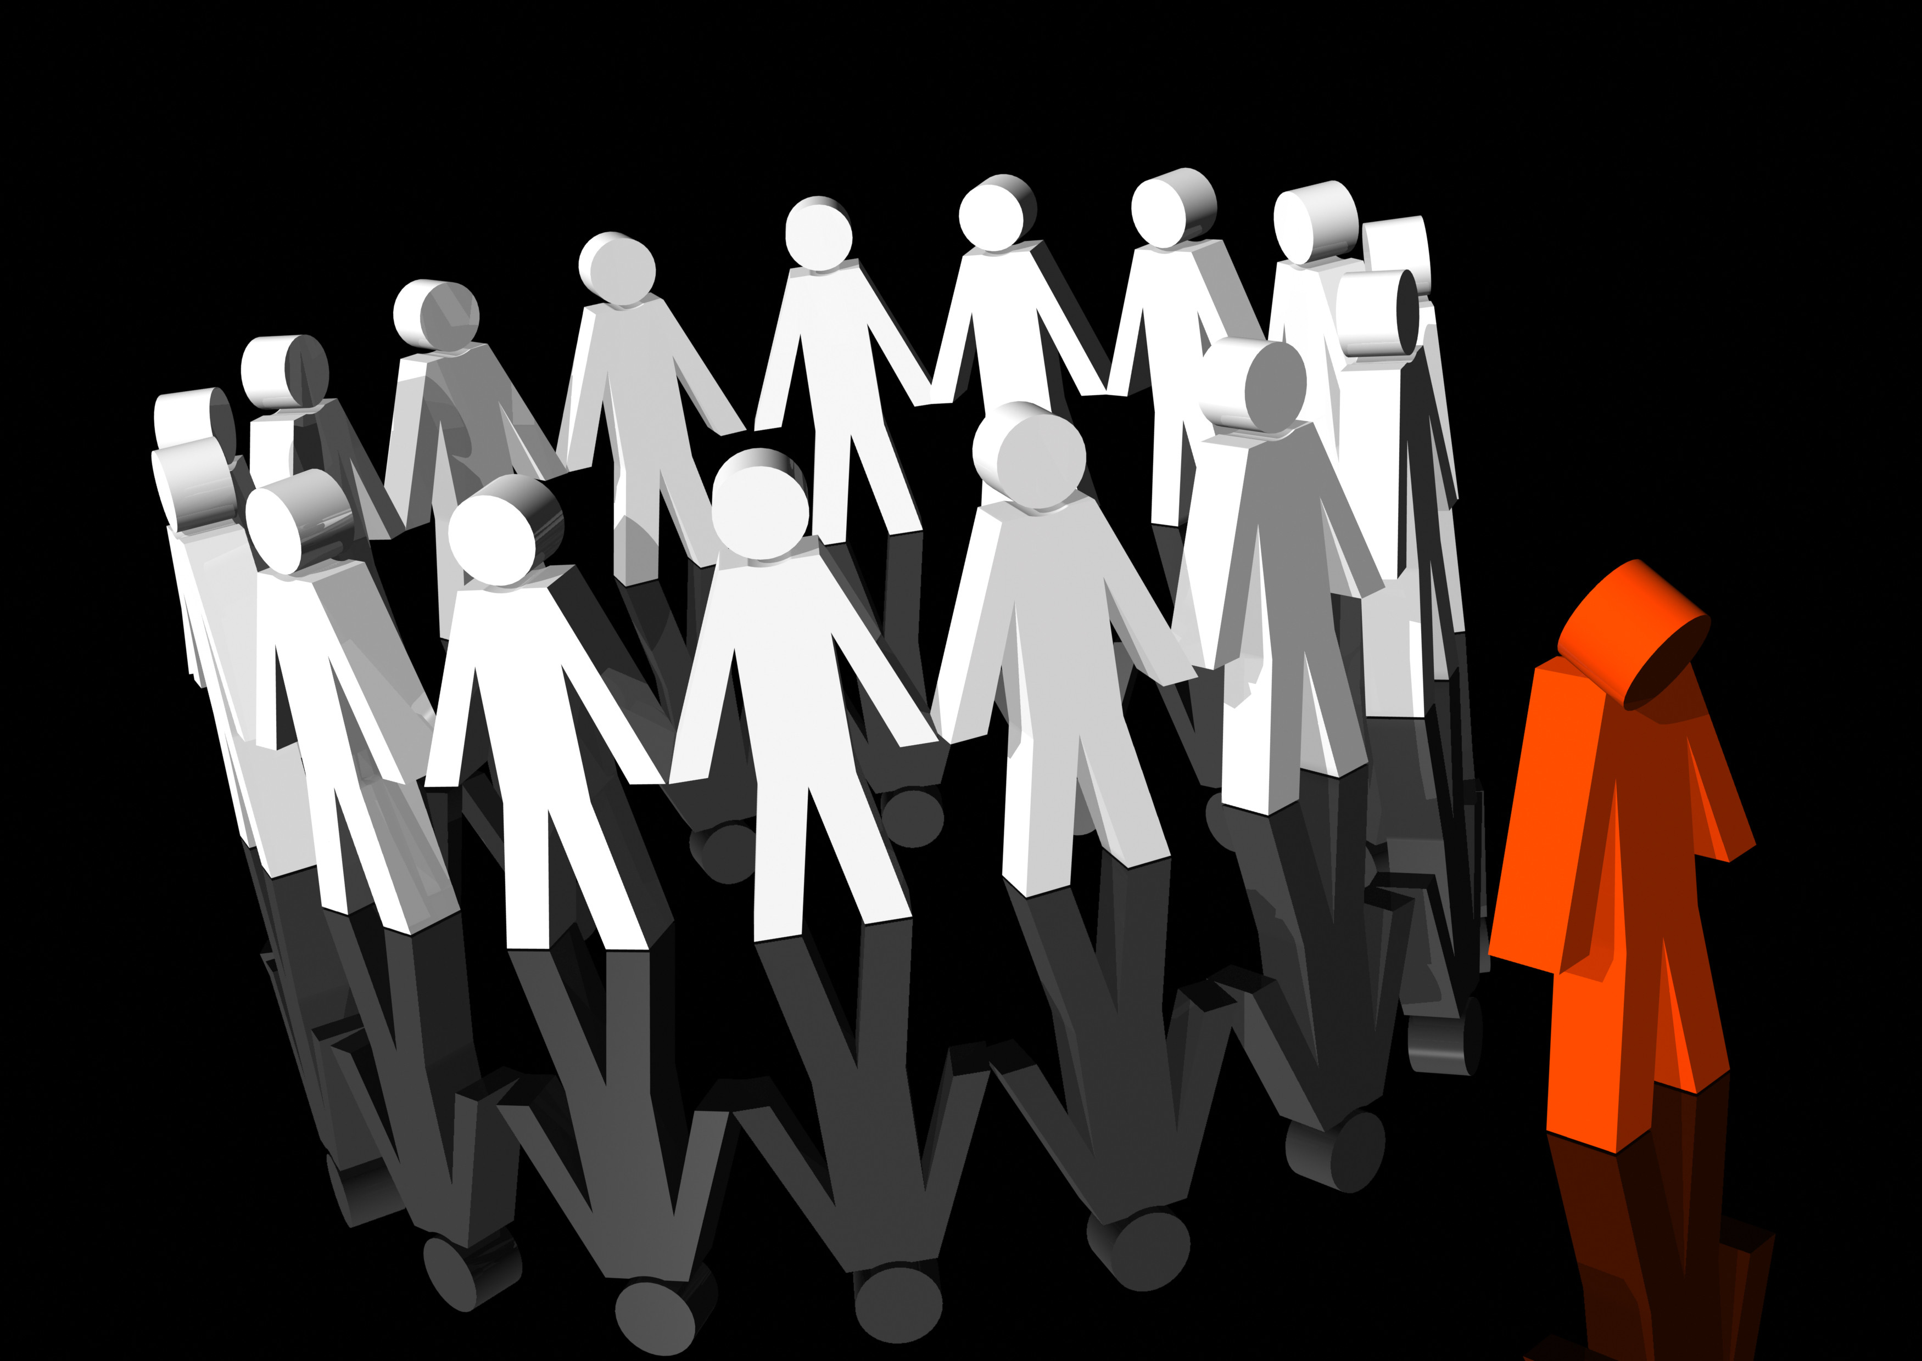
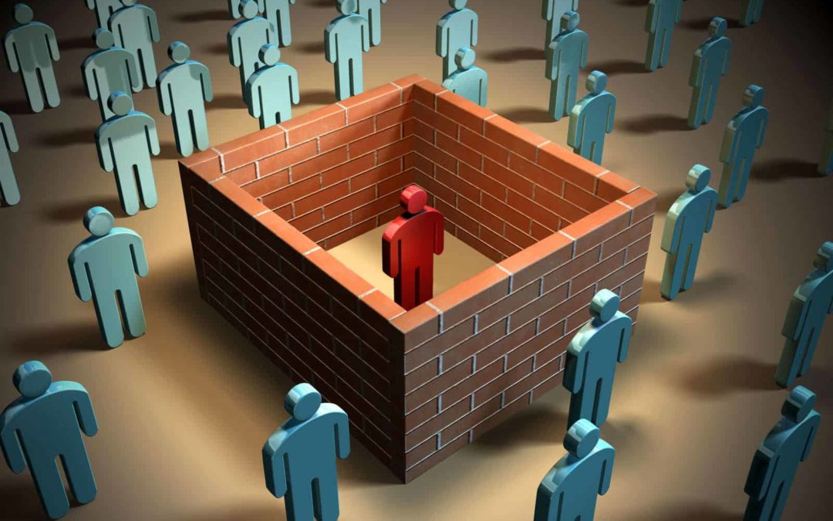
Isolation
Being an outsider in society
Prejudices
Stereotypes
Intolerance

Slide 7
Thanks for your attention
Čajanová Lucie, Hampejsová Barbora, Vázalová Alžběta, Velasová Tereza, Žáková Edita

