Slide 1
Tax Office Příbram

Slide 2
Czech Republic is divided into 14 regions.
Příbram is located in Central Bohemia.
Tax Office in Příbram is one of the branch offices in Central Bohemia.
This office has about 150 employees.
They collect taxes.
The most important tax is income tax, real estate tax, and so on…

Slide 3
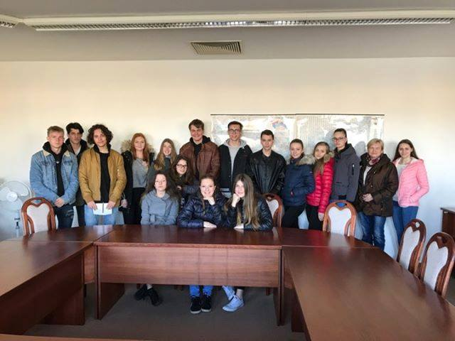
It was very useful.

Slide 4
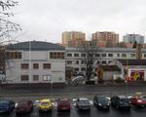

Slide 5
Thank you for your attention

