Slide 1
ERASMUS+ 31 – 6 March 2019
Idar-Oberstein

Slide 2
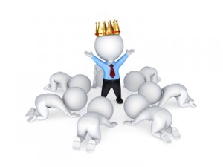
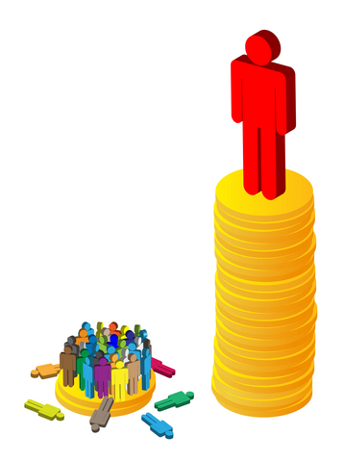
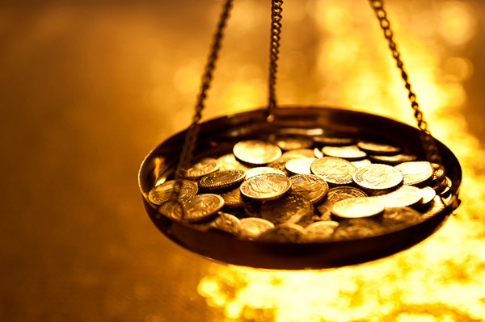
Workshop - Wealth and Power

Slide 3
The Have Not-s: participants with 7 or fewer coins:
• You will have difficulty surviving due to disease, malnutrition, lack of clean water.
• Many of you starve, many children die.
• You have inadequate shelter.
• You have a lack of education.
• You have little to nothing to satisfy your basic needs.
• Your vote counts 0,5.

Slide 4
The Have Some-s: participants with 8-15 coins:
• You are able to meet your basic needs:
• you have access to basic education,
• you have adequate food and nutrition,
• you have health care,
• you have adequate housing.
• Your vote counts 2.

Slide 5
The Have-s: participants with 16 or more coins:
• You are able to meet all your basic needs and most of your wants:
• you have access to basic and higher education (higher schooling, university),
• you have adequate food and nutrition,
• you have good health care,
• you have adequate housing,
• you have toys, televisions, cars, computers, and other luxury items.
• Your vote counts 5.

Slide 6
rEFLECTION
How do you feel about how you got the coins? How do you feel about how they were divided? Was everybody treated fairly?
Who was at a disadvantage (e.g. the people with the socks)? Who do they represent in our society?
Who are the Have-s and Have-Not-s in our world / our country / our school?
Do you think there should be a redistribution of wealth and power throughout the world? Why or why not? How would you do it? What principles guide you in this decision?

Slide 7
vIDEO
The miniature world
TMB Panyee FC

